Slide 1

Unit 5 Canada – “The True North”
Period 3 Language points

Slide 2
Discovering useful
words and expressions

Slide 3
Task 1:
Observe the words below, and guess their meanings.

Slide 4
Discussion
multi = many | meaning
multicoloured
multichannel
multiform
multinational
multistor(e)y
multimedia
multipurpose
multifaith
multimember

Slide 5
Check
multi = many | meaning
multicoloured | made of many colours
multichannel | having many channels
multiform | existing in many forms
multinational | including many nations
multistorey | having many stories / storeys
multimedia | using many media
multipurpose | used for many purposes
multifaith | including many religions / faiths
multimember | made of many members / people

Slide 6
Discussion
-ward(s) = in a direction | meaning
forward(s)
eastward(s)
westward(s)
southward(s)
backward(s)
outward(s)
northward(s)
inward(s)
toward(s)

Slide 7
Check
-ward(s) = in a direction | meaning
forward(s) | ahead, to the front
eastward(s) | to the east
westward(s) | to the west
southward(s) | to the south
backward(s) | to the rear; to the back
outward(s) | out, in a direction away
northward(s) | to the north
inward(s) | to the inside
toward(s) | in a direction to

Slide 8
What do we call it?
1. With the development of hi-tech, we can enjoy various TV programs through a lot of channels.
multichannel
2. To save space, people have to live in the buildings with many storeys.
multistorey
3. In our country, there are altogether 55 minorities.
multinational

Slide 9
4. In many countries like America, the Republican Party is not the only party.
multiparty
5. Newly developed software can be used for solving different problems.
multipurpose
6. Our school provides teachers with several media, such as TVs, radios, computers and projectors.
multimedia

Slide 10
Finish these sentences with proper words.
1. His foot caught in a rock and he fell _________.
2. In winter, swallows will fly ____________.
3.The door of your classroom opens __________.
4. Recently the price of houses is moving _______.
5. After he leaves his house, he begins a gentle __________ walk to the subway station.
forward
southwards
outward
upwards
downward

Slide 11
Task 2:
Match the words with their meanings.

Slide 12
Keys: 1- B 2 - H 3 - A 4 - E
1. bags that people take with them when they travel
A quiz
B baggage
C surround
D scenery
E chat
F slightly
G aboard
H minister
2. a government member who is in charge of a government department
3. a short informal test
4. to talk to someone in a friendly, informal way

Slide 13
Keys: 5 - G 6 - D 7- F 8 - C
A quiz
B baggage
C surround
D scenery
E chat
F slightly
G aboard
H minister
5. on a ship, plane, bus or train
6. general appearance of nature around you, especially beautiful nature
7. in or by a very small amount, so small that it almost cannot be seen
8. to be all around somebody or something on every side

Slide 14
Task 3:
Choose a pair of expressions to complete each sentence (on p. 70).
Be sure to use the correct expression in the correct form.

Slide 15
As far as / far; as well as / well; at dawn / dawn;
in the distance / distance; catch one’s eye /
catch sight of; have a gift / have a gift for;
manage / manage to do; settle / settle down;
rather than / rather
1. _______, we got our fishing poles and headed out to the lake. _____ is the best time to catch fish!
2. It’s not ___ at all to Atlanta! _______ I can tell, it will take us only about half an hour to drive there.
At dawn
Dawn
far
As far as

Slide 16
As far as / far; as well as / well; at dawn / dawn;
in the distance / distance; catch one’s eye /
catch sight of; have a gift / have a gift for;
manage / manage to do; settle / settle down;
rather than / rather
3. The two tall trees ____________ made Jack realize that he was going in circles, although he felt like he had come a great _______.
4. He can’t speak any foreign languages very ____, but his business always takes him to France and Spain ________ Germany!
in the distance
distance
well
as well as

Slide 17
As far as / far; as well as / well; at dawn / dawn;
in the distance / distance; catch one’s eye /
catch sight of; have a gift / have a gift for;
manage / manage to do; settle / settle down;
rather than / rather
5. A: Darren may not be the best reporter, but he ________ people under him very well.
B: Yes, I agree! At first I doubted his ability, but in the end he ____________ the job well.
6. A: What’s this? I _________ on my desk! Hmm … it looks like a CD!
B: Let’s look! ... You’re right! My, you really ____________ guessing.
manages
managed to do
have a gift
have a gift for

Slide 18
As far as / far; as well as / well; at dawn / dawn;
in the distance / distance; catch one’s eye /
catch sight of; have a gift / have a gift for;
manage / manage to do; settle / settle down;
rather than / rather
settled
7. A: I’m glad we’ve finally _____ our holiday plans!
B: So am I. Now I can finally _________ and relax!
settle down
8. A: That’s so disappointing! As soon as those birds _____________ us, they flew away!
B: Well, the zoo has lots of other animals! The monkey mountain _____________. Let’s go there!
caught sight of
caught my eye

Slide 19
As far as / far; as well as / well; at dawn / dawn;
in the distance / distance; catch one’s eye /
catch sight of; have a gift / have a gift for;
manage / manage to do; settle / settle down;
rather than / rather
9. A: Would you _____ visit Inner Mongolia or Tibet this summer?
B: Oh,I think I’d like to just stay at home and rest __________ go anywhere!
rather
rather than

Slide 20
Task 4:
According to the picture and the given words, complete the following paragraph on p. 36.

Slide 21
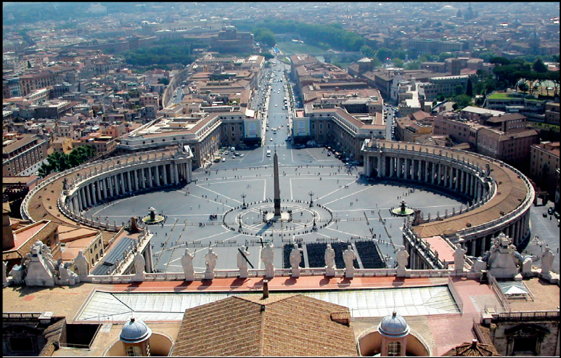
acre border
harbour measure
surround urban within
The city of Rome, Italy, completely _________ the smallest country in the world, the Vatican City State. It has an area of 0.44 square kilometres with a ______ _________ 3.2 kilometres long. Because the Vatican is entirely ______ Rome, it has no ________ for ocean ships. The country is really just one small city: its _____ area covers 100 percent of the country.
surrounds
border
measuring
within
harbour
urban

Slide 22
Language points
learning

Slide 23
1. rather than
would do A rather than do B
prefer to do A rather than do B
Rather than fish, we’ll have meat and soup for lunch today.
Rather than ride on a crowded bus, he goes to work by bike every day.
I would like to stay at home rather than go to the park today.
I prefer to go out rather than stay in the classroom.

Slide 24
2. surround
To be all around on every side
The trees surround the house.
The enemy was surrounded by the army.
We are surrounded by comforts.

Slide 25
3. settle down
to establish a home and live a quiet life
to become used to a way of life , job, etc.
to sit down comfortably
He has settled down in the countryside.
He is settling down well in his new job.
He settled himself down in his chair.

Slide 26
4. manage to do
to succeed in taking, using, or doing sth.
The little boy had somehow managed to tie his shoelaces together.
I managed to get in contact with the lady, who’s in charge of this project in the company.

Slide 27
5. have a gift for
to have a natural ability to do sth.
I have a gift for music.
She has no gift for painting.
He was a man of excellent gifts.

Slide 28
6. confirm
to give support or certainty to a fact, a belief, statement, etc.
His letter confirmed everything.
Let me confirm that. You say you arrive in New York today, don't you?
He looked around to confirm that he was alone.

Slide 29
7. in the distance
keep one’s distance
at a distance
I could see the bus coming in the distance.
The dog looked dangerous, so I decided to keep my distance.
The picture looks better at a distance.

Slide 30
8. impress
to influence deeply, esp. with a feeling of admiration
We are very impressed by his behavior．
The students worked hard to impress their teacher.
I was deeply impressed by the scenery here.
Her words impressed themselves on my memory.

Slide 31
The Press Conference
for Li Daiyu and Liu Qian

Slide 32
Group work
Li Daiyu and Liu Qian are going to give a press conference about their trip to Canada.
Now work in groups of four. Two students act as reporters to ask any questions about their trip.
The other two students act as Li Daiyu and Liu Qian respectively to answer questions.
Try to use the words and phrases we have learnt in this unit.

Slide 33
Now
1. Make up questions in pairs.
2. Compare them and choose the best.
3. Practise the interview.

Slide 34
Example
Reporter A: Hello, Li Daiyu.
Which city impressed you most?
Li Daiyu : It’s a good question.
Toronto impressed me most,
because it is a modern and
wealthy city in Canada.
Reporter A: Thank you.

Slide 35
Homework
1．Finish Exercises 1 and 2 on p. 70.
2．Finish Exercise 4 on p. 71.

