Slide 1

英语课标教学课件
选修6

Slide 2


Poems

Slide 3

【写作任务】
请根据下面所给提示写一篇英语短文，介绍英国浪漫主义诗人乔治•戈登•拜伦(George Gordon Byron)。

Slide 4
★ 英国19世纪初期伟大的浪漫主义诗人。
★ 1788年出生于伦敦一个贵族家庭。
★ 天生腿残疾，但是喜欢体育运动；爱好 骑马、射击、游泳等。
★ 爱读历史类书籍和诗歌，12岁开始诗。
★ 剑桥大学毕业。
★1824年去世。
★ 代表作有《唐•璜》(Don Juan)和《恰尔德•哈洛尔德游记》(Childe Harold’s Pilgrimage)。

Slide 5
【写作要求】
一、作文要包括如下要点：
1. 生平；2. 教育；3. 爱好；4. 作品； 5. 评价。
二、只能用5个句子表达上面所给的信息。

Slide 6
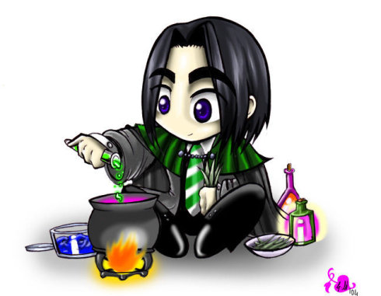
【写作分析与指导】
1. 写作思路：本篇习作是介绍英国浪漫主义诗人拜伦。我们可以按如下思路进行创作：(1)确定要点：根据所给的提示和要求可知，本篇习作有5个要点。(2)搜集词汇：根据所给的提示以及表达的需要，写出写作中可能用到的词汇，包括单词和短语。(3)组词成句：根据表达的需要，用适当的句式把词汇扩展成句子。此时要注意

Slide 7
【写作分析与指导】
主谓一致、单词拼写、代词一致和动词时态等方面。(4)连句成文：文章要有一定的逻辑性，所以我们要根据写作要求，确定句子顺序，选用恰当连词使句与句之间具有一定的逻辑性，也可根据需要选择一些恰当的过渡性词句。
2. 时态与人称分析：
时态以过去时为主；人称以第三人称为主。

Slide 8
二、词句储备
1. 写作中可能使用的词语有：
(1) 贵族的 _____________
(2) 浪漫的 ____________________
(3) 残疾/残疾的 _________________
(4) 至于 _________________
(5) 剑桥大学 _________________________
(6) 许多 _______________________
noble
romantic
disability/disabled
as for/as to
University of Cambridge
a great many/many a(an)

Slide 9
(1) 1788年，乔治•戈登•拜伦出生于伦敦一个贵族家庭，是英国19世纪初期伟大的浪漫主义诗人。
George Gordon Byron, born into a noble family in London in 1788, was considered to be the greatest romantic poet in the early 19th century.
(2)尽管天生腿残疾，但是拜伦喜欢体育运动，如骑马、射击、游泳等。
Though born with disability on one of his legs, he loved sports, such as horse riding, swimming, shooting and so on.

Slide 10

(3) 拜伦爱读历史类书籍和诗歌，12岁开始作诗。
He loved reading history books and poetry and at the age of 12, he began to write poetry.
(4)可惜的是，他英年早逝，尽管如此，在他短暂的一生中，他创作了大量的诗歌。
It was a pity that he died young, but in his short life, he created a great many poems.

Slide 11

三、下笔成文
George Gordon Byron, born into a noble family in London in 1788, was considered to be the greatest romantic poet in the early 19th century. Though born with disability on one of his legs, he loved sports, such as horse riding, swimming, shooting and so on. He also loved reading history books and poetry and at the age of 12, he began to write poetry. As for

Slide 12
education, he had higher education, graduating from the University of Cambridge. It was a pity that he died young, passing away in 1824, but in his short life, he created a great many poems, including the famous ones Don Juan and Childe Harold’s Pilgrimage.

Slide 13

【点评】
本篇习作思路清晰，信息整合到位，涵盖了所有的要点，而且行文流畅，句与句之间过渡自然。同时，作者恰当地使用了非谓语动词和省略句等较复杂的句式，提高了文章的层次，同时也避免了句式单一。

