Slide 1

必修3

Slide 2
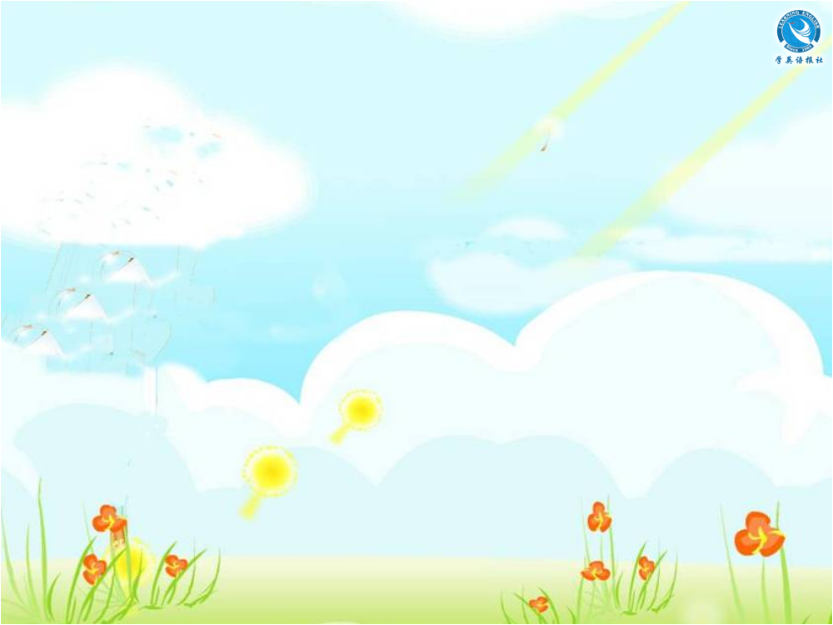
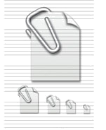
Unit 5
Canada — “The True North”
Listening
注: 另附 word 文档。
点击此处链接

Slide 3


Using Language
Listen to the text.
WHAT IS A CANADIAN?

Slide 4


Listen again and fill in the blanks.
I am a Canadian and very ______ of my country. However, people sometimes don’t know what being Canadian really ______. People who come to Canada are _________ to be proud of their own culture and keep their own _______. Except for the Native Indians, everybody else who lives here came from another country or their ________
did. Canada is a _______ of many cultures
proud
means
encouraged
customs
ancestors
mixture

Slide 5
and races. It is _____ we call a multicultural country.
We have ____ official languages, French and English. Even though we encourage people to keep their own customs, we ______ everyone to learn French or English in order to ____ in Canada. If you live in the province of Quebec, you are expected to speak _______. However, the Native Indians and
what
two
expect
live
French

Slide 6
the Inuit of Canada are still ______ to keep their languages alive. You can hear some of their languages in the names of ______ and _____ as well as cities. “Canada” means “village”. Toronto and Ottawa are also Native Indian names. There are ______ and television programmes, ___________ and magazines in over ___ different languages across Canada, and the Toronto city
trying
rivers
lakes
radio
newspapers
80

Slide 7
government offers help to people in ____ languages.
Many of our ____ cities have areas where people from the same culture live near each other － there might be a __________, a Little Italy, a Korea Town and so on. However, people whose _______ have lived in Canada for a long time are usually all ______ up. My own family is a mixture of English, Native
70
big
Chinatown
families
mixed

Slide 8
Indian and French. My neighbour’s family is Chinese, German and _______!
When I say that I am proud to be a Canadian, maybe you can help me ______
what a Canadian is.
African
decide

Slide 9
Workbook-Listening
Listen to the text.
A COMPARISON OF CHINA AND CANADA
Li Daiyu and Liu Qian’s Canadian friends asked them to tell them something about China. The two cousins decided to present a short report together, comparing China
and Canada.
LD = Li Daiyu LQ = Liu Qian

Slide 10
Listen again and fill in the blanks.
LD: China is a very large country. It’s about
_________ square kilometres in area,
and ______ kilometres from east to west.
It’s so big that it’s difficult to ________.
Perhaps it’s easier to compare it to
________.
LQ: China has many of the _________
mountains in the world. They’re in the
_____ of the country, as they are in
9,600,000
5,000
describe
Canada
highest
west

Slide 11
Canada, but China has more mountains where many great ______ begin.
LD: China has ____ countries to the north,
Mongolia and Russia, unlike Canada,
which has no countries to its ______, but
only the Arctic ice and snow.
LQ: China has _________ neighbouring
countries. Its borders are over _______
kilometres long. Canada, however, has
only ____ neighbour, the USA to the
south. Both Canadians and Americans
rivers
two
north
fourteen
20,000
one

Slide 12
speak English, but it’s ____ so easy for Chinese to talk with their neighbours, even if they live close to the _______.
LD: China’s Gobi Desert, in the _________ of China, is very special. There is nothing _______ in Canada. In winter and spring sometimes the cold ____ blows dust southward from the Gobi Desert to the northern parts of China. Even the Great Wall cannot keep out the _____.
not
border
northwest
similar
air
dust

Slide 13
LQ: Both China and Canada have _____ rivers and many lakes as well as busy ____ cities on the Pacific Ocean. China is famous for the _____ longest river in the world, the ___________ River, and Canada has the famous Niagara _____.
LD: Canada, ________, has nothing like China’s southern island of Hainan.
While it is ________ and _________ in
long
port
third
Changjiang
Falls
however
snowing
freezing

Slide 14
Mohe in north China on the Chinese-Russian border, people nearly _______
kilometres south in Hainan can sit on the ______ in the sunshine.
LQ: There is ________ to sit on the beach in winter in Canada!
5,500
beach
nowhere

Slide 15
Workbook-Listening Task
Listen to the text.
THREE GREAT CANADIANS

Slide 16
Listen again and fill in the blanks.
A great jazz piano ______ is a … Canadian! One of the greatest Canadian __________ is world-famous for his jazz music. Oscar Peterson is a piano player _____ Montreal. He has made over _____ recordings and CDs and has played with the ________ jazz musicians in ________. Although he is quite ____ now, he still goes on tour with his music group.
player
musicians
from
150
greatest
history
old

Slide 17
A brave ________ researcher is a …
Canadian! Dr Nancy Olivieri, a _________
doctor from Toronto, has become famous
for refusing to support a ____ that she was
working on. A big drug company paid her to
do the research, _____ when she found that
the drug was dangerous to children, she
made a public _______. The drug company
and the hospital _______ she worked said
medical
children’s
drug
but
report
where

Slide 18
they would make her _____ her job. She
refused to _______ her report, and is now a
hero to _______ medical scientists.
The best _______ player in the world is
a … Canadian! Everyone who is interested
in ____ hockey has heard of the Canadian
____ Wayne Gretsky, “the Great One”.
People say he is the greatest hockey player
_____ ever lived and think highly of him
lose
change
honest
hockey
ice
star
who

Slide 19
mostly for the _____ that he is a real team
player. He _______ that working with his
team to score goals was _____ important
than being the star, but, in fact, he was
the star player and ______ a record
number of goals.
fact
believed
more
scored

Slide 20
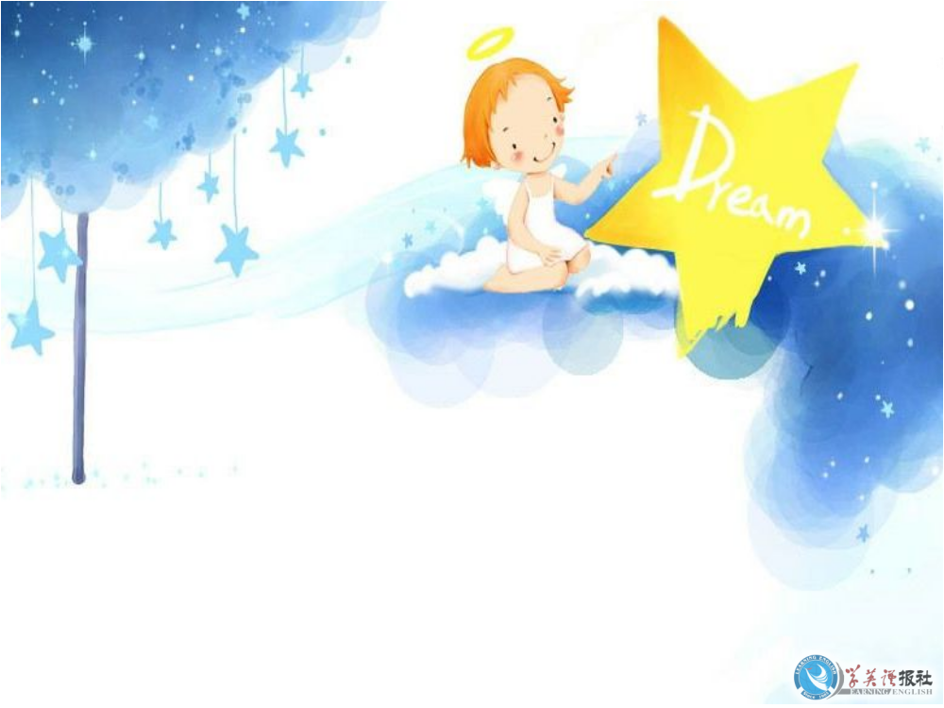
Thank you!

