Slide 1
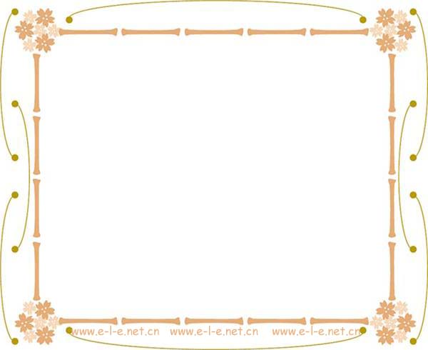

Module 5
Great People and Great Inventions of Ancient China

Slide 2
Function
Giving reasons
1 Mencius believed that the reason why man is different from animals is that man is good.
2 Often, the reason why people are unhappy is that they do not have enough love.

Slide 3
the difference of because, as, since and for
Because is used when the reason is the most important part of the sentence or utterance. The because clause usually comes at the end.
I went to China last week because I wanted to learn Chinese.

Slide 4
As and since are used when the reason is already well known and is therefore usually less important. The as or since clause is usually placed at the beginning of the sentence.
As the lesson had already started, we went down to the back of the room and occupied some empty seats there.
Since John had already eaten, I made do with a piece of bread.

Slide 5
For suggests that the reason is given as an afterthought. It is never placed at the beginning of the sentence and is more characteristic of written, rather than spoken English.
I decided to stop reading — for it was very late and I wanted to go to sleep.

Slide 6

高考链接
1. He found it increasingly difficult to read, ____ his eyesight was beginning to fail. (2006北京)
A. and B. for C. but D. or

Slide 7
高考链接
2. Jenny was very sad over the loss of the photos she had shot at Canada, ____ this was a memory she especially treasured. (2006广东)
A. when B. where C. as D. if

Slide 8
高考链接
3. A man cannot smile like a child, ____ a child smiles with his eyes, while a man smiles with his lips alone. (2006湖南)
A. so B. but C. and D. for

Slide 9
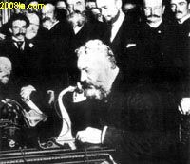
Speaking
In 1875, Alexander Graham Bell built the first telephone that transmitted electrically the human voice.

Slide 10
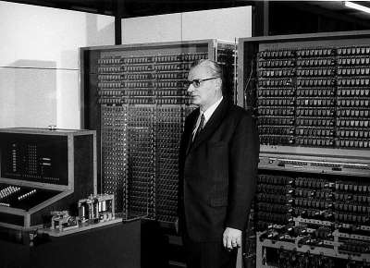
In 1936 Konrad Zuse built the first freely programmable computer.

Slide 11
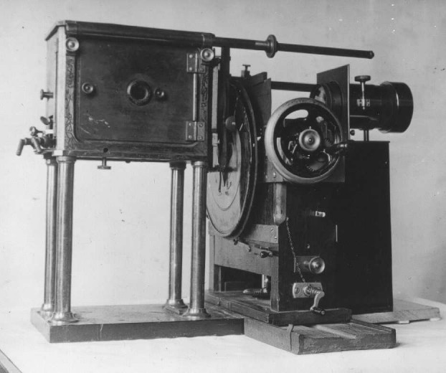
In 1884, Paul Nipkow sent images over wires using a rotating metal disk technology with 18 lines of resolution.

Slide 12
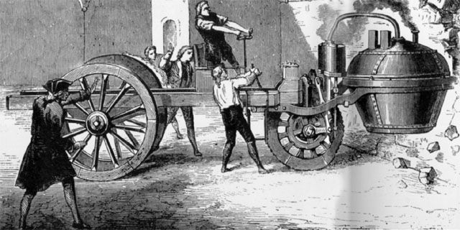
In 1769, the very first self-propelled road vehicle was invented by French mechanic, Nicolas Joseph Cugnot.

Slide 13
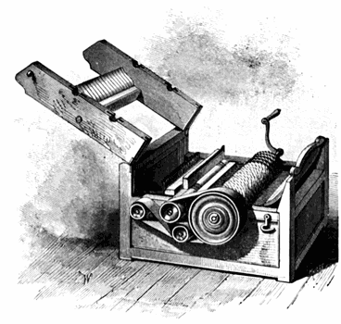
Eli Whitney patented the cotton gin on March 14, 1794.

Slide 14
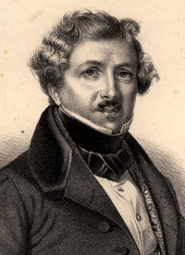
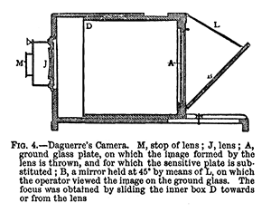
Louis-Jacques-Mandé Daguerre is considered the inventor of the first practical process of photography in 1837.

Slide 15
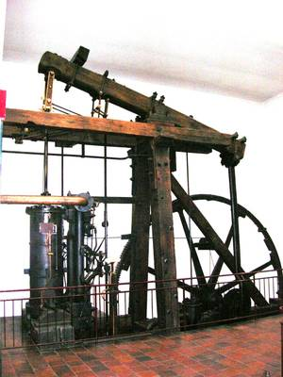
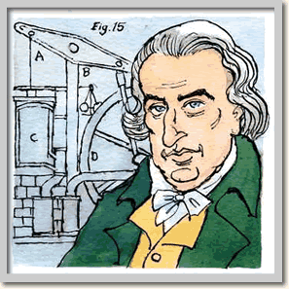
James Watt improved Newcomen’s design and invented what is considered the first modern steam engine in 1765.

Slide 16
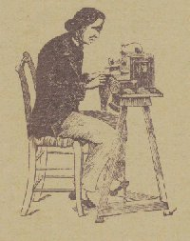
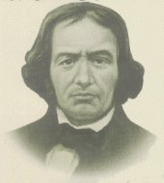
The first functional sewing machine was invented by the French tailor, Barthelemy Thimonnier, in 1830.

Slide 17
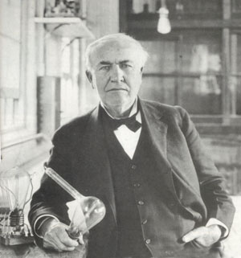
In 1879, Thomas Alva Edison invented a carbon filament that burned for forty hours.

Slide 18
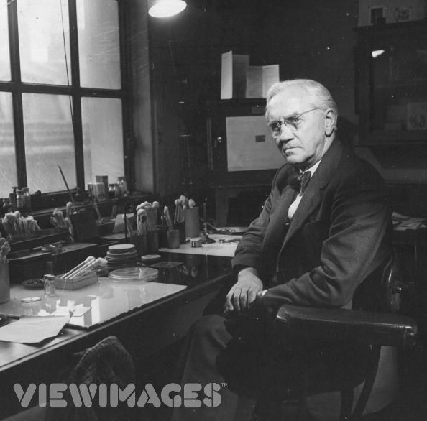
Penicillin was discovered by Alexander Fleming in 1928.

Slide 19

Discussion
The importance of the inventions

Slide 20
I think penicillin is more useful than the light bulb because penicillin saves lives.
I think the light bulb is more useful than the Sewing Machine because the light bulb gives light to the world.
I think the Sewing Machine is more useful than the Steam Engine because the Sewing Machine makes clothing which dresses man.

Slide 21
I think the automobile is more useful than television because the automobile takes people and things to all the places they are expected to go.
I think television is more useful than computers because television brings what is happening in the world to you at home.
I think computer is more useful than the telephone because computer makes it possible for man to do almost anything he wants to do.

Slide 22
I think the Steam Engine is more useful than the Camera because the Steam Engine makes the ships go around the world.
I think the Camera is more useful than the Cotton Gin because the Camera takes pictures of all that are in the world.
I think the Cotton Gin is more useful than the Automobile because the Cotton Gin makes cloth out of cotton.

Slide 23
Everyday English
1 A: _____, you need to be a bit mad to be an inventor.
B: __________________, then my friend Peter Ling is a bit mad. He’s an inventor. He’s just invented a clock that not only ___________, but also plays a song to wake you up!
If so
To give an example
tells the time

Slide 24
2 A: The Chinese are very clever people. __________, they are much better at maths than most westerners.
B: I agree. A Chinese friend of mine explained a difficult maths problem to me, and _____________________ I understood.
They say
for the first time ever

Slide 25
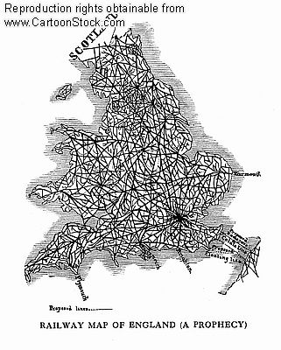
Cultural Corner
The Industrial Revolution

Slide 26
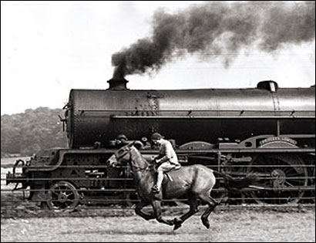

Slide 27
The Industrial Revolution may be defined as the application of power-driven machinery to manufacturing. It had its beginning in remote times, and is still continuing in some places. In the eighteenth century all of western Europe began to industrialize rapidly, but in England the process was most highly accelerated. England's head start may be attributed to the emergence of a number of simultaneous factors.

Slide 28
Discussion
1 What changes happened with the Industrial Revolution?
2 What do you know about the development of industry in China?

