Slide 1


Module 5
Great People and Great Inventions of Ancient China

Slide 2
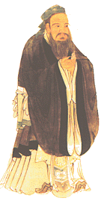
孔子（前551～前479）名丘，字仲尼。
春秋后期伟大的思想家、教育家，儒家的创始人。鲁国人。是儒家学派的创始人，提出了“仁”的思想，是中国古代著名的思想家和教育家。
Great People
Confucius

Slide 3
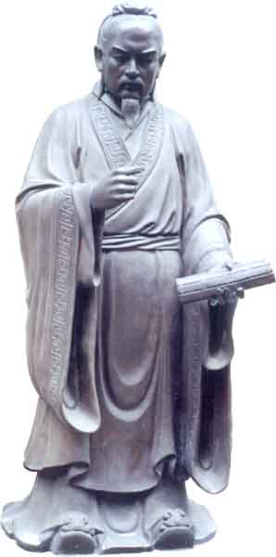
孟子(前372—前289)名轲，战国中期鲁国邹人。受业于子思(孔子之孙，名)之门人，曾游历于宋、滕、魏、齐等国，阐述他的政治主张，还曾在齐为卿。晚年退而著书，传世有《孟子》七篇。他是战国中期儒家的代表。
Mencius

Slide 4
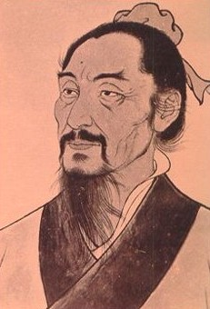
墨翟（公元前468—376），人们尊称墨子。他是战国初年的鲁国人，大约生于公元前468年，死于公元前376年。
Mozi

Slide 5
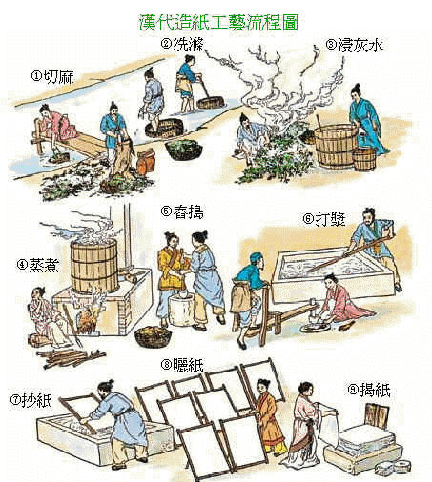
Great Inventions
Paper-making

Slide 6
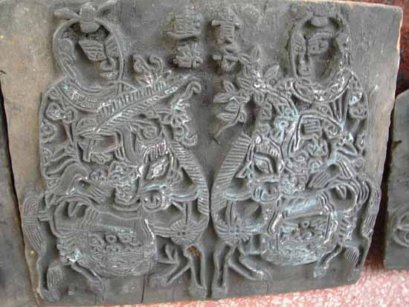
Printing

Slide 7
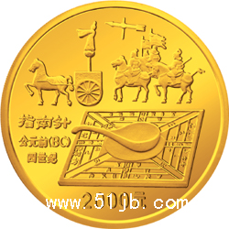
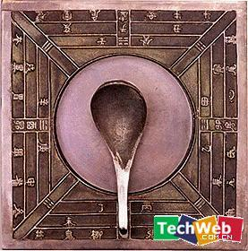
Compass

Slide 8
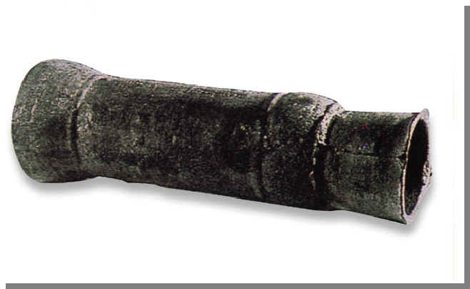
Gun-powder

Slide 9
Introduction
state:
organized political community forming part of a country
州 ，国家
philosopher :
A person who studies or teaches philosophy
哲学家
philosophy:
Search for knowledge and understand of the nature and meanings of the universe and of human life
哲学

Slide 10
ruler：
A person who rules or governs
统治者
importance:
being important
重要性
treat :
act or behave in a certain way towards sb.
对待
teaching :
that which is taught
学说

Slide 11
1
equal importance look after philosopher philosophy ruler state teachings thinker treat war
In ancient China, private teachers traveled from state to s____ explaining their p________ Confucius was the most important of the ancient Chinese p__________ Confucius’s t_________ influenced society for more than 2000 years.
tate
hilosophy
hilosophers
eaching

Slide 12
hinkers
Other important t_______ included Mencius and Mozi. All three teachers believed in the i_________ of kindness and good government. Mencius’s ideas were very similar to those of Confucius, but some of Mozi’s t_________ were very different. For example, he hated the idea of w_____ and believed that strong people should l_________ weaker people.
mportance
eachings
ar
ook after

Slide 13
Please tell whose ideas the statements are:
2
1. Man is born good.
2. All human beings are equal.
3. The family is important. We are
members of a group.
Mencius
Mozi
Confucius

Slide 14
4. Treat others in the way you want to be
treated.
5. People are more important than rulers.
6. We should love all human beings.
Confucius
Mencius
Mozi

Slide 15

Discussion
Say something more about Confucius, Mencius and Mozi.

Slide 16
Vocabulary
equal
importance
philosopher
philosophy
teaching
thinker
kindness
adj.平等的
n.重要，重要性
n.哲学家
n.哲学
n.(常作复数)教导，学说
n.思想家
n.善良

Slide 17
order
principle
position
stress
resign
adviser
influential
love
n.秩序
n.原则，准则
n.职位
vt.强调
vi.辞职
n.顾问
adj.有影响的
n.仁爱

Slide 18
Reading
1. Confucius lived in a country where
there was no war a long time ago.
2. Confucius was a philosopher whose influence has been the greatest for more than 2000 years.
3. Mencius was a student taught by Confucius.
4. Some rulers followed the advice which was given by Mencius.
5. Mozi was a man who lived an unusual life.
F
T
F
F
T

Slide 19
Complete the following form.
Philosopher | Born time | Main ideas
Confucius
Mencius
Mozi
stressed the importance of kindness, duty and order in society.
551BC
If the government was kind, people would be good. People were more important than rulers.
372BC
We should love all human beings and look after those who are weaker than ourselves.
476BC

Slide 20
Expressions
1.be at war with
2. bring up
3. become famous for
4.in some ways; be similar to
Ancient China was a place where states were often at war with each other.
His father died when he was young, he was brought up by his mother.
He became famous for his unusual clothes and behaviour.
In some ways, his beliefs were similar to those of Confucius.

Slide 21
1
p42
1.an idea that influences the way you behave __________
2.to start an organisation or philosophy
__________
3.the feeling that something is true and exists __________
4.when people obey laws and rules and do not cause trouble __________
5.to look after children until they are adults
___________
principle
found
belief
order
bring up

Slide 22
2
p42
1. give a lot of importance to ___________
2. job ___________
3. doing what he suggested
________________
4. tell your employer that you are going to leave your job ___________
5. someone who gives advice ___________
6. having a lot of influence ____________
stress
position
follow one’s advice
resign
adviser
influential

Slide 23
3
p42
1. The Chinese people ___ for over 2,000 years.
A. followed Confucius’s teachings
B. influenced Confucius
2. Mencius believed that people are ___ important than rules.
A. less B. more
A
B

Slide 24
B
3. Mohism began ______.
A. 476 BC B. by Mozi
4. Mozi did not agree with ______.
A. kindness B. war
5. Mencius had important government positions, _______.
A. but Mozi did not
B. and so did Mozi
B
B

Slide 25
Exercises
1.他在床上休息。
He is at rest in the bed.
2.我们从小被教育要尊敬老人。
We were brought up to respect the old.
3.鲁迅因为他的作品而为人所知。
Lu Xun was famous for his works.

Slide 26
4. 爱因斯坦是一位著名的科学家。
Einstein was famous as a great scientist.
5.长城为全世界的人所熟知。
The Great Wall of China is famous to all over the world.
6.从某种意义上讲 你是正确的，但我仍有疑虑。
In a way, you are right, but I still have doubts.
7. 玛丽的帽子和珍的是一样的。
Mary’s hat is similar to Jane’s.

Slide 27
1. Whose influence has been the greatest among all the philosophers of ancient China?
A. Mencius B. Mozi
C. Confucius D. Zhuangzi
2. Confucius stressed the importance of the following aspects except__________
A. Kindness B. friendship
C. order D. duty

Slide 28
3. Which is NOT the right statement about Mozi?
A. He was known for his unusual clothes and behavior.
B. He hated the idea of war.
C. All his beliefs were the same as Confucius.
D. He believed all men were equal.

Slide 29
4. “If the government was kind, then people would be good.” is the teaching of _________.
A. Mencius B. Confucius
C. Mozi D. Xunzi

Slide 30
5. Which belief by Mozi was similar to that of Confucius?
A. We should love all human beings.
B. The government shouldn’t treat people badly.
C. We should look after those who are weaker than ourselves.
D. The government was most important.

Slide 31
6. Which shows the right order of time when the three great thinkers lived?
A. Confucius--- Mencius ---Mozi
B. Mencius----Mozi----Confucius
C. Confucius---Mozi---Mencius
D. Mozi--- Mencius---Confucius

Slide 32
7. From the text we can infer that ___________
A. Only in time of war could philosophers produce great teaching.
B. It was not easy to find a state where people would follow the thinker's teaching.
C. Great philosophers must have been born in poor families.
D. Influential philosophers wouldn’t agree with each other.

Slide 33

Homework
Write a short passage to introduce an ancient person who is well-known.
Tell us something about his or her deeds,main ideas and achievements.

