Slide 1
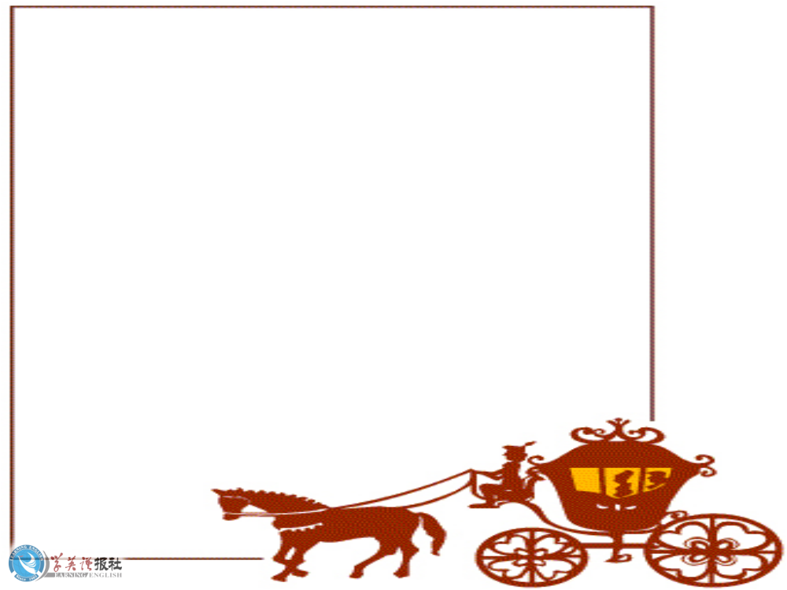

Unit 3 Workbook
Listening

Slide 2
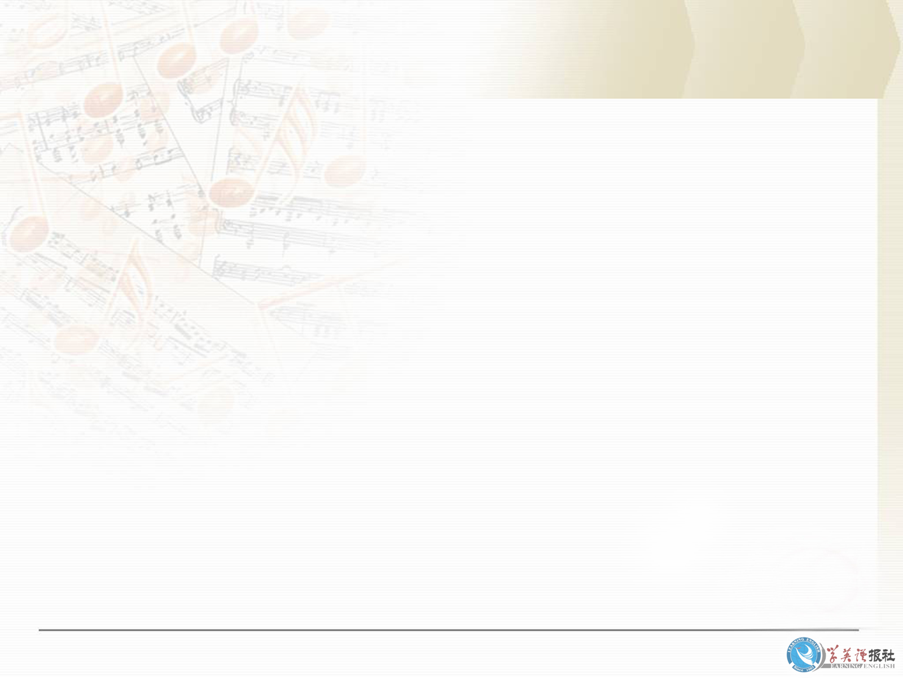
During her final year of high school, Li Yue began to feel sick all the time, so she visited the doctor. Listen to her talking to the doctor and complete Li Yue’s chart.

Slide 3
Medical chart
Name: Li Yue
Age: 18
Occupation: __________
Today’s date: ____________
Symptoms: ____________
________________________________________
Student
headaches,
tired all the time, not sleeping and eating well

Slide 4
Possible problem: ___________
Proposed action :
__________________________________
______________________
______________________
stress
1. Do some tests to rule out anything
physical.
2. Discuss ways to relax.

Slide 5

Listening text
( D = Doctor L = Li Yue )
D: Hello, Li Yue. What can I do for
you today?
L: Well, I’ve been getting a lot of
headaches lately.
D: Mmm?

Slide 6
L: And I feel tired all the time. The
problem is that I’ve got so much
work to do, but my head aches and
I keep wanting to go to sleep.
D: I see. Are you sleeping well?
L: No, not really.

Slide 7
D: Mmmm. Now let’s see. You’re
preparing the College Entrance
Exams, aren’t you?
L: Yes, that’s right. I’ve got so much
to do but I can’t do it when I’m
feeling so ill.
D: Well. Don’t get upset. We’ll sort
it out.

Slide 8
L: I hope so.
D: OK. Well, I have to do some tests to
rule out anything physical, but I really
think the problem is stress.
L: Stress?
D: How much time do you study each day?
L: I don’t know. As much as I can.
D: And how much time do you take
to relax?

Slide 9
L: None at all. I don’t have relaxing time.
D: I know it’s difficult. I remember when
I was studying for exams, study
seemed more important than anything
else. But you will actually do better in
your exams if you balance study with
some relaxation.

Slide 10
L: Really?
D: Yes. Look, how about this? Let me do
these tests and then you come back in
a few days for the results. If the problem
is stress, we can talk about ways to relax
and still get your schoolwork done.
L: That’ll be good, thanks.
D: Not at all. And in the meantime, relax
a bit.
L: I’ll try.

Slide 11
Listening task
Listen to Part 1 and complete these sentences.
Well, I am here today to tell you that it’s OK to ____________, but _____
_____________________________.
2. I never ________ properly and in the end I __________. I started to have __________, I ________________,
worry a little
be
careful about worrying too much
relaxed
became ill
headaches
didn’t sleep well

Slide 12
I ___________________ and I ________ all the time.
3. Finally I ________________ and that’s
how I __________________.
didn’t feel like eating
was tired
went to the doctor
learned about stress

Slide 13
Listen to Part 2 and answer these questions below.
1. What did the doctor tell Li Yue about?
2. What does Li Yue say could happen of you dtudy all time without a break?
3. What things does Li Yue suggest that students could do to relax?

Slide 14
What did the doctor tell Li Yue about?
2. What does Li Yue say could happen of you study all time without a break?
The doctor told Li Yue to keep a balance in her life between work and relaxation.
Li Yue says you could become ill.

Slide 15
3. What things does Li Yue suggest that
students could do to relax?
Li Yue suggests that the students have fun, keep in touch with friends and do some exercise every day.

Slide 16
Discuss the following questions in your group.
1 Do you agree with Li Yue’ advice?
2 What do you do to relax?
3 Do you think you have balanced your
study time and time for relation? Or do
you think you should do more study or
take more breaks?
4 Do you think Li Yue has given s good
speech to the students?
Give your reasons.

Slide 17

Listening text
LI YUE’S TALK TO THE STUDENTS
Part1 Good morning, teachers and students, and thank you for coming to listen to me. I know this is a very busy time for you now that you are preparing for the College Entrance Examinations. So I want to tell you about what happened to me last year, and hope you don’t make the

Slide 18
mistake I made. Are some of you worried about your exams? Well, I’m here today to tell you that it’s OK to worry a little, but be careful about worrying too much. You see, what I did was to worry so much that all I did was study from morning to night. I never relaxed properly and in the end became ill.

Slide 19
I started to have headaches, I didn’t sleep well, I didn’t feel like eating and I was tired all the time. In the end I couldn't study any more because my heart hurt so badly that I kept falling asleep in class.
Finally I went to the doctor and that’s how I learned about stress.

Slide 20
Part 2 The doctor explained to me that to do well in your exams you should keep a balance in your life. If you don’t take time out to relax and enjoy yourself, you may become ill. You must balance work with rest. You need to have fun. You need to keep in touch with your friends and do some exercise every day.

Slide 21
You may be surprised to find how much better you feel after even a small break. So, my advice to you today is to think carefully about your physical and mental health. Just take 30 minutes a day to get some fresh air,
do some exercise or meet friends.
That will make all the difference.

Slide 22
Don’t feel guilty if you see a film,
go riding in the country or go hiking once a week. I promise you it will help your schoolwork.
Thank you for listening to me and I hope you find my advice useful.
(sound of audience clapping)

Slide 23

Thank you!

