Slide 1
Paper 2

Slide 2
21-25 BACBD 26-30 CDABB
31-35 ADADB 36-40 BDAGE
41-45 DBACB 46-50 DACDB
51-55 BCADC 56-60 ADACB
61. worse 62. to live
63. herself 64. wrote
65. lucky 66. but
67. has taught 68. choices
69. the 70. wisely

Slide 3
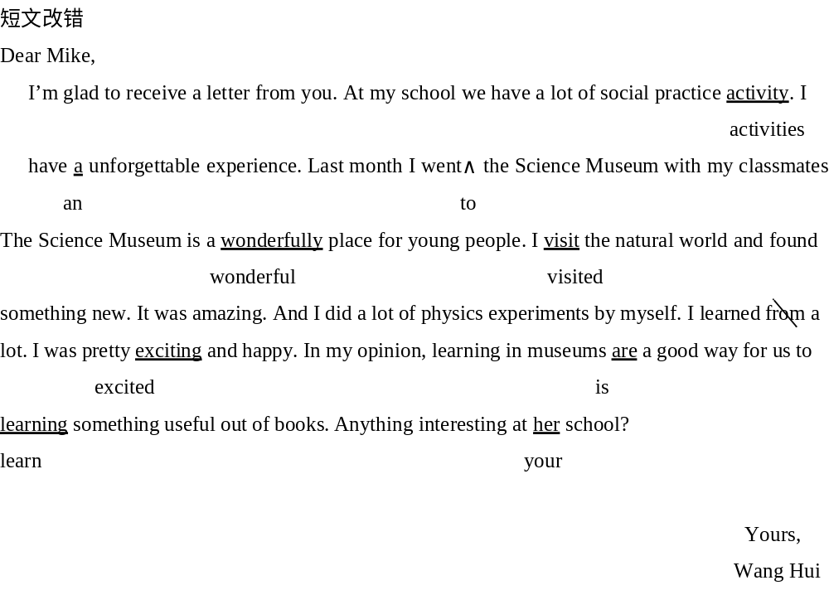

Slide 4
At the beginning of every school year, I feared coming home with that first night of homework after a summer of fun. And I feared getting a teacher who had a long list of rules and a stare that could kill a cat.
But there was always one part of beginning a new school year that I enjoyed. I always liked going to the store to arm myself with new school supplies (用品) even if I didn’t need them.
Sure, my pencils, erasers and notebooks from the previous (以前的) school year may have had some life left in them. The pencils had a few centimeters of lead (铅) leftover (剩余物). The notebooks had unused sheets of paper. But this didn’t matter. Every year, Dad would take us to Wal-Mart and let us buy the newest and coolest pencils, erasers and notebooks.

Slide 5
Besides school supplies, many parents also took their kids to buy new clothes and book bags just in time for school.
I guess many of my classmates and I must have shown up to school on the first day with something that smelled like a new car. We’d keep our new pencil bags and notebooks on top of our desk a little bit longer, just to make sure our classmates saw them.
All of this buying sounds a little environmentally unfriendly (不够环保的). But our parents seemed to think that buying these school supplies was worth it if doing so meant we’d work a little harder in school. Who knows? Perhaps we’d even start loving to do our math homework.
Leftover supplies from past years were always stuffed into the living room desk. Used clothes that had lost their appeal (吸引力) were sent to thrift shops (旧货店), where they would be sold for 50 cents a piece.
Meanwhile, all of this new stuff did make us excited about going to school, at least for a week.

Slide 6
WORDS IN FOCUS
fear
v./n. be afraid of 害怕，担心
Many people feared to go out at night.
stare
n./v. a fixed look with eyes open wide 凝视，注视
I asked him about it, but I only got a blank stare in return.
arm
v. provide what you need to do something 装备，提供
The guidebook arms the reader with a lot of useful information.
besides
prep. as well as, in addition to 除……之外
Besides milk and cheese, we also need vegetables.
stuff
v. fill something so that there is no room for anything else 塞满，填满
The boy stuffed his pockets with candy.
meanwhile
adv. at the same time （与此）同时
Please set the table. Meanwhile, I’ll start making dinner.

Slide 7
SENTENCE BANK
释义：当然，我上一学年用过的铅笔、橡皮、笔记本可能还有利用价值。
修辞：have some life left在此为拟人写法，形象地表明这些东西尚可使用，与下文描写的开学大购物形成对比。
释义：我想很多同学会和我一样，在开学第一天带着新文具到学校。这些文具的味道，都像新车一样好闻。
重点词：must have done用来表示对过去已经发生的事情的肯定推测，意为“肯定已经”；show up 露面，到达。
释义：但是我们的父母似乎认为，如果给我们买这些东西意味着我们在学校会更加努力的话，那这一切就是值得的。

Slide 8
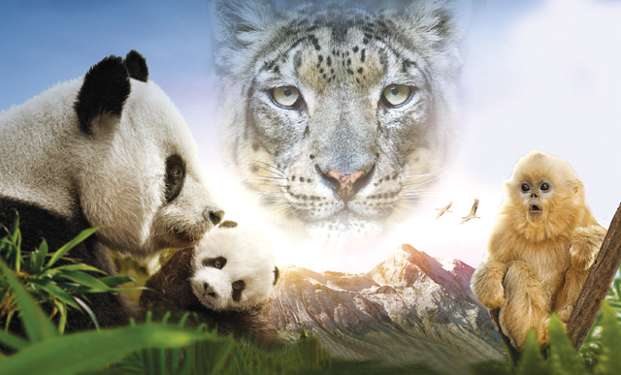
Nature shows culture

Slide 9
While CCTV’s educational TV show Animal World (《动物世界》) is well known, few big screen wildlife documentaries have been made by China’s film industry.
But Born in China, which came out on Aug 12 in the mainland, may be important for Chinese filmmakers who want to get into nature-themed films. The movie, directed by Chinese filmmaker Lu Chuan, was shot in the Qinghai-Tibet Plateau (青藏高原) and shows the animals’ lives during different seasons.
Born in China not only brings to audiences the lives of animals that are rarely seen in the wild – giant pandas, snow leopards (雪豹), golden monkeys, and Tibetan antelopes (藏羚羊), for example – but also shows audiences Chinese traditional culture. The film mainly focuses on life and love within three animal families – giant pandas, golden monkeys and snow leopards.
A symbol (标志) of China, the giant panda is both black and white. Its body is thought to show yin and yang, which ancient Chinese ideas of the world were based on. Yin shows darkness and yang shows brightness.

Slide 10
The panda’s gentle nature also shows how yin and yang, when perfectly balanced (平衡的), lead to peace and harmony (和谐). These can be seen in the documentary when a giant panda mother guides her growing baby to gradually look for independence and explore the world.
Unlike the shy giant pandas, monkeys always have strong personalities. In fact, perhaps China’s most colorful literary creation (文学创作) is a monkey: the Monkey King, from the epic (史诗般的) Ming Dynasty (1368-1644) novel Journey to the West (《西游记》) by author Wu Cheng’en. The monkey has many conflicting (相矛盾的) traits (特性). On one hand it stands for impatience, as in the Chinese phrase that translates as “monkey anxious (焦急的)”, but on the other hand, its use in Chinese points to cleverness and energy. Born in China follows a 2-year-old golden monkey who feels like his life has been changed for the worse by his new baby sister, quickly joins up with a group of other free-spirited monkeys, but finally returns to his family and understands the meaning of responsibility.

Slide 11
While the golden monkey learns to protect his family, a mother snow leopard – an animal rarely caught on camera – also faces the very real drama of raising her two cubs (幼崽) in a harsh (严酷的) environment. The leopards, known for their rapid attacks and quick footwork (脚步), have inspired a form of pictographic boxing (象形拳) in Shaolin martial arts (武术).
“Born in China is a means to show off Chinese traditional culture,” director Lu told the Binhai Times newspaper. “From five-animal exercises to pictographic boxing, Chinese people have learned from wild animals since ancient times. This is why I felt an urge to shoot this type of nature-themed documentary.”

