Slide 1

Unit 4 Earthquakes
Revision

Slide 2
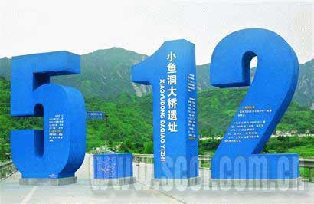
What can you think of when looking at this number?

Slide 3
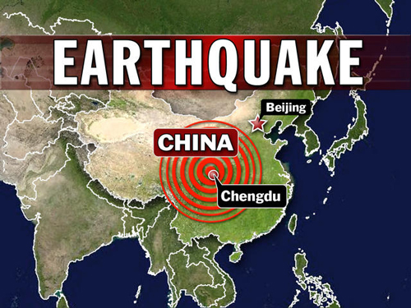
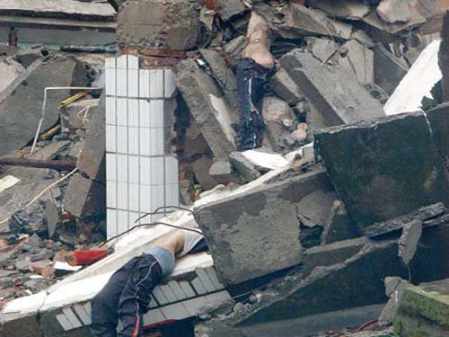
earthquake
1.On May 12th,a big _____________（地震） happened in Sichuan.
2.It was a ___________ (灾难) to the whole nation.
3.A lot of people were ____________ (埋葬)during the earthquake
disaster
buried

Slide 4
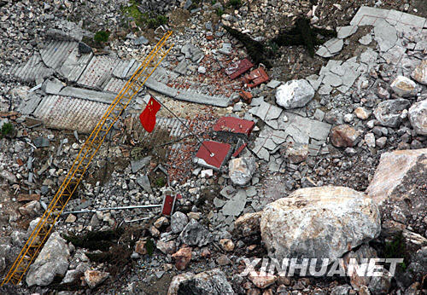
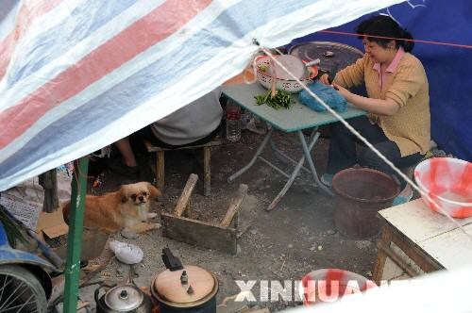
Thousands of
4.________________（成千上万） people lost their life and many buildings were _________(破坏)
5.Luckily, our government sent the _________ (军队) to _________ (拯救) the survivors.
6.After the earthquake, the survivors live in kinds of __________(避难所).
7.Wenchuan earthquake ______(使震惊)the nation.
destroyed
army
rescue
shelters
shocked
shocking
The __________event of 2008 in China was Wenchuan earthquake.

Slide 5
An earthquake will s______ us.
shock
v.
We will be s______ by an earthquake.
shocked
adj.
An earthquake will be a s_____ to the nation.
_______
shock
n.
?
adj.
a s_______event
shocking

Slide 6
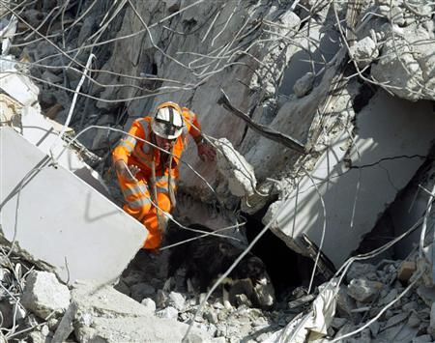

4
A rescue worker is searching for s_______.
urvivors

Slide 7
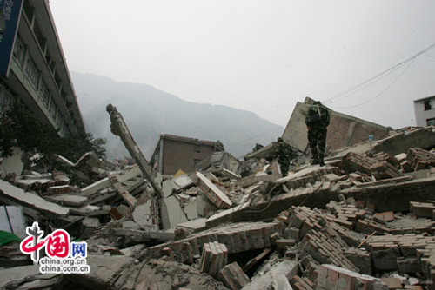
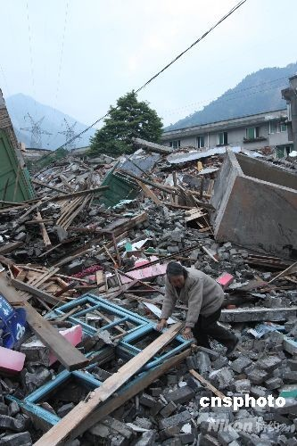
5
似乎一切都在地震中被毁坏了。(as if )
It seemed as if everything was destroyed
in the earthquake.

Slide 8
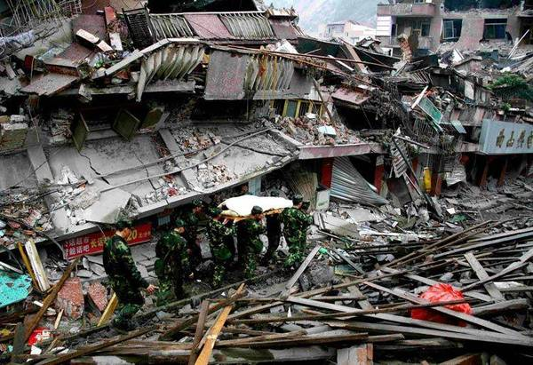
The whole city lay ________.
in ruins
4

Slide 9
Task two
Words and phrases using.

Slide 10
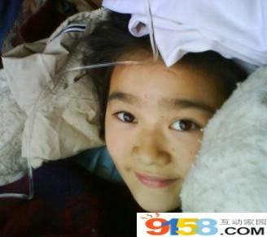
I think I am a lucky girl, though I just suffered the great ___________. I still remember I was having class when suddenly the floor ___________. It seemed the world was _________. I didn’t realize that was an ___________ which killed so many people and _________ so many houses. I was really very lucky to be ___________by our army. Though I was___________, I am alive now.
My mother told me that I was successfully __________ by hands, but still ______________ other children were _________ for ever. So I think I should smile .
We lost our home and our school but we were happy to live in the ___________, because we know the whole ________were trying their best to help us.
disaster
shook
at an end
earthquake
destroyed
rescued
injured
dug out
a great number of
buried
The smiling girl
shelters
nation
shelter shake earthquake destroy injure rescued
dig out a great number of bury at an end nation disaster

Slide 11

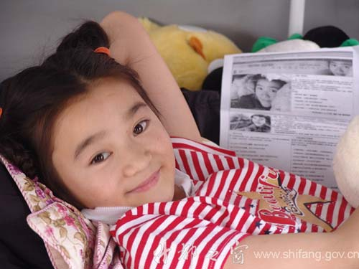
Suppose you are the reporter of the newspaper China Daily, please interview the smiling girl.
You

Slide 12
You: When the earthquake happened, what did you do first?
S.G:
You: What did you see outside？
S.G: ( people / buildings / roads / electricity/ animals…..)
You: Did anyone came to help?
S.G: ( rescue workers / doctors…)
You: How did you feel once you were saved? Who did you thank most?
S.G: (…be grateful to sb…/I’d like to express my thanks to...)
You: What did you want to do most now ?
S.G: ( help others/ study with / meet sb….)
You:

Slide 13
Replace the underlined words and expressions.
There was a big earthquake in Tangshan in 1976. Strange things happened before the earthquake, e.g., the water, the well walls, and the animals were all different from usual. But the people didn’t care about these things, and went to bed as what they did every day.
At 3:42 am everything began to shake. One–third of the nation
felt it. In fifteen terrible seconds the large city were totally destroyed. It seemed as if it was the end of the world. More than 400,000 people were killed or hurt. Nearly everything was destroyed. Then later that afternoon, another big earthquake shook Tangshan. People began to wonder how long the disaster would last. But all hope was not lost. A lot of soldiers came to save those who were kept under the ruins and help those who survived. Slowly the city began to breathe again.
thought little of
events,
as usual.
in ruins.
the world was at an end.
injured.
A large number of
rescue
trapped
survivors.

Slide 14
Task three
Sentence and grammar in the text

Slide 15
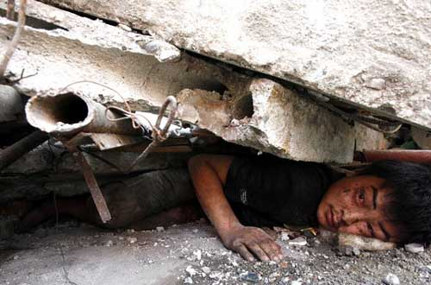
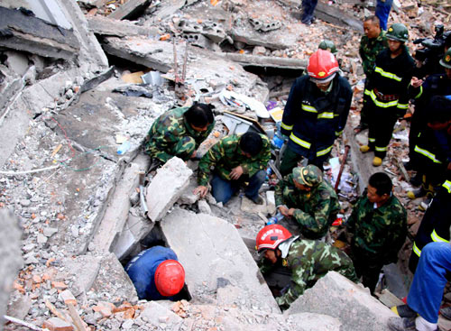
bury
dig out
People were buried under the ruins.
Rescue workers tried to dig out the people.
Rescue workers tried to dig out the people _______ were buried under the ruins.
who

Slide 16
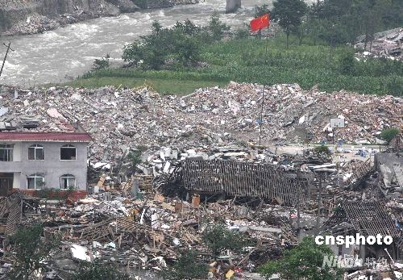
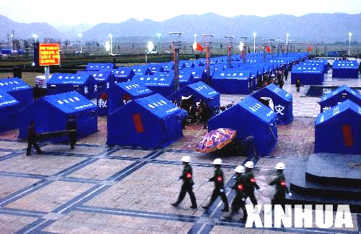
shelters
Lots of survivors’ houses were destroyed.
Workers built shelters for survivors.
Workers built shelters for survivors
______________________________.
whose houses were destroyed

Slide 17
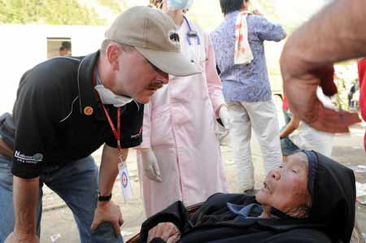
The doctors were giving help to the patients.
They came from the Red Cross Society.
The doctors who came from the Red Cross Society were giving help to the patients.

Slide 18

关系代词用法总结
关系代词 | 指代 | 所做成分
who
whom
which
that
whose (of which)
人
主／宾
人
宾
物
主／宾
物／人
主／宾
人／物
定

Slide 19
用which, that, who, whose 完成下面句子
1. I can see a building _______________lies in ruins.
2. The rescue workers dug out the girl ______leg was seriously injured.
3. The parents ________ children were killed burst into tears.
4.A boy __________ is trapped under the ruins is being treated.
5. This is the house _______ door became useless after the earthquake.
6.An old man _______ was 90 years old was buried under the building.
7.I went there right away to help rescue the people _______ homes were destroyed in the earthquake.
8. A number of children _________ parents died were left homeless.
which/that
whose
whose
who/that
whose
who/that
whose
whose

Slide 20
A terrible earthquake hit Wenchuan _____ lies in the north of Sichuan province . It could be felt even in Shanghai,_____________________________(定语从句：上海离汶川有2000多公里远). The people ______ felt the shake so clearly in the tall buildings ran down to the outside __________（立刻）.
When I watched news report on TV , (我很震惊地看见整个汶川破败不堪。完全被摧毁的学校的数量达到100所。许多医生正在帮助那些受伤的人。士兵正努力挖出那些被困在废墟里的孩子家长。
When I saw rescue workers _______ those ____ were killed in the earthquake, I ________________. (大哭起来)I decided to do something to help them.
which
which is more than 2000 km away
who/that
right away
I was really shocked to see the whole Wenchuan was in ruins.The number of schools which were destroyed completelyreached 100. A great number of doctors were helping those who were injured. The soldiers tried their best to dig out the children who were trapped in the ruins.
bury
who
burst into tears

Slide 21

Homework:
Suppose you are a survivor of the Sichuan earthquake, write a short letter to a newspaper about the earthquake and express your thanks for the help you’ve got.

Slide 22
Para 1. What happened in the earthquake?
Para 2. What did the people do to help the survivors?
Para 3. Express your thanks to the society or the people.
destroy, shock, disaster, bury, frighten,
right away, as if, at the end, in ruins…
a great number of, rescue, shelter, dig out,bury...
*Here, I wish to express my thanks for the great efforts that….
*I’d like to express my thanks to …who….
*……

Slide 23
Summing up
Write down what you have learned about earthquakes. ______________________________________________________________________________________________________
From this unit you have also learned
●Key words and phrases:____________________________
___________________________________________________
___________________________________________________
● Useful expressions:_________________________________
___________________________________________________
● A new grammar item:_______________________________
___________________________________________________
knowledge about earthquake/
natural disasters /how to help others in the earthquake
earthquake, destroy, shock,
rescue, disaster, bury, shelter, frighten, a great number of,
right away, as if, at the end, in ruins, dig out, tens of thousands of
It seemed as if….
I ‘d like to express my thanks to…who
The Attributive Clause(定语从句)

Slide 24
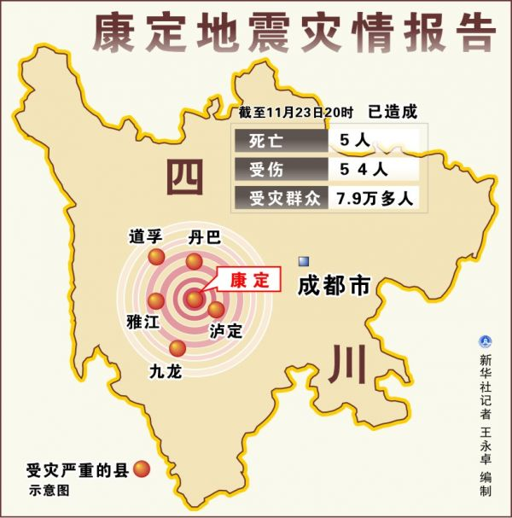
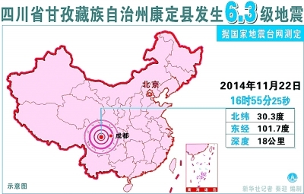
Can you think of some words about earthquake?
earthquake
shook
An_________ of magnitude 6.3____ China’s ___________province of Sichuan on Saturday
Five people _______and 54 others________.
southwestern
were killed
were injured

Slide 25
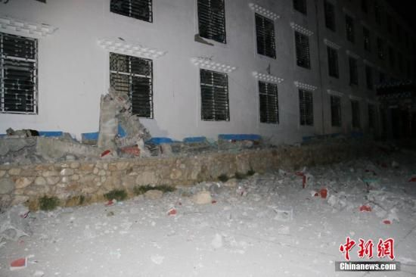
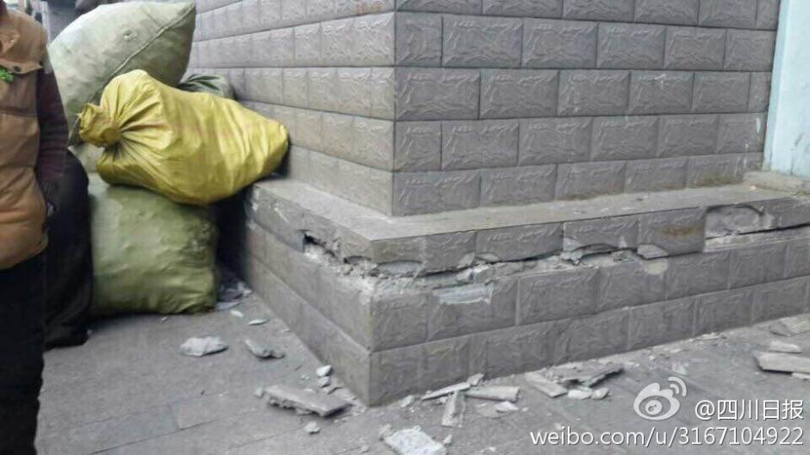
The walls of the building and the roads______.
cracked

Slide 26
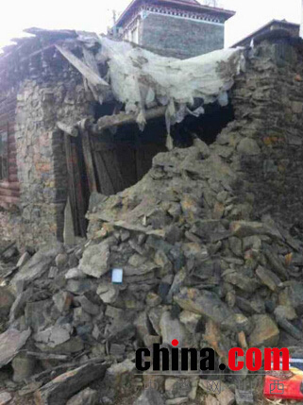
Some village huts were d________.
destroyed

Slide 27
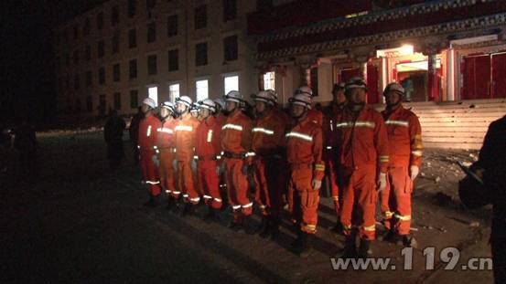
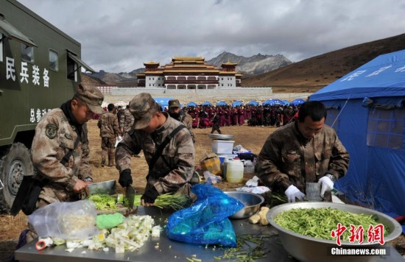
All hope was not lost.
___________________不是所有的希望都破灭了。
The _________were sent to______________.
The soldiers were cooking dishes for the
_____________.
rescue workers
help the survivors
homeless people

Slide 28
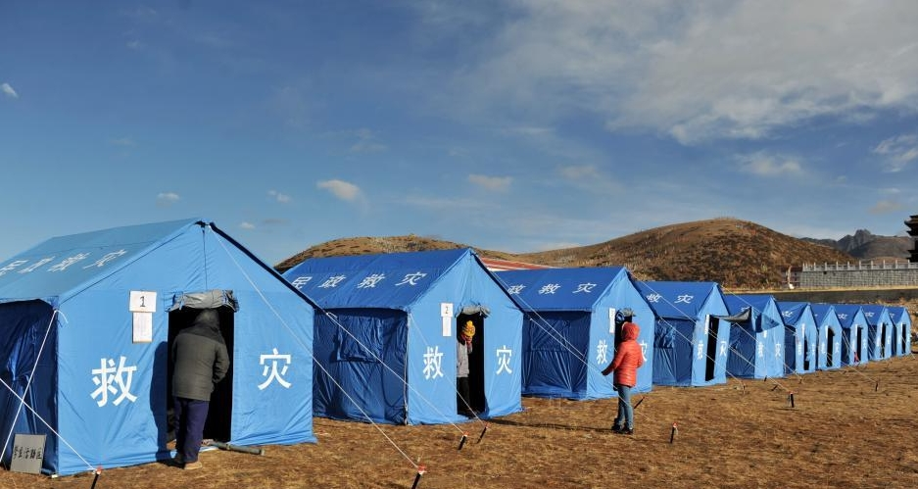
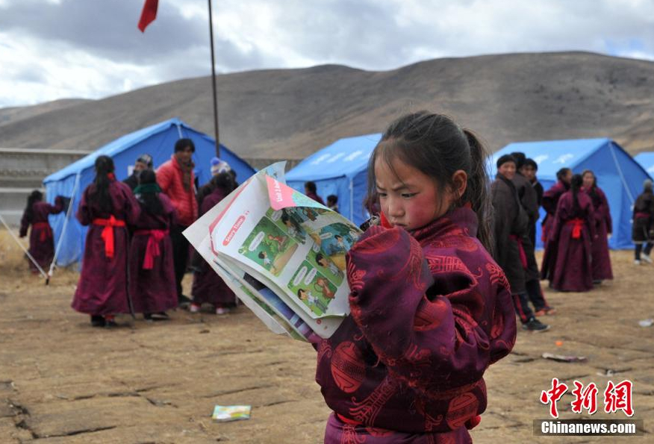
_________were built and the students could study again.
Shelters

