Slide 1
Presentation
——Elsa

Slide 2
Chiffon Cake(戚风蛋糕）
It is a kind of basic cake.Usually,it is used as the main part of a birthday cake.Because it tastes exquisite and soft like chiffon(雪纺绸）,it is named Chiffon Cake.

Slide 3
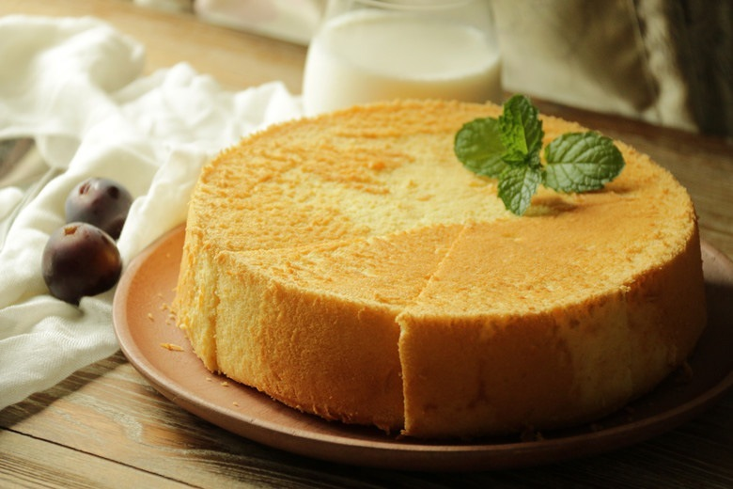

Slide 4
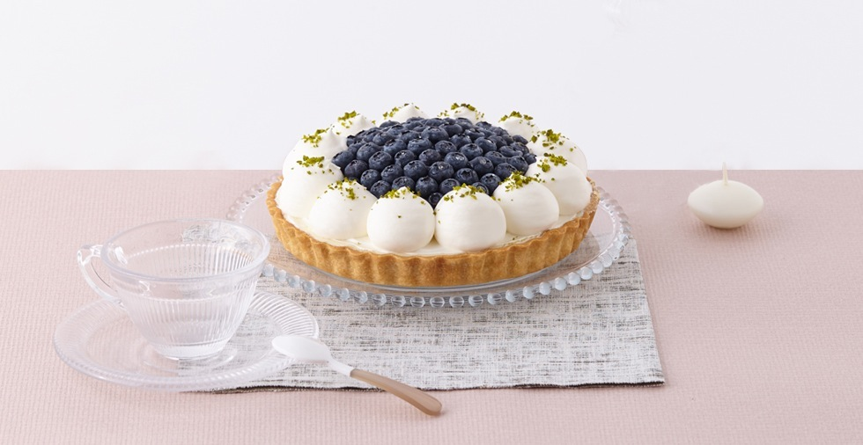

Slide 5
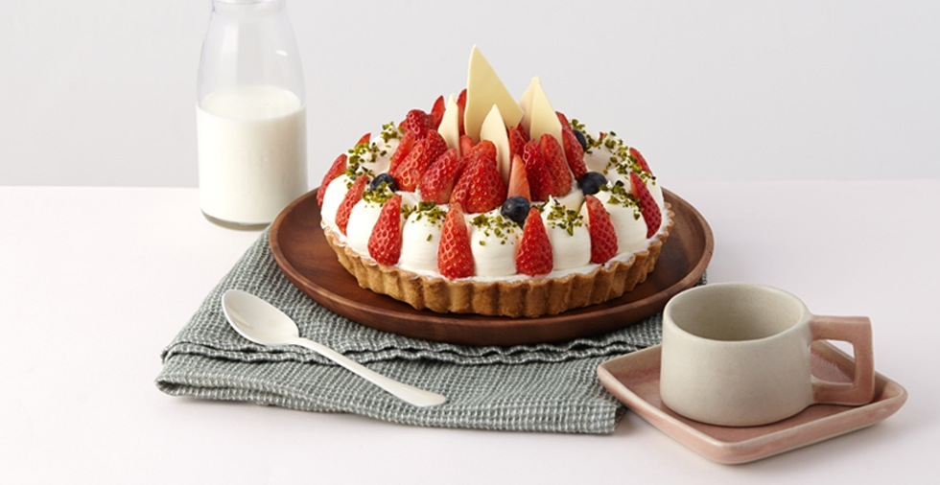

Slide 6
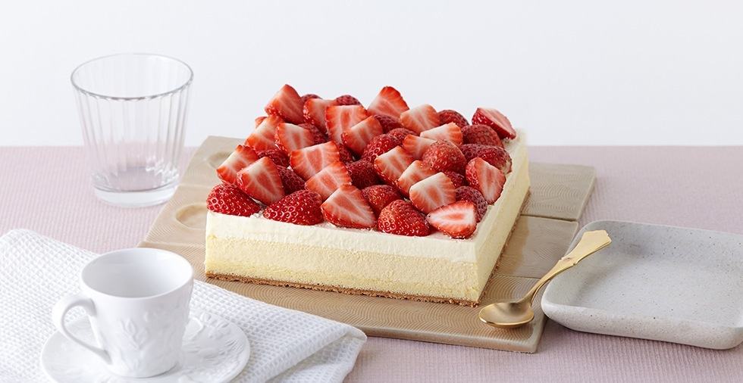

Slide 7
Mousse Cake(慕斯蛋糕）
It tastes quite different from the common cakes we eat in our school,because the main part of it is the fresh cream which is added edible coagulant(食用凝固剂）and then be frozen.People often use some fruits to decorate them.

Slide 8
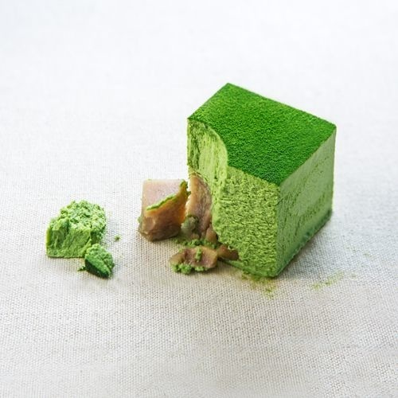
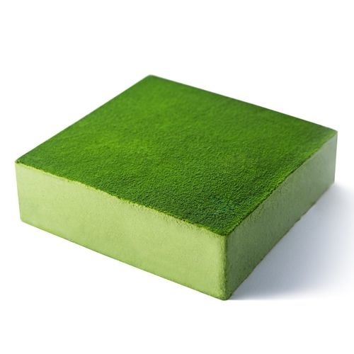

Slide 9
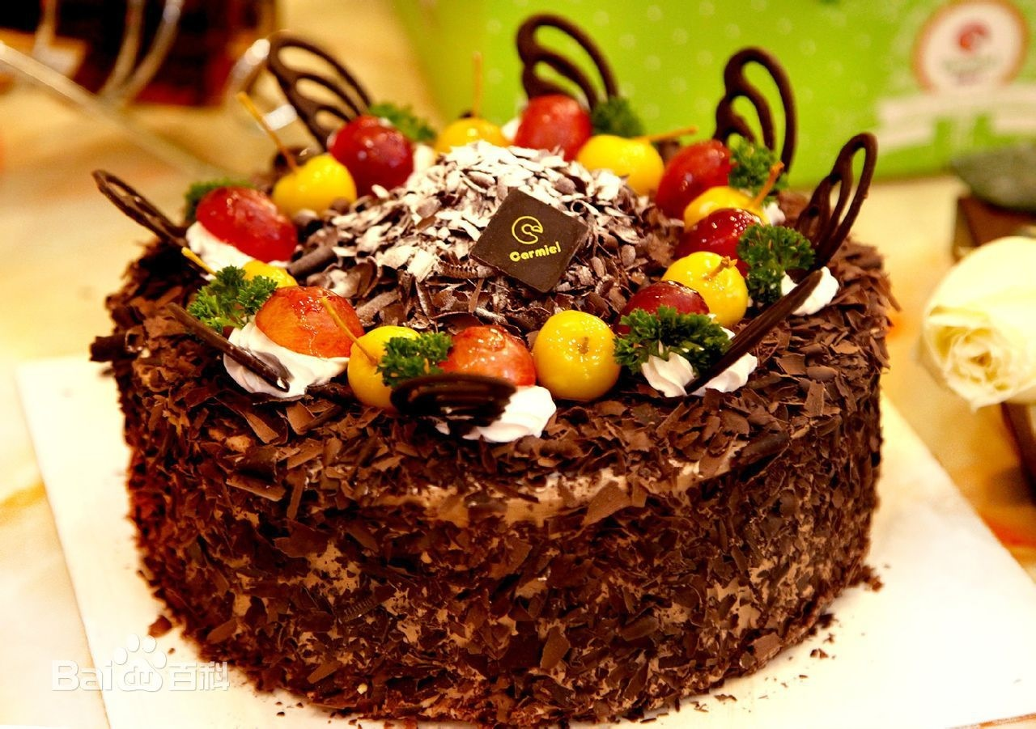

Slide 10
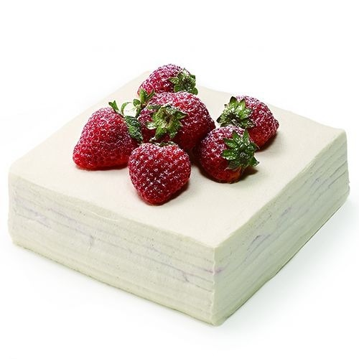

Slide 11
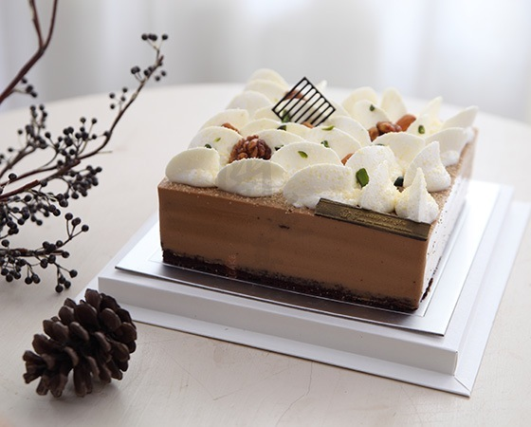

Slide 12
Fondant Cake(翻糖蛋糕）
It is derived from the British art cake.Nowadays it has become the best way for the Americans to decorate their cakes.It is very beautiful,but expensive.

Slide 13
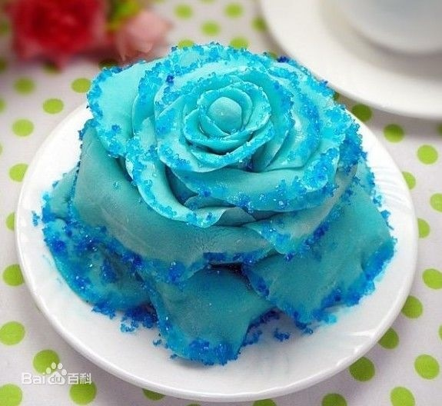

Slide 14
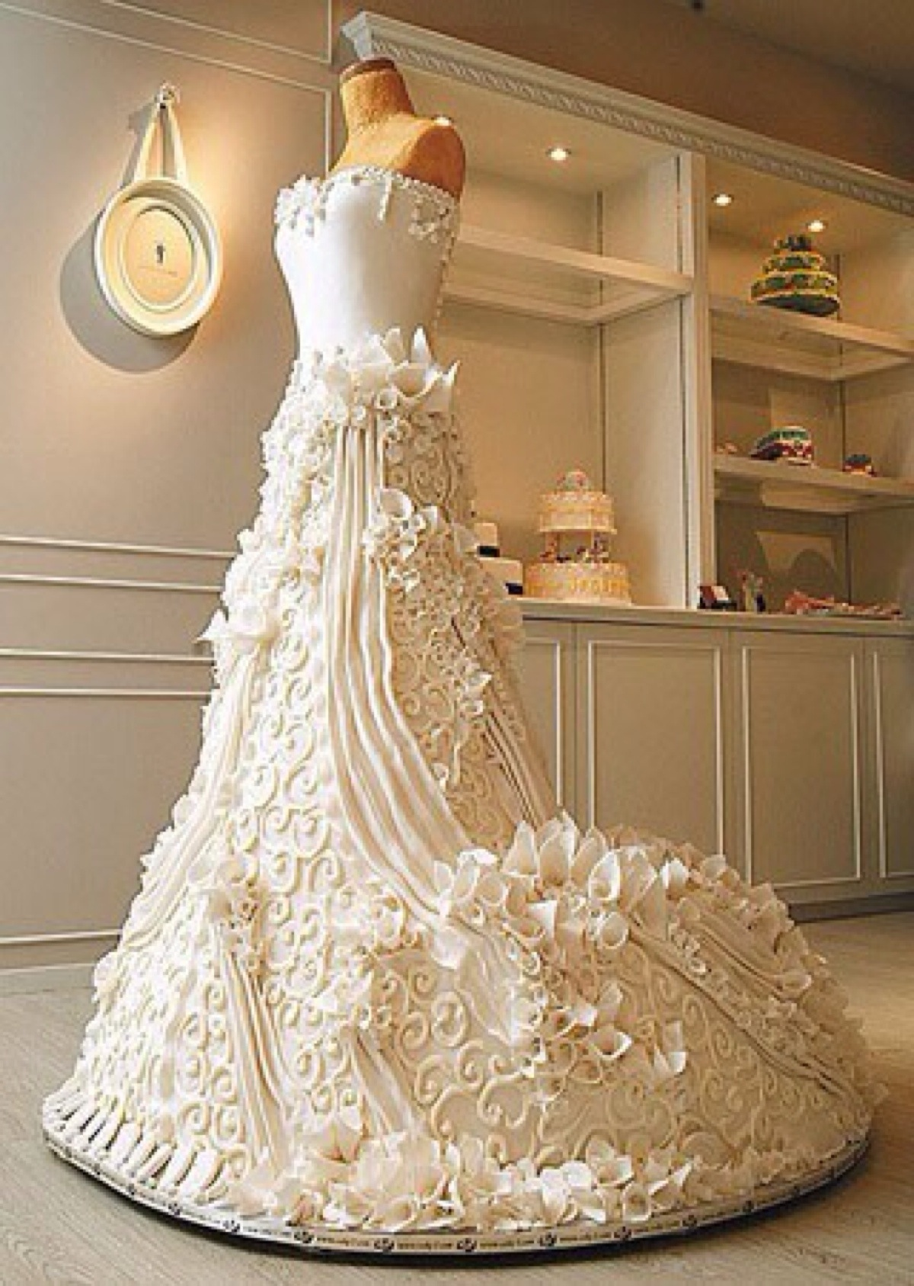
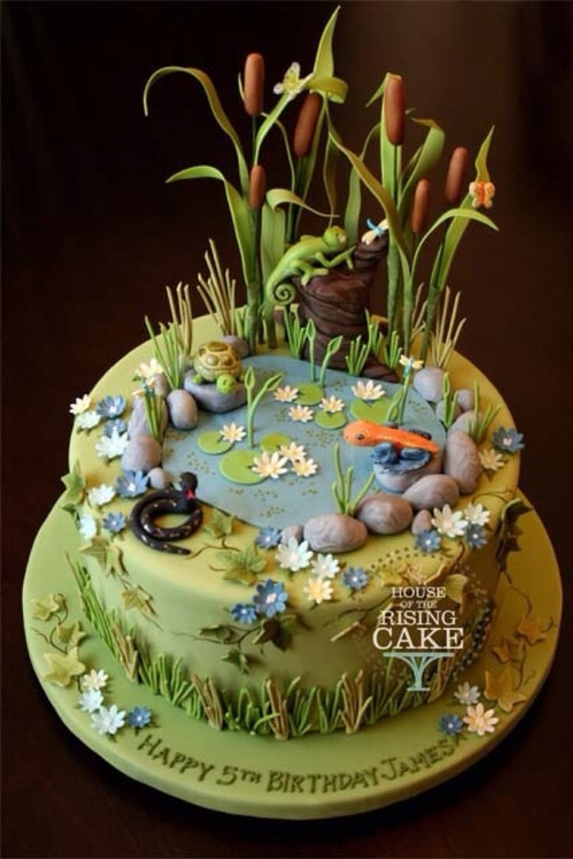

Slide 15
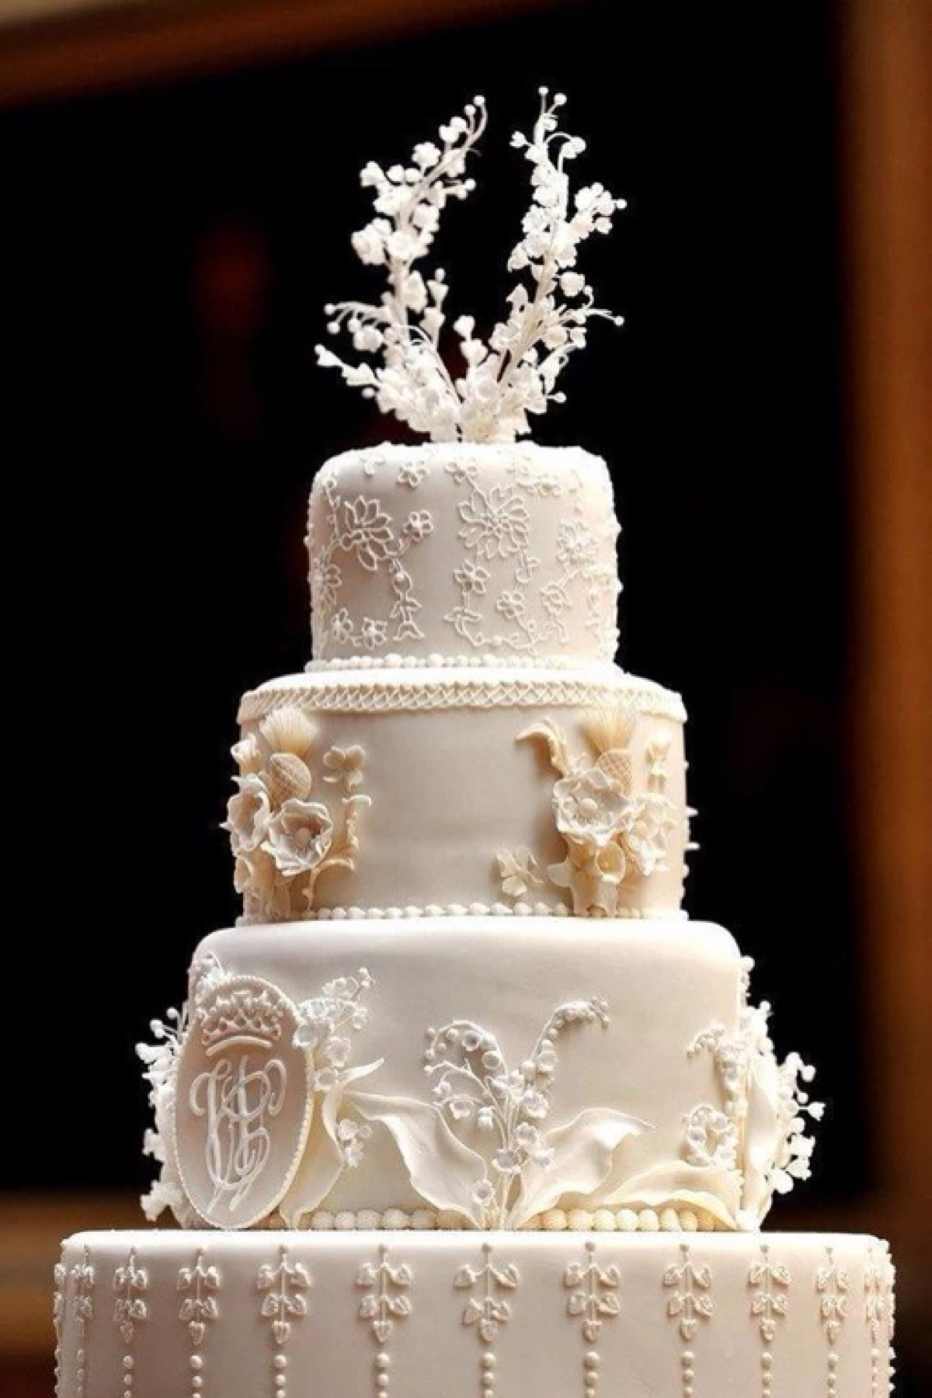
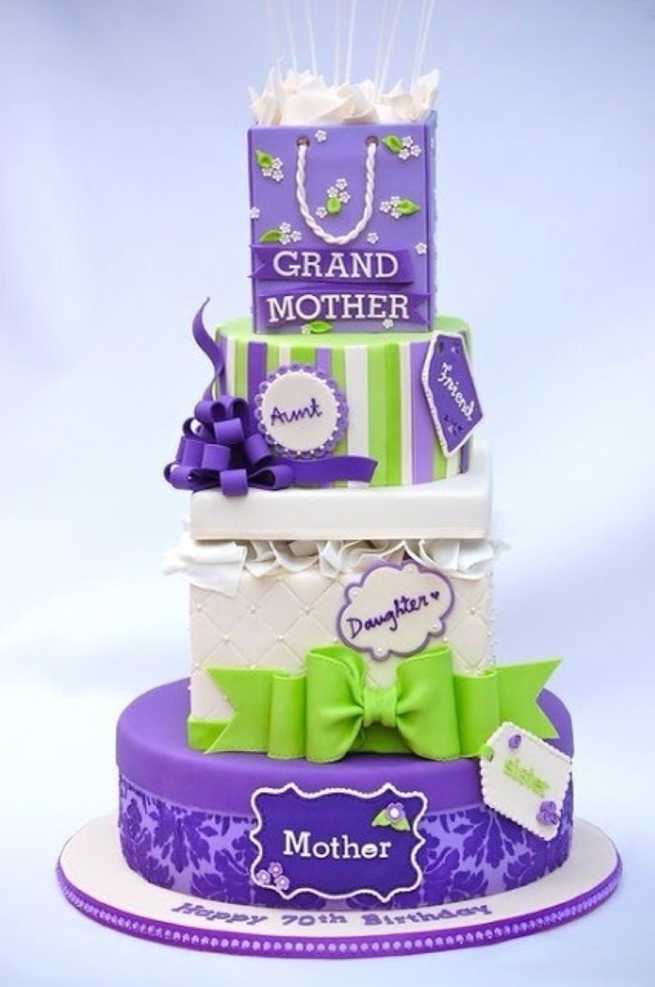

Slide 16
Conclusion:
1.Although the cakes are delicious,you’d better not eat too much of them,or you will be fat.
2.You can also try to make a cake by yourself if you like.You are sure to enjoy the production process.

Slide 17
Thank you!

