Slide 1
Choose the correct answers.
1. Which of the following statements is true?
A. Paintings in Middle Ages were very realistic.
B. Western art has changed a lot since the 5th century.
C. Impressionist paintings were painted mainly indoors.
D. Modern art began in the Renaissance.
B

Slide 2
2. In the Renaissance, painters ___.
painted religious scenes in a more realistic style
B. focused more on religion than on humans
C. began to paint outdoors
D. returned to classical Roman and Greek ideas about art
D

Slide 3
3. ____ discovered how to make paintings look more real by using perspective.
Giotto di Bondone.
Masaccio.
Claude Monet.
D. Pablo Picasso
B

Slide 4
4. According to the text, art is influenced less likely by ____.
A. social changes
B. the way of life
C. agriculture
D. beliefs of people
C

Slide 5
5. When did people focus more on people and less on religion?
From 5th to 15th century AD.
From 15th to 16th century.
C. From late 19th to early 20th century.
D. From 20th century to today.
B

Slide 6
6. Most people hate the impressionists’ style of painting at first because their paintings _____.
A. very abstract
B. very realistic
C. the same as traditional style of painting
D. very ridiculous
D

Slide 7
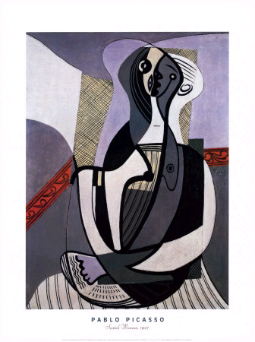
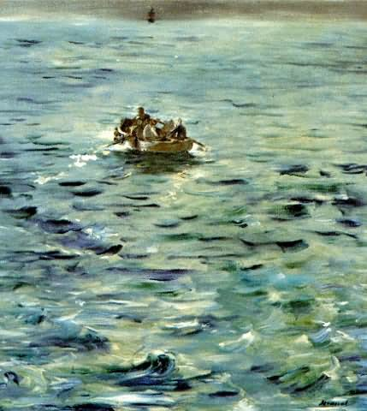
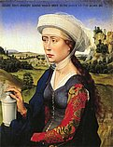
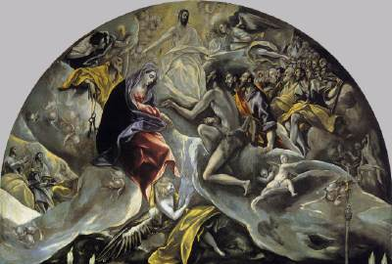
Please match the paintings with the right styles.
C
B
D
A
The Middle Ages B. Renaissance
C. Impressionism D. Modern Art

Slide 8
True or false ?
1. Western art has changed very little over the last seventeen centuries.
2. Paintings in the Middle Ages did not use perspective.
F
T

Slide 9
3. Impressionists painted landscapes.
4. You cannot recognize any object in
abstract modern art.
5. In the Renaissance most artists
painted indoors.
Abstract art is still an art style
today.
T
T
T
F

Slide 10
Language Points
1. Art is influenced by the customs
and faith of a people.
faith n. 信任, 信仰
I kept faith with him.
我信守了对他的诺言。
He who loses faith, loses all.
失去信心的人, 失去所有。

Slide 11
faithful adj. 忠诚的, 可靠的
have faith in 相信, 信任
in good faith 老实地; 诚恳地
break one's faith with sb.
对某人不守信用
keep faith with 忠于信仰; 守信

Slide 12
2. As there are so many different styles of
Western art that it would be impossible to
describe all of them in a short text．
so…that…如此…以至于…可引导结果状语从句
so+adj/adv原形+that…
  so+adj+a(an)+[c]单数+that
  so many/few +pl +that
  so much/little +[u]+that

Slide 13
[考例] _____ that Maric was able to set up new
branches elsewhere. (07陕西)
A. So successful her business was
B. So successful was her business
C. So her business was successful
D. So was her successful business
B
3. consequently
adv. 所以, 因此
D
It rained that day and ___ the baseball game was called off.
A. however B. still C. so D. consequently
adj. consequent 随后的, 相应的
n. consequence 后果

Slide 14
他睡过头了, 结果迟到了。
He overslept, _____________ he was late.
It rained heavily that day and __________
the baseball game was called off.
句型转换:
As a result of her mother’s illness, she left
school.
Her mother became ill; ____________
she left school.
consequently
consequently
consequently

Slide 15
consequent adj. 作为结果的; 随之发生的
the earthquake and the consequent confusion
地震及由此而引起的混乱
His long illness and consequent absence put
him far behind in his work.
他因病缺席很久, 耽误了很多工作。
be consequent on
因...而引起的; 随...而发生的; 是...的后果

Slide 16
4. During the Middle Age, the main aim
of painters was to represent religious
themes.
aim v. (常与at连用) 瞄准, 对准; 努力, 力争
He aimed to swim a mile.
他的目标是游一英里。
n. 目标,目的 (purpose)
What is your aim in life?
你生活的目的是什么?
adj. aimless 无目的, 无目标的

Slide 17
这些措施旨在削减政府的开支。
These measures ______ reducing
government expenditure.
他在生活中没有目标。
He has ______ in life.
aim at
no aim

Slide 18
5. A conventional artist of this period was not interested in showing nature…
conventional adj. 常规的, 传统的; 因循守旧的
conventional weapons 常规武器
a conventional design 传统图案
conventional opinions 旧观念
The chairman made a few conventional remarks. 主席说了几句客套话。

Slide 19
6. A typical picture at this time was full of religious symbols,…
typical adj. 典型的; 具有代表性的; 象征性的
a typical character 典型人物
typical example 典型事例
He is a typical pupil; he is like most of the other pupils.
他是一个有代表性的学生, 他和大多数其他学生一样。

Slide 20
7. But it was evident that ideas were
changing in the 13th century...
evident adj. 明白的, 明显的
evidence n. 证据; 证明
The applause made it evident the play was a hit. 掌声显然表明该剧是成功的。
It's evident that you are tired.
显然你累了。

Slide 21
8. People began to concentrate less on
religious themes and adopt a more
humanistic attitude to life.
1) concentrate on(upon) 集中在; 专心于
concentrate one's attention on/upon
把注意力集中在
I concentrate on the lecture.
我专心听讲。

Slide 22
2) adopt v. 采用, 收养, 接受
adopt an idea / a new technique.
采纳意见; 采用新技术
We should adopt the consumers' suggestion.
adopt a child 收为养子
Having no children of their own, they adopted an orphan.
他们没有亲生儿女, 就收养了一个孤儿。

Slide 23
9. They paid famous artists to paint…
their houses and other possessions…
possession n.
拥有, 占有, 领土, 领地, 财产(常用复数)
possess v. 拥有 possessor n. 拥有者
He possesses two cars. 他有两辆汽车。
She possesses some interesting pictures.
她有一些有趣的画儿。
have/take possession of
拥有某物
be in possession of sth

Slide 24
10. When people first saw his paintings
they were convinced that they were
looking through a hole in the wall at a real scene.
当人们第一次看到他的画时, 还以为是透过墙上的小洞来观察真实的场景, 并对此深信不疑。

Slide 25
[点拨] 该句是一个复合句, when引导一个
时间状语从句, 主句为they were convinced,
且包含一个省略了that的宾语从句。
looking后面接了两个介词短语 through
a hole和at a real scene, in the wall 作
a hole的后置定语, 汉语意为“通过墙上
的小洞来观察真实的场景”。

Slide 26
convince vt. 使确信; 使信服
be convinced that / of
相信
adj. convincing 有说服力的
that
I was convinced ______ he knew the truth.
I couldn’t convince him ___ his mistake.
The doctor convinced me ___ stop smoking.
The more he said, the less ___________ he was.
of
to
convincing

Slide 27
convince sb. to do sth. 说服某人做某事
convince sb. of sth. 使某人相信某事
[考例] Scientists are convinced _____ the
possible effect of laughter _____ physical
and mental health. (江西 2007)
A. of; at B. by; in
C. of; on D. on; at
[点拨] 根据搭配be convinced of ...和
effect on ...可知选C。
C

Slide 28
11. By coincidence, oil paints were also
developed at this time…
by coincidence 碰巧, 由于巧合
what a coincidence！多么凑巧的事情啊！
What a coincidence to meet you here.
真巧在这儿碰到你。
Just by coincidence, I met my old school-
mate again fifty years later.
碰巧, 50年后我遇到一位老校友。

Slide 29
12. In the late 19th, Europe changed a great deal, …
a great deal, a good deal 用作n./adv.
大量的; ….得多 (跟在比较级后)
He ate a great deal for supper yesterday. (n.)
She is a great deal better today.
She has a great deal of experience.

Slide 30
昨天晚上他吃了很多。
___________________________________
他跑得比我快得多。
_______________________________
a great/good deal of为形容词, 只接不可
数名词
那个项目花费了大量金钱。
_______________________________ the
project.
He ate a great deal for supper yesterday.
He ran a great deal faster than me.
A great deal of money was spent on

Slide 31
修饰可数名词 | many, a few, a good/great many, a large/ big great/ / small number of Many a +单数名词 More than one +单数名词
修饰不可数名词
修饰可数和不可数名词
much a good/great deal of
a large amount of (谓语动词用单数)
large amounts of (谓语动词用复数)
a lot of/lots of plenty of
a large quantity of (谓语动词用单数)
large quantities of (谓语动词用复数)

Slide 32
13. Among the painters who broke away
from the traditional style of painting…
  break away from… 逃走, 逃脱; 革除
  (习惯等)
You must break away from such bad habits.
你必须革除这样的坏习惯。
Break away from the enemy jail.
从敌人的监狱逃路。

Slide 33
14. shadow n. 影子
shade n. 任何遮住阳光的地方
As the sun set, the became
longer.
Under the floodlight, each player in
the football match has four .
Let’s find some and take a rest.
shadow
shadows
shade

Slide 34
15. On the one hand, some modern art is abstract; that is, the painter does not attempt to paint objects as we see them with our eyes, but instead concentrates on certain qualities of the object, using colour, line and shape to represent them.
[翻译] 有些现代艺术是抽象的, 也就是说, 画家并不打算把我们眼睛看到的东西如实地画出来, 而是集中展现物体的某些品质特性, 用色彩、线条和形状把它们呈现出来。

Slide 35
1) on the other hand “另一方面”, 引出不同的(尤指对立的)观点
[考例] I would like a job which pays more, but _____ I enjoy the work I’m doing at the moment. (浙江2006)
A. in other words B. on the other hand
C. for one thing D. as a matter of fact
B

Slide 36
in other words 换句话说
for one thing 一则, 常与
for another thing连用
as a matter of fact 事实上

Slide 37
2) 本句中的that is可以作that is to say,
意为“换句话说”, 相当于in other words,
用于更清楚地解释刚刚说过的话。解释
部分是一个由but连接的并列句: 前一个
分句包含一个as引导的方式状语从句;
后一个分句中的using colour, line and
shape为动词-ing形式短语作状语。

Slide 38
3) abstract adj. 抽象的; 深奥的 n. 摘要
an abstract concept 抽象概念
abstract philosophical problems
深奥的哲学问题
Her ideas seem a little abstract.
她的思想有点儿让人费解。
Astronomy is an abstract subject.
天文学是一门深奥的学科。
to make an abstract of a speech
将演说作一摘要

Slide 39
in the abstract
就一般而言, 理论上来讲
abstract sth from sth 从某物中提炼出某物
我们将从理论上来考虑这个问题。
We will consider this problem
______________.
将一本书做成一个摘要。
Make __________ of a book.
橡胶是从树木提取的。
rubber is _________ from trees.
in the abstract
an abstract
abstracted

Slide 40
4) attempt n/v 尝试、企图
The second question was so difficult that I didn’t even attempt it.
I attempted to speak but was told to keep quiet.
She made an attempt to lock the door. attempt to do/doing = try to do/doing
尝试/努力去做某事

Slide 41
at the first/second attempt 第一/二次尝试
他试图行走直到摔倒。
He ________________________________
他参加过考试, 可是失败了。
He ________________________ but failed.
attempted walking until he fell over.
attempted the examination
Shelly had prepared carefully for her biology
examination so that she could be sure of passing
it at her first _________.
A. intention B. attempt C. purpose D. desire
B

Slide 42
根据提示将下列句子翻译成英语。
我试图使他相信那个人不是个好人, 可他不在乎。(convince)
2. 在过去几个月里, 我们的医疗队取得了很大成功。(a great deal)
3. 他在这家公司工作已有几十年了(scores of)
I tried to convince him that the man wasn’t a good person, but he did not care.
Our medical team has achieved a great deal in the last few months.
He has been working in the company for scores of years.

Slide 43
4. 那个男孩想熬夜看世界杯但被他的
父母阻止了。(attempt)
5. 要是她会唱歌, 我就邀请她参加晚会了。
(if)
The boy attempted to stay up for the World Cup but was stopped by his parents.
If she could sing, I would invite her
to the party.

Slide 44
6. 如果我是你, 我会在房子周围种些树。
(if)
7. 但愿我有更多的时间。(wish)
8. 我父亲很希望自己上过大学。(wish)
If I were you, I would plant some
trees round the house.
I wish I had more time.
My father wishes that he had
gone to university.

