Slide 1

Language Points
1 In our solar system eight planets
circle around the sun.
system: n. 系统,体系,制度,体制
a. What are the difference between
the American and British systems
of government?
英美两国的政府体制有什么不同？
b. Do you know how to log in to the
system?
你知道怎么登录进入这个系统吗？

Slide 2
2 However, according to a widely
theory…
theory: n. 学说，理论.
词形变化:名词复数:theories
a. Do you agree to the wave theory of
light?
你同意光的波动理论吗？
b. Not everyone can understand
Einstein's Theory of Relativity.
不是每个人都能读懂爱因斯坦的相对论。

Slide 3
3 The earth became so violent that it was not clear whether the shape would last or not.
violent: a. 暴力的,激烈的
词形变化:副词:violently
a. She was in violent temper.
她暴跳如雷。
b . A tough, often aggressive or violent
young man.
小阿飞，强壮，好斗或暴力的年轻人

Slide 4
4.They were in time to produce carbon…
in time:及时，终于
in time (for sth/ to do sth)= not late
The car came to a halt just in time to prevent an accident.
汽车及时停下，避免了一场车祸。
b. Can we get to the station in time?
我们能及时到达车站吗？

Slide 5
5 They multiplied and filled the oceans and seas with oxygen…
a. multiply乘 A and / by B
Four multiplied by seven is twenty-eight. 7乘4等于28
b multiply v. 增加
We must multiply our efforts to clear up the mystery. 我们必须加倍努力来澄清这一神秘的事件。

Slide 6
６.They produced young generally by laying eggs.
laying eggs 下蛋
lay, lie 区别
lay vt (laid, laid, laying)
把东西放平，下蛋
lie vi (lain, lain, lying) 平放
lie vi (lied, lied, lying) 撒谎

Slide 7
7.Thus they have, in their turn, became the most important animals on the planet.
in one’s turn: 轮到某人
turn既可做动词也可做名词，当做名词时有不同的意思，形成很多搭配，如
a hand's turn 举手之劳, 一臂之力;
a turn of fortune's wheel 命运的转变
in the turn of a hand 顷刻之间

Slide 8
8 which prevents heat from escaping from the earth into the space. prevent...from 使...不做某事,
阻止... 做某事
What prevented you from joining us last night?
昨晚什么事使你不能参加我们的晚会?

Slide 9
阻止某人做某事 :
prevent sb. (from) doing sth.
stop sb. (from) doing sth.
keep sb. from doing sth.
If nothing prevents, …
如果没有什么阻碍的话 , …

Slide 10
Put the following sentences into
Chinese:
What it was to become was a mystery until the dust began to slowly combine into a ball moving around the sun.
随后它会变成什么曾经是一个谜，直到最后这团尘埃开始慢慢地合成一个环绕太阳运转的球状物。

Slide 11
2. The problem was that the earth became violent because it was not clear whether the solid shape was to last or not.
问题是地球（开始）变得激烈动荡，不知道这个固体形状是否会继续存在下去。

Slide 12
3. It allowed the earth to dissolve harmful gases, which had become part of the earth’s atmosphere, into the oceans and seas.
它使得地球得以把曾经存在于大气层中的有害气体，溶解在海洋里。

Slide 13
4. Whether life will continue on the earth for millions of years to come will depend on whether this problem can be solved.
在未来的千百万年中，生命能否在地球上延续将取决于这个问题能否得到解决。

Slide 14
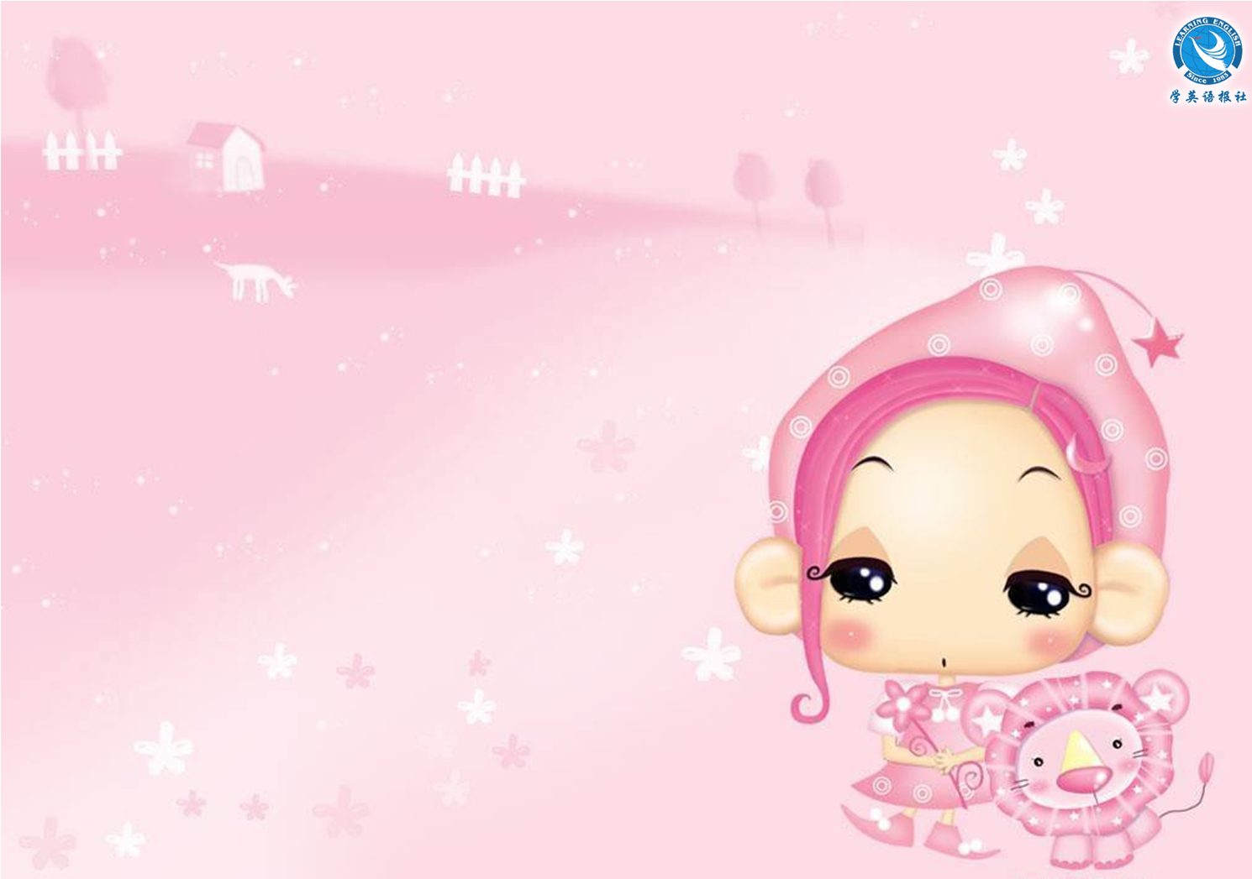
Thank you.

