Slide 1

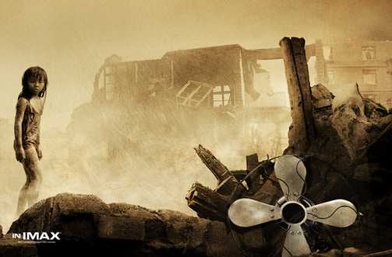

Unit 4
A NIGHT THE EARTH
DIDN’T SLEEP

Slide 2

Words review
earthquake
quake
right away
well
crack
smelly
farmyard
pipe
burst
million
n. 地震
n. 地震
立刻；马上
n. 井
n. 裂缝；噼啪声
vt. & vi.（使）开裂；破裂
adj. 发臭的；有臭味的
n. 农场；农家
n. 管；导管
vi. (burst, burst) 爆裂；爆发
n. 突然破裂；爆发
n. 百万

Slide 3
event
as if
at an end
nation
canal
steam
dirt
ruin
in ruins
suffering
extreme
n. 事件；大事
仿佛；好像
结束；终结
n. 民族；国家；国民
n. 运河；水道
n. 蒸汽；水汽
n. 污垢；泥土
n. 废墟；毁灭
vt. 毁灭；使破产
严重受损；破败不堪
n. 苦难；痛苦
adj. 极度的

Slide 4
injure
survivor
destroy
brick
dam
track
useless
shock
rescue
trap
electricity
vt. 损害；伤害
n. 幸存者；生还者；残存物
vt. 破坏；毁坏；消灭
n. 砖；砖块
n. 水坝；堰堤
n. 轨道；足迹；痕迹
adj. 无用的；无效的；无益的
vt. & vi.（使）震惊；震动
n. 休克；打击；震惊
n. & vt. 援救；营救
vt. 使陷入困境
n. 陷阱；困境
n. 电；电流；电学

Slide 5
disaster
dig out
bury
mine
miner
shelter
a (great)
number of
title
reporter
n. 灾难；灾祸
掘出；发现
vt. 埋葬；掩埋；隐藏
n. 矿；矿山；矿井
n. 矿工
n. 掩蔽；掩蔽处；避身处
许多；大量的
n. 标题；头衔；资格
n. 记者

Slide 6

1. To summarize the main idea and retell
the passage — A night the earth didn’t
sleep
2. To know more about the terrible
earthquake that nearly destroyed the city
of Tangshan in Hebei Province in 1976

Slide 7
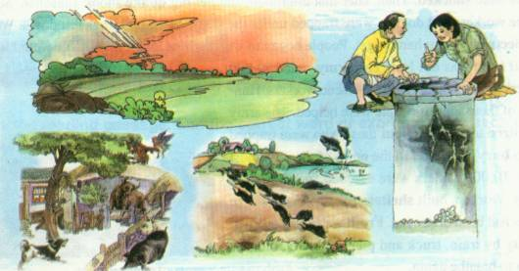
bright lights
Can we predict earthquakes?
What strange phenomena do you think may appear before an earthquake?
fish jump out of the ponds
deep cracks
Chickens and pigs were too nervous to eat; mice run out of the fields.

Slide 8


Skimming for general idea

Slide 9

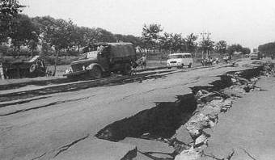
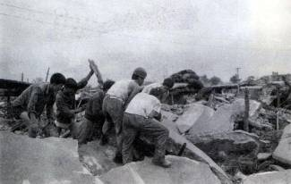
Main idea of the passage
The passage mainly talks about
_____________________________
_________________.
an earthquake that happened in
Tangshan in 1976

Slide 10
Scanning for specific information

Slide 11

Scan the passage and find out the topic sentence of each paragraph.
Paragraph | Main idea
1
2
3
4
Before the earthquake
During the earthquake
After the earthquake
The rescue work

Slide 12
Before the earthquake
？
Strange things were happening in the countryside of northeast Hebei.
Strange things
Find the key words
water in the wells
well walls
smelly gas
chickens and pigs
mice
fish
bright lights
the sound of planes
water pipes
signs before an earthquake

Slide 13
During the earthquake
Everything began to shake. It seemed as if the world was at an end!
The earthquake had begun.
Find the key words
What happened?
a huge crack
steam
hard hills
people died or injured
city laid in ruins

Slide 14
After the earthquake
Everywhere they looked nearly everything was destroyed.
？
hospitals
factories
buildings
bricks
dams
bridges
Railway tracks
cows
pigs and chickens

Slide 15
The rescue
Why？
All hope was not lost.
the army sent…
The army organized teams to dig out …
Miners were rescued…
Workers built shelters…
Fresh water was taken to …
The city began to breathe again.

Slide 16

















What do these numbers stand for?
3:42 am
11
kilometers
200 kilometers
15 seconds
2/3
8 & 30
75%, 90%
400,000

Slide 17




3:42 am
At 3:42 am everything began to shake.
11
kilometers
11 kilometers directly below the city
The earthquake was felt in Beijing, which is more than 200 kilometres away.
200 kilometers
A huge crack was 8 kilometers long and thirty metres wide.
8 & 30

Slide 18






15
seconds
In 15 seconds a large city lay in ruins.
Two-thirds of the people in Tangshan died or were injured.
2/3
The number of people who were killed or injured reached more than 400,000.
400,000
75% of the city’s factories and buildings and 90% of its homes were gone.
75%,
90%

Slide 19

Summary :
From this period, we know some knowledge of earthquakes in three ways: _________ before earthquakes, _________ caused by earthquakes and _________ after earthquakes.

Slide 20



P27 4
Discussion
Explain in your own words what the writer means by the title “A night the earth didn’t sleep”. In pairs, suggest another title for the text.

Slide 21

Reference answer
1. “A night the earth didn’t sleep” is a poetic way of saying that an earthquake happened.
2. Another title might be “Tangshan’s great challenge”.

Slide 22

1. From whose point of view are events described? How do you know?
A writer who didn’t see the quake. He uses the third person “they” when he writes.
2. What is the mood of this passage? How is this mood created?
The mood is serious and a bit sad, but not hopeless.
The mood is created by giving details of how many people and animals were killed or injured and how many buildings were destroyed and the last sentence in the reading.
3. What do you think the writer chose to express his feelings about the quake rather than simply report what happened?
He knows that giving some feelings will make the reading more interesting.
Discuss with your partner and try to figure out the answers to the following questions.

Slide 23

____________ happened in Tangshan. For a few days, water in the wells _____________. From the ______ of wells __________came out. Mice, chicken, pigs and even fish became ________. At 3:00 am, everything began to ______.It seemed that the world was _________. _________ of the nation ____ it. _____________cut across the city. The city lay _______. Two-thirds of the people died or ___________. Then later that afternoon, another big quake ______ Tangshan. People began to wonder _____________________________. But all hope ____________. Soldiers came to help those ________. Slowly, the city began to _________________.
Strange things
rose and fell
cracks
smelly gas
nervous
Fill in the blanks to finish the Summary of the text and then try to retell it.
shake
at an end
One-third
felt
A huge crack
in ruins
were injured
shook
how long the disaster would last
was not lost
survivors
breathe again

Slide 24
Careful reading
重难点句式分析

Slide 25

linking verb
1. It seemed as if the world was at an end!
世界似乎到了末日！
▲
表语从句
as if “仿佛; 好像” 可在look, seem等系动词后引导表语从句。
at an end 结束; 终结
1. 看来他好像不能按时到达了。
It looks as if he won’t arrive in time.
2. 他的职业生涯结束了。
His career was at an end.

Slide 26

2. Everywhere they looked nearly everything
was destroyed.
everywhere引导地点 状语从句
人们随处看到的一切几乎都被毁了。
Translation
我走到哪里，我女儿就跟到哪里。
____________________________________
My daughter follows me everywhere I go.

Slide 27
2. then, later that afternoon, another big quake which was almost as strong as the first one shook Tangshan.
定语从句
as…as… “与…一样”，其中的第一个as为副词，其后通常接adj. 或 adv.(用原级)，第二个as可用作连词。
She’ll soon be as tall as her mother.
她很快就会和她母亲一样高了。
接着，在下午晚些时候，又一次和第一次一样强烈的地震震撼着唐山。

Slide 28
Translation
1. 我跑的没你快。
I can't run as fast as you.
2.这些是我们所有人都坚信的原则。
These are principles which we all believe in.

Slide 29

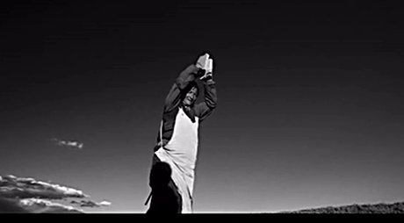
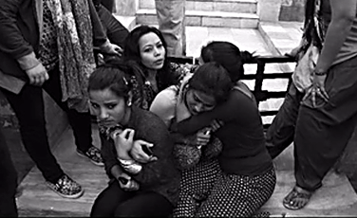
Life is precious. So take care of yourself, and take care of your life, it is hard to win and easy to lose.

Slide 30

Spelling Bee
Now two minutes to test your spelling.
1. English-Chinese
well, pipe, million, event, nation, canal,
steam, dirt, suffering, brick, dam, track,
electricity, disaster, mine, miner, shelter
2. Chinese-English
爆裂，毁灭，极度的，损害，破坏，
震动，援救，无用的，掩埋，使陷入困境
When finishing, exchange your papers to see who does the best.

Slide 31

Homework
1. Try to retell the text by using the key words below:
who (people of Tangshan/the army); where (Tangshan); how; when (For three days →At about 3:00 am on July 28, 1976 → At 3:42 am on July 28, 1976 → Afternoon of July 28, 1976 → Soon after the quake).
2. Look for some earthquake information about Japan through the library, internet or other sources. Find out why Japan often has earthquakes. What measures are taken by the Japanese government to prevent them?

