Slide 1
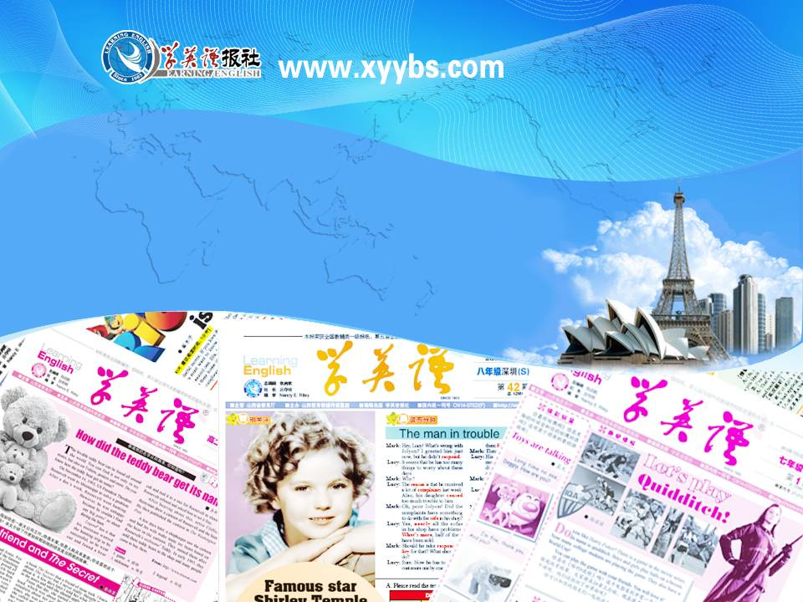
同步教学辅助课件
必修1

Slide 2

Unit 4
Words Review

Slide 3
a deep hole in the ground from which you can get water, oil, or gas
n. 井
well
a tube inside which liquid or gas flows from one place to another
n. 管; 导管
pipe
to break open or apart suddenly, or to make sth. do this
vi. 爆裂; 爆发
when sth. breaks open and what is inside breaks out
n. 突然破裂; 爆发
burst
the number 1 000 000
n. 百万
million

Slide 4
anything that happens, esp. sth. important or unusual
n. 事件; 大事
event
a country, esp. when thought of as a large group of people living in one area with their own government, language, traditions, etc.; a large group of people of the same race who share the same language, traditions and history, but who might not all live in one area
n. 民族; 国家; 国民
nation

Slide 5
a long thin stretch of water which is artificially made either for boats to travel along or for taking water from one area to another
n. 运河; 水道
canal
the hot gas that is produced when water boils
n. 蒸汽; 水汽
steam
dust, soil or any substance that makes a surface not clean
n. 污垢; 泥土
dirt

Slide 6
the broken parts that are left from an old building or town; when sth. is spoilt or destroyed
n. 废墟; 毁灭
to spoil or destroy severely or completely; to cause a person or company to lose all their money or their reputation
vt. 毁灭; 使破产
ruin
when you experience physical or mental pain
n. 苦难; 痛苦
suffering

Slide 7
very large in amount or degree
adj. 极度的
extreme
to hurt or cause physical harm to a person or animal
vt. 损害; 伤害
injure
to damage sth. so badly that it does not exist or cannot be used
vt. 破坏; 毁坏; 消灭
destroy
a rectangular block of hard material used for building walls and houses
n. 砖; 砖块
brick

Slide 8
a wall built across a river which stops the river's flow and collects the water, esp. to make a reservoir (= an artificial lake) which provides water for an area
n. 水坝; 堰堤
dam
rails that a train moves along; a mark or line of marks left on the ground or on another surface by an animal, person or vehicle which has moved over it, showing the direction they moved in
n. 轨道; 足迹; 痕迹
track

Slide 9
of no use; not working or not achieving what is needed
adj. 无用的; 无效的; 无益的
useless
to make someone feel upset or surprised
vt. & vi. (使)震惊; 震动
a serious medical condition, usually the result of injury in which a person has lost a lot of blood and they are extremely weak; (the emotional or physical reaction to) a sudden, unexpected and usually unpleasant event or experience
n. 休克; 打击; 震惊
shock

Slide 10
when someone in a dangerous situation is helped and made safe; to help someone or sth. out of a dangerous, harmful or unpleasant situation
n. & vt. 援救; 营救
rescue
to keep sb. in a dangerous place or bad situation that they want to get out of but cannot
vt. 使陷入困境
trap

Slide 11
a device or hole for catching animals or people and preventing their escape; a dangerous or unpleasant situation which you have got into and from which it is difficult or impossible to escape
n. 陷阱; 困境
trap
a form of energy, produced in several ways, which provides power to devices that create light, heat, etc.
n. 电; 电流; 电学
electricity

Slide 12
(an event which results in) great harm, damage or death, or serious difficulty
n. 灾难; 灾祸
disaster
to put a dead body into the ground, or to put sth. into a hole in the ground and cover it; to cover sth. or someone completely with a large quantity of sth.; to put sth. in a place where it is difficult or impossible to find or see
vt. 埋葬; 掩埋; 隐藏
bury

Slide 13
a hole or system of holes in the ground made for the removal of substances such as coal, metal, and salt by digging
n. 矿; 矿山; 矿井
mine
a person who works in a mine
n. 矿工
miner
(a building designed to give) protection from bad weather, danger or attack
n. 掩蔽; 掩蔽处; 避身处
shelter

