Slide 1
优秀学生
1. 有些练习不严谨甚至误导思路
2. 忘了一些固定搭配
3. 语篇的逻辑最容易出错

Slide 2
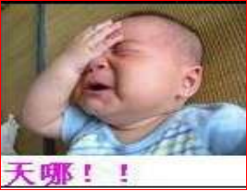
优秀学生
1. 有些练习不严谨甚至误导思路
老师你要先做！

Slide 3
2. 忘了一些固定搭配
如
（1）all the eyes were fixed
were fixing
upon me.
on/at/to/in
（2） I was still late for the first class.
at

Slide 4
如此词汇：fix, seat, dress, lose, interest,
involve, determine, locate
situate …

Slide 5
八大动词
1. lie
lie
lay
2. find
found
3. wind
wound

Slide 6
4. hang
hang
5. dress
6. seat
7. leave
8. keep

Slide 7
3. 语篇的逻辑最容易出错
如：
（1）but I was still late for the …
and
(2) However, I could say …
But/And
(3) for I did not spend …
because/as/since

Slide 8
优秀学生
1. 有些练习不严谨甚至误导思路
2. 忘了一些固定搭配
3. 语篇的逻辑最容易出错

