Slide 1
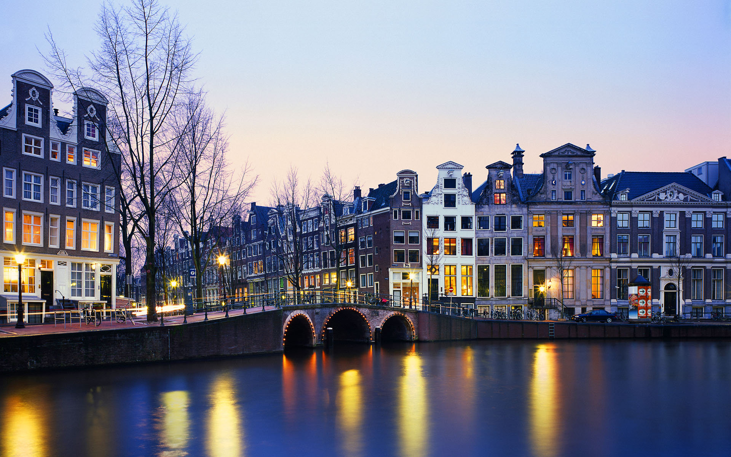
April in Holland
By ZSH.
Thanks to the pictures from
‘The Lonelyplanet’.

Slide 2
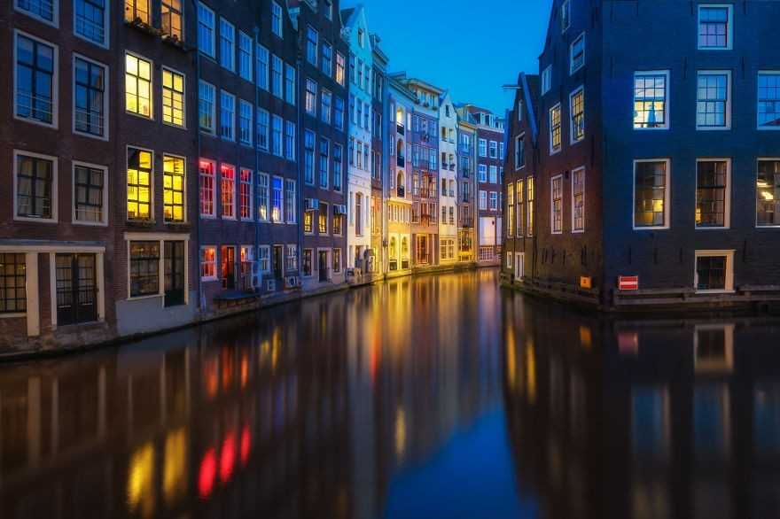
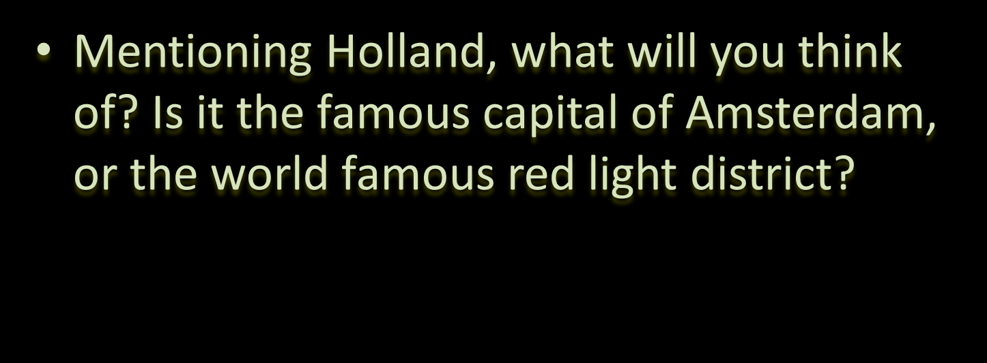

Slide 3
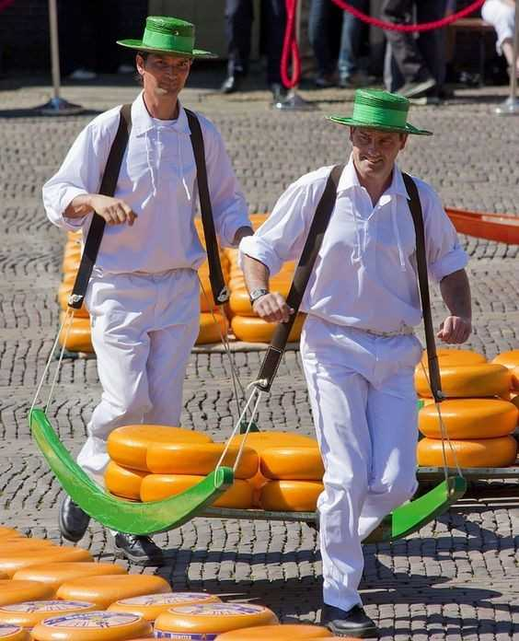

Or the tulips（郁金香）, windmills（风车）, clogs（木鞋）, diamonds, cheese connect to the dreamlike life of Dutchman?

Slide 4
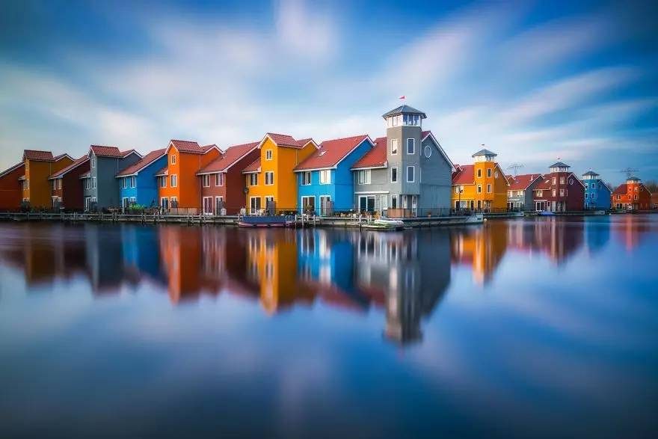

Are there the concentrated bicycles in the street, or the Holland style buildings that you recognize?

Slide 5
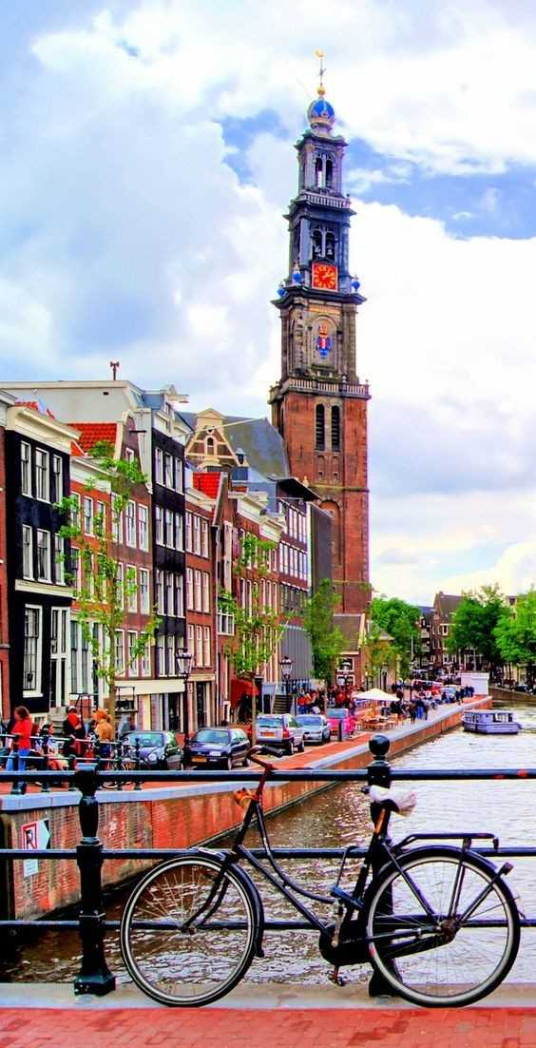
In Holland, you can travel between thousands of museums and art galleries（画廊）

Slide 6
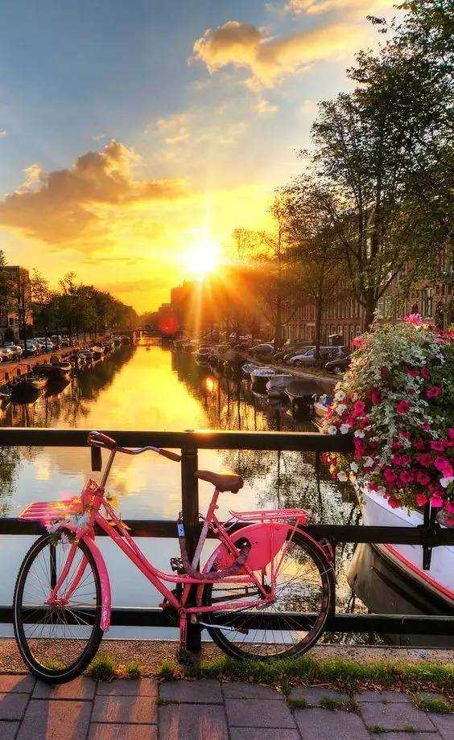
In Holland, you can ride a bicycle to explore the streets.

Slide 7
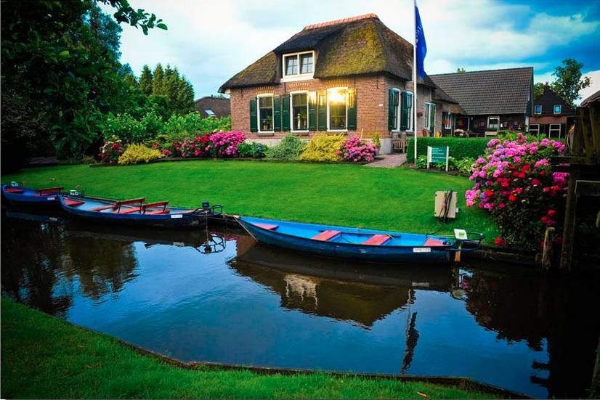
In Holland, you can be intoxicated in the charming natural scenery

Slide 8
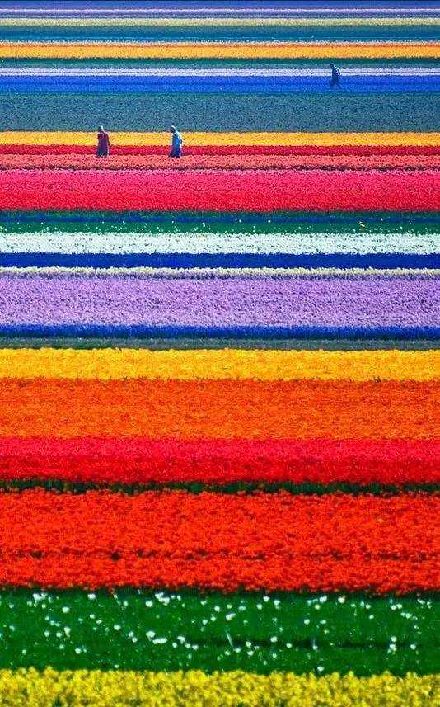
In Holland, you can kiss her on the forehead of a tulip flower field .

Slide 9
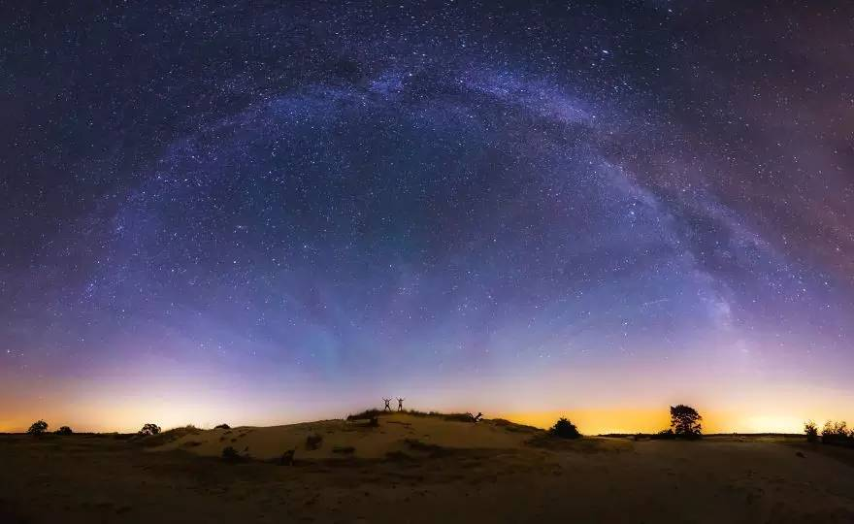
In Holland, you can do a lot of things that can only be done here......

Slide 10
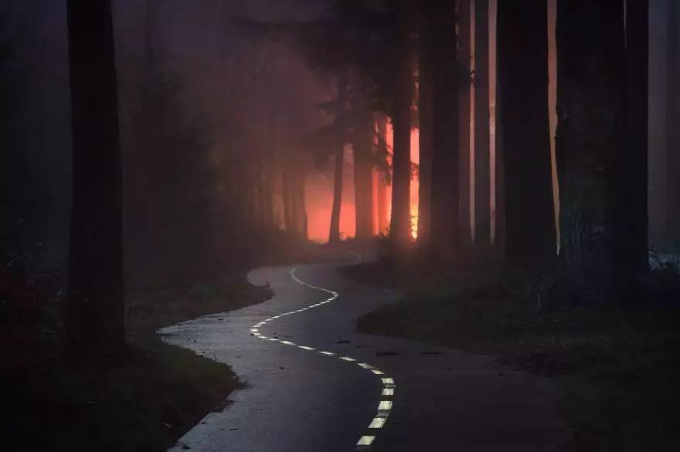
Perhaps you are accustomed to many magnificent city and scenic spots, but has been unable to fully appreciate the simple and plain scenery, in Holland, there is no mountain, no high-rise and the land is flat. But once you have set foot on this land, you will sigh: This is the dream

Slide 11
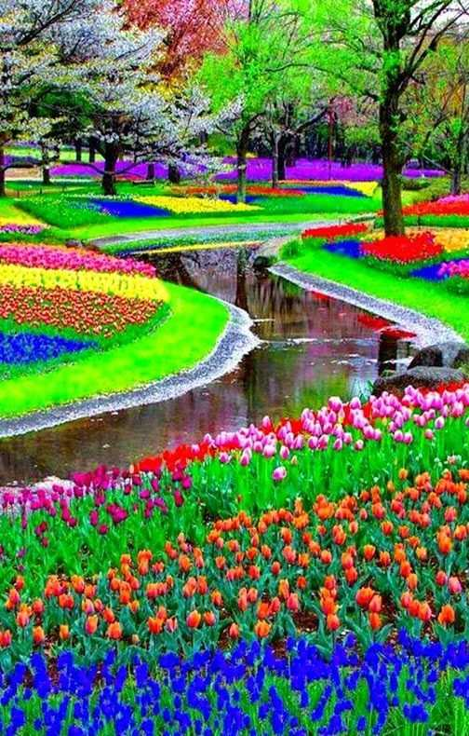
Especially the annual March to May, the Dutch flowers in full bloom, when you see the stunning color feast, you won‘t strange, why here is known as “Europe’s most beautiful spring garden’’.

Slide 12
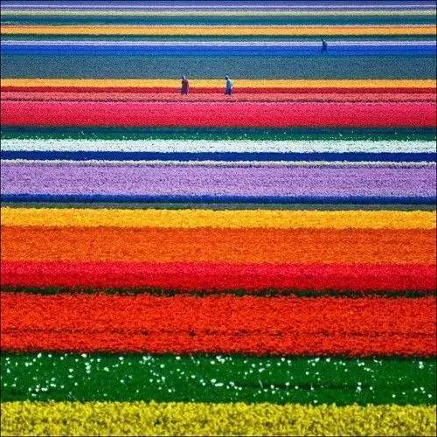

Do you know that Spring is the best season for tulips?

Slide 13
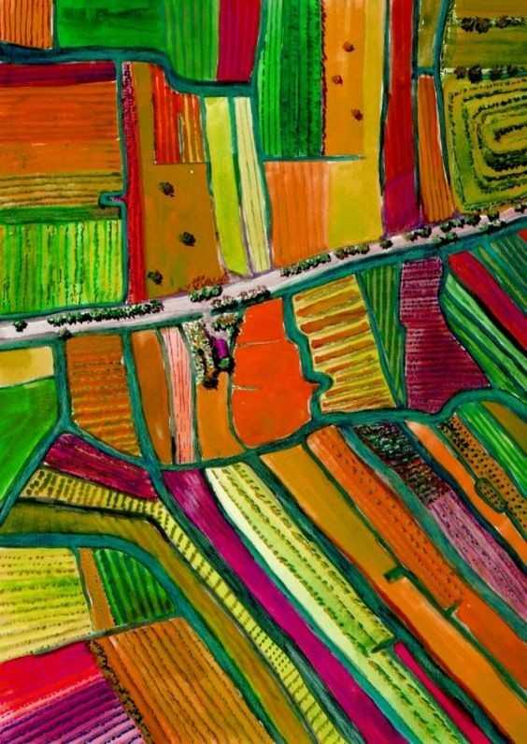
The multi-coloured tulips are full of attraction.

Slide 14
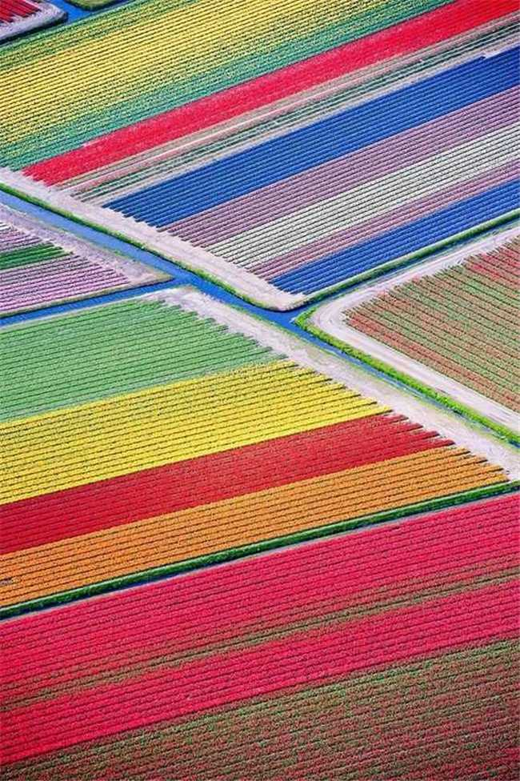
Walking through this place, certainly , will make you feel relaxed and incredible.

Slide 15
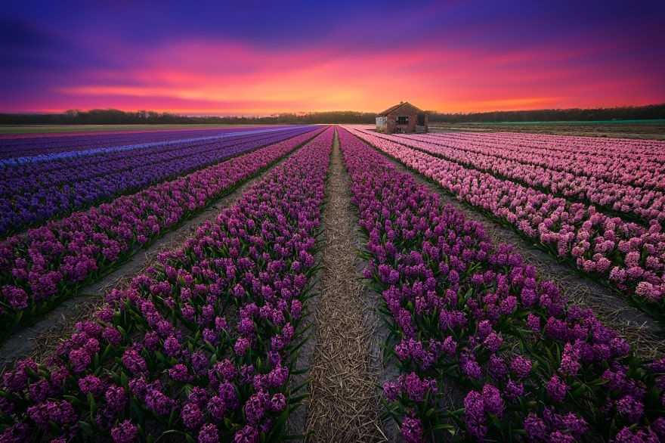
Stroll（漫步） in the field of tulips and make yourself smile like a flower.

Slide 16
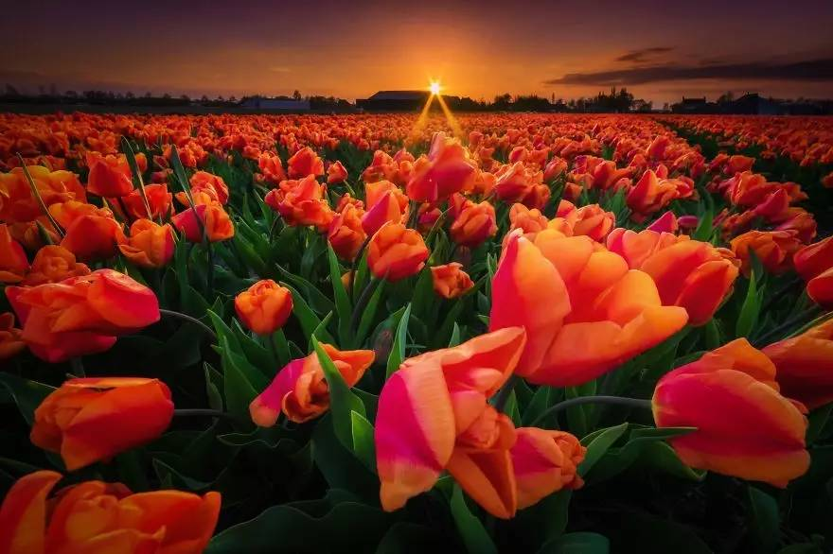

Slide 17
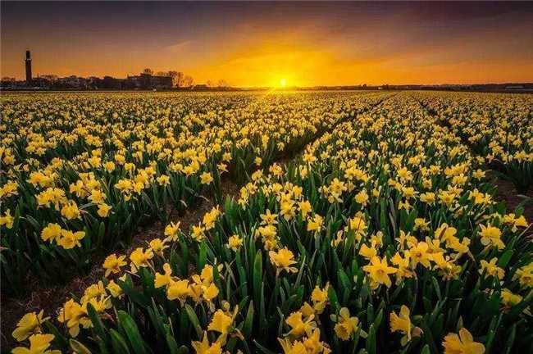

Slide 18
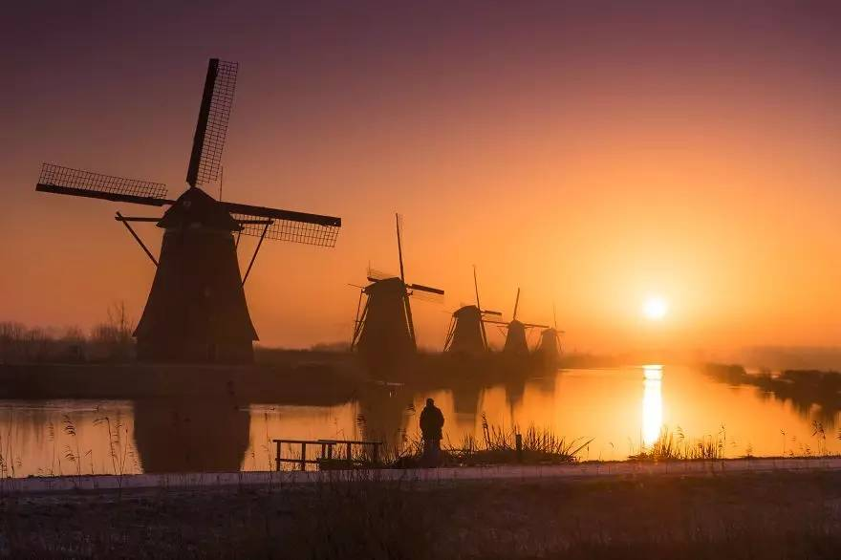
Even if the times change , the widely using of power windmills, the ancient windmills are still the most charming(迷人的) views from the sight of tourists.

Slide 19
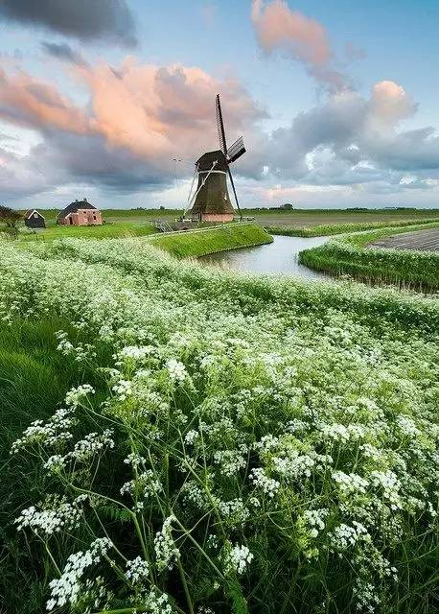
Far away to see the huge windmill, which is rotating slowly, seems like a giant who indulges(沉湎） in his years.

Slide 20
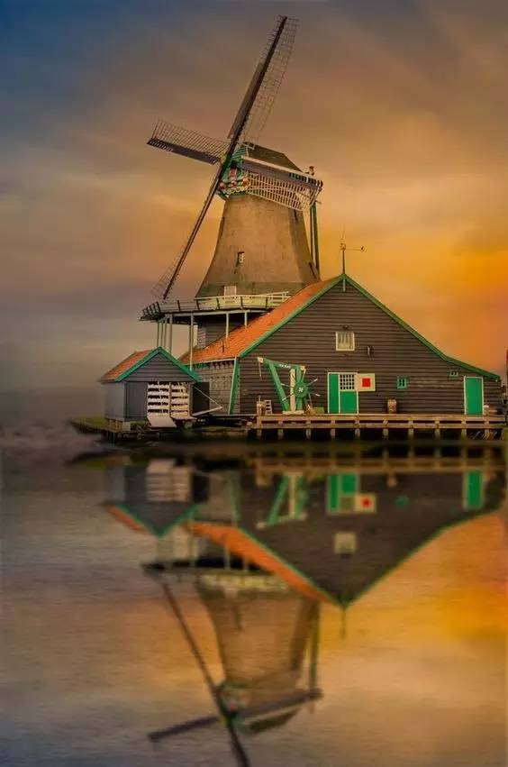
Watching the wind leaf rotates in wind is like a picture of flow. Listening to the sound of rolling stone in mill(磨坊）, is like a melody（旋律）.

Slide 21
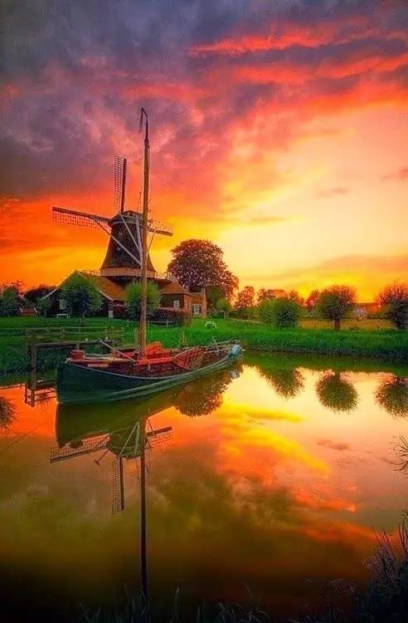
In the red sky within sunset, looking the dreamy windmill, time seems to stop.

Slide 22
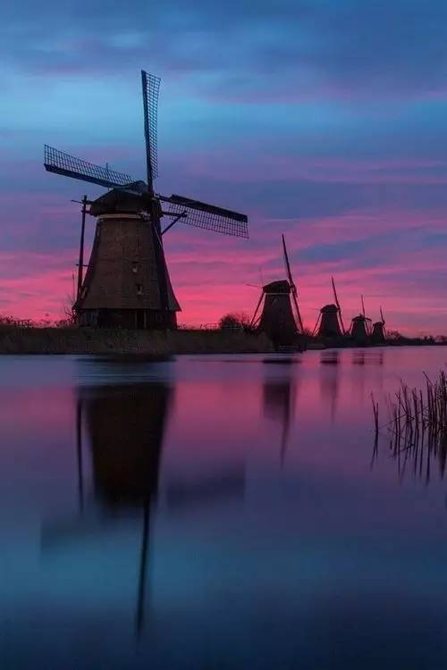
Even picking up the phone to shoot some photos are difficult to forget.

Slide 23
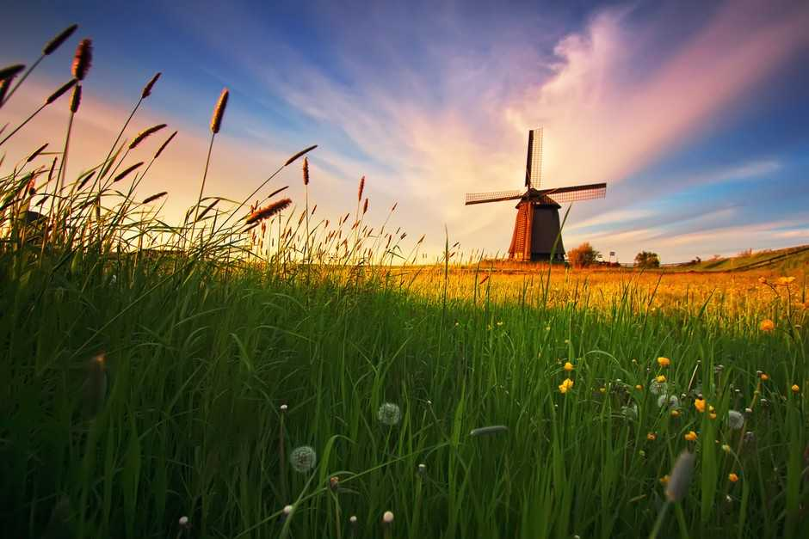

Slide 24
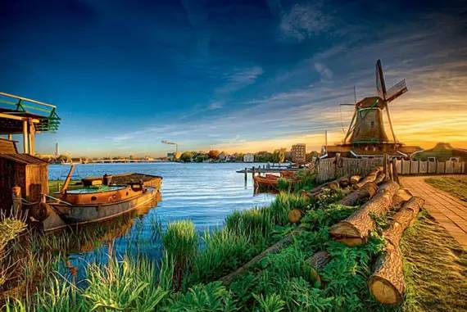


Slide 25
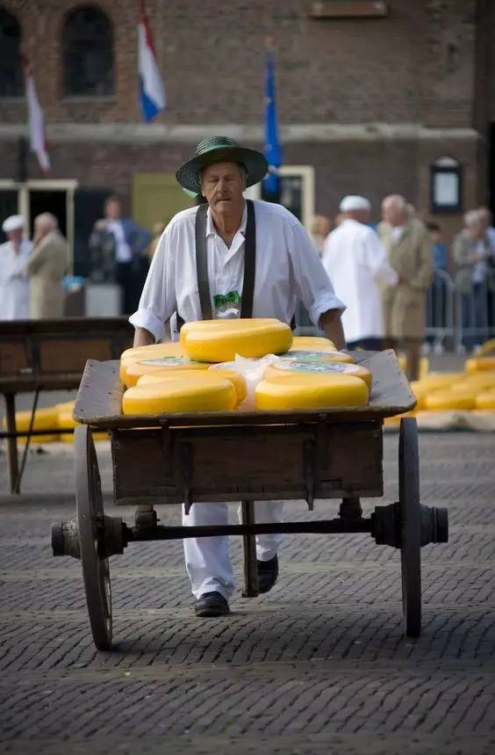
Only this place can let you experience the history of cheese.

Slide 26
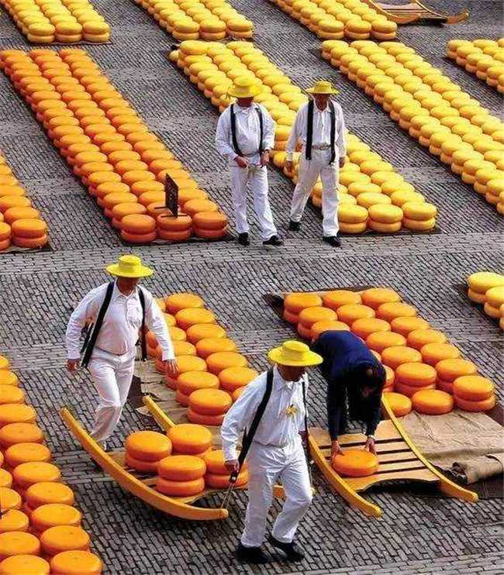
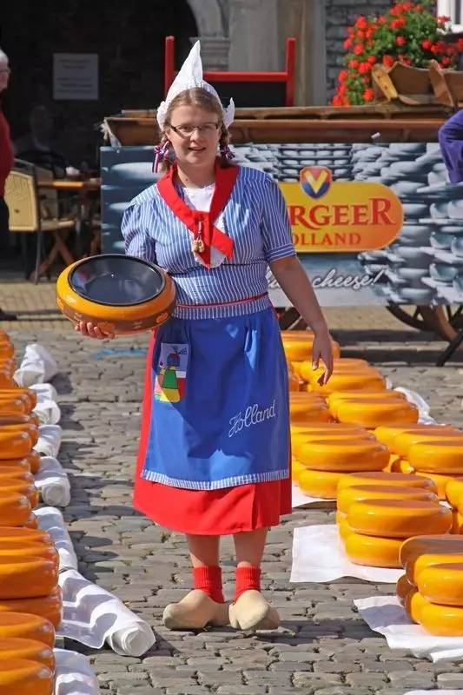

Slide 27
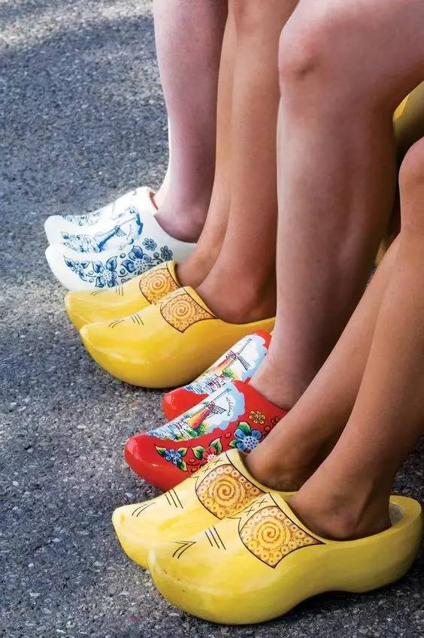
Sabots(木鞋）

Slide 28
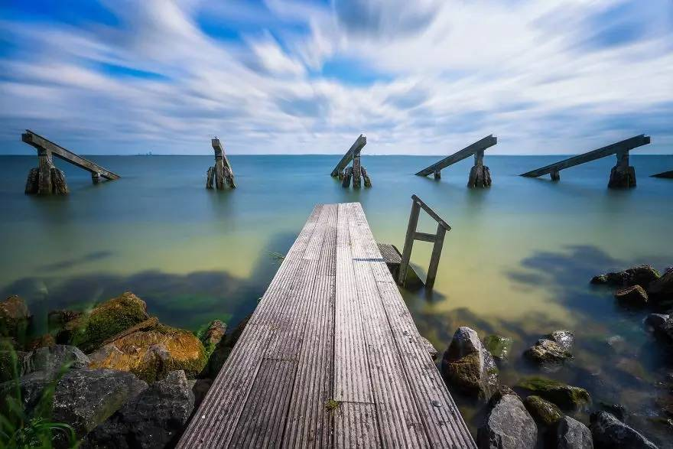
Strolling on the golden beach, feel the vast and boundless sea.

Slide 29
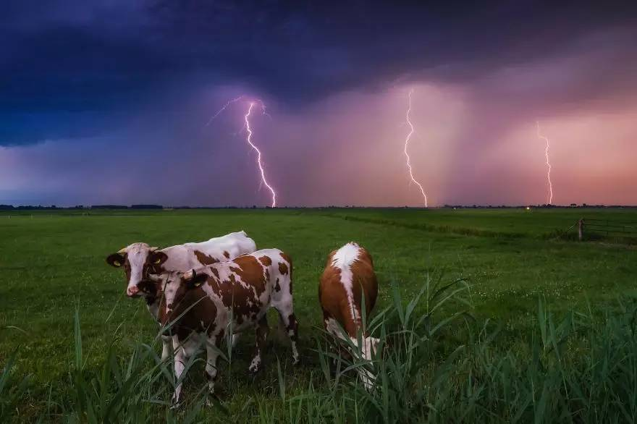
A group of cows are grazing within a leisure stoll. You will see the beautiful white swan rises rapidly from the green flight if lucky.

Slide 30
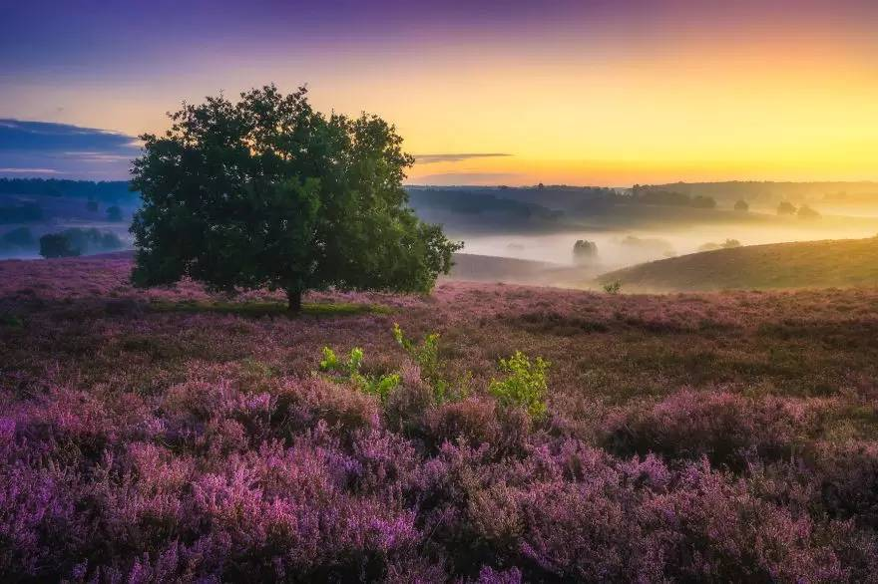
The sky is pure,without any variegation(杂色）

Slide 31
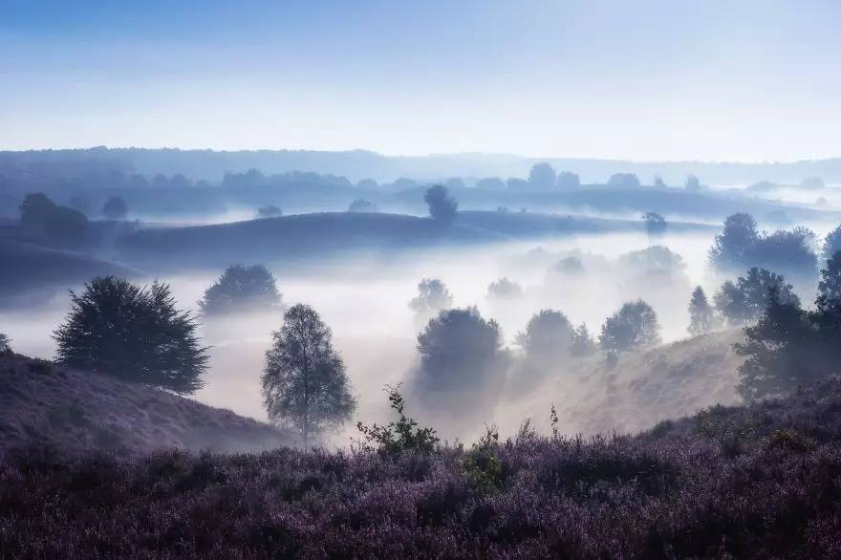

Slide 32
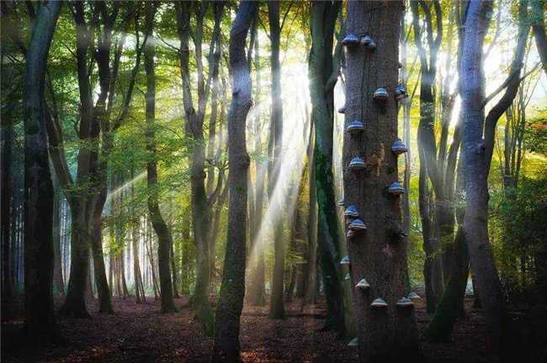

Slide 33
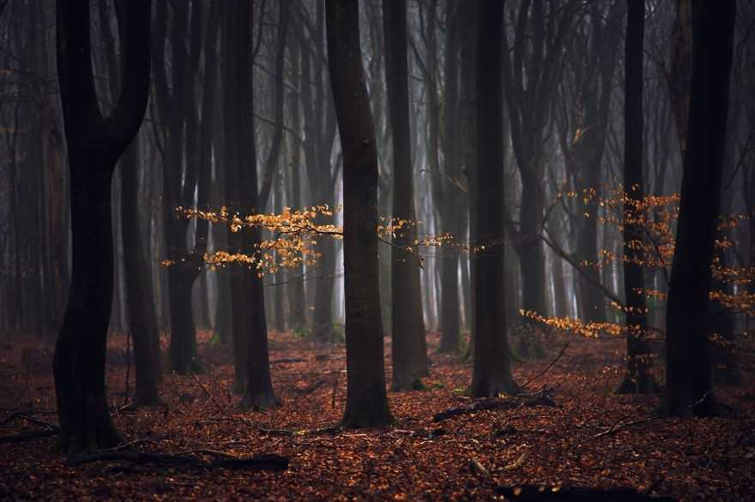

Slide 34
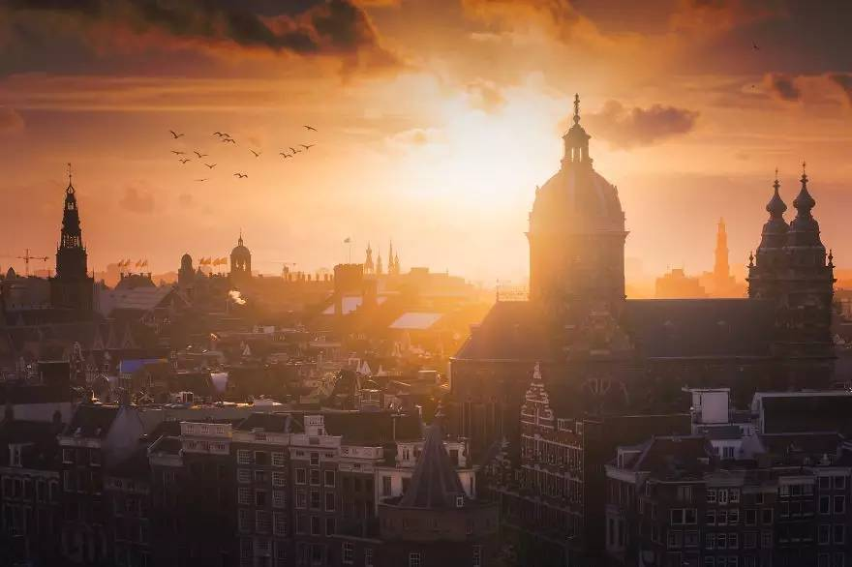
Holland is beautiful and simple

Slide 35
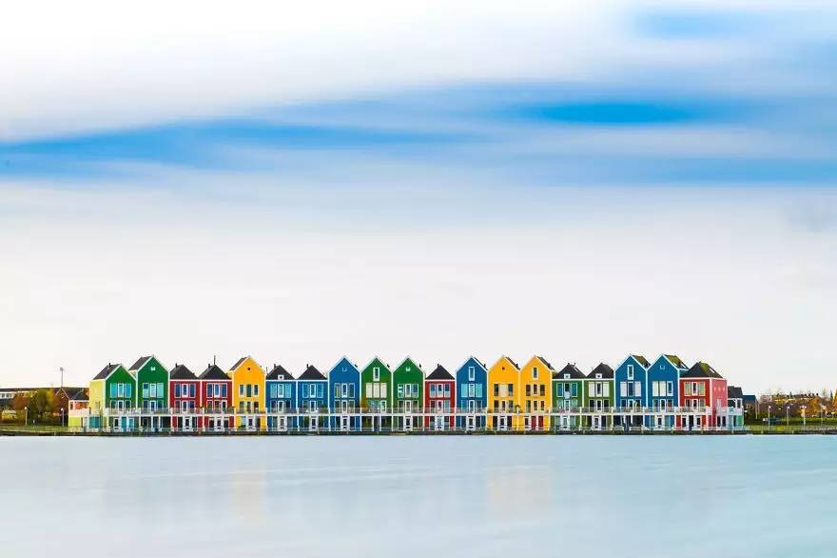

Slide 36
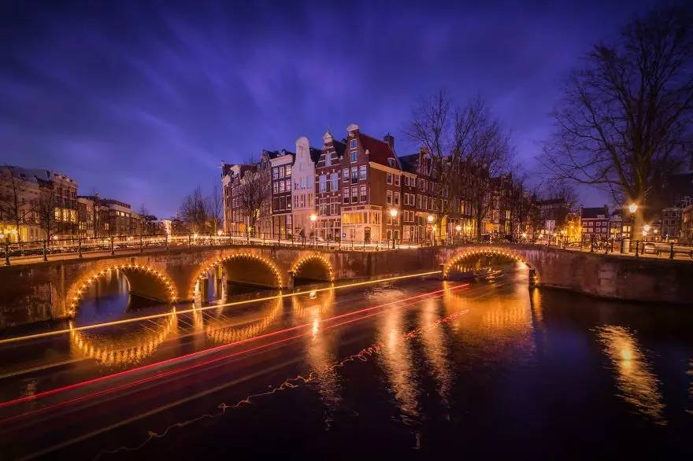

Slide 37
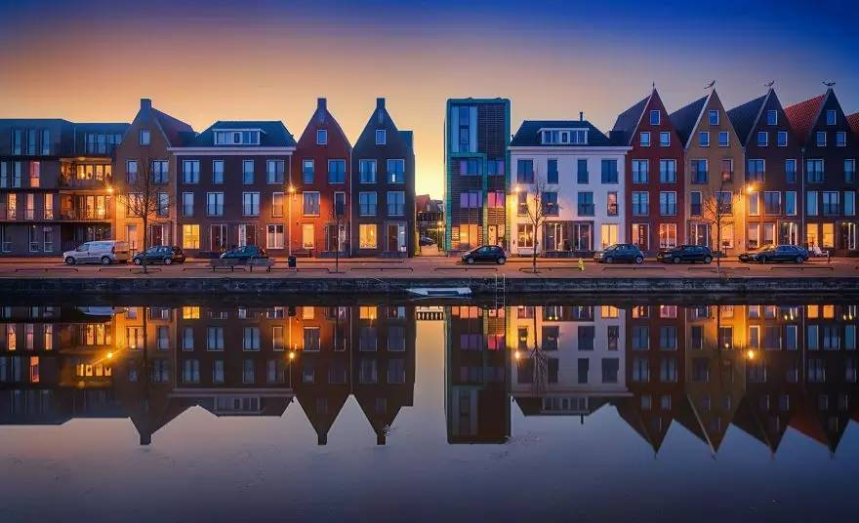

Slide 38
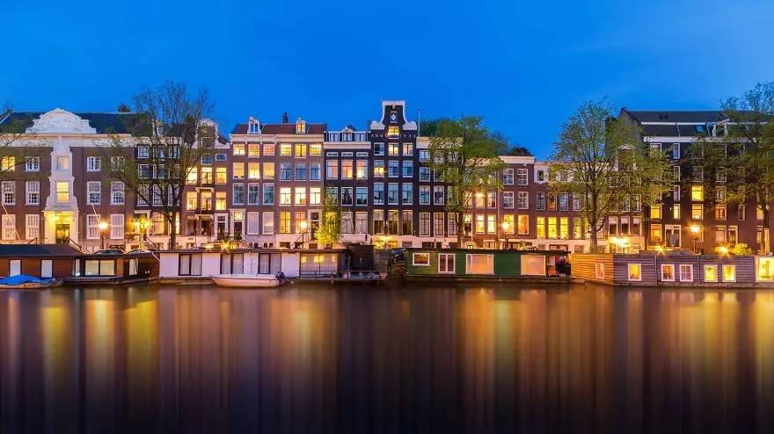

Slide 39
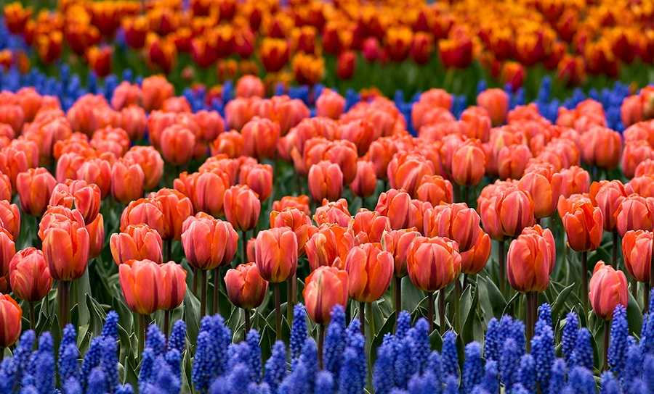

Slide 40
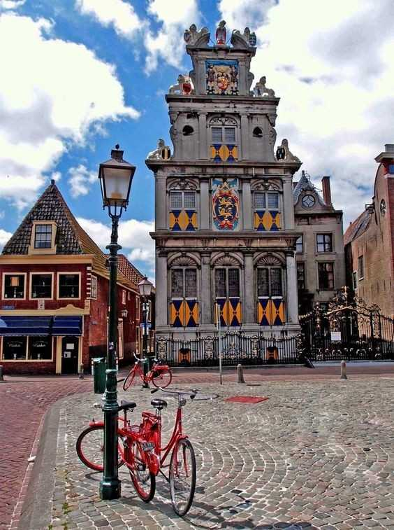
In this world, Holland is the best choice if you want to see the image of Middle Ages.

Slide 41
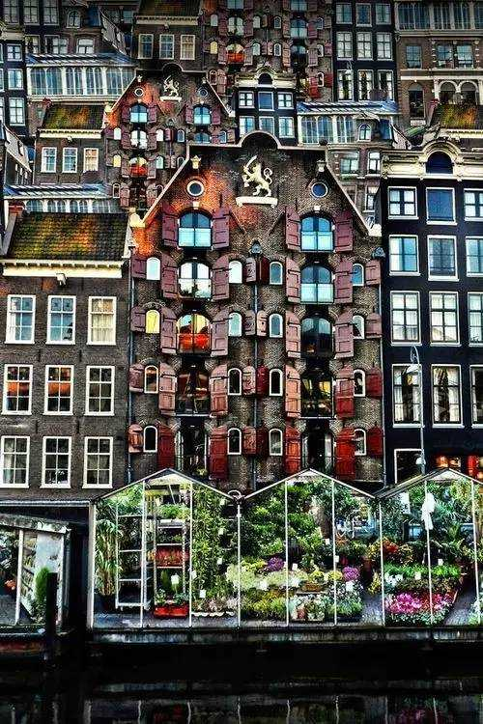
Goodbye Holland!

Slide 42
A journey of a thousand miles begins with single step.(千里之行,始于足下.)

