Slide 1
Module 1

Slide 2



The biggest wealth in life
health

Slide 3

Abstract
With the development of the economy, people pay more attention to the importance of health. But, there are still a great numbers of people neglecting it, especially white-collars. This phenomenon will be obviously dangerous in the near future. As the saying goes, health is not everything, without health you will lost everything. So it is necessary for us to regard the importance of keeping health.
随着经济的发展，人们更加重视健康的重要性。但是，仍然有大批的人对其忽视，尤其是白领。在不久的将来，这种现象将很危险。常言道，健康不是一切，但是没有健康，你将失去一切。因此，我们有必要意识到健康的重要性。

Slide 4

Importance of health
Without health, everything is nothing

Slide 5




Slide 6
BUT

Slide 7

Present situation
Recently the number of people who are in subhealth is increasing remarkably.
At the beginning of 2009, Chinese Center for Disease Control announced that the data of each kind of mental illness patient is above 100,000,000 people.
About 250,000 people suicide every year in china.(Zhongxin net)
Subhealth :
Mental illness :
The rate of suicide :

Slide 8
The four major factors affecting health
1. Acts and lifestyle factors(行为和生活方式）
Behaviour and lifestyles that are due to their own bad behaviour and lifestyles, directly or indirectly the adverse effects to health. such as diabetes, hypertension, coronary heart disease, colon, breast, prostate cancer, obesity, sexually transmitted diseases and AIDS, mental diseases, such as suicide and behaviour and lifestyles.
行为和生活方式因素是指因自身不良行为和生活方式，直接或间接给健康带来的不利影响。如糖尿病、高血压、冠心病、结肠癌、前列腺癌、乳腺癌、肥胖症、性传播疾病和艾滋病、精神性疾病、自杀等均与行为和生活方式有关。

Slide 9
life style
The way of life and the poor by the chronic non-communicable diseases, AIDS and sexually transmitted diseases in the rapidly increasing. In recent years my malignant tumours, cerebrovascular and cardiovascular diseases accounted for 61% of total deaths.
According to the United States, as long as the behavioural risk factors: unreasonable diet, lack of physical exercise, smoking, alcohol and drug abuse, can be reduced by 40% to 70% of the dead, 1/3 of the acute disability, 2/3 of the chronic disabilities.
由于生活方式和不良行为导致了慢性非传染性疾病及性病、艾滋病的迅速增加。近年来我国恶性肿瘤、脑血管病和心血管病已占总死亡原因的61％。
据美国调查，只要有效地控制行为危险因素：不合理饮食、缺乏体育锻炼、吸烟、酗酒和滥用药物等，就能减少40％～70％的早死，1／3的急性残疾，2／3的慢性残疾。

Slide 10





Slide 11
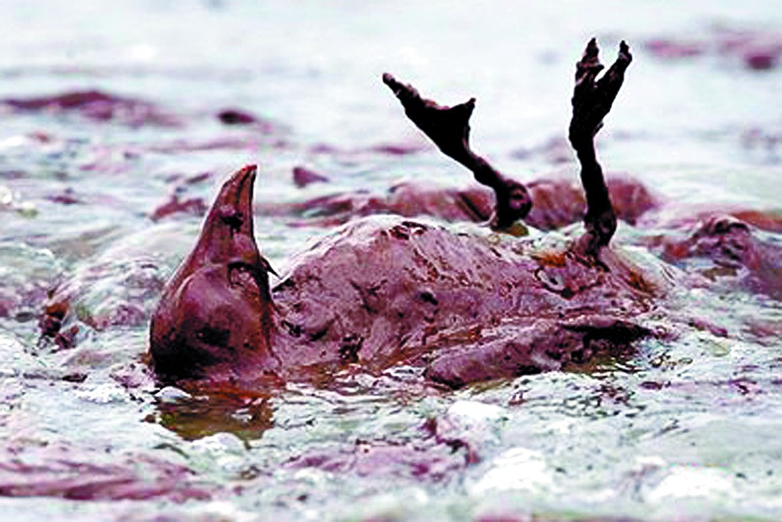

Environmental factors
⑴Natural Environment
To maintain the natural environment and human harmony, and protect, promote the health of the 10 importance. If they destroy human harmony with nature, human society will suffer a retaliatory nature.
。

Slide 12
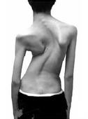

Biological factors(生物学因素 )
Biological factors inherited Genetic 。According to an investigation, the national birth defects Total incidence of 13.7% , with severe mental retardation, 2 million people each year. genetic and hypertension, diabetes, cancer and other diseases .

Slide 13


Environmental factors
(2)Social Environment
Social Environment including legal, social, economic, cultural, education, population, ethnic, professional, social and health of the relevant policies, laws and regulations。

Slide 14
How to keep healthy?
Counting calories is annoying, so instead of doing that, just eat the portion size and when ordering a large portion of something, save the rest of it for another meal. The food will not disappear!
Some foods, like celery and gum, help you burn calories by chewing. *
Snacking on vegetables fills you up quicker than snacking on sugar substance and tastes better, too.
Too much sugar is not very ideal.
Eat fruits when craving something sweet. The thought of fresh fruit may not sound as satisfying before you bite into it but it actually is more satisfying than junk food. And then your mind craves the real foods again not the junk.
Jog up and down stairs in your house if there is no park close to where you live.
Make an attempt to walk to work or school if it is not too far away. You can do this everyday or just twice a week.

Slide 15

Balanced diet
Regular eating habits (3 and 5 meals a day)

Slide 16
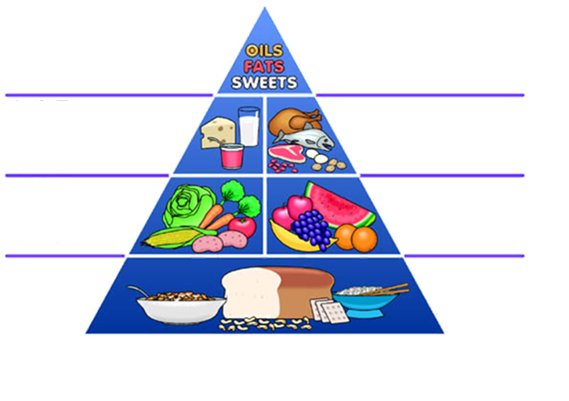
* Proper nutrition
eat less
eat properly
eat more
eat most

Slide 17





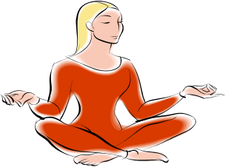
4.3 Do exercises
1.Walking
(4or 5 per week,30-40minutes)
2.Riding
3.Running
(30minutes or more)
4.Climbing stairs
5. Doing aerobics
(properly)
6.Doing yoga
(properly)

Slide 18
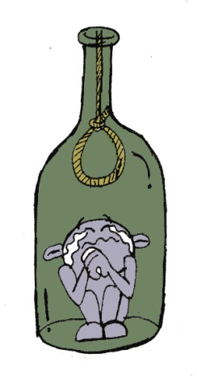




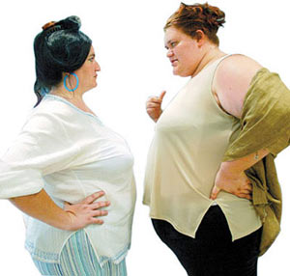


4.5 Some don’ts for good health
Quit smoke
Less drinking
Don’t stay late
Don’t overeating

Slide 19
Conclusion
As we know that poor health would deprive everything in our life, but good health enables us to enjoy our life, achieve our goals and realize our dreams. So Health is much more important and valuable than anything else such as wealth or even wisdom.

Slide 20

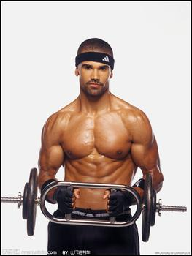
So follow me!!

Slide 21
That’s all thankyou
I bless everyone will keep good health

