Slide 1


英语课标教学课件
选修6

Slide 2
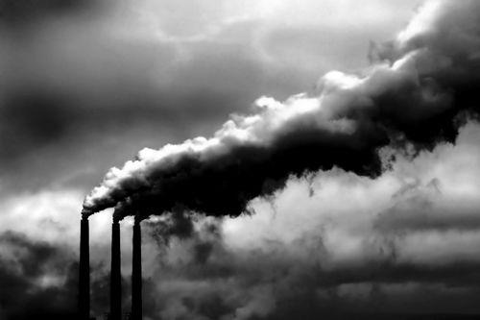
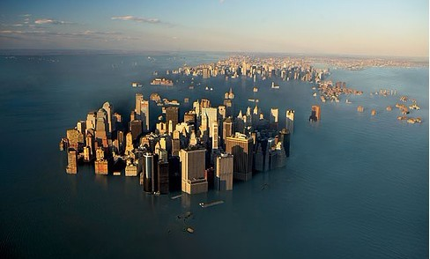
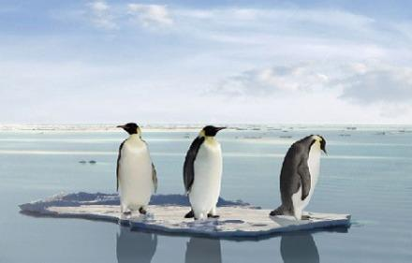
Global warming

Slide 3
a picture which shows how two sets of information or variable amounts are related, usually by lines or curves
n. 图表; 坐标图; 曲线图
graph
happening, done or chosen by chance rather than according to a plan
adj. 胡乱的; 任意的
random
sth. that exists and can be seen, felt, tasted, etc., esp. sth. which is unusual or interesting
n. 现象
phenomenon

Slide 4
to agree with or support an opinion, belief or theory; to pay money regularly to be a member of an organization or to support a charity; to pay an amount of money regularly in order to receive or use sth.
vi. 同意; 捐赠; 订阅
subscribe
vt. (签署)文件; 捐助
a substance which is used to provide heat or power, usually by being burned
n. 燃料
fuel

Slide 5
the amount or number of sth., esp. that can be measured or is fixed
n. 量; 数量
quantity
to be likely to behave in a particular way or have a particular characteristic; to care for sth. or someone
vi. 趋向; 易于; 照顾
tend
vt. 照顾; 护理

Slide 6
used when expressing rates, prices or measurements to mean for each
prep. 每; 每一
per
information, esp. facts or numbers, collected to be examined and considered and used to help decision-making, or information in an electronic form that can be stored and processed by a computer
n. 资料; 数据
data

Slide 7
a general development or change in a situation or in the way that people are behaving; a new development in clothing, make-up, etc.
n. 趋势; 倾向; 走向
trend
a sudden event that causes very great trouble or destruction
n. 大灾难; 浩劫
catastrophe
to cause to fill or become covered with water, esp. in a way that causes problems
n. 洪水; 水灾
flood

Slide 8
to disagree with sth. or someone, often by speaking or fighting against them
vt. 反对; 反抗; 与(某人)较量
oppose
to disagree with a principle or plan; completely different
adj. 反对的; 对立的
opposed
not violent, severe or extreme; gentle and calm; describes food or a food flavour that is not very strong
adj. 温和的; 温柔的; 淡的
mild

Slide 9
a result of a particular action or situation, often one which is bad or not convenient
n. 结果; 后果; 影响
consequence
to say or write sth., esp. clearly and carefully
vt. 陈述; 说明
state
a set of similar things; the amount, number or type of sth. between an upper and a lower limit
n. 种类; 范围
range

