Slide 1
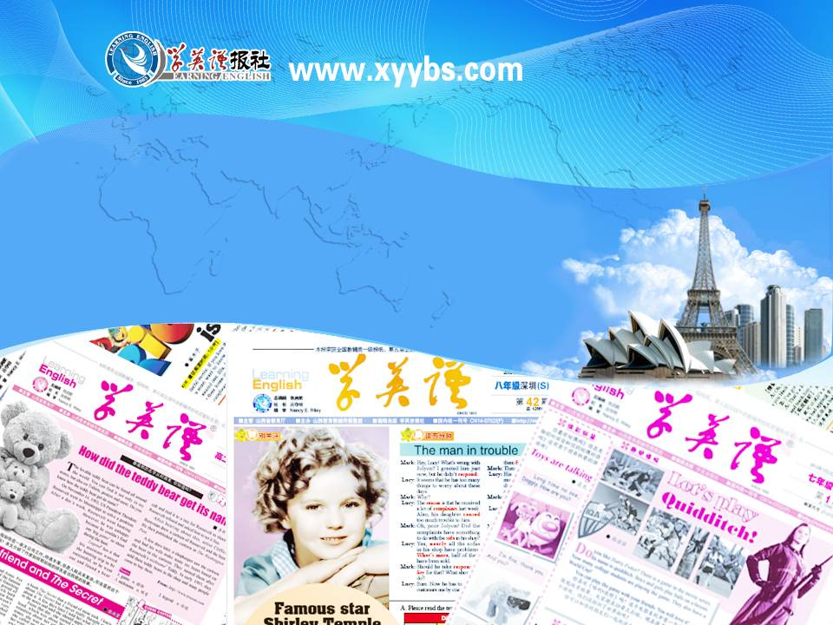
英语课标教学课件
选修6

Slide 2
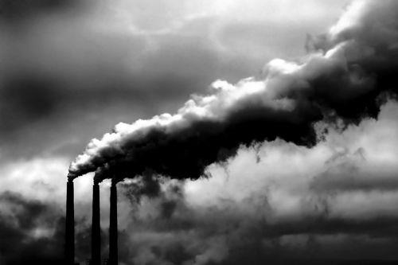
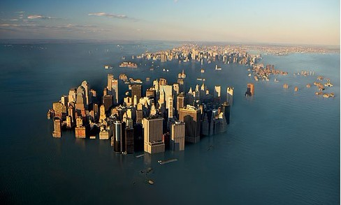
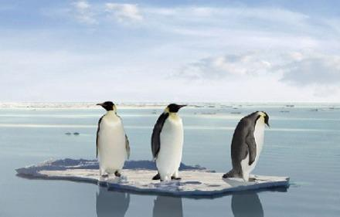
Global warming

Slide 3
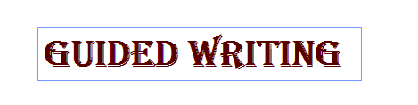
【写作任务】
请根据下面所给信息写一篇短文，呼吁全社会行动起来，应对全球气候变暖问题。

Slide 4
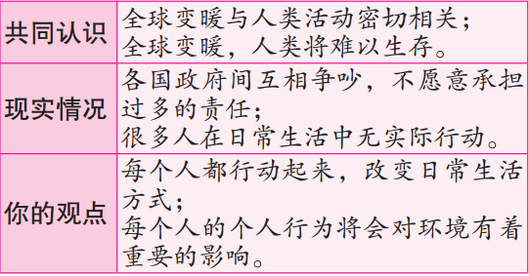
【写作要求】
只能用5个句子表达上面所给的信息。

Slide 5
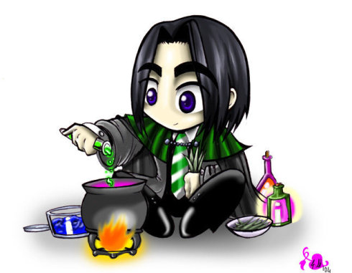
【写作分析与指导】
1. 写作思路：表格中的信息共有三个要点，细节比较具体。因此，我们只要合理地将这些信息转化为英语，不漏掉任何一个要点即可。在具体的写作过程中，应注意如下几点：(1) 合理使用简单句、并列句和复合句，这样写出来的文章才不至于单调。(2) 灵活使用所学语法知识，如时态、语态、非谓语动词等。(3) 根据句子间的逻辑关系，合理地使用关联词语和过渡词汇，从而使得上下文的联系更加紧密，过渡更加自然。

Slide 6
二、词句储备
1. 写作中可能使用的词语有：
(1) 全球变暖 _______________
(2) 与……相关 ____________________
(3) 承担责任 _________________
(4) 采取行动 _________________
(5) 生活方式 _________________________
(6) 争吵 _______________________
(7) 建议/主张 ____________________
(8) 有影响 _______________________
global warming
be associated with
take responsibility
take actions
lifestyle / way of life
quarrel
suggest / advocate
make a difference to
Notes:
make a difference to

Slide 7
(1) 我们都认为，气候变暖与人类活动紧密相关，而气候变暖，人类将难以在地球上生存。
We all believe that human activities are closely associated with global warming, which will make it difficult for us to live on the earth.
(2)各国政府间互相争吵，不愿意承担过多的责任。
Governments in different countries are quarrelling with each other instead of taking more responsibilities.

Slide 8
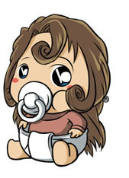
(3)大多数人在日常生活中没做出任何行动去减少温室气体的排放。
Most individuals don’t take any action in their daily life to reduce greenhouse gases.
(4) 我建议我们每一个人都立即行动起来，改变日常生活方式。
I suggest every one of us take immediate action and change our daily lifestyle.
(5) 毫无疑问，我们的个人行为对环境有着重要的影响。
There is no doubt that our personal behavior will make a big difference to the environment.

Slide 9

三、下笔成文
It is believed that human activities are closely associated with global warming, which will make it difficult for us to live on the earth. However, governments in different countries are still quarrelling instead of taking more responsibilities. On the other hand, most individuals don’t take any action in their daily life to

Slide 10
reduce greenhouse gases. Therefore, I suggest that every one of us take immediate action and change our daily lifestyle. There is no doubt that our personal behavior will make a big difference to the environment.

Slide 11
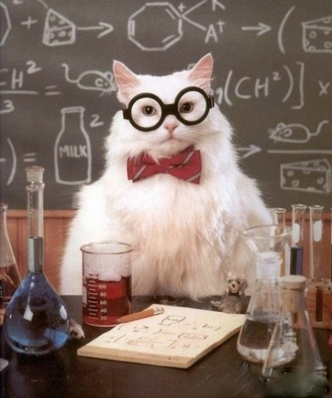
【点评】
本篇习作思路清晰，信息整合到位，涵盖了所有的要点，而且行文流畅，句与句之间过渡自然。同时，作者恰当地使用了多种复合句等较复杂的句式，提高了文章的层次。

