Slide 1

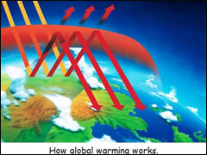
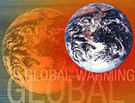
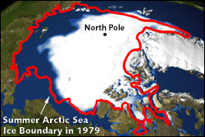

Slide 2
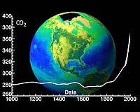

Slide 3
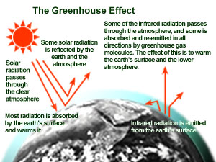

Slide 4
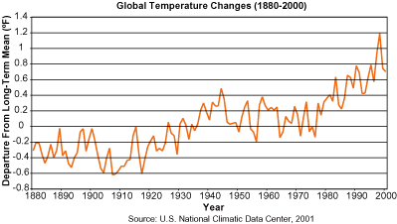

Slide 5
Global warming may be faster than UN predicted
Australia's CSIRO's atmospheric research unit has found the world is warming faster than predicted by the United Nations' top climate change body, with harmful emissions exceeding worst-case estimates.

Slide 6
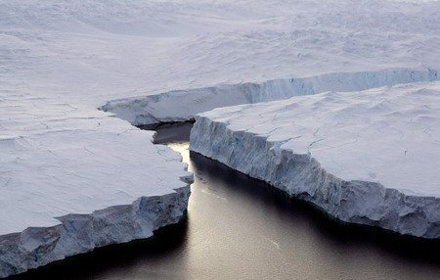
An enormous iceberg breaks off the Knox
Coast in the Australian Antarctic Territory,
January 11, 2008.

Slide 7
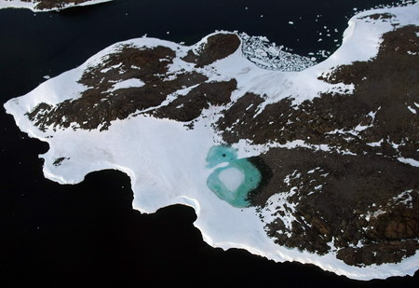
A turquoise lake forms from melting snow
near Cape Folger on the Budd Coast in the
Australian Antarctic Territory, January 11,
2008.

Slide 8
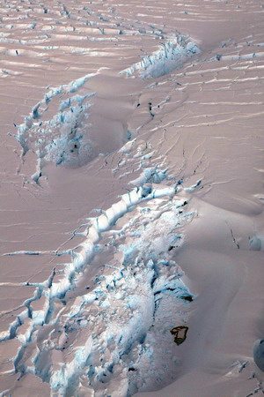
A deep crevasse forms in the iceshelf as an enormous iceberg breaks off the Knox Coast in the Australian Antarctic Territory on January 11, 2008.

Slide 9
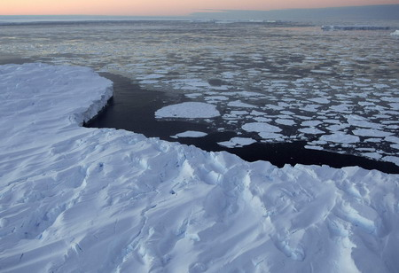
Giant tabular icebergs surrounded by ice floe drift in Vincennes Bay in the Australian Antarctic Territory January 11, 2008.

Slide 10
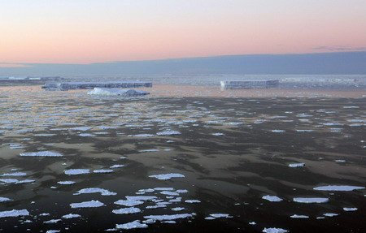
Giant tabular icebergs surrounded by ice
floe drift in Vincennes Bay in the Australian
Antarctic Territory January 11, 2008.

Slide 11

Here are 8 simple actions you can take to help reduce global warming.
1. Reduce, Reuse, Recycle
Do your part to reduce waste by choosing reusable products instead of disposables.

Slide 12
2. Use Less Heat and Air Conditioning
3. Change a light bulb
4. Drive less
5. Buy Energy-Efficient Products
6. Use the "Off" Switch
7. Plant a tree
8. Encourage Others to Conserve

Slide 13
Global Warming is a dramatically urgent and serious problem. We don't need to wait for governments to find a solution for this problem: each individual can bring an important help adopting a more responsible lifestyle: starting from little, everyday things. It's the only reasonable way to save our planet, before it is too late.

