Slide 1


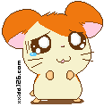

MODULE 2
No Drugs
外研版
高中英语
第二册

Slide 2
INTRODUCTION Vocabulary and speaking

Slide 3
General description of common drugs

Slide 4
◆Cocaine [可卡因]
Type of Drug: Stimulant
Fact: derived from the leaves of the coca bush that grows in the mountainous region of Bolivia and Peru. It is sold on the streets as a fine white powder .
Effect: Body actually forgets to sleep at beginning, later person experiences extreme fatigue, exhaustion and depression, bacterial infections of brain and heart.

Slide 5
◆Heroin [海洛因]
Type of Drug: Narcotic
Fact: derived from the opium poppy that is grown illegal in some areas in Southern Asia, the Middle East, Mexico, and Colombia. Today, no medical uses of Heroin at all.
Effect: flu-like symptoms - Nausea, vomiting, euphoria, cramps, diarrhea, runny nose, teary eyes, sweating, weakness

Slide 6
◆Marijuana[大麻]
Type of Drug: Hallucinogen
Fact: Comes from parts of the hemp plant which contains 400 known chemical. Marijuana continues to be proven to contain higher levels of cancer-causing chemicals than Tobacco!

Slide 7
▲Effect:
①white blood cells: reduction of strength of immune system.
② lungs : cause asthma, infections etc.
③brain: decrease ability to concentrate, short term memory, bad vision, irregular sleep patterns, mood swings. lack of interests in past or future.

Slide 8
◆Tobacco (nicotine)[烟草][尼古丁]
Type of Drug: Stimulant
Fact: Tobacco contains mainly of 2 substances:
①Nicotine: addictive stimulant
②Tar: yellowish brown fluid which causes cancer,
▲ Effect:
① physical: cancer, heart disease, stroke, stomach ulcer,
② psychological: anxiety, sleep disturbances, nervousness, headaches

Slide 9
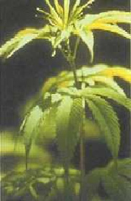
Marijuana[大麻]

Slide 10

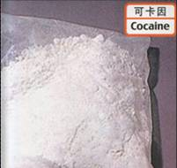
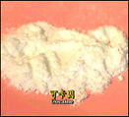
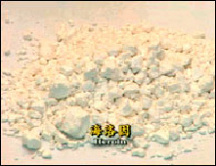
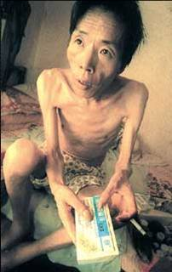

Slide 11
2
Find words in the box which mean:
bronchitis cancer cigarette death die heart disease injured tobacco

Slide 12
1. the end of life ___________
2. stop living ___________
3. two things some people smoke __________________
death
die
cigarette / tobacco

Slide 13
4. three illnesses __________________________
5. hurt _______________________
bronchitis/ cancer/ heart disease
injured

Slide 14
READING AND VOCABULARY

Slide 15
2
Read the opening paragraphs of two different articles and decide what the topic of each article is. Choose the topic from this list.

Slide 16
A drug Addict and His Story
Dangerous Activities of Teenagers
The Dangers of Using Cocaine
1
2

Slide 17
READING AND VOCABULARY

Slide 18
3
Choose the correct meaning of these words.
If a drug is addictive, does it mean that
(a) you can easily stop taking it
(b) you cannot stoop taking it?
(b)

Slide 19
2. Does powerful mean
(a) very strong (b) very weak?
If something increases , does it
(a) get bigger (b) get smaller?
4. Is a drug dealer someone who
(a) sells drugs (b) uses drugs?
(a)
(a)
(a)

Slide 20
5
Read the article again and decide if these sentences are true or false.

Slide 21
1. Cocaine can be smoked and also injected.
2. People who inject cocaine are in more danger if they share needles.
T
T

Slide 22
3. Cocaine makes your heart go more slowly.
4. Smoking crack cocaine can change people’s behavior.
F
T

Slide 23
6
Complete these questions and answers about Adam Rouse.

Slide 24
_________ was Adam Rouse when he started using drugs? ________
2. Which drug ____________ first? _________.
How old
15
did he use
Cannabis

Slide 25
3. Who ______________ it from?
_____________________.
4.What was the second drug that the man _____________? ___________________
did he buy
A man in the street
offered him
Crack cocaine

Slide 26
5. How did Adam pay for the drugs?
_______________________________.
6. What did the police do?
They took Adam ____________________.
He stole something to pay for the drugs
to the police station

Slide 27
7. Did Adam take the doctor’s advice?____.
8. Where _______________ work now?
_____________________________________________________
Yes
does Adam
In a centre for drug addicts, helping others to stop taking drugs.

Slide 28
FUNCTION Talking about results
Complete these sentences with so , as a result or as a result of.

Slide 29
1. Adam knew that taking drugs was bad, _______ he stopped.
2. He stopped taking drugs _______________ meeting the doctor.
so
as a result of

Slide 30
3.Adam met a doctor who explained the problem. _____________, he stopped taking cocaine.
4. Crack cocaine is very addictive, _____ users cannot easily stop using it.
as a result
so

Slide 31
5. He was extremely ill ______________ taking crack cocaine .
6. He became addicted to crack cocaine, _________ he became very ill.
as a result of
so

Slide 32
Check the meaning of these words and answer the questions.
3

Slide 33
activity break the law burglary connection crime criminal estimate illegal ratio shopping centre treatment

Slide 34
Which word refers to somewhere that you can buy things?
2.Which means that something is against the law?
shopping centre
illegal

Slide 35
3.Which word describes someone who breaks the law?
4. Which one is the crime of stealing from a shop?
5. Which one is the crime of stealing from a house?
criminal
shoplifting
burglary

Slide 36
Thank you

