Slide 1
2014红牛坠山赛最佳山地车技巧集锦

Slide 2
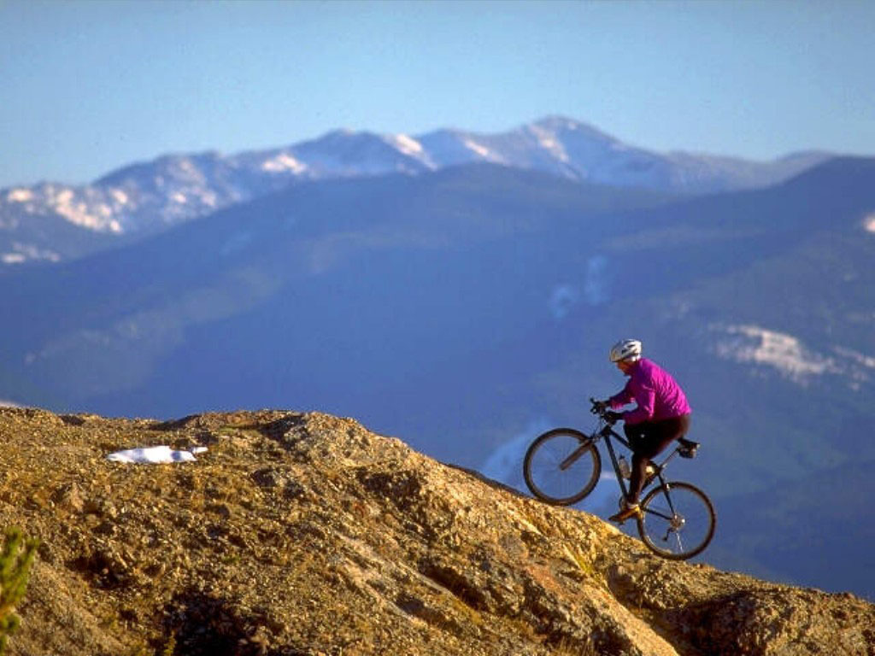
Mountain Biking (MTB)
Bicycle is one of the noblest(高贵的) inventions.
Mountain biking is similar to life.

Slide 3

Complex by design, simple by nature. The bike is nothing more than circles turning circles. It`s the human creation that makes it elegant.
Notes:
设计复杂，本质却简单。自行车只不过是一圈一圈地循环往复。是人类的创造使其高贵。

Slide 4
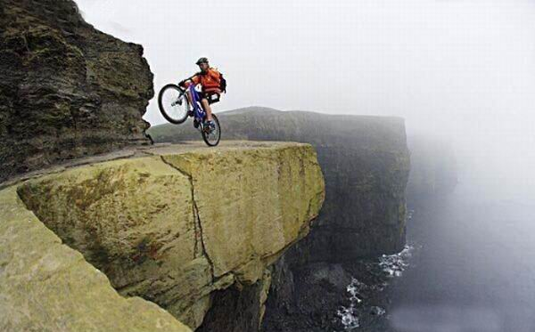
Balance a bike ,keep the pedals （脚踏板）turning. Forget about everything except right now.

Slide 5
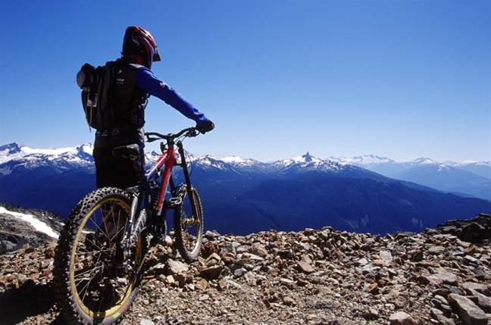
You don`t have to spend hours thinking, designing, questioning. But you can spend a few seconds lost in one monment .

Slide 6
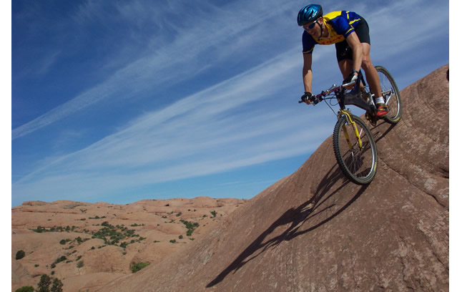
No time to think, just reaction ,focus.
All your worry will be washed away in a rush. And you will enjoy the feeling of cruising (漫游)in the mountains.
Notes:
无需思考，而只是条件反射，全神贯注。所有的担心都会在疾驰中一扫而空

Slide 7

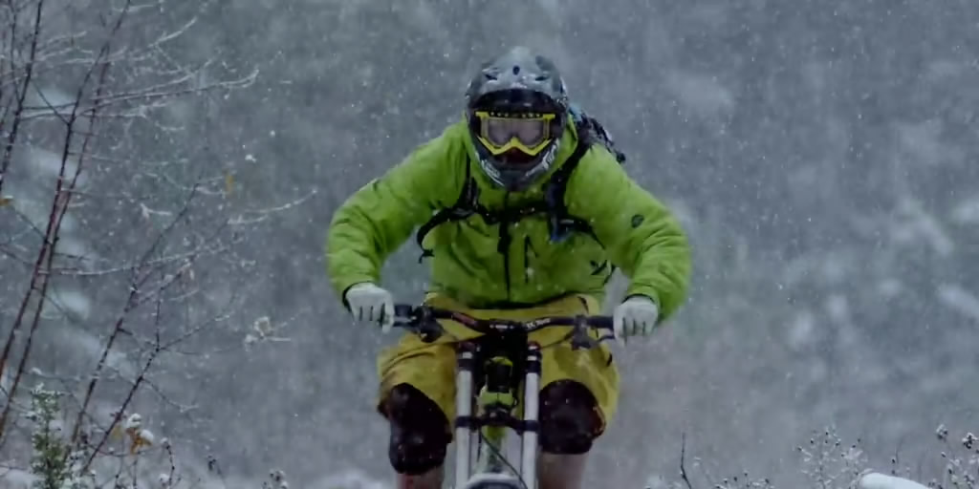
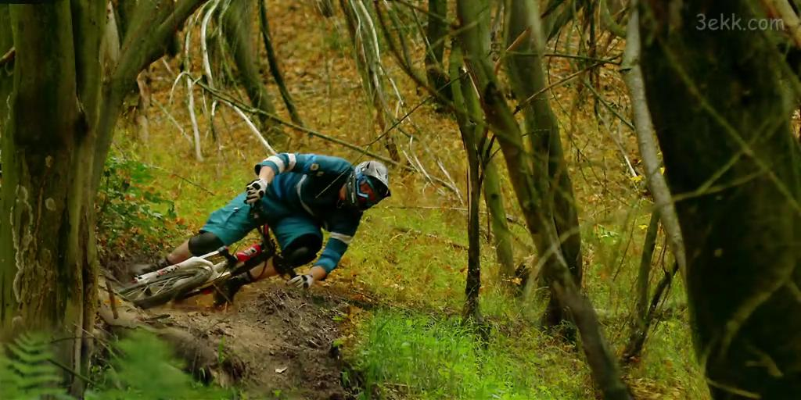
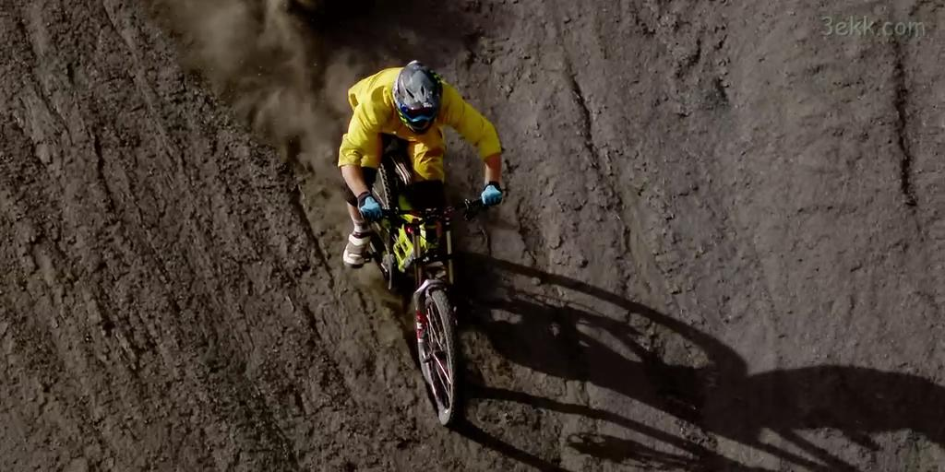
You will enjoy yourself deep in the forest ,riding off the routes, dropping into gullies(沟壑), caught in the rain.

Slide 8
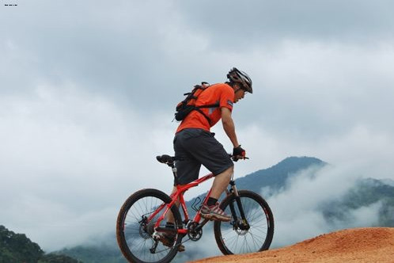
Sometimes you gallop（疾驰）like a horse on the grassland.

Slide 9
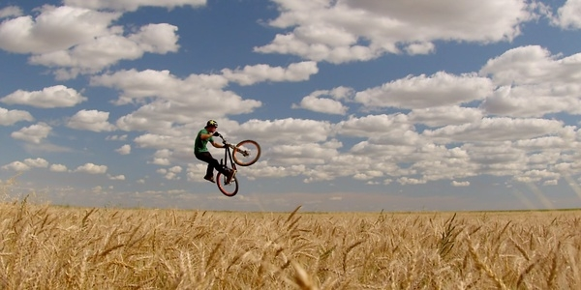
Sometimes you fly like a tercel（雄鹰）in the sky.

Slide 10
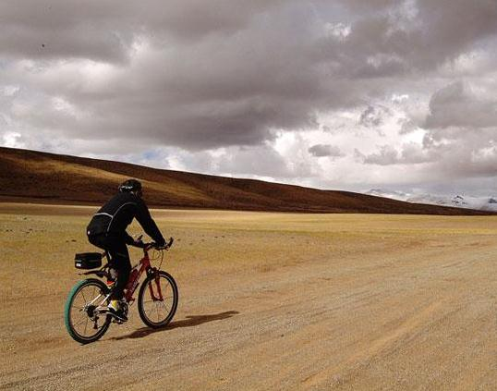
Will it last forever ?
······we build things···
we love them······
There are forces that aim to take it away.
Notes:
No matter how well we build things ,no matter how hard we love them.

Slide 11

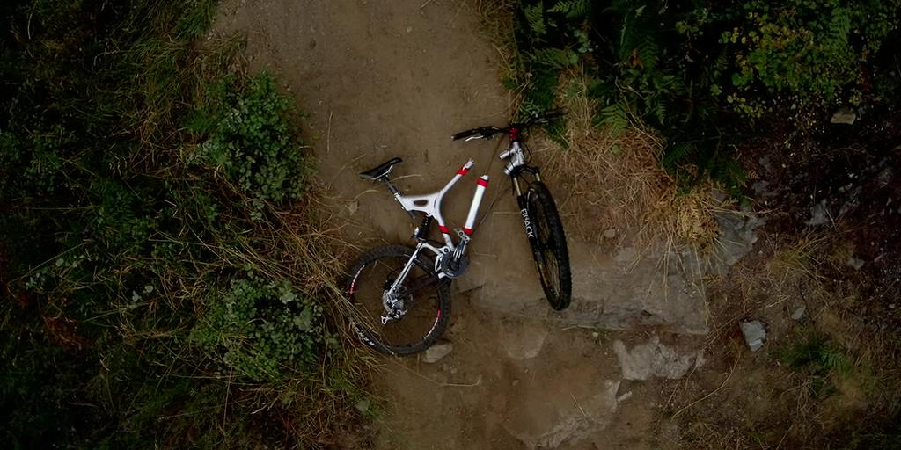
Maybe one day, far gone in the mountains, your bike breaks in two and you hurt yourself.
You may ask yourself：is it over?

Slide 12
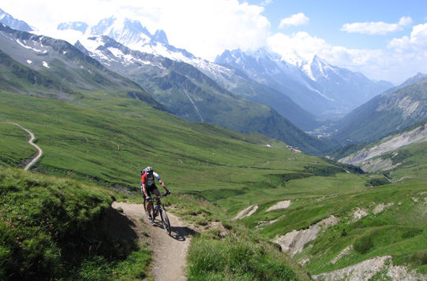
The answer is that no matter how dangerous the trail(林道) will be, You should try again. Never give up.

Slide 13
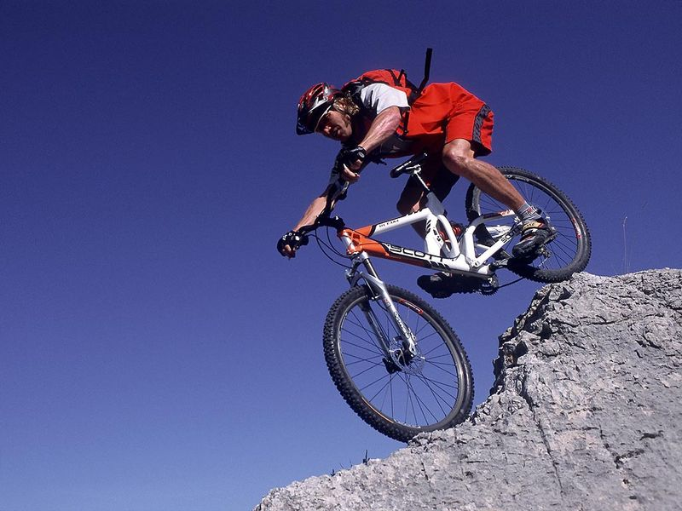
You have passed through different experiences, stories, adventure.
Stopped ,
but not disappear.

Slide 14
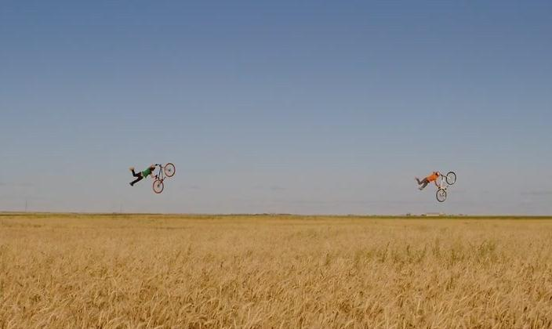
The feeling of riding is deep in your heart,no one can steal it away.Though your bike stopped,the feeling is still go on.

Slide 15

For now, as far as we can tell .
The cycle of life never ends.

Slide 16



