Slide 1
Presentation

Slide 2
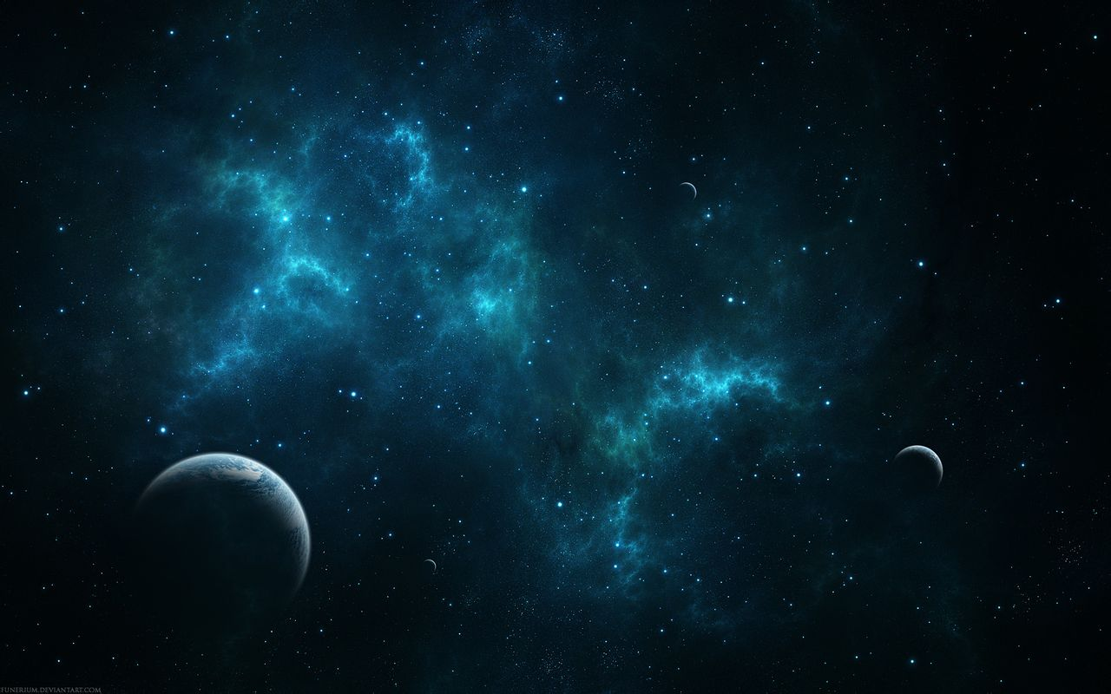
The Dark Forest
黑暗森林法则
Two axioms of Astrociology
宇宙社会学两条公理
Survival is the first need for any civilization
生存是文明最根本需要
Civilizations grow and expand, but the total quantity of matter in the universe never changes.
文明不断增长和扩张，但宇宙中的物质总量保持不变

Slide 3

The Three-Body Problem
Remembrance of Earth’s Past

Slide 4
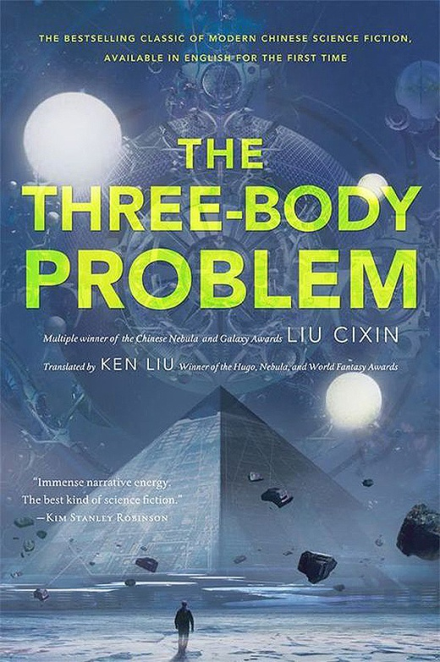
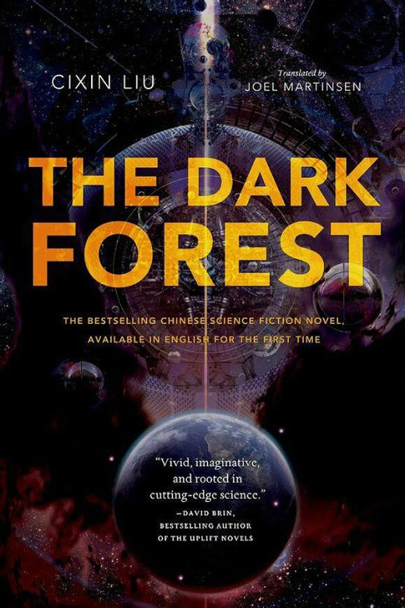
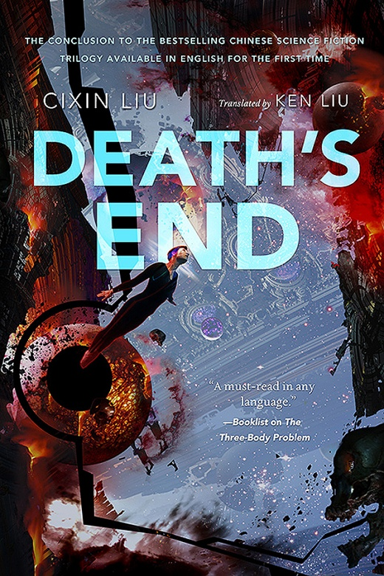
What is The Three-Body Problem

Slide 5
Plot
Red Coast , a secret military project, aiming to explore outer space civilization. But when Ye Wenjie exposed（暴露） the position of the Earth on purpose, the destiny of human beings had been completely changed. Trisolaran Space Fleet set off for invasion......
Tips:
Trisolar system contains Proxima（比邻星）
The distance between the Sun and Proxima is about 4 light-year

Slide 6
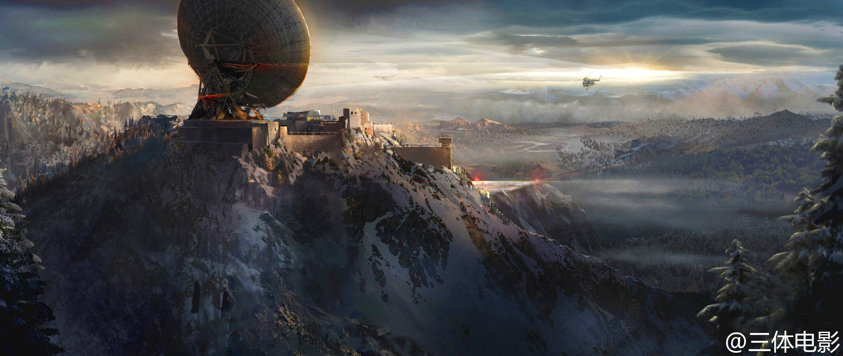
Red Coast Base
红岸基地

Slide 7
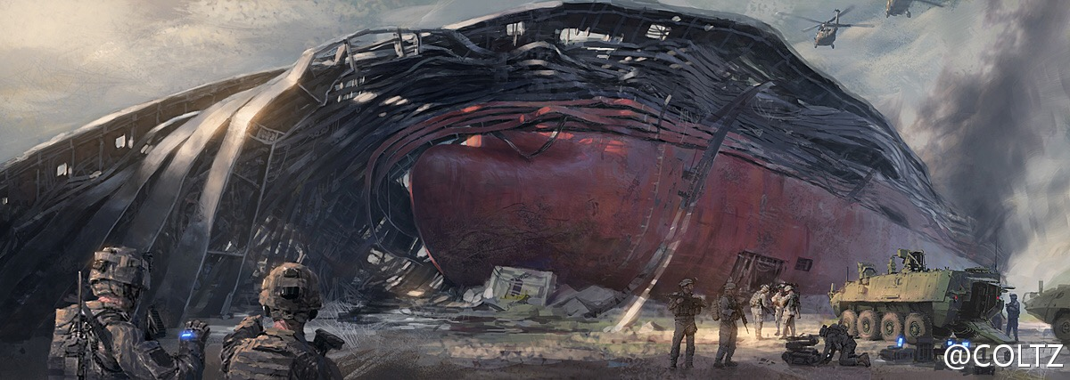
Operation Guzheng
古筝行动

Slide 8
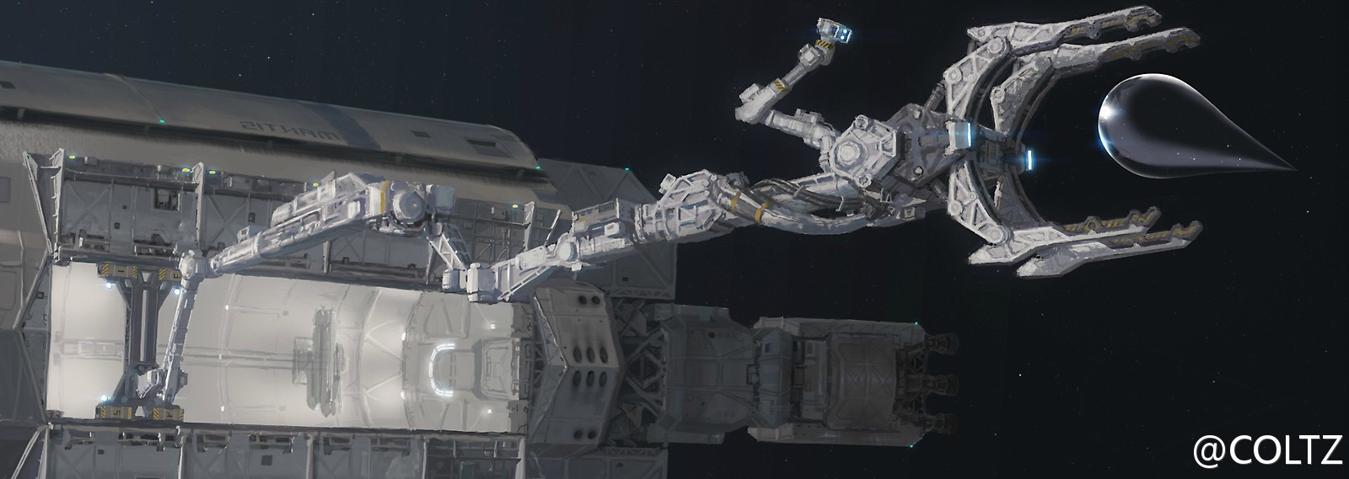
Droplet
水滴

Slide 9
Thank you

