Slide 1
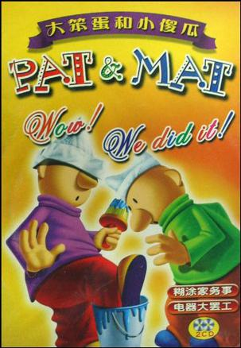
Pat&Mat

Slide 2
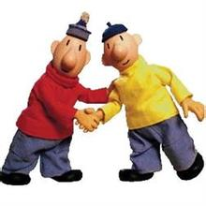

Slide 3
The main idea
Pat and Mat are two guys who think they can fix everything well. However bad the things are, they can repair it. People think they are awkward, because they can only make the things worse. But they don't think so. They can always get inspired in trouble and they are satisfied with the final results.

Slide 4
The characters of them
They often say “Wow! We did it!” to celebrate for success.
They are very cute.

Slide 5
The cartoon is also made into a kind of game.It is different from common games,it is very positive.It needs you to think over.

