Slide 1
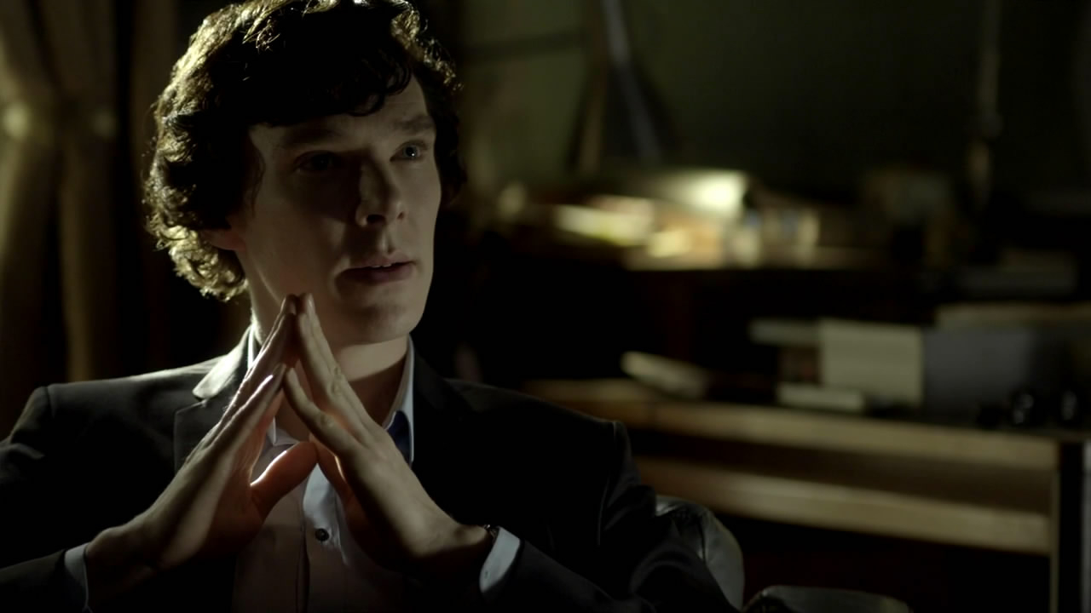
Sherlock
http://www.bilibili.com/video/av447355/

Slide 2
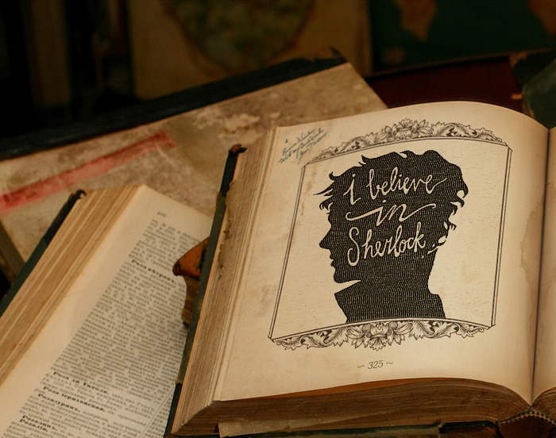
Brief introduction
is based on the detective novel of Arthur Conan Doyle
took the background from the 19 century to the 21 century
a series of dangerous and unusual events

Slide 3
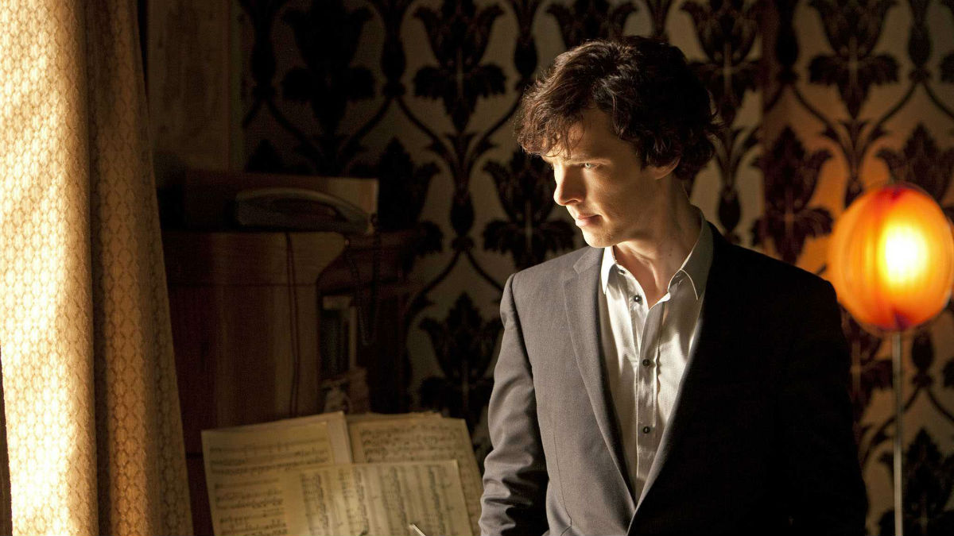
Main character
Sherlock
Holmes
consulting detective
Intelligent
Apartness

Slide 4
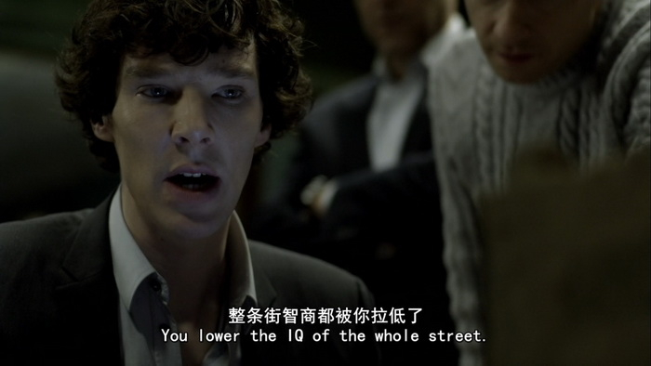
classic line

Slide 5
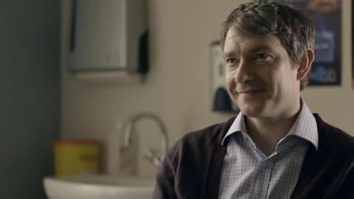
John Watson
Sherlock's assistant
Brave
Reliable

Slide 6
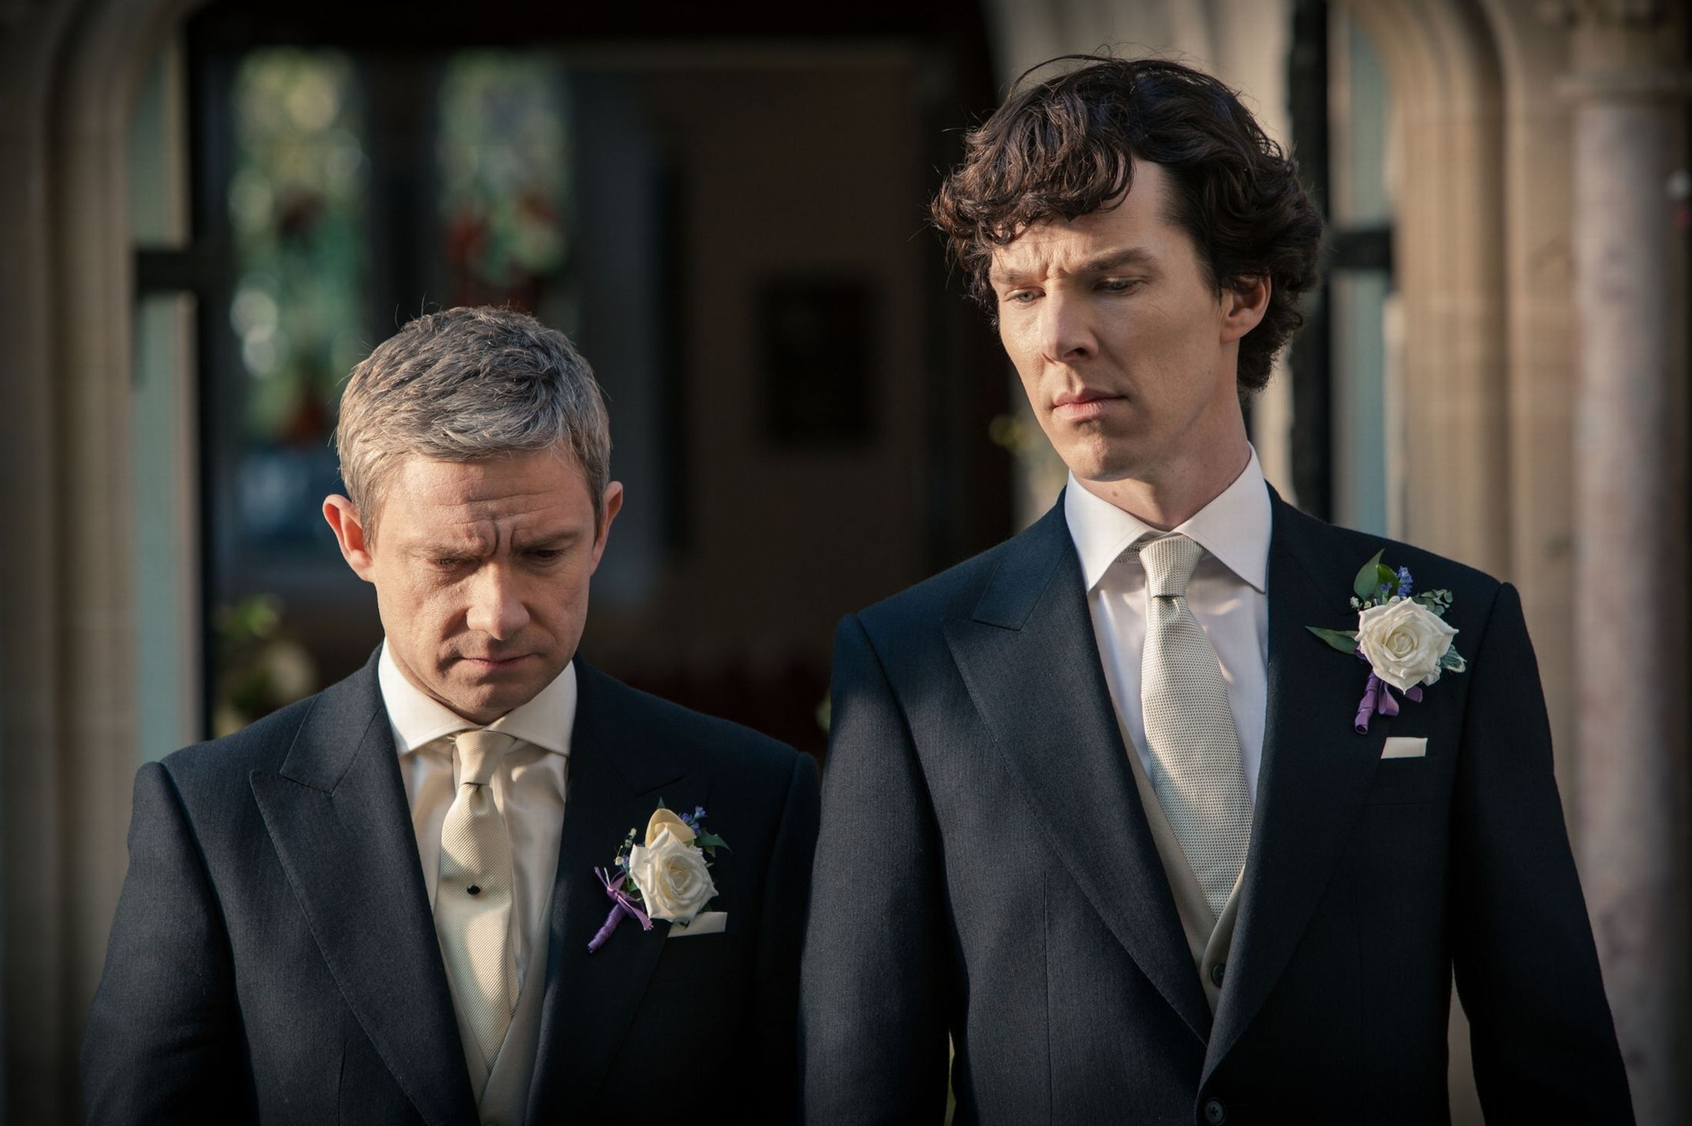
The best friends

Slide 7
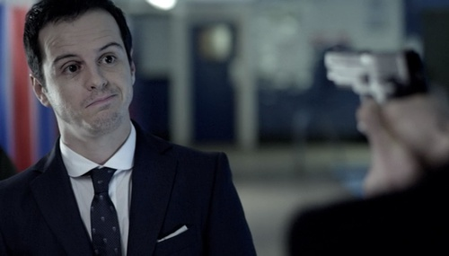
Jim Moriarty
Sherlock's archenemy
Insidious

Slide 8
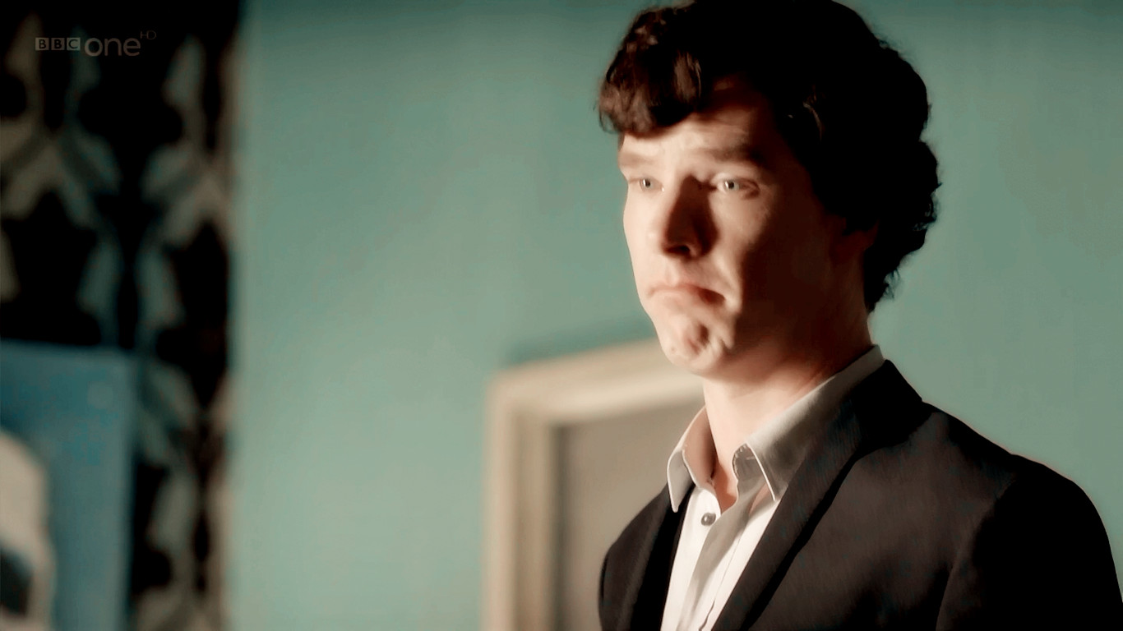
a hugh hit in Britain

Slide 9
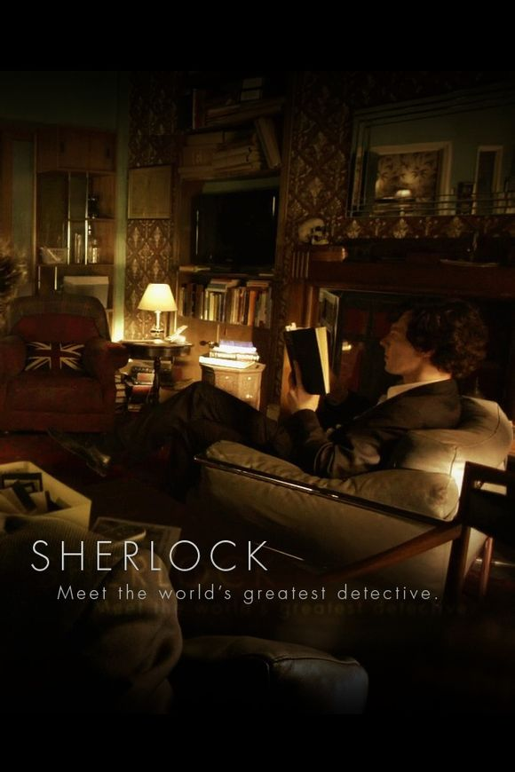
Conclusion
the right one for right now
a lasting hold on the public imagination
fanciful rearrange, mixing together strands
inventive,humorous and unexpected
always in the sprit of the original work

Slide 10
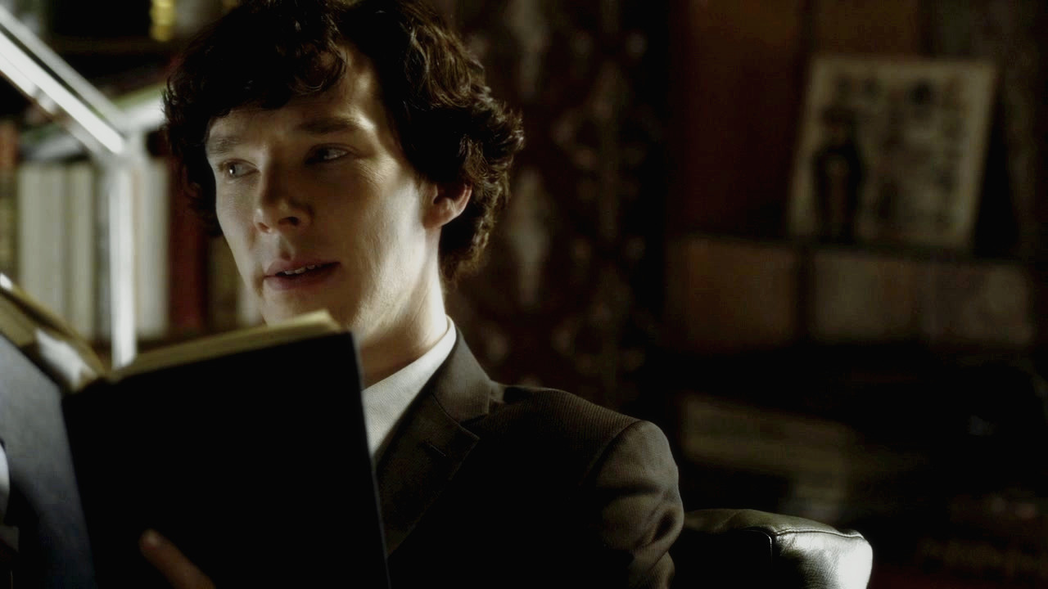
"The game is never over."

Slide 11
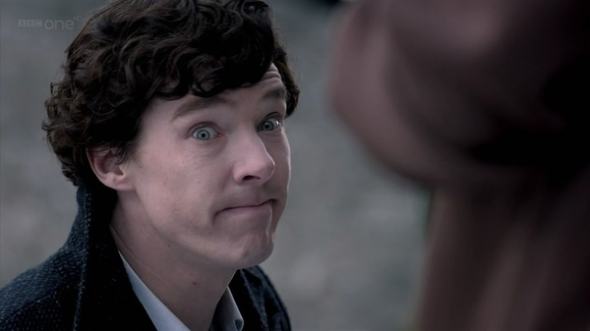
Thank you for your watching.

