Slide 1
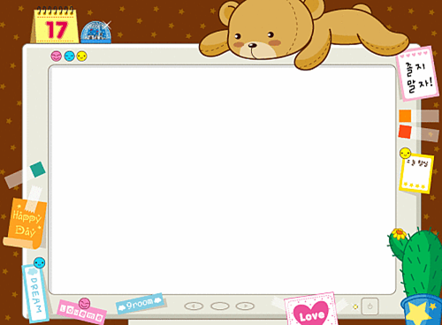

高中第二册
Module 6
Films and TV Programmes

Slide 2

Function
Talk about how often you do things
seldom, rarely, occasionally, every now and then, often, sometimes, once a week, every day, (four) times a week, from time to time, every two days, twice a month

Slide 3
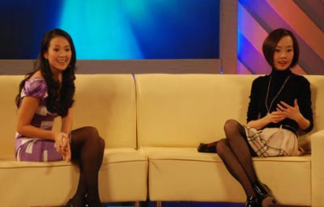
How often do you watch…?
chat show

Slide 4

comedy programme

Slide 5
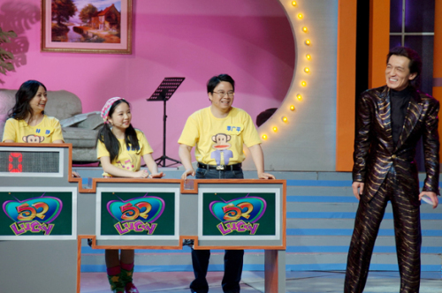
quiz show

Slide 6

soap opera

Slide 7

sports programme

Slide 8
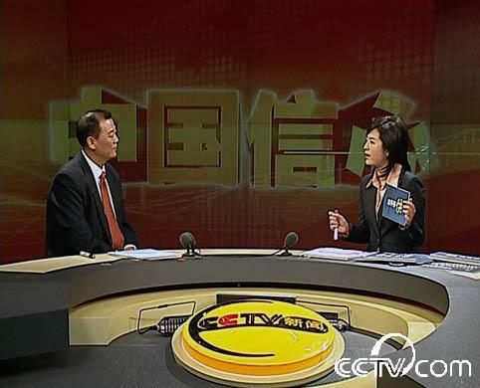
the news

Slide 9

TV/radio drama

Slide 10

Everyday English
a short space of time absolutely
good for you the box
the thing is what’s on
the box
1. I only watch ______ on Sundays.
2. He finished it in __________________.
3. A: _________ TV this evening?
B: There’s a really good drama.
a short space of time
What’s on

Slide 11
4. A: I won!
B: ____________!
5. There’s something I need to tell you, sir. __________, I haven’t done my homework.
6. A: Do you enjoy watching movies?
B: _________!
Good for you
The thing is
Absolutely

Slide 12




