Slide 1

Module 6
外研版
高中英语
第二册
Film and TV Programmes

Slide 2
Introduction

Slide 3
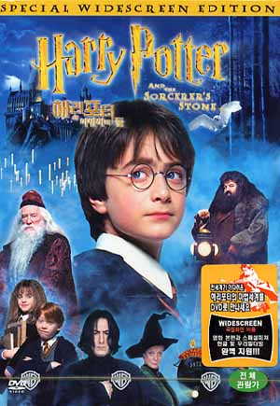





Slide 4

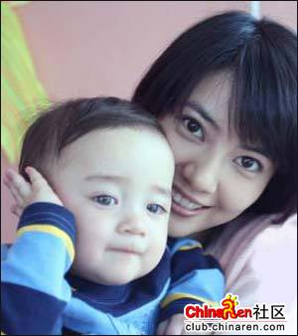



Slide 5


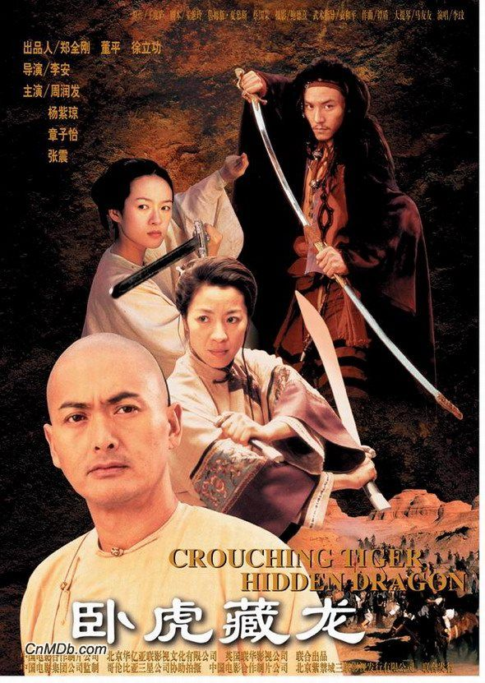


Slide 6
Look at the film posters above and answer the questions
1. What’re the films called?
2. Who direct them?
3. Who star in them?
4. When did they come out?

Slide 7
Match the types of films in box A with one of the words in box B

Slide 8
A. romantic film; thriller; martial art film; comedy; adventure film
B. gun; amusing; be/fall in love; crime; exciting; fight; sword

Slide 9
Look at the film poster. Which words do you think will be in the film review?

Slide 11
action; actor; actress; character; desert; express; female; master; male; martial arts; play a part; unusual

Slide 12
Which is the best summary of the film?

Slide 13
1. It takes place on Peking rooftops and in the deserts of western China.
2. It is a martial arts film that tells the story of a stolen sword, and the fight to get it back.
3. It tells the story of two people who love each other.
√

Slide 14
What you know about these things or characters?

Slide 15
1. Ang Lee
2. Wuxia stories
3. Xiulian’s sword
4. Zhang Ziyi
5. Chow Yun-Fat
6. Yu Xiulian and Li Mubai’s relationship

Slide 16

According to the definitions below, then find the words in the text

Slide 17
1. happen 2. sometimes
3. the top part of a building that covers it
4. causing strong feelings, especially sad feelings

Slide 18
5. an extraordinarily good film, book, painting, etc.
6. moving in a smooth and attractive way
7. the man one has promised to marry
8. jump into the air or a long distance

Slide 19

Language learning
1. belong to
2. take place
3. be/fall in love with
4. leap through the air
5. every now and then

Slide 20
6. care about
7. play the part of
Use your dictionary and learn the phrases by yourself

Slide 21
Listening

Slide 22
Do you know the meanings of these words?

Slide 23
ad (advertisement)
argue
(TV) channel
disagree
entertaining
neighbour
programme
relax

Slide 24
Listen to the interview and number the questions

Slide 25
1. Do you enjoy advertisements?
2. How often do you watch it?
3. How often do you change channels in an evening?

Slide 26
4. What’s your favourite TV programme?
5. Do you have a television in your home?
6. Do you watch a lot of films on television?

Slide 27


Listen again
choose the right answer

Slide 28
1. The boy’s family has
(a) one television (b) two television
2. The boy watches TV
(a) every night for 2 hours (b) all evening
3. The boy thinks films are
(a) relaxing (b) tiring

Slide 29
4. The boy prefers
(a) serious programme
(b) comedy programme
5. The boy thinks advertisements are
(a) boring (b) interesting
6. The boy enjoys Neighbours because
(a) it is relaxing
(b) the acting is so brilliant

Slide 30
Function
Talk about how often you do things

Slide 31
Do you know the types of TV and radio programme

Slide 32
chat show
comedy programme
quiz show
soap (opera)
sports programme
the news
TV/radio drama

Slide 33
How often do you watch the different types of programme

Slide 34
seldom; rarely; occasionally;
every now and then; often; sometimes;
once a week; every day; (four) times a week; from time to time;

Slide 35
every two days;
twice a month
Use the words and phrases below

