Slide 1
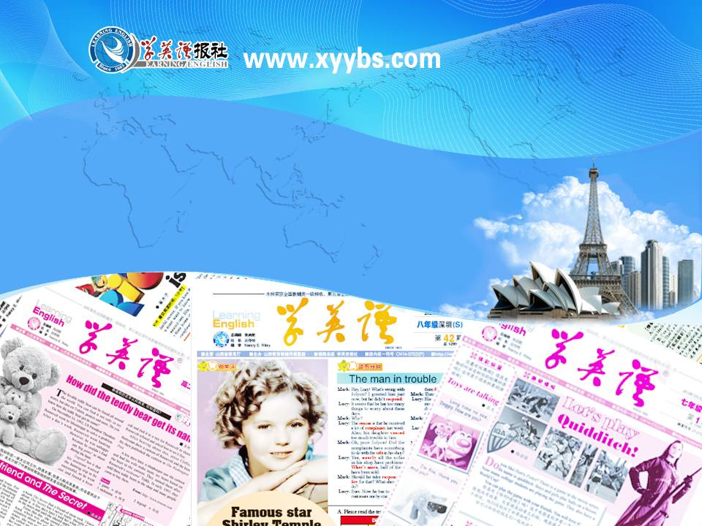
同步教学辅助课件
必修5

Slide 2

Unit 3
Words Review

Slide 3

an idea, a feeling or an opinion that you get about sb./sth., or that sb./sth. gives you; a mark made on the surface of sth. by pressing an object onto it
n. 印象; 感想; 印记
impression
happening a lot or all the time
adj. 时常发生的; 连续不断的
constant
all the time or often
adv. 不断地
constantly

Slide 4
an aircraft with a jet engine, which is able to fly very fast
jet
n. 喷气式飞机
happening or existing before sth. or someone else
adj. 在前的; 早先的
previous
not knowing what to do or believe, or not able to decide about sth.; not known or fixed, or not completely certain
adj. 不确切的; 无把握的
uncertain

Slide 5
sth. that helps you form an opinion or make a decision about sth. else; a person whose job is showing a place or a particular route to visitors
n. 指导; 向导; 导游
to show sb. the way to a place, often by going with them; to show sb. a place that you know well; to direct or influence sb's behaviour
vt. 指引; 指导
guide

Slide 6
a small solid piece of medicine
n. 药片
tablet
the part of a spacecraft in which the people on it live; a small container with medicine inside which you swallow
n. 太空舱; 胶囊
capsule
a person whose job it is to organize a particular event, or to provide services to particular people, or to take care of a particular place
n. 乘务员; 服务员
steward

Slide 7
a person who serves passengers on a ship or aircraft
n. 女乘务员
stewardess
a hole or space that sth. or someone can pass through; the beginning of sth.
n. (出入的)通路; 开口; 开端
opening
in a direction to the left or right, not forwards or backwards
sideways
adv. 往(向、从)一侧; 侧着; 侧面朝前

Slide 8
the place where someone or sth. is and the things that are in it; the place where someone lives and the conditions they live in
n. 周围的事物; 环境
surroundings
that is near or around sth.
adj. 周围的
surrounding
to accept behaviour and beliefs which are different from your own, although you might not agree with or approve of them
vt. 容忍; 忍受
tolerate

Slide 9
to not have or not have enough of sth. that is needed or wanted
vi. & vt. 缺乏; 没有
when sth. is not available or when there is not enough of it
n. 缺乏; 短缺的东西
lack
a small change
n. 调整; 调节
adjustment
a covering for all or part of the face which protects, hides or decorates the person wearing it; appearance or behaviour that hides the reality
n. 面具; 面罩; 伪装
mask

Slide 10
a vehicle with four wheels, which is usually pulled by horses and was used esp. in the past; any of the separate parts of a train in which the passengers sit
n. 运输工具; 四轮马车; 客车
carriage
to push sth. closely and firmly against sth.; to be pushed in this way; to make strong efforts to persuade or force sb. to do sth.
vi. & vt. 按; 压; 逼迫
press

Slide 11
an act of pushing sth. with your hand or with a tool that you are holding; the process of printing books, newspapers, etc.; newspapers and magazines, and those parts of television and radio which broadcast news, or reporters and photographers who work for them
n. 按; 压; 印刷; 新闻
press
to (cause sth. to) become firmly fixed together, or in position, or closed
vt. 系牢; 扎牢
fasten

Slide 12
a strip of leather or material worn around the waist to support clothes or for decoration
n. 腰带; 皮带
belt
to shine brightly and suddenly, or to make sth. shine in this way
vt. & vi. (使)闪光; (使)闪现
flash
to change suddenly or completely, esp. from one thing to another, or to exchange by replacing one person or thing with another
vt. 转换
switch

Slide 13
a small device, usually pushed up or down with your finger, that controls and turns on or off an electric current; a sudden or complete change, esp. of one person or thing for another
n. 开关; 转换
switch
a list of the times when events are planned to happen, esp. the times when buses, trains and planes leave and arrive
n. 时间表; 时刻表
timetable

