Slide 1

presentation
——刘楷

Slide 2

Hello everyone!
Today my topic is about sports.
First let me show you some pictures.

Slide 3
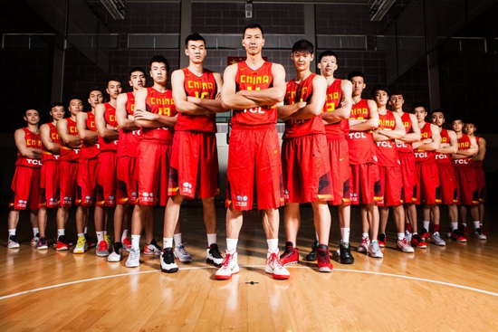
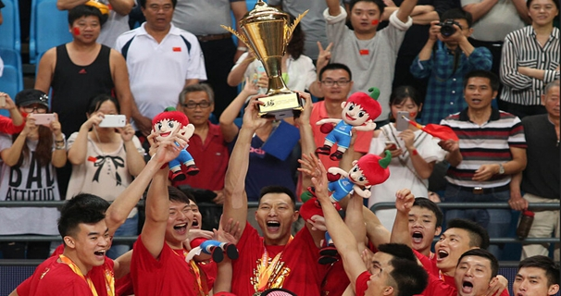
China won the Asian
men's Basketball
Championship !!!
Basketball !!

Slide 4
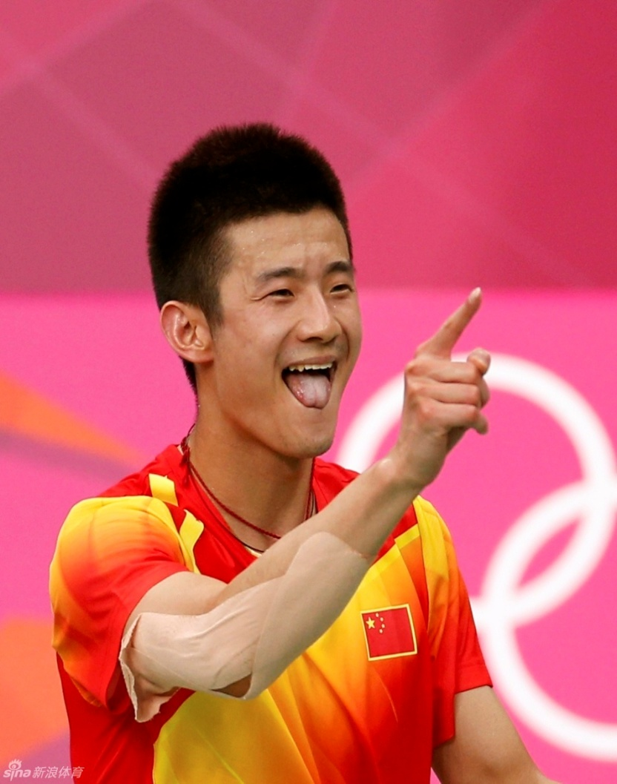
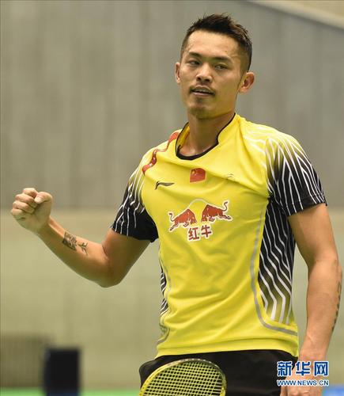
Badminton !!

Slide 5
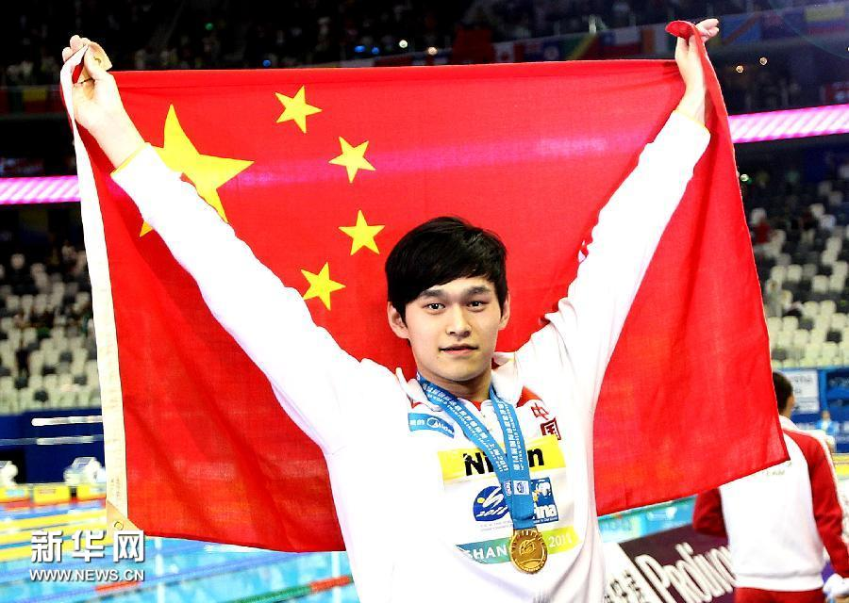
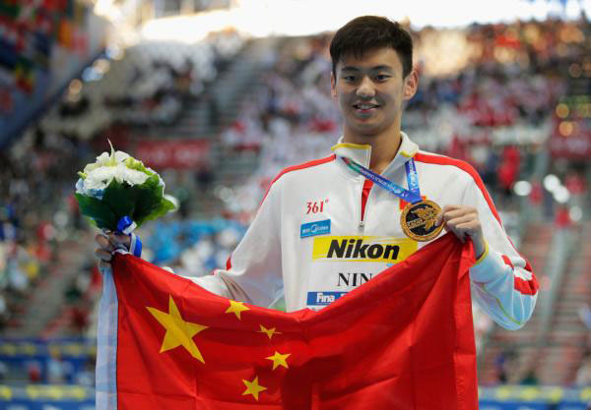
Swimming !!

Slide 6
The pictures that I show you are all about china famous team and shorts player and they all have great contributions for our country.
Although we can not be as famous as them ,we can learn something from them.
For example……

Slide 7
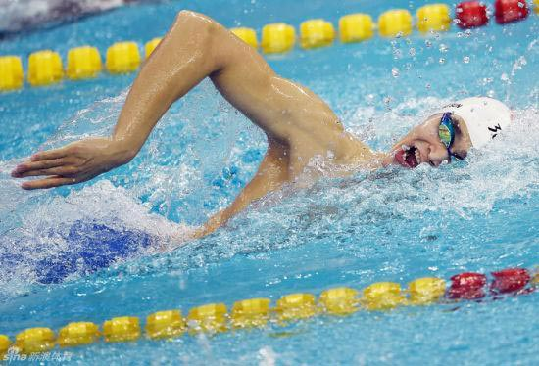
Hard--working
We all know Sun yang ,but do you
know he must swim about 10000 meter per day?
Although it is very hard ,he still try he best to complete it.
So he could be a winner and we should learn from him.

Slide 8
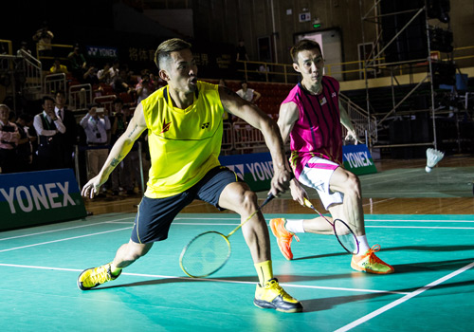
Modest
Although Lin dan play badminton very well ,he also learn from he opponent Li zhong wei .So that they can play better and better.

Slide 9

Goal
As a sportsmen,I think they all have a goal in their mind .So we should also have a goal and we should do everythng to reach the goal.

Slide 10
Thanks for watching and listening .

