Slide 1
procrastination（拖延症）
presented by Marcy
高一（8）班 邱雅卓

Slide 2
Procrastinator's Timeline
I'll start early this time
I've got to start soon
what if I don't start
there's still time
there's something wrong with me
the final choice: To Do or Not to Do
I'll never procrastinate again

Slide 3
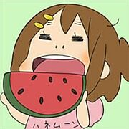
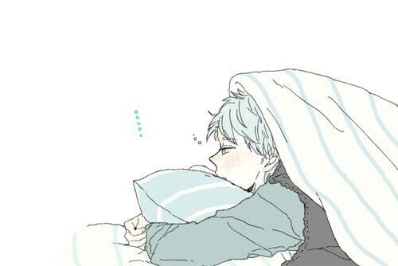
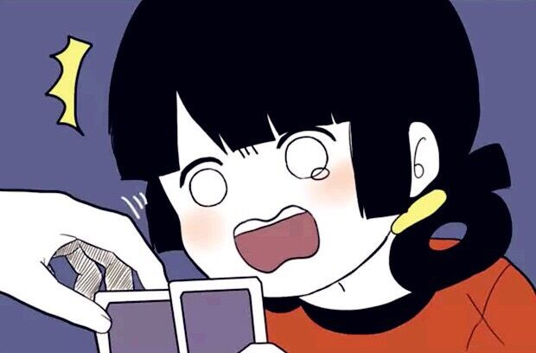
What do we do when we procrastination?
  eat? sleep? play games?

Slide 4
Negative effects
stress and anxiety
health problems
Impeding your ability to achieve your goal

Slide 5
Reasons
low confidence in your ability to succeed
task aversiveness: expecting that the process will be difficult or the outcome will be unpleasant
the goal or reward is too far away to feel real or meaningful
difficulties in self-regulation

Slide 6
Some helpful tips
write down you task in a visible place with their due dates
break the task into small components
make the tasks look easy in your mind
reward yourself for a job well done

Slide 7

Don't procrastination anymore
What makes you most happy is being able to do what you want to do

Slide 8
Thanks for watching

