Slide 1
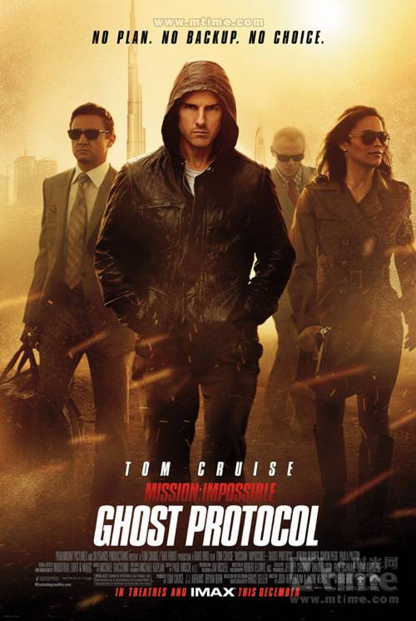

Slide 2
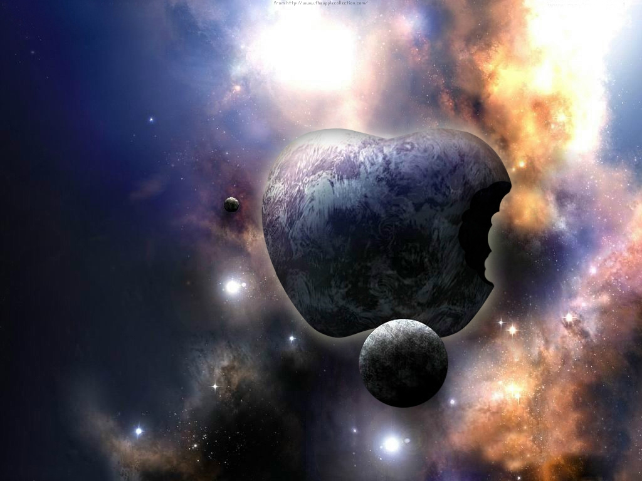
Main Idea
Mission: Impossible – Ghost Protocol is a 2011 American action film. It is the fourth installment in the Mission: Impossible series .

Slide 3

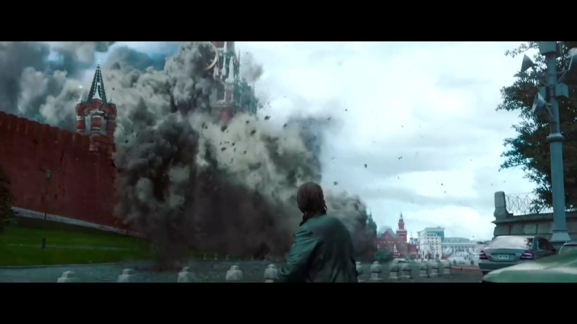
When agent Ethan Hunt performed a secret espionage(间谍活动) in Moscow,a bomb placed by terrorists blew up the landmark in Russia:the Kremlin.The Russian government immediately announced that the attack has gone beyond the general scope of the terrorist attacks。It is completely“a provocation (挑衅，挑拨）of the war”.

Slide 4
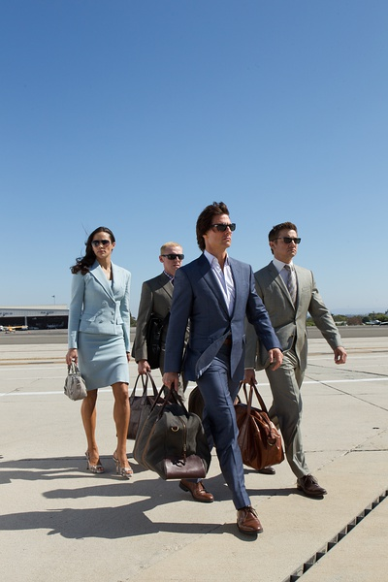
Blamed for the terrorist bombing of the Kremlin,IMF operative Ethan Hunt is disavowed along with the rest of the agency when the United States President initiates “Ghost Protocol”. Left without any resources,connections, technology or backup. Their mission is to find and stop terrorists intent on nuclear war and track down the people truly responsible for the attack . Ethan is forced to embark on this mission with a team of fellow IMF fugitives .
Can they accomplish this impossible mission and prevent the war between the United States and Russia?

Slide 5

The Actors
Tom Cruise ---Ethan Hunt <美>
Jeremy Renner—Wllliam Brandt<美>
Simon Pegg---Benji Dunn<英>
Paula Patton---Jane<美>
Anil Kapoor ---Brij Nath<印>
Lea Seydoux ---Sabine Moreau<法>

Slide 6
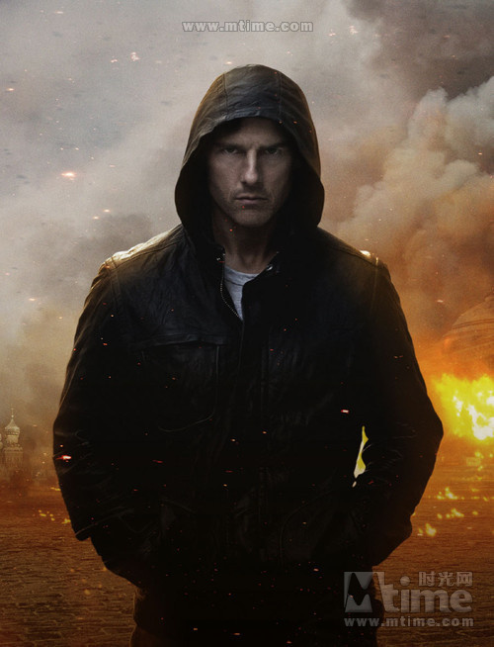

Ethan Hunt acted by Tom Cruise is the heart and the soul of the movie.He is an IMF agent.

Slide 7
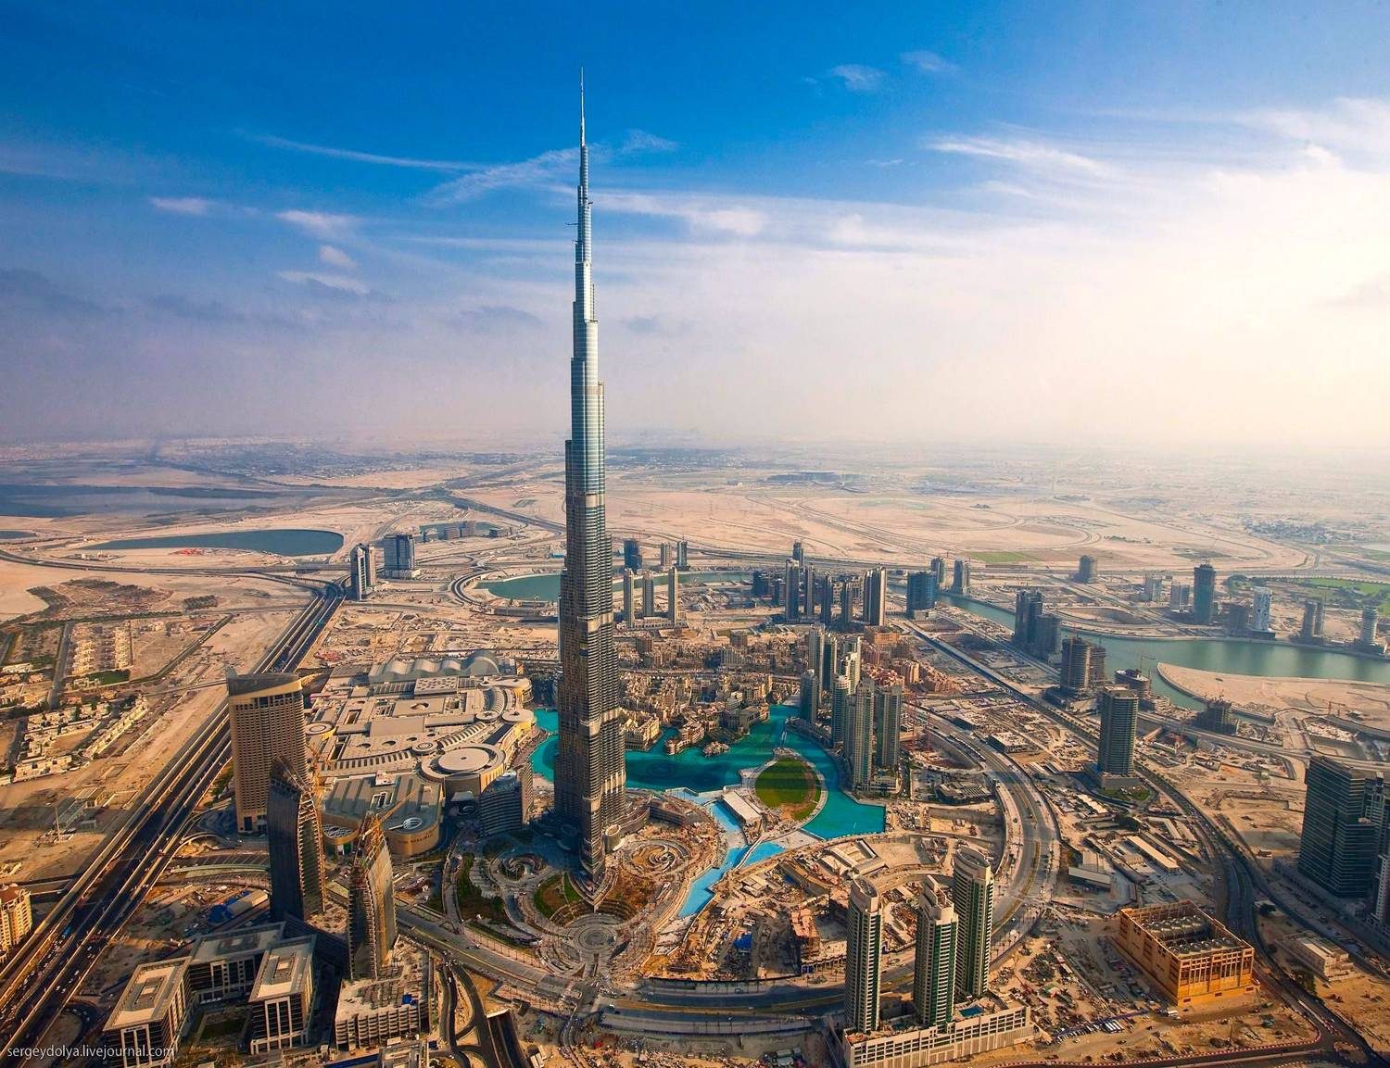

Slide 8
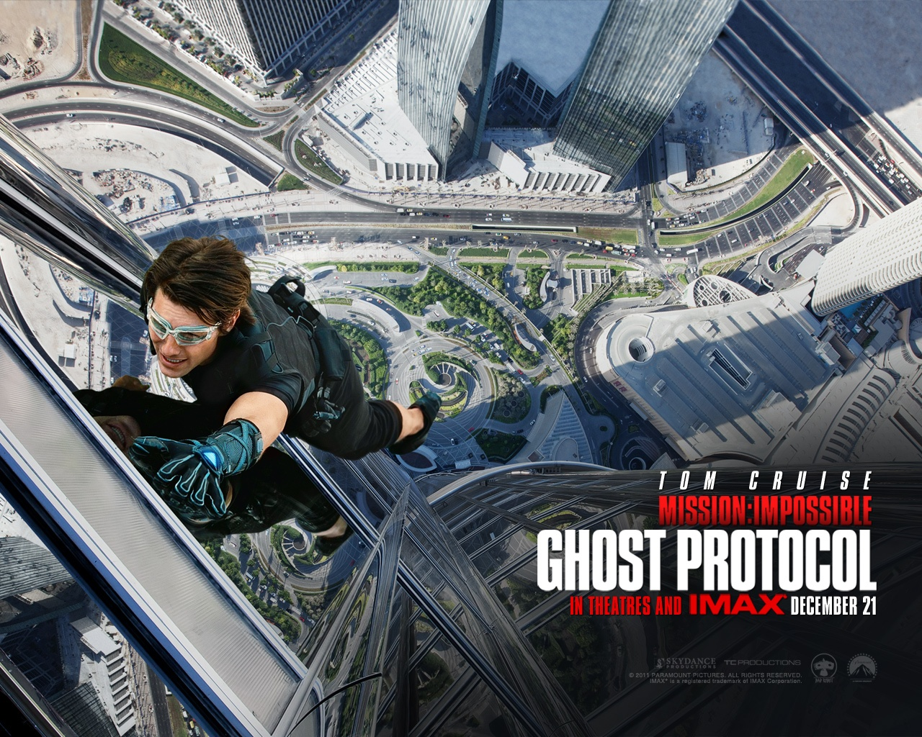
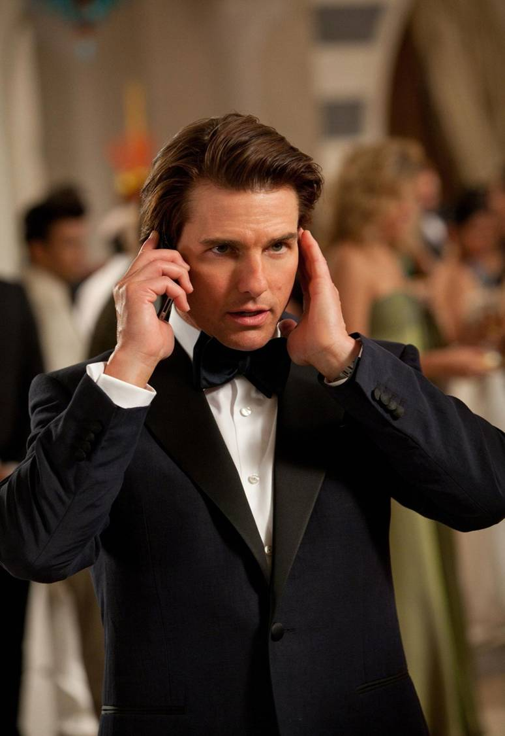

Slide 9
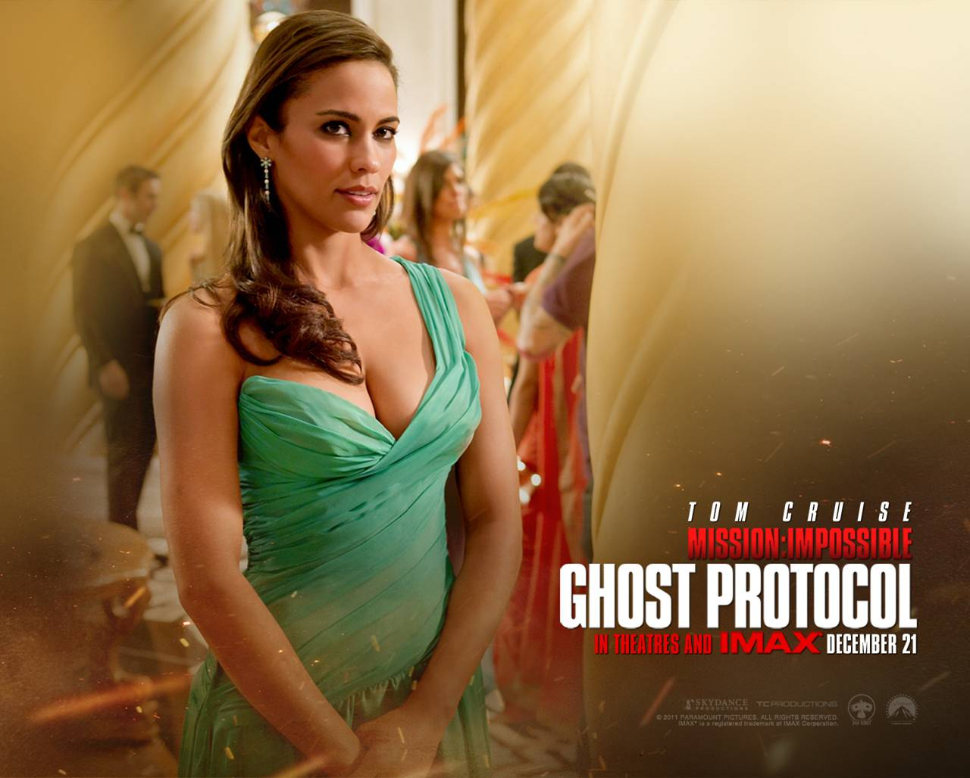
Jane Carter acted by Paula Patton.
As an IMF agent,she adds an elegant sexiness to the team missions.

Slide 10
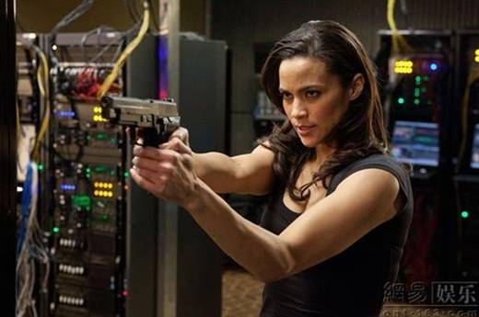
REALLY?

Slide 11
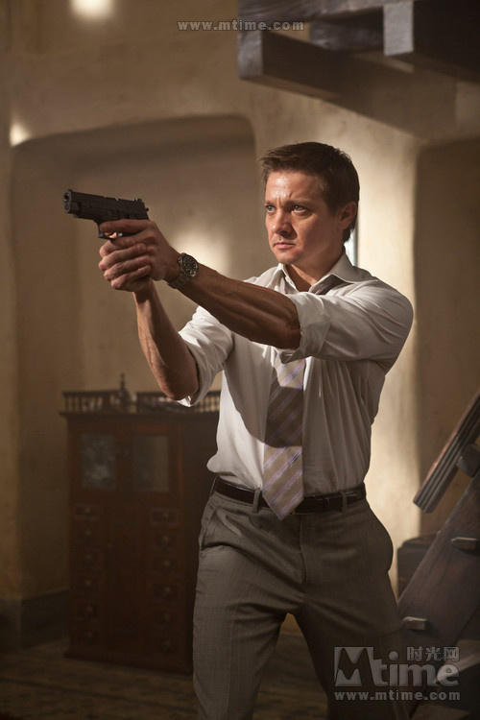
William Brand acted by Jeremy Renner
He is the IMF chief analyst(IMF首席设计师）.He is dressed in a decent suit,and just like a white-collar worker.But he is very quick and strong.

Slide 12
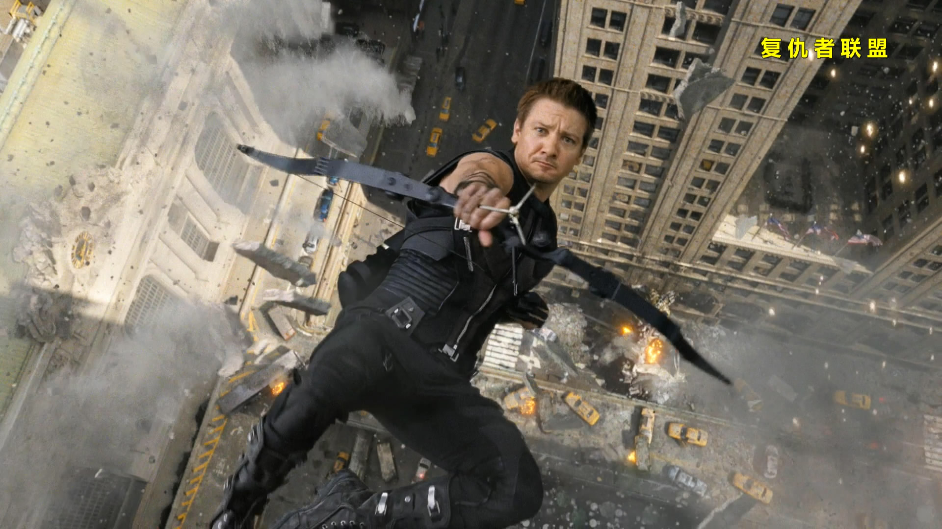
It’s very similar.

Slide 13
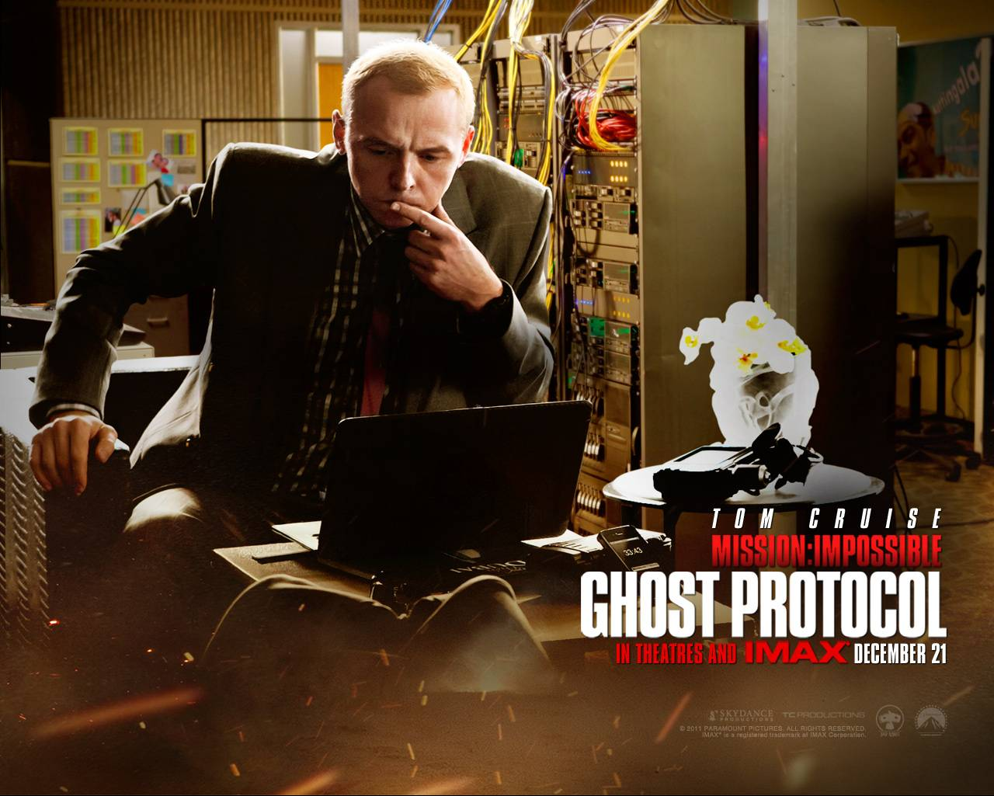
Benji Dunn acted by Simon Pegg
He is the IMF Field technical agent(IMF外勤技术特工）.He is an IT essence.

Slide 14
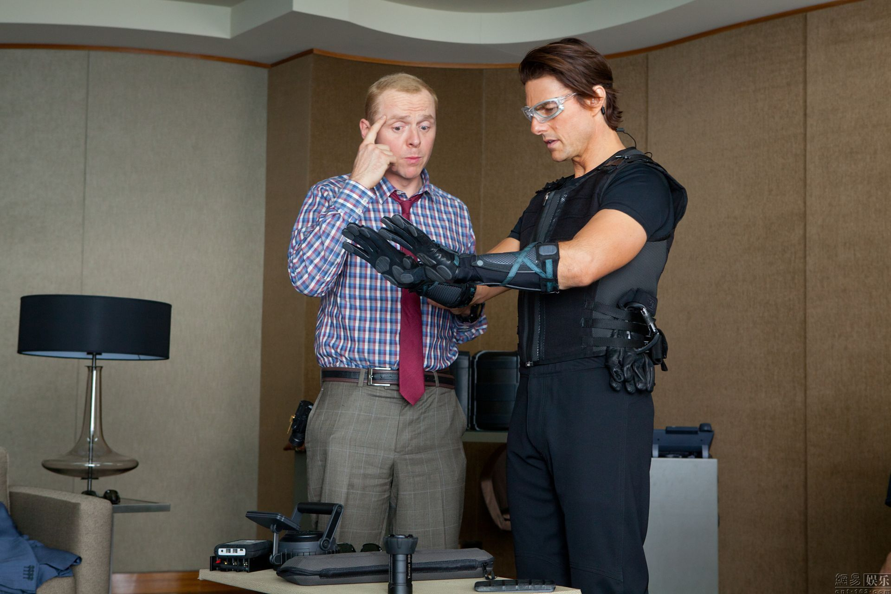

Slide 15

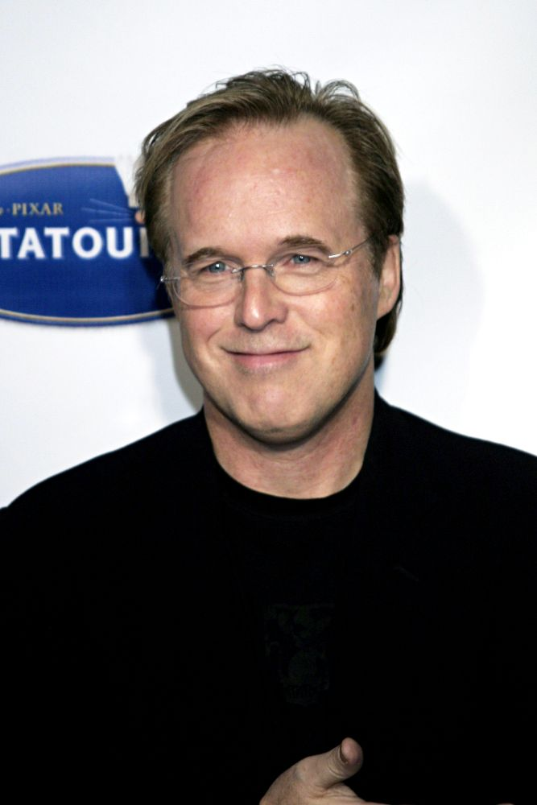
1.Director:Brad Bird's first time direction of real actors exhibits the same zestful energy and fun that we got from his animated films such as The Incredibles . Upon release, Mission: Impossible – Ghost Protocol became a critical and commercial success . It also grossed over $694 million worldwide,becoming the highest-grossing Mission: Impossible film .

Slide 16
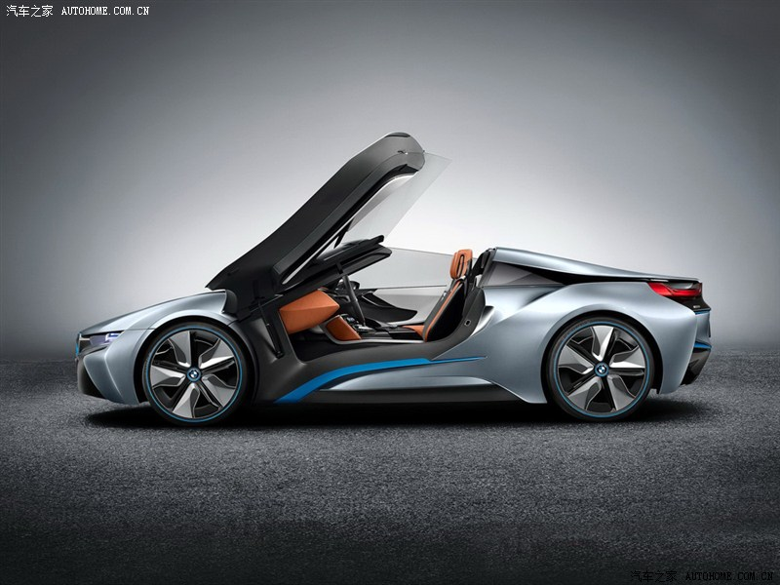
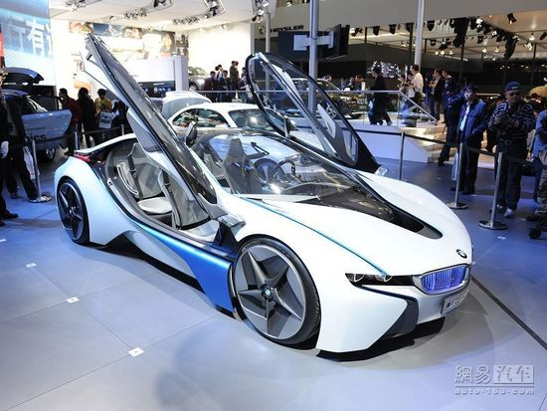
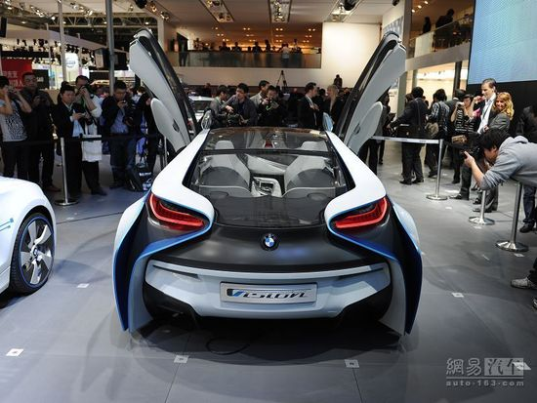

Slide 17
http://www.iqiyi.com/v_19rrhgwlyo.html

Slide 18
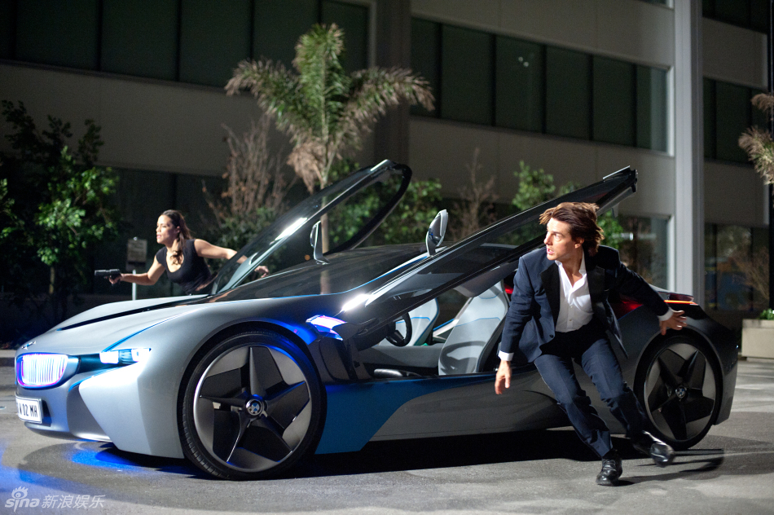

I hope all of you to enjoy this movie!
Thank You

