Slide 1
school uniform
by Tiffany

Slide 2
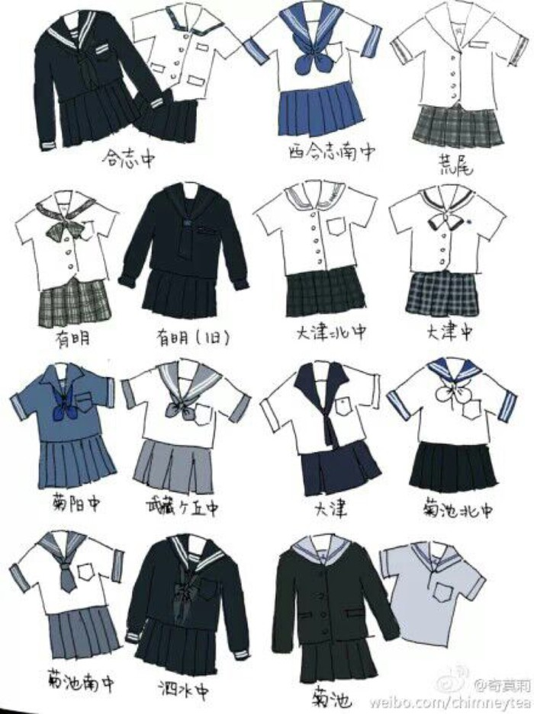
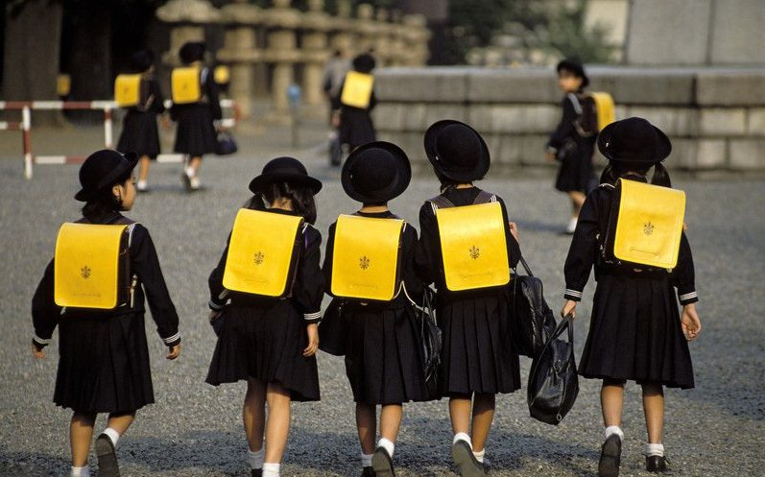
Japan

Slide 3
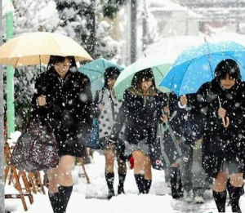
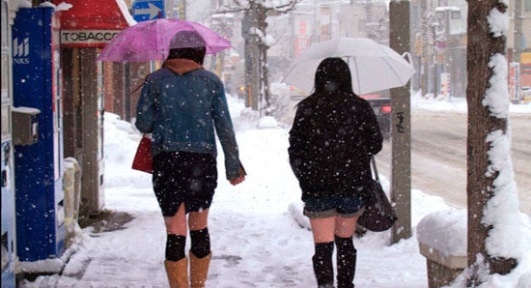
cold?

Slide 4



American

Slide 5


British

Slide 6


Slide 7



Slide 8
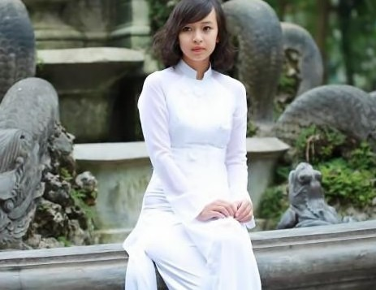
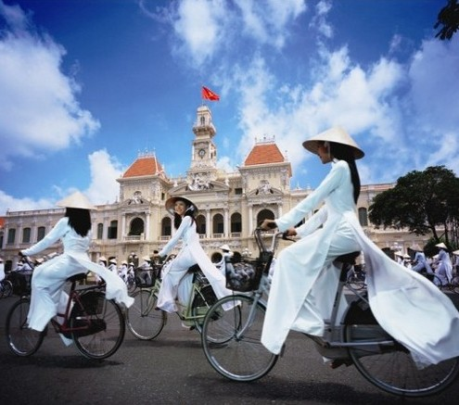
Vietuam

Slide 9
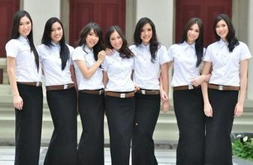
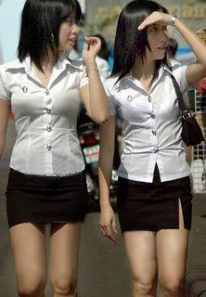
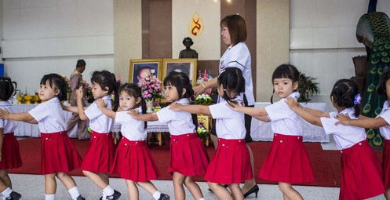
Thailand

Slide 10
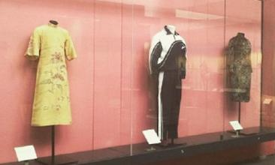
China(Shenzhen)
British Museum collection Shenzhen school uniforms

Slide 11
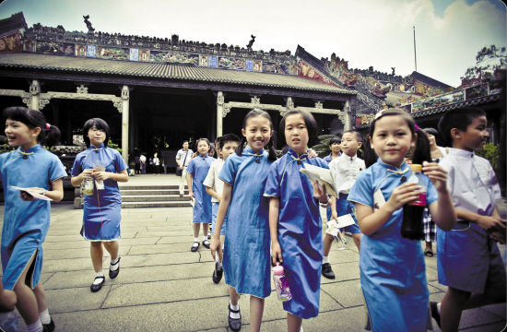

China(HongKong)

Slide 12
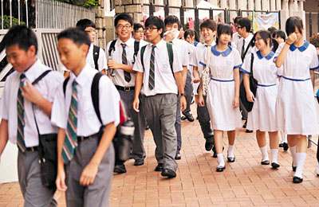
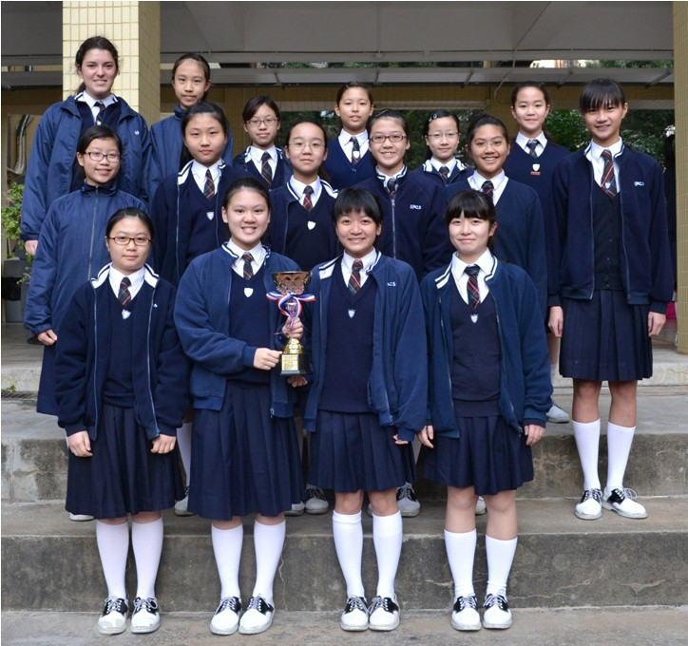

Slide 13
conclusion
School uniform represents the school culture, even the urban culture. The school uniforms which are highly agreed with can be part of the culture. In campus culture in China, school uniforms should be able to reflect a synchronized with the times of the grade, so that students will be willing to wear.

