Slide 1
Chocolate
BY Cindy

Slide 2
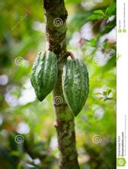
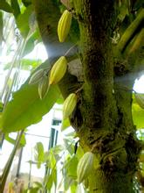
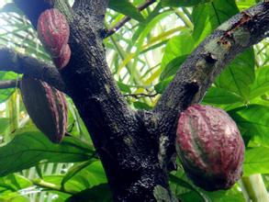
Cacao trees

Slide 3
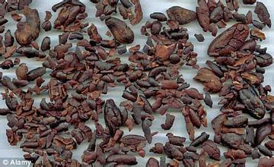
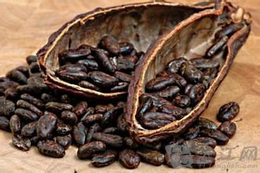
Cacao beans

Slide 4
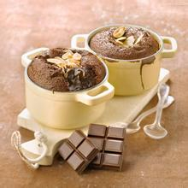
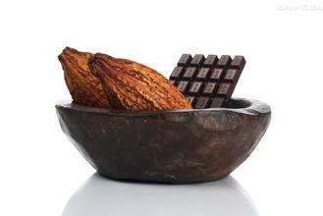
The Maya civilization grew cacao trees in their backyard and used the cacao seeds to make a frothy, bitter drink .

Slide 5
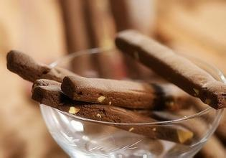

By the 19th century the Swiss had learned how to make it into a solid form which could be eaten rather than drunk.
Chocolate bars rapidly became a popular snack for Europeans and people in most parts of the world.

Slide 6
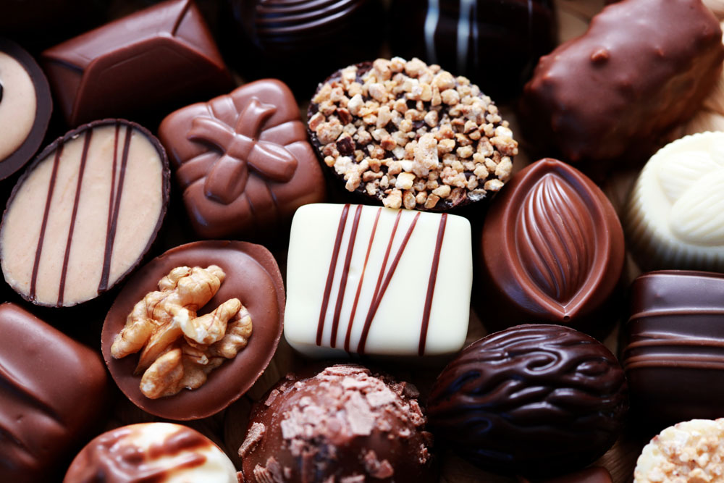
varieties

Slide 7
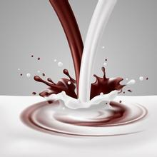
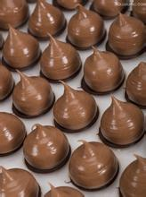
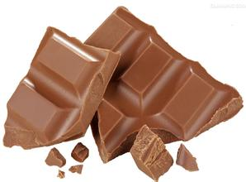
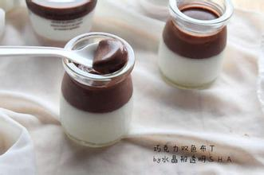
Milk chocolate

Slide 8
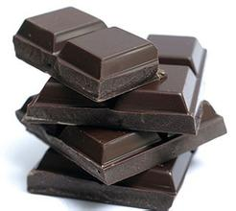
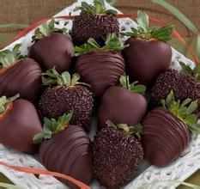
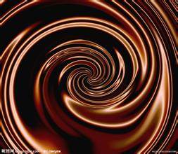
Dark chocolate

Slide 9
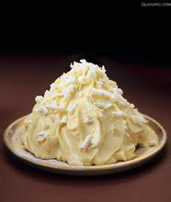
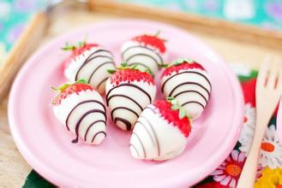
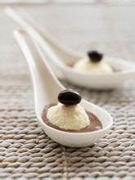
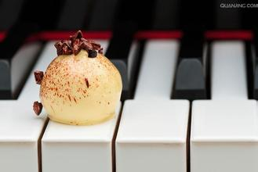
White chocolate

Slide 10
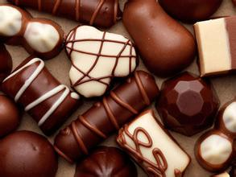
Nut chocolate
Spearmint chocolate
Liqueur chocolate
Mix mix chocolate
Almond chocolate

Slide 11

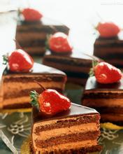
CHOCOLATE CAKE

Slide 12
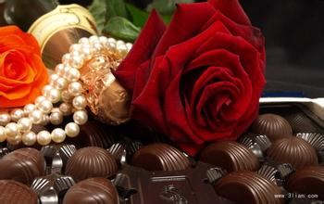
It has always been one of the most popular gifts between lovers, especially on Valentine's Day.

Slide 13
Although its fat content is high, it is no higher than ice-cream and French fries. And recent research has shown that much of the fat content in it cannot be absorbed by the body and 75% of the saturated fat in chocolate contains a substance which actually helps digestion.

Slide 14
However, if you eat too much chocolate, it will make you fat, as is true of many other foods.

Slide 15


Slide 16

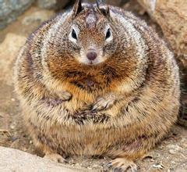
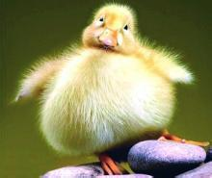
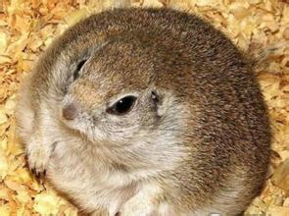
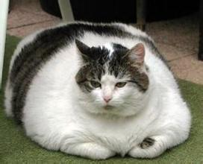

Slide 17
Thank you

