Slide 1

Writing Skills

Slide 2
Teaching goals
-----教学目标
How to make an outline
How to pick out important points
How to write beautiful sentences
How to organize the sentences logically

Slide 3
假设你是李华,你购买了一部某外国公司生产的手机.因有质量问题,要求该公司更换.请根据下列要点,用英文写一封电子邮件.
1.问题: 手机不响铃,不能发短信;该产品已售完,无法更换;型号新,无配件,无法维修.
2.要求: 公司应尽快予以更换.
注意:1.词数为120左右;
2.参考词汇:
配件(spare part)

Slide 4
Task 1 Examine the content carefully
The style:
exposition（说明文）
The main idea:
Present the problems with the phone
and ask for a change
Person:
the first person第一人称
Tense:
the present tense 现在式
and the past tense过去式

Slide 5
Task2 提炼要点,确定重点词汇,划分段落
Important points：three problems plus one demand
要点： 三个问题加一个要求
Point 1:
not ring; not send messages
Point 2：
sold out; not change…for…
或not exchange…for… 或not replace…with…
Point 3：
new model; no spare parts;
repair/fix/maintain
Point 4：
require/request sb. to do sth
或demand of sb. to do sth.

Slide 6
Task 3连词成句
1.手机不响铃,不能发短信
It doesn’t ring . It doesn’t send short messages.
2.该产品已售完,无法更换
The model has been sold out . They can’t change a new one for me.
3.型号新,无配件,无法维修
It is a new model in China. It is impossible to fix it without the right spare parts.
4.要求公司应尽快予以更换
I demand of /require/request your company to change a new one for me as soon as possible.

Slide 7
Task 4 提升句子，组句成篇
注意：灵活运用好句式
一.使用非谓语动词(nonfinite verb)使句子简洁高档
二.巧用倒装(inversion )结构增强句子的表现力
三.尝试多样化表达方式,如：
1.感叹句(the exclamatory)
2.with短语
3.定语从句(the attributive clause )
4.各种名词性从句
5.各种状语从句 (the adverbial clause)

Slide 8
1. 手机不响铃,不能发短信
整合前： It doesn’t ring . It doesn’t send short messages.
整合后：
可以造至少两个并列句(or, meanwhile, either )
a. It can’t ring or send short messages.
b. It doesn’t ring at all and meanwhile it doesn’t send short messages.
（Neither ….nor句式）
c. It can neither ring nor send short messages.
可造至少两个倒装句式（not only…but also , nor, neither ）
d. Not only does it fail to ring, but also it can’t send a message.
e.The mobile phone can’t ring, nor can it send messages.

Slide 9
2.该产品已售完,无法更换
整合前：The model has been sold out . They can’t change a new one for me.
整合后：
a. The new model has been sold out so that they can’t change a new one for me .
b. The model has been sold out, as a consequence, it’s impossible for them to change a new one for me.
(非限制性定语从句 nonfinite attributive clause)
c. The model has been sold out, which makes it impossible for me to have a new one.
（主语从句）
d. The fact that the model has been sold out makes me unable to change it.
（结果状语从句至少两个so that ，as a consequence/result）

Slide 10
3.型号新,无配件,无法维修
整合前： It is a new model in China. It is impossible to
fix it without the right spare parts.
整合后：
a.Since it’s a new model and there’re no spare parts,I can’t get it repaired .
b.So new is its type without any spare parts that I can’t get it repaired.
c.With its new type and no spare parts left, I find it hard to have it repaired.
原因状语从句because，since，as和倒装句各一个 so…that
with结构一个

Slide 11
4.要求公司应尽快予以更换
整合前：I require/request your company to change a
new one for me as soon as possible.
整合后：
宾语从句
To conclude, I demand/require/request that your company should have my phone changed as soon as possible.
用appreciate it if
B. I’d really appreciate it if you could replace it soon.
包含宾语从句、同位语从句、虚拟语气及被动语态的句子
C. I hope that my requirement that you should change a new phone of the same model for me can be satisfied as soon as possible.

Slide 12
5.检查誊写
仔细誊写，保证字迹工整，卷面整洁。

Slide 13
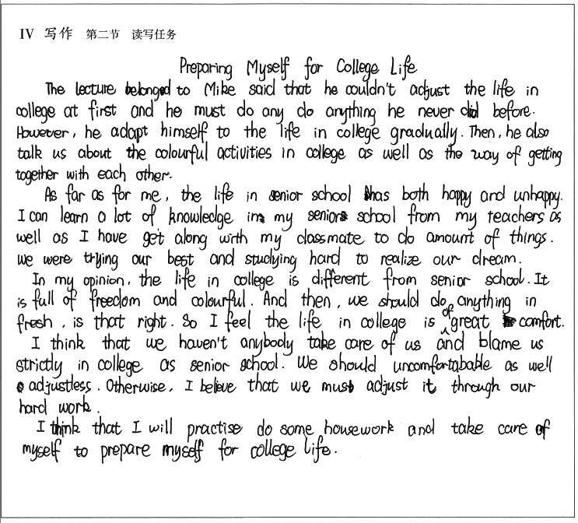
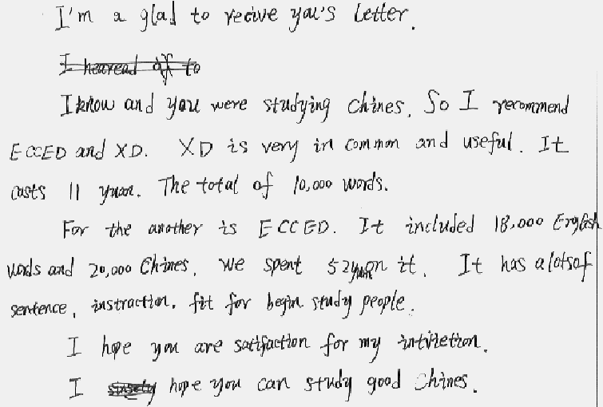
Which one is preferred?

Slide 14
Dear Sir,
……Ten days after that, it didn’t ring or send short messages. Then I took it to the seller, but was told that the model had been sold out and I had to wait at least three months for a new one. Later I went to the repairman. He said since it was a new-model in China, it was impossible to fix it without the right spare parts. I was so desperate on hearing that. How can I wait that long?
Therefore, I require that you send me a new one of the same model within a month.
Thank you for your consideration.
Yours,
Sincerely

Slide 15
summary
书面表达的五个步骤
  仔细审题（4确定）
（1）体裁格式_________
（2）题材内容_________
（3）中心人称_________
（4）主体时态_________
2.提炼要点，确定重点词汇，划分段落
3.连词成句
4.提升句子 组句成篇
5.检查誊写

