Slide 1

英语国际音标

Slide 2
元音和辅音的定义：
发音时声带振 动，呼出的气流通过口腔时不受阻碍，这样形成的语音称为元音。
不论声带振动与否，发音时呼出的气流通过口腔或鼻腔时受到一定的阻碍，这样形成的语音称为辅音。
发音时声带不振动的辅音称为清辅音。
发音声带振动的辅音称为浊辅音。

Slide 3
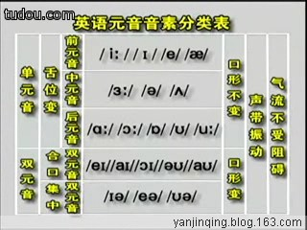
元音音标学习

Slide 4
长元音

Slide 5
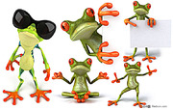
[a:]
[ɔ:]
[3:]
[ i:]
[u:]

Slide 6
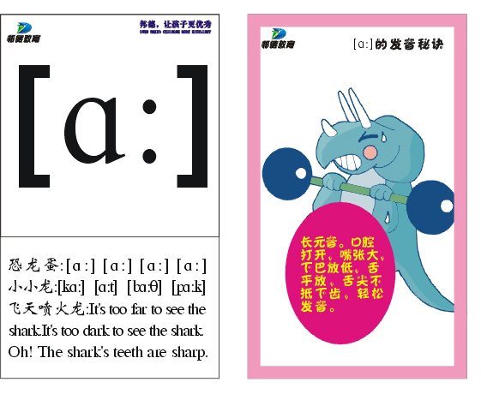

Slide 7
[a:] 发这个音的字母和字母组合a ar au ear
ar: car star arm March scarf garden dark
a: grass plant fast
father last dance
au: laugh aunt
ear: heart

Slide 8
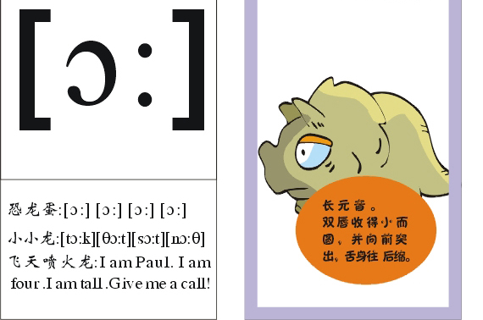

Slide 9
[ɔ:] 发这个音的字母和字母组合a aw al or oor
a: water
aw: draw strawberry
al: ball wall
or: horse corn fork or short
oor: floor door

Slide 10

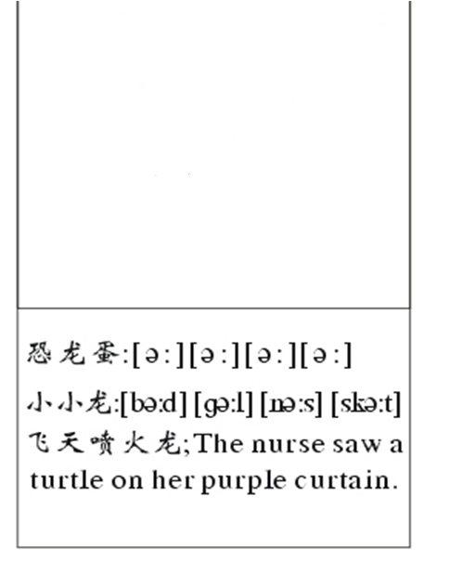

[3:]

Slide 11
[ә:] 发这个音的字母和字母组合er ir ur ear or
er: her serve term
ir: bird girl skirt first
skirt shirt dirty
ur: nurse Thursday turtle
purple curtain
ear: early learn
or: word work world

Slide 12
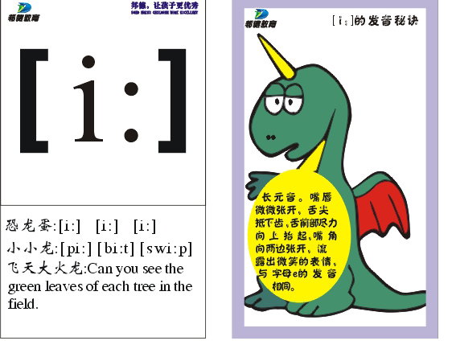

Slide 13
[i:] 发这个音的字母和字母组合e ea ee
e: me be she he we evening
ee: sweet bee sweep sheep see three green
ea: meat leaf sea pea eat clean teach

Slide 14
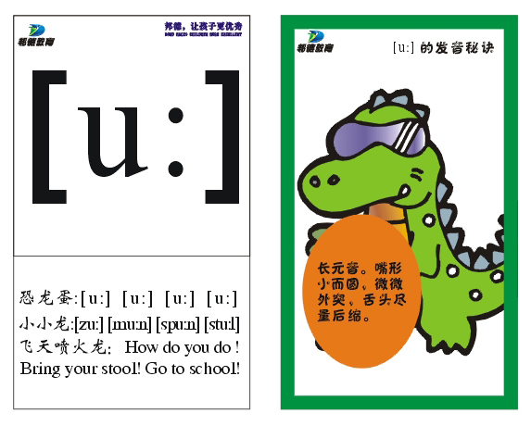

Slide 15
[u:] 发这个音的字母和字母组合o oo ui
o: do who whose
oo: food moon too
ui: fruit juice
u: ruler rude

Slide 16
短元音

Slide 17
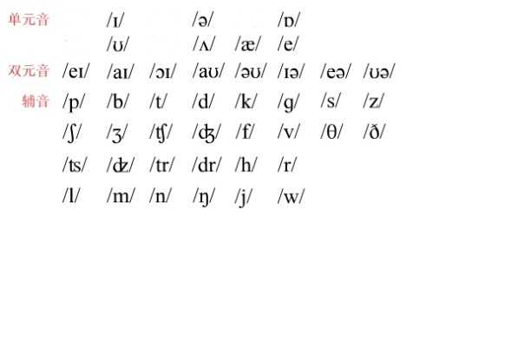
/Λ/
[a:]
[ɔ:]
[3:]
[ i:]
[u:]
/ ә /
/ I /
/æ/
/ e /

Slide 18
[Λ] 发这个音的字母和字母组合o u oo ou
o: son come colour
love money
u: sun nut jump gum brush supper us bus
ou: touch cousin country

Slide 19
[ɔ] 发这个音的字母和字母组合o a
o: fox coffee dog shop
dog doctor long
a: watch

Slide 20
[ә] 发这个音的字母和字母组合ure er ar or a e
ure: picture
er: teacher brother dinner
father sister
ar: sugar
or: doctor
a: panda about above camera sofa China

Slide 21
[i] 发这个音的字母和字母组合i e y ey ay
i: pig fish in fifteen six ship thin
e: begin behind jacket basketball
y: happy heavy busy lorry carry sunny lovely study thirsty twenty thirty windy rainy
ey: monkey money
ay:Sunday Saturday Friday

Slide 22
[u]发这个音的字母和字母组合o oo u
o: woman wolf
oo: look good book
foot wood
u: bull bullet

Slide 23
[æ] 发这个音的字母和字母组合a
a: dad cap cat bad apple bag flag hand rabbit ant black fat
has stand rat map

Slide 24
[e] 发这个音的字母和字母组合e ea
e: egg bell desk leg pet
ten pen
ea: bread head breakfast

Slide 25
双元音

Slide 26
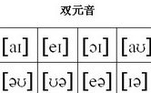


Slide 27
[ei] 发这个音的字母和字母组合a ai ay
a: cake make name game
snake gate lazy
ai: rain train wait
ay: day May play today way

Slide 28
[ai] 发这个音的字母和字母组合i y ie uy
i: kite bike nice tiger write knife
y: by cry fly my sky try why
ie: tie pie
uy: buy

Slide 29
[әu] 发这个音的字母和字母组合o oa ow
o: nose rose poen over
oa: boat coat soap goat
ow: show window snow bowl

Slide 30
[au] 发这个音的字母和字母组合ou ow
ou: house mouse mouth trousers
ow: flower cow how now down

Slide 31
[ɔi] 发这个音的字母和字母组合oi oy
oi: oil boil coin
oy: boy toy

Slide 32
[iә] 发这个音的字母和字母组合ear eer
ear: ear hear tear
eer: deer beer

Slide 33
[uә] 发这个音的字母和字母组合oor our ure
oor: poor
our: tour
ure: sure pure

Slide 34
[eә] 发这个音的字母和字母组合air ear
air: hair chair pair
ear: pear bear wear

Slide 35
元音音标学习

Slide 36

一. 读音标,将下列单词补充完整或写出字母，单 词的音标。
[klaud] [set] [kɔin] [krɔ:s]
c__ __ __d s__ __ c__ __n cr__ __s
[flæg] [trein] [desk] [smail]
f__ __g tr__ __n d__ __ __ s__ __le
［nәuz］ [said] [iә] [kau]
[peә] [puә] [bæt] [wu:d]
[pleisiz] [tuә] ['θiәtә] ［rәuz］
[skweә]

Slide 37
读音标写单词。
[bi:] [bә:d] [si:] [swi:t] [′bizi]
[hә:] [′dɔktә] [′sistә] [li:f] [hi:]
[bru:m] [dɔ:] [sit] [bә:d]
[fut] [wi:] [dɔg] [′sistә]
［pa:st］ [ru:m] [swet] [sit]
[fæt] [gɔt] [cΛp] [shә:t]

