Slide 1

英语国际音标

Slide 2
元 音 | 12个单元音
 | 8个双元音
长元音 | [a:] | [ә:] | [i:] | [ɔ:] | [u:]
短元音 | [Λ] | [ә] | [i] | [ɔ] | [u] | [æ] | [e]
[ai] | [ei] | [ɔi] | [iә ] | [eә ] | [uә ] | [au] | [әu]
辅 音 | 10 对 | 清 辅 音 | [p] | [t] | [k] | [f] | [s] | [∫] | [t∫] | [tr] | [θ] | [ts]
 |  | 浊 辅音 | [b] | [d] | [g] | [v] | [z] | [3] | [d3] | [dr] | [ð] | [dz]
 | 3个鼻音 |  |  | [m] | [n] | [η]
 | 3个似拼音 |  |  | [h] | [r] | [l]
 | 2个半元音 |  |  | [w] | [j]

Slide 3
辅 音 | 10 对 | 清 辅 音 | [p] | [t] | [k] | [f] | [s] | [∫] | [t∫] | [tr] | [θ] | [ts]
 |  | 浊 辅 音 | [b] | [d] | [g] | [v] | [z] | [3] | [d3] | [dr] | [ð] | [dz]
 | 3个鼻音 |  |  | [m] | [n] | [η]
 | 3个似拼音 |  |  | [h] | [r] | [l]
 | 2个半元音 |  |  | [w] | [j]

Slide 4
[t] 发这个音的字母和字母组合 t tt
t: table tea taxi
ticket cat rat fat
tt: butter matter

Slide 5
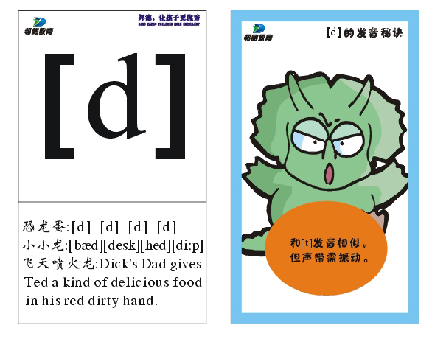

Slide 6
[d] 发这个音的字母和字母组合d ed
d: seed red bed
read cold head
ed: smiled opened played

Slide 7
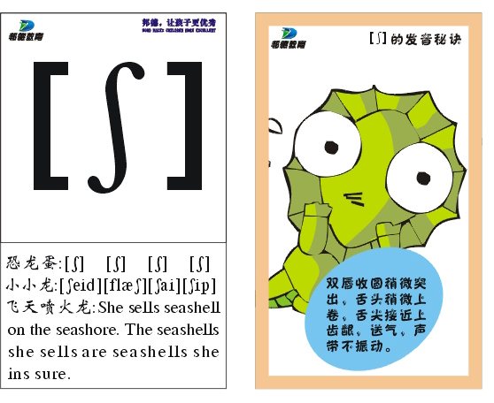

Slide 8
[∫] 发这个音的字母和字母组合s sh
s: sugar sure
sh: ship sheep wash
shop she cash

Slide 9
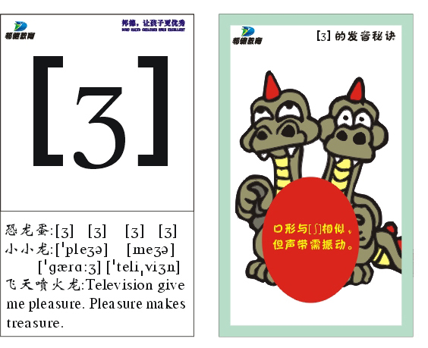

Slide 10
[3]发这个音的字母s
s: television usually garage
measure collision decision
pleasure

Slide 11
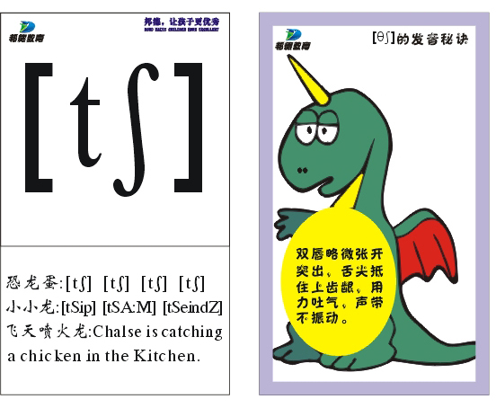

Slide 12
[t∫]发这个音的字母和字母组合ch tch
ch: teacher peach cherry chair
tch: watch match

Slide 13
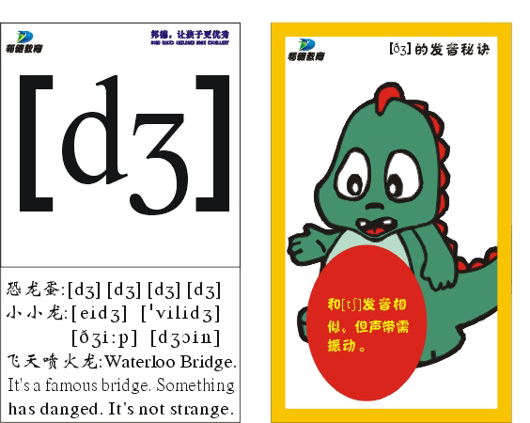

Slide 14
[d3]发这个音的字母和字母组合g j ge
g: ginger giraffe
j: jump job jam
ge: orange cabbage cage

Slide 15
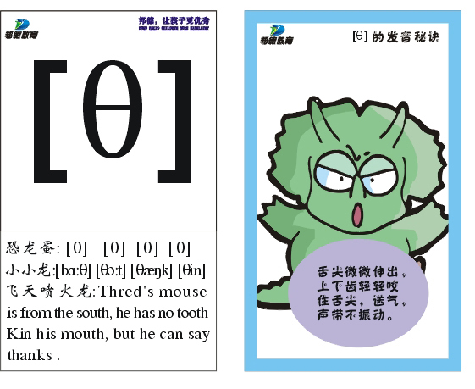

Slide 16
[θ]发这个音的字母和字母组合th
th: three thin third
teeth mouth

Slide 17
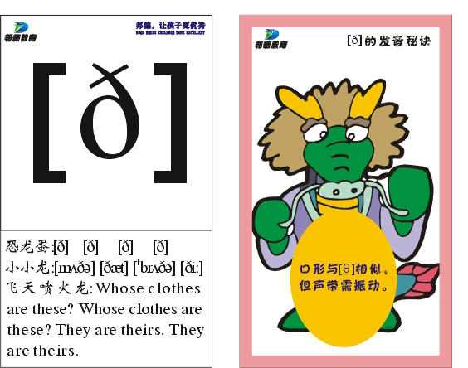

Slide 18
[ð]发这个音的字母和字母组合th
th: father mother brother clothes weather

Slide 19
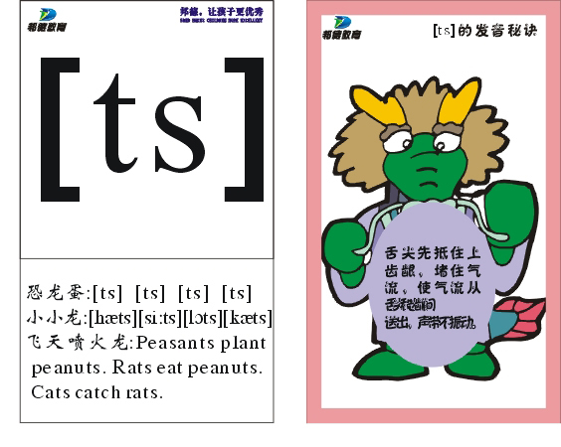

Slide 20
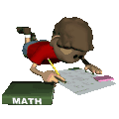
[ts] 发这个音的字母和字母组合ts tes
ts: seats goats coats
cats pets eats
tes: gates kites dates tastes

Slide 21
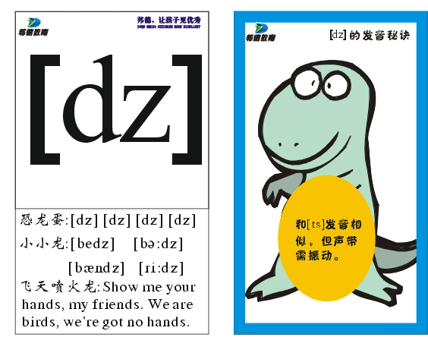

Slide 22
[dz] 发这个音的字母和字母组合ds des
ds: seeds woods friends birds beds
des: rides

Slide 23
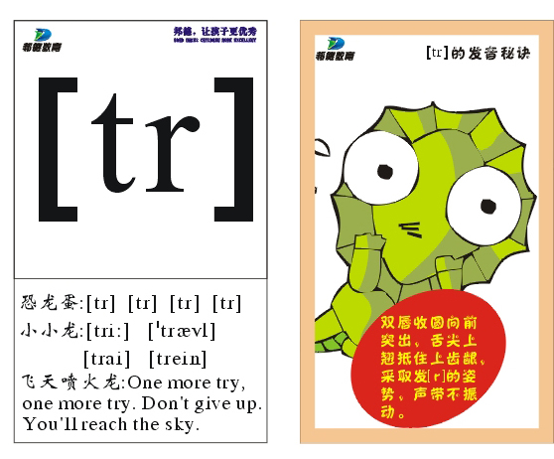

Slide 24
[tr] 发这个音的字母和字母组合tr
tr: tree truck trousers strawberry trick

Slide 25
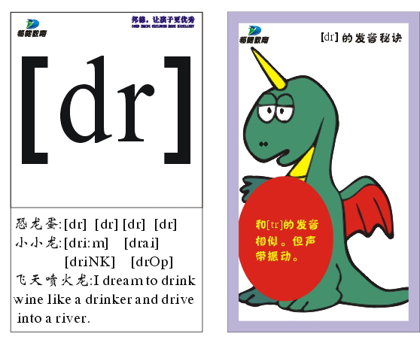

Slide 26
[dr] 发这个音的字母和字母组合dr
dr: draw drink driver
dragon dry

Slide 27
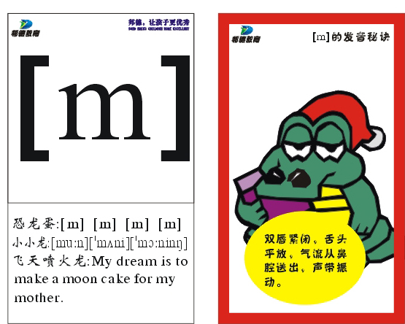

Slide 28
[m] 发这个音的字母和字母组合m mb
m: mouth mouse milk monkey moon
money mum
mb: climb comb thumb

Slide 29
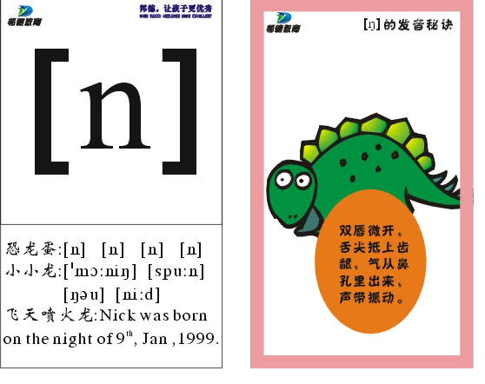

Slide 30
[n]发这个音的字母和字母组合n kn gn
n: noodles train rain plane
kn: knee knife knock
gn: sign

Slide 31
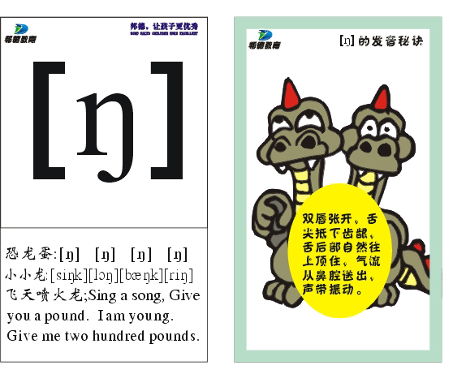

Slide 32
[η]发这个音的字母和字母组合n ng
n: ink bank tank finger
ng: sing hang song king reading running

Slide 33


Slide 34
[j]发这个音的字母和字母组合y
y: yo-yo yogurt
yard yes you
your

Slide 35
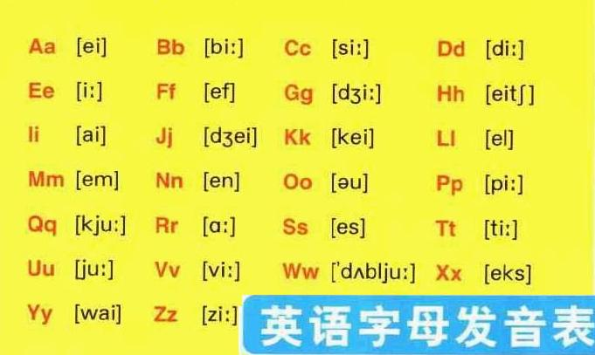
26个字母音标

Slide 36
语音的基本常识
1、音节的划分
一个单词的音标中有几个元音就有几个音节。
2、重读音节
任何双音节或多音节单词的音标中，有重读音节和非重读音节 ，哪一个音节重读，该音节的左上方或该音节的元音上方标有重读符号“'”。

Slide 37
单音节词
meet [mi:t] 遇见 glad [glæd] 高兴的
pen [pen]钢笔 men [men] 男人
ten [ten] 十 pet [pet] 宠物
team [ti:m] 团队 me [mi:] 我

Slide 38
双音节词
[’hɒbɪ] hobby
[fɑ:ðə] father
[’sʌmə] summer
[’sæǀəd] salad
[əʊpən] open
[weðə] weather

Slide 39
多音节词
[’fæməǀɪ] [’kɔmədɪ]
[’kəʊkənʌt] [mi:dɪəm]
[’vɪdɪəʊ] [ɪk’saɪtɪŋ]

Slide 40
3、浊化音
以sp__, st___, sk___开头的单词中，清辅音/p/ /t/ /k/分别要发浊辅音/b/ /d/ /g/。
[skriːm] [ˈskɔlə(r)] [skɔː(r)] [skəʊld]
[spiːtʃ] [spiːd] [speɪn] [ˈspɪrɪt]
[stæmp] [stɑːv] [ˈsteɪtəs] [ˈstʌdɪ]

Slide 41
[ˈtiːneɪdʒə(r)] [səˈspenʃ(ə)n]
[stəˈtɪstɪks] [ˈstrʌɡ(ə)l]
[ʌnɪmˈplɔɪmənt] [trænsˈleɪʃ(ə)n]
[rɪspɔnsɪˈbɪlɪtɪ] [rɪˈkwaɪəmənt]
[rɪˈlaɪəb(ə)l] [ˈnəʊbədɪ]
[fʌndəˈment(ə)l] [ˈfʌŋkʃən]
[ˈpraɪvɪt] [ˈplætfɔːm]
[əbˈteɪn] [ˈswɔləʊ]
[ˈsensɪtɪv] [rɪspɔnsɪˈbɪlɪtɪ]
[ˈprezɪdənt] [prəˈfesə(r)]

Slide 42
[prepəˈreɪʃ(ə)n] [ˈɔpəzɪt]
[pəˈtenʃ(ə)l] [prəˈhɪbɪt]
[ˈeksələnt] [rezəˈveɪʃ(ə)n]
[suːˈpɪərɪə(r)] [ˈnɜːsərɪ]
[reprɪˈzentətɪv] [rekəˈmend]
[ˈriːzənəb(ə)l] [ɔptɪˈmɪstɪk]
[rɪˈleɪʃənʃɪp] [rɪˈmeɪn]
[ɪnfəˈmeɪʃ(ə)n] [ˈhaʊswaɪf]
[pəˈzeʃ(ə)n] [pəˈsentədʒ]
[ˈstændəd] [ˈmʌltɪplaɪ]

Slide 43
[səkˈsesfʊl] [kɪndəˈɡɑːt(ə)n]
[dʒenəˈreɪʃ(ə)n] [ˈfɜːnɪtʃə(r)]
[rɪˈvɪʒ(ə)n] [rɪˈsepʃənɪst]
[səbˈmɪt] [refəˈriː]
[kwɔlɪfɪˈkeɪʃ(ə)n]ˈ [ˈrekəɡnaɪz]
[stɑːˈveɪʃ(ə)n] [ˈmænɪdʒ]
[ˈspɔnsə(r)] [ˈsplendɪd]
[ˈspeʃəlɪst] [ˈspeɪsʃɪp]
[ˈsʌbdʒɪkt] [ˈɡrædjʊəlɪ]
[ˈspɪrɪtʃʊəl] [kwɔlɪfɪˈkeɪʃ(ə)n]

Slide 44
4、定冠词the的读音
e.g. the man
c.f. the old man

Slide 45
5、连读
在一个短语或句子中，如果相邻两词的关系相等密切，而前一个词以辅音结尾，后一个词以元音开头，辅音和元素连在一起读。

Slide 46
英语连读的规则
一.连读的条件：
1.相邻的两词在意义上必须密切相关，同属一个意群。连读所构成的音节一般都不重读，只需顺其自然地一带而过，不可读得太重。
(1)“辅音+元音”型：连读在同一个意群里，如果相邻两词中的前一个词是以辅音结尾，后一个词是以元音开头，这就要将辅音与元音拼起来连读。
eg. I’m~an~English boy.
It~is~an~old book.
Let me have~a look~at~it.
Ms Black worked in~an~office yesterday.
Put~it~on,please. Not~at~all. Please pick~it~up.

Slide 47
2. “r/re+元音”型连读
如果前一个词是以-r或者-re结尾，后一个词是以元音开头，这时的r或re不但要发/r/，而且还要与后面的元音拼起来连读。
eg. They’re my father~and mother.
I looked for~it here~and there.
There~is a football under~it.
There~are some books on the desk.
Here~is a letter for you.
Here~are four~eggs.
But where~is my cup?
Where~are your brother~and sister?
但是，如果一个音节的前后都有字母r，即使后面的词以元音开头，也不能连读。
The black clouds are coming nearer and nearer.（nearer与and不可连读）

Slide 48
3.“辅音+半元音”型连读
英语语音中的/j/和/w/是半元音，如果前一个词是以辅音结尾，后一个词是以半元音，特别是/j/开头，此时也要连读。
eg. Thank~you.
Nice to meet~you.
Did~you get there late~again?
Would~you like~a cup~of tea？
Could~you help me, please?
“音的同化”—常把/d/+/j/读成/dV/，did you听上成了/dIdVu/，would you成了/wudVu/，could you成了/kudVu/。

Slide 49
4.“元音+元音”型连读:如果前一个词以元音结尾，后一个词以元音开头，这两个音往往也要自然而不间断地连读到一起。
eg. I~am Chinese.
He~is very friendly to me.
She wants to study~English.
She can’t carry~it.
The question is too~easy for him to answer.

Slide 50
5.当短语或从句之间按意群进行停顿时，意群与意群之间即使有两个相邻的辅音与元音出现，也不可连读。
Is~it a~hat or a cat?（hat与or之间不可以连读）
There~is~a good book in my desk. （book与in之间不可以连读）
Can you speak~English or French? （English与or之间不可以连读）
Shall we meet at~eight or ten tomorrow morning? （meet与 at，eight与or之间不可以连读）
She opened the door and walked~in. （door与and之间不可以连读）

Slide 51
二.失去爆破: 6个爆破音有3对/p/，/b/; /t/，/d/; /k/，/g/
失去爆破，又叫不完全爆破，就是在某些情况下，只须做出发音的准备，但并不发音，稍稍停顿后就发后面的音。
(1)“爆破音+爆破音”型
6个爆破音中的任意2个相临时，前一个爆破音会失去爆破，即由相关的发音器官做好这个发音的姿势，稍做停顿后即发后面的爆破
eg. The girl in the re(d) coat was on a bla(ck) bike jus(t) now.
The bi(g) bus from the fa(c) tory is full of people.
Wha(t) time does he get up every morning?
This is an ol(d) pi(c)ture of a bi(g) car.
The ol(d) do(c)tor has a ca(t), too.
We’re going to work on a farm nex(t) Tuesday.
What would you like, ho(t) tea or bla(ck) coffee?
It’s a very col(d) day, but it’s a goo(d) day.
You can put i(t) down in the bi(g) garden.
I bought a chea(p) book, but it’s a goo(d) book.

Slide 52
(2)“爆破音+摩擦音”型:如果前面是爆破音，其后紧跟着某些摩擦音（如/f/，/s/，/W/，/T/等），那么前面那个爆破音仅有十分轻微的爆破，而后面那个摩擦音则要完全爆破。
eg： Goo(d) morning, Mr. Bell.
Uncle Li’s fa(c)tory is qui(te) near to the cinema.
I wen(t) there alone a(t) nine las(t) night.
-Do you know his bi(ke) number? -Sorry, I don’(t) know.
The forty-firs(t) lesson is qui(te) difficult.
Goo(d) luck, Lin Tao.

Slide 53
Liason 连读
1. Sit on the chair 2. without any difficulty
3. in a minute 4. a woman of forty
5. best of all 6. arrive in the city
7. at eight o’clock 8. an old man and a girl
9. ask any person 10. walk across the street
11. on a foggy day 12. fall in the river
13. in our classroom 14. talk with a friend of mine
15. a student in the English Department

Slide 54
16. tell us a story 17. find it in my desk
18. waited and waited 19. run after it
20. at the end of the street 21. here and there
22. take care of it 23. after a while
24. take for example 25. for an hour
26. a pair of trousers 27. wait for a student
28. find the answer after all
29. put more on her plate
30. sit at the other end of the room

Slide 55
31. can’t hear it 32. no air and water
33. the other answer 34. 150 kilometers per hour
35. a fire in a forest 36. discover a new star
37. doctor and nurse 38. far easier than that
39. the owner of the house 40. the paper in the desk

Slide 56
1. I don’t understand the theory at all.
2. Jane has saved a lot of money.
3. It isn’t our mistake.
4. My mother came and opened the door.
5. Instead of a shirt, Tom bought a jacket.
6. There was a man and a woman sitting behind me.
7. I shall graduate from middle school in one and a half years.
8. Don’t let him in while I’m reading.
9. He is a tall and handsome young man.
10. When I went into my office, he was talking with a friend of his.

Slide 57
11. While I was waiting for our bus, the rain stopped.
12. There is only one hospital in the town.
13. Perhaps that pair of shoes will fit me.
14. He came in and asked for a cup of coffee.
15. Here is your bag.
16. He is standing at the other end of the bridge.
17. There are no clean glasses in the kitchen, we have used them all.
18. Could you open the door for us?
19. He didn’t finish his work until after eight yesterday evening.
20. Don’t worry, we’ll find the answer after all.

Slide 58
21.Columbus thought he had arrived in India.
22.I remember going into the camp and getting a hot meal and clean clothes.
23.You need to work at it.
24.I made enough for an army.
25.I’ll make you two fried egg.
26.The same shift on Tuesday.
27.Her last question is about her other interest.
28.I hope your friend sends in an application.
29.They have their own special characteristics.
30.The other waiter hid the bottle I’d opened wrongly.

Slide 59
36.When you get there, radio Ginger and tell him to come.
37.Sport balloon flights are best early in the morning or late in the afternoon when the wind is light.
38.The flight recorder of the DC10 airliner which crashed in the Antartic a fortnight ago.
39.Fifteen people are to appear in court in Manchester.
40.The trouble began when groups of rival supporters whose teams had both been playing London clubs began to insult each other.

Slide 60
31.This gas will put anyone to sleep for exactly three minutes.
32.You’re going to go round to the manager’s desk and steal all the
money.
33.I think it’s risky.
34.If you walk out with 50,000 pounds under your arm, somebody will surely notice you.
35.You go into the bank with a motor-cycle helmet on, and a black rubbish bag in your pocket.

Slide 61
  41. Would you like a weekend in Las Vagas?
  42. Mary stopped outside a shoe shop and looked in the window.
  43. When an atom is divided, heat appears.
  44. Talk of a quick election was pure speculation.
  45. He hoped it would lead to a basis for negotiation.

Slide 62
  46. How did you find it at first being stared at all day?
  47. People weren’t aware in a scientific way of the role of different micro-organisms and enzymes in producing different types of cheese.
  48. Cheese started being made on a large scale in factories.
  49. They might not become great artist or composers.
  50. It suddenly struck us that somebody must have taken this money.

Slide 63
51. The point is that his university life might not have been so difficult if his ability has been recognized sooner.
52. I knew it’s sudden, but this is an important opportunity.
53. Well, I wasn’t clear about my future.
54. It’s rather cold out here on the deck.
55. Mike and I had a hamburger this afternoon and we talk.
56. You couldn’t pick a finer medical school than Michigan.
57.The small producer working from his farm dairy continued to exist and still exist today.

