Slide 1

Module 4
Sandstorms in Asia

Slide 2
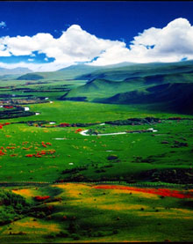
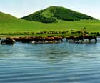
Please look at these pictures.
How beautiful they are !

Slide 3
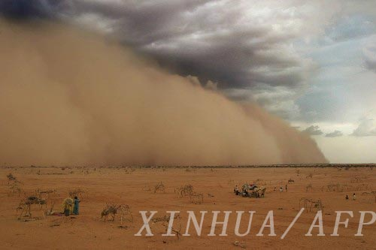
But one day something happened！

Slide 4
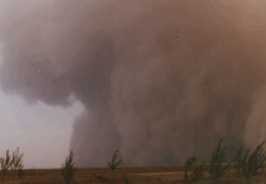

Slide 5
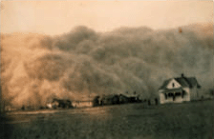

Slide 6
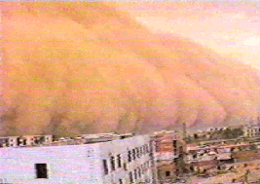
What natural disaster it is?
It is a sandstorm. It is very frightening.

Slide 7
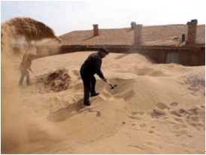
The sand almost buries the house.

Slide 8
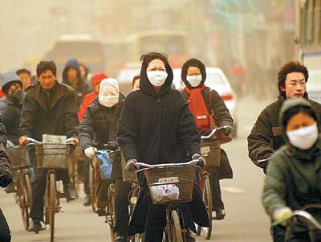
cycle/wear/mask

Slide 9
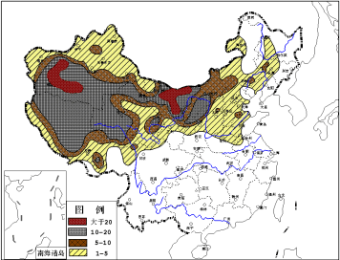
Inner Mongolia has many sandstorms
every year. It is far away from the sea, so it is an inland region.

Slide 10
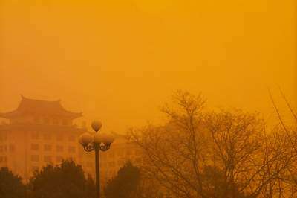
INTRODUCTION
Look at the picture below and complete the passage.
below bury
last sandstorm
frightening

Slide 11
1
p31
There has been a _________. It _________ for ten hours and was very __________. The wind was ________ the sand high around the houses, and some cars were ______by the sand.
sandstorm
has lasted
frightening
blowing
buried

Slide 12
Words preview
mass
campaign
dune
desertification
process
adj.大量的，大规模的
n.战役，活动
n.沙丘
n.(土地的)沙漠化
n.进程，过程

Slide 13
citizen
dust
forecast
strength
cycle
mask
n.公民，市民
n.沙尘，灰尘
vt.预报，预告
n.力量，力气
vi.骑自行车
n.面罩

Slide 14
VOCABULARY
2
p33
citizen, cycle, dust, expect, forecast, process, situation

Slide 15
1 to ride a bicycle ______
2 someone who knows a lot about a subject
______
3 things that happen one after another
______
4 someone who lives in a town or city.
_____
5 very small bits of dirt or earth _____
6 to say what will probably happen ______
cycle
expert
process
citizen
dust
forecast

Slide 16
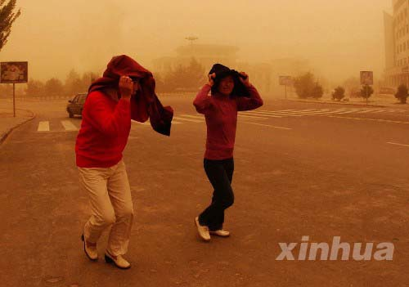
Pre-reading
Look at the photo and answer the questions.
MODULE4

Slide 17
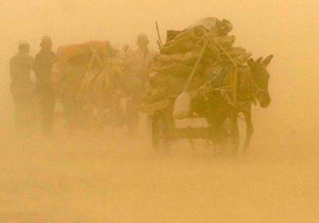
sandstorm

Slide 18
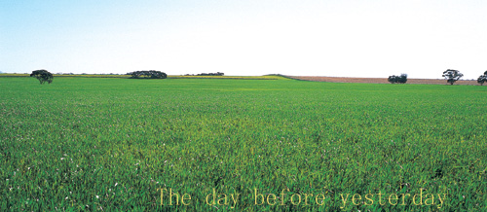
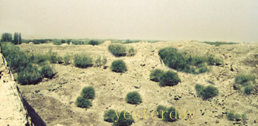
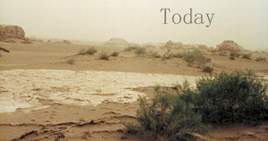
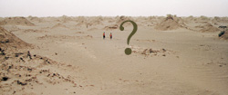
The day before yesterday
Yesterday
Today
Look at these pictures. Now work in pairs. Discuss the following statements and decide which statement is false.

Slide 19
Discuss the following statements.
1 Sandstorms begin in desert areas.
2 Deserts are created by climate changes.
3 Deserts are also created because people cut down trees and dig up grass.
4 Sandstorms from Asia have blown across the Pacific Ocean to America.

Slide 20
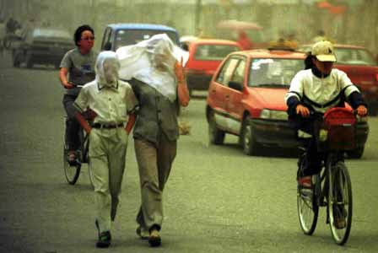
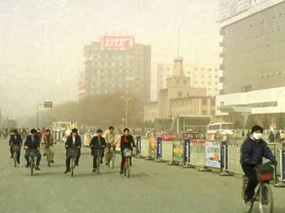
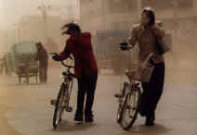
Fast-reading
Look at the photos. Read the text quickly and answer the questions.

Slide 21
1. Terrible sandstorms are coming around the world.
What is happening?
2.Because climate changes and people cut
down trees and dig up grass, land
becomes desert, then desertification
happens.
2.Can you explain why the desertification happen?
3.Traffic moves very slowly because the
thick dust makes it difficult to see.
3.What happens to traffic when
sandstorms take place? Why?
4.Experts advise people not to go out. If
cycling in the sandstorm, one had
better wear a mask.
4.What shall people do if a
sandstorm arrives?

Slide 22
Detailed-reading
How many parts can this article be divided into ?
Part I (para.1) :
major disaster in Asia- sandstorm
Part II (para.2-5) :
description, cause, influence, suggestion
Part Ⅲ (para.6):
measures

Slide 23
mass
1.A government campaign has been started to
help solve the sandstorm problem.
2.The winds in a sandstorm can sometimes
prevent you from seeing the sun.
3.Northwest China is the sandstorm centre in
Central Asia.
4.The Chinese Central Weather Station can
only forecast a sandstorm some months
before it arrives.
5.It is frightening to be cycling in a sandstorm.
6.The government is planting trees to the east
of Beijing to prevent the desert coming
nearer.
F
T
part of
F
weeks
F
T
west
F

Slide 24
 | sandstorm
Definition (定义)
Features (特点)
Places
Reason for increase
Measures (措施)
strong, dry winds that carry sand
so thick that…; strong enough to …
Central Asia, North America, Central Africa and Australia
desertification; climate changes; cut down; dig up
Government is planting trees. Experts advise people not to go out when it comes.

Slide 25
Post-reading
Let’s talk about sandstorms.
1. What are sandstorms ?
2. Where are major sandstorms in China?
They are strong, dry winds that carry sand.
Gansu province, western and northeast Inner Mongolia.

Slide 26
世界四大沙尘暴多发区
世界上共有四大沙尘暴多发区,分别是:
北美（美国西部和墨西哥的北部）、
澳大利亚、
中亚（亚洲中部的五个国家）、
中非地区（非洲撒哈拉沙漠南缘地区）。

Slide 27
3. How will a sandstorm influence us?
It’s dangerous to go out.
People have to wear masks.
It delays the flights.
Cars slow down because of it.

Slide 28
4. What do you think is the cause of
sandstorms?
1. Serious air and water pollution.
2. Cutting down too many trees.
3. Desertification.
4. The growing population of the world.
5. Climate changes.
6. Waste in the use of water.
7. High temperature and little rain.

Slide 29
5. How can we prevent sandstorms?
1. Control water and air pollution.
2. Build green fences along the desert.
3. Forecast sandstorm’s time to
prevent disaster.
4. All countries work together to make
a plan to control and prevent
sandstorms.

Slide 30
中国政府防治沙尘暴的四大对策
一、在北京北部的京津周边地区建立以植树造林为主的生态屏障；
二、在内蒙古浑善达克中西部地区推动以退耕还林为中心的生态保护带。坚决贯彻退耕还林还草、严禁过度放牧，重点恢复和保护草地资源，适度建设防风林；

Slide 31
三、在河套地区和沙化土地地区以保护水资源和天然绿洲为中心，控制沙化土地扩大，保住天然绿洲，逐步扩大人工林；
四、蒙古国南部荒漠地区是现在和将来长期影响我国的主要沙尘暴源区，因此应尽快建立一个与蒙古国长期合作防治沙尘暴的计划框架。

Slide 32
5
p33
1 Weather experts have f________ another big sandstorm in a week’s time.
2 It’s f__________ to be outside in a sandstorm.
3 I was in a big storm. Luckily, we all s_______.
orecast
rightening
urvived

Slide 33
5
p33
4 There’s a lot of d____ on the flood.
5 Sandstorm is a long p_______ that take many years.
6 Many Beijing c______ cycle to work.
ust
rocess
yclists

Slide 34

Homework
Think about
As a senior high student, what should we do to improve our environment?

