Slide 1

Module 4
Sandstorms in Asia

Slide 2
Module 4 Grammar
Infinitive
1.不定式的用法
2.不定式的时态与语态

Slide 3
1. 作主语
1. To master a foreign language is
necessary for a college student.
2. It is good manners to help people in trouble.

Slide 4
2. 作表语
Your job is to wash dishes.
All I did was (to) give him some advice.
当作表语的不定式解释主语中do的意义时，to可以省略。

Slide 5
3. 作宾语
She promised to give him a chance.
agree, demand, ask, decide, expect, hope, want, offer, plan, pretend, promise, afford, prepare, refuse, manage, fail, dare, fear, swear等动词后面均可直接跟不定式作宾语。

Slide 6
少数介词后面可跟不定式作宾语
1.It has no choice but to lie down and sleep.
2.They didn’t open their mouths except to complain.

Slide 7
当句子中的主动词为do时, but, except后的动词不定式省去to;
can’t but, can’t choose but, can’t help but, do nothing but, rather than, had better之后省略to.

Slide 8
He does nothing but play all day.
At the news she didn’t say anything but to cry.
He can’t choose but do it.
There’s nothing to do except/but wait till it stops raining.

Slide 9
4. 作宾语补足语
The teacher told his students to pay more attention to their pronunciation.
I would like the problem to be discussed at the next meeting.

Slide 10
A. ask, tell, order, command, beg, get, request, require, invite, force, permit, cause, forbid, allow, wish, want, expect, encourage, advise, persuade, warn, would like等动词可以接带to的不定式作宾补。

Slide 11
B. think, consider, believe, suppose, know, feel, find, understand等动词后常接to be + adj. 作宾补。
We all know him to be a good player.

Slide 12

The flu is believed _____ by viruses that like to reproduce in the cells inside the human nose and throat. (04sh)
A. causing B. being
C. to be caused D. to have caused

Slide 13
C. 不定式作补语，可根据需要在前加
how, where, when, what等疑问词。
Could you tell me how to repair the machine?
No one told me where to find him.
Please show us what to do with these sentence patterns.

Slide 14
D. see, hear, watch, feel, notice, let, make, have等后跟不定式作宾补时, 不加to, help后可加可不加.
I never let my child stay in the house all day.
Have him come in, please.
I heard her say that she’d like to go to the concert.

Slide 15
5. 作主语补足语
I was asked to help him with his lessons.
主语补足语就是主动语态中的宾语补足语
She was seen to go out a minute ago.
He was made to give up drinking.
He was heard practising singing a song this time yesterday.

Slide 16
6.作后置定语
She was the first girl to work out the problem. (主谓关系)
He has an important meeting to attend. (动宾关系)
He keeps his promise to write to us regularly. (同位关系)

Slide 17
不定式作宾语，动词如果不是及物动词，后面应加必要的介词
The ice is too thin for us to walk on.
I hired a room to live in when in the US.

Slide 18
7. 作目的状语， to可用in order to或so as to代替（so as to 不能置于句首）。
She got off the train in Beijing to see a friend.
Some scientists went to Germany to attend a medical conference.
They started very early in order not to miss the train.

Slide 19
8. 作结果状语
不定式作结果状语表示出乎意料的结果, 且不定式前常有only, never, 强调惊讶或失望。
V-ing作结果状语强调一种必然的因果关系。

Slide 20
He hurried to his house, only to find it had been broken into.
I stood there, never to be feeling so stupid.
Her parents died, leaving her an orphan.
There was a tornado yesterday, causing
100 deaths.

Slide 21
不定式的复合结构
1. 疑问词+不定式 的复合结构
When to start has not been decided yet.
The problem is how to persuade him to change his mind.
主语
表语

Slide 22
We must learn what to do in face of difficulties.
I wonder if you could tell me how to get to the station.
宾语
宾语补足语

Slide 23
2. 带有逻辑主语的结构
It’s kind of you to lend me such a beautiful necklace.
It’s important for us to master a foreign language.
The first thing for us to do is to clean the room.
主语
主语
定语

Slide 24
It is + adj. + of sb. to do
It is + adj. + for sb. to do
此结构中的形容词说明逻辑主语的特征，可作逻辑主语的表语
此结构中的形容词说明句中行为动词的特征

Slide 25
It is foolish of you to say such words.
You are foolish to say such word.
It is necessary for us to learn our lessons well.
We are necessary to learn our lessons well.

Slide 26


Slide 27
不定式 | 主动式 | 被动式
一般式
完成式
进行式 |  | /
完成进行式 |  | /
to do
to be done
to have
been done
to have done
to be doing
to have
been doing

Slide 28
1) 不定式的一般式
不定式的一般式所表示的动作通常与主要谓语的动作同时或几乎同时发生，或是在它之后发生。
1. He seems to know this.
2. They invited us to go there this
summer.
3. I expect to hear from you soon.

Slide 29
2) 不定式的完成式
不定式的完成式所表示的动作在谓语所表示的动作之前发生。
1. She seemed to have heard about
this matter.
2. I am sorry to have kept you waiting
so long.

Slide 30
3) 不定式的进行式
不定式的进行式表示正在进行的与谓语动词同时发生的动作。
1. The boy pretended to be listening
when the teacher looked at him.
2. He seems to be eating something.

Slide 31
4) 不定式的完成进行式
如果不定式表示的动作在谓语动作之前一直进行，就需要用完成进行式。
1. They are said to have been working
in Tibet for 20 years.
2. We are happy to have been helping
each other these days.
3. I’d like to have been told the news
earlier.

Slide 32
5) 不定式的被动式
当不定式逻辑上的主语是这个不定式所表示的动作的承受者时，不定式一般要用被动形式。
The meeting to be held tomorrow is very important.
I had to shout to be heard.

Slide 33
6) 动词不定式的否定
由not或never加不定式构成。
Try not to be late again next time.
He wished us never to meet her again.

Slide 34
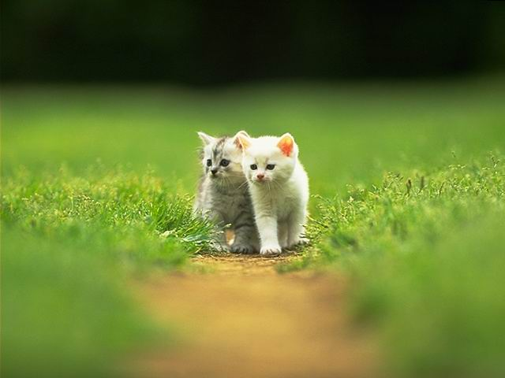


Slide 35

The purpose of new technologies is to make life easier ________ it more difficult. (1999)
A. not make B. not to make
C. not making D. do not make
2. I’ve worked with children before, so I know what ______ in my new job. (2000)
A. expected B. to expect
C. to be expecting D. expects

Slide 36
3. Charles Babbage is generally considered _____ the first computer. (98)
to invent B. inventing
C. to have invented D. having invented
4. Allen had to call a taxi because the
box was _______ to carry all the way
home. (2003)
much too heavy B. too much heavy
C.heavy too much D. too heavy much

Slide 37
5. The boy wanted to ride his bicycle in the street, but his mother told him
______. (1995)
A. not to B. not to do
C. not do it D. do not to
6. Little Jim should love _____ to the
theatre this evening. (1997)
A. to be taken B. to take
C. being taken D. taking

Slide 38
7.There are five pairs ___, but I’m at a
loss which to buy. (1999上海)
to be chosen B. to choose from
C. to choose D. for choosing
8. ________ late in the afternoon, Bob
turned off the alarm. (2001)
A. To sleep B. Sleeping
C. Sleep D. Having sleep

Slide 39
9. With a lot of difficult problems
______, the newly-elected president
is having a hard time. (2002)
A. settled B. settling
C. to settle D. being settled

Slide 40
10. She will tell us why she feels so
strongly that each of us has a role
______ in making the earth a better
place to live. (2003)
A. to have played B. to play
C. to be played D. to be playing

Slide 41
11. In order to gain a bigger share in the international market, many state-run companies are trying ______their products more competitive. ( 2002)
to make B. making
C. to have made D. having made

Slide 42
12. The teacher asked us _____ so
much noise. (2003)
A. don't make B. not make
C. not making D. not to make

Slide 43

高考链接
1. —The last one _______ pays the meal.
—Agreed! (2007全国I)
A. arrived B. arrives
C. to arrive D. arriving

Slide 44
高考链接
2. There is nothing more I can try ______ you to stay, so I wish you good luck. (2007上海)
A. being persuaded B. persuading
C. to be persuaded D. to persuade

Slide 45
高考链接
3. My parents have always made me ____ about myself, even when I was twelve. (2007江苏)
A. feeling well B. feeling good
C. feel well D. feel good

Slide 46
高考链接
4. When asked why he went there, he said he was sent there for a space flight. (2007江西)
A. training B. being trained
C. to have trained D. to be trained

Slide 47
高考链接
5. the safety of gas, the government has checked the city’s gas supply system thoroughly. (2007上海春)
A. To ensure B. Ensuring
C. Having ensured
D. To have ensured

Slide 48
高考链接
6. The children talked so loudly at dinner table that I had to struggle ______.(2007 浙江)
A. to be heard B. to have heard
C. hearing D. being heard

Slide 49
高考链接
7. The crowd cheered wildly at the sight of Liu Xiang, who was reported ______ the world record in the 110-meter hurdle race. (2007 辽宁)
A. breaking B. having broken
C. to have broken D. break

Slide 50
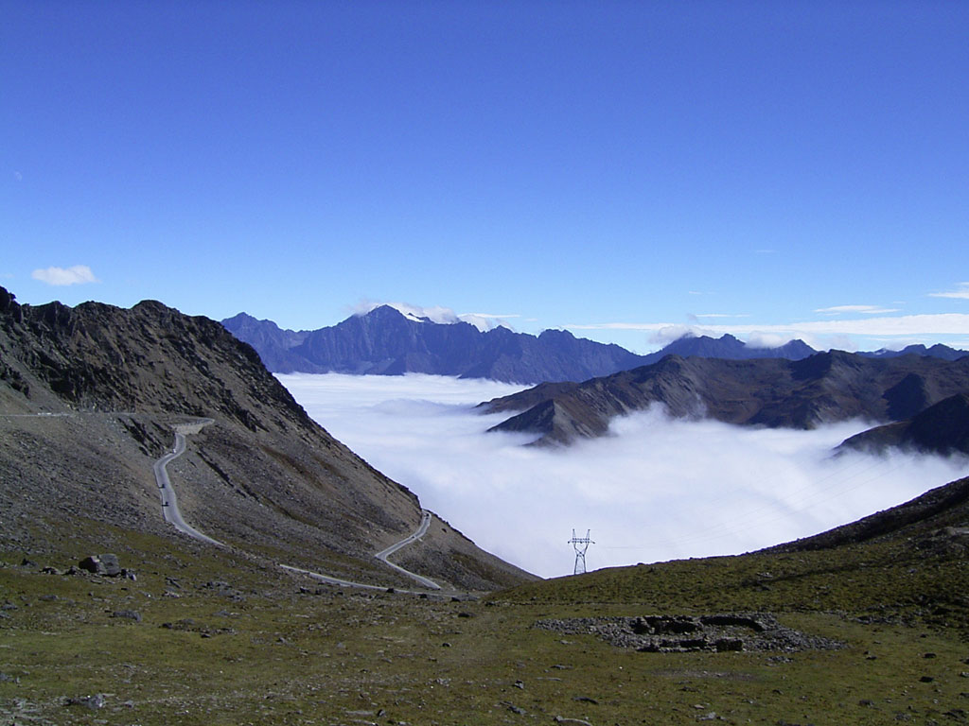

Exercises

Slide 51


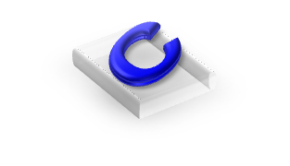

1.The will to live helps a patient ______.
A. to recover B. to die
C. recovering D. dying
2.Life is ______ short to waste.
A. to B. too C. two D. twice
3.It’s not good ______ a man to be alone.
A. to B. of C. for D. with
4.It ______ the whole life to learn how to
live.
A. take B. took C. taken D. takes

Slide 52

C
5.What a joy ____ is to swim in this big river!
A. it’s B. its C. it D. itself
6.They haven’t decided ______ to go.
A. where B. what
C. whatever D. weather
7.Mother allows him ______ the TV play
after he has finished his homework.
A. seeing B. to watch
C. watch D. watching
A
B

Slide 53
D
8.Would you be _____ to open a window?
A. enough kind B. kindly enough
C. enough D. kind enough
9.He tried _____ but she refused _____.
A. to explain; to listen
B. to explain; listening
C. explaining; to listen
D. explaining; listening
10. John is easy____.
A. to get along B. to be got along
C. to get on with D. to be got on with
A
C

Slide 54

11.They don’t allow these books _____ out of the reading room.
A. to take B. to be taken
C. to bring D. to be brought
12.There’s no choice but _____ till it stops
raining.
A. wait B. waiting C. waited D. to wait
13.The pickpocket was observed ____ the
man’s wallet.
A. take B. taken C. took D. to take
B
D
D

Slide 55
14.He is said ______ abroad.
A. to have been sent B. to have sent
C. have been sent D. have sent
15.When the teacher passed him, he
pretended _____ the novel.
A. not to be reading B. not to be seeing
C. to be not reading D. to be not seeing
16.Andrew was the second person _____.
A. to interview B. interviewing
B. interview D. to be interviewed
A
A
D

Slide 56
17.It was ______ of you to give up what you
rightly owned.
A. foolishly B. foolish C. impolite D. cleverly
18.I prefer ______ rather than ______ a long
chat with him.
A. to do some reading, have
B. read, to have
C. do some reading, to have
D. to read, have
19.The chair looks rather hard, but in fact it
is very comfortable to______.
A. sit B. be sat C. be sat on D. sit on
B
A
D

Slide 57

20. Mrs. Green warns her daughter
______ after drinking.
A. to never drive B. never drive
C. never to drive D. never driving
21.The houses ______ are for the
teachers and construction work will
soon start.
A. built B. to be built
C. to build D. being built
C
B

Slide 58

22.The missing girl was last seen
______ in that shop.
A. doing some shopping
B. to be doing some writing
C. do some shopping
D. to do some talking
23.He would love ______ to your
birthday party but he had to work
extra hours to finish a report.
A. going B. having gone
C. to go D. to have gone
A
D

Slide 59
24.The problem ______ next month has
something to do with our daily life.
A. discussed B. to be discussing
C. being discussed D. to be discussed
25.—Have you any letters ______, sir?
— No, thanks.
A. to type B. to be typing
C. to be typed D. typed
D
C

Slide 60
26.Every minute is made full ______ of
______ our lessons well.
A. to use, study B. use, studying
C. use, to study D. used, studying
27.Don’t take the medicine. It can’t help
______ rid of your cough.
A. getting B. to get C. to getting D. gets
28.Rather than ______ on a crowded bus, he
always prefers ______ a bicycle.
A. ride, ride B. riding, ride
C. ride, to ride D. to ride, riding
C
B
C

Slide 61

29. “He is too anxious to leave.”
Of the following which translation is right?
A.他非常急切地想走 B.他非常急而不能走
C.他不急着走 D.他不急却要走
30.Mary happened ______ when they speak
ill of her.
A. to be past B. to be passing
C. passing by D. to pass beside
A
B

