Slide 1
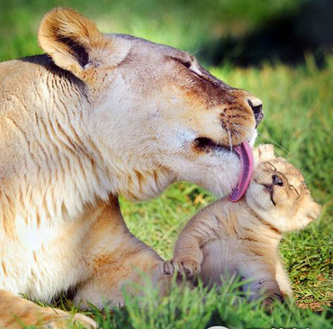
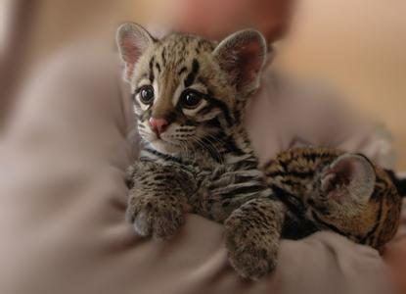
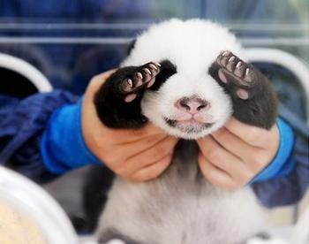
Unit 4
Wildlife protection

Slide 2
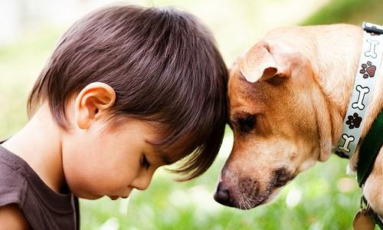
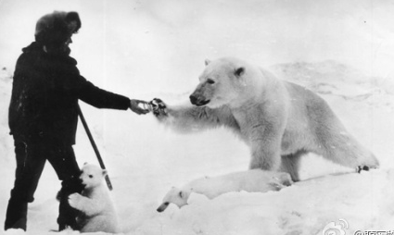
HOW DAISY LEARNED
TO HELP WILDLIFE

Slide 3

(1) Choose the best answer.
The passage is about ______.
A. some protection of wildlife
B. a journey of a flying carpet
C. Daisy’s wonderful experience with
some animals

Slide 4

(2) Fill in the table. Test your reading speed.
 | Animals she met | Places she went
First visit
Second visit
Third visit
antelope
Tibet
elephant
Zimbabwe
monkey
Rainforest

Slide 5
(1)Write down the main idea and the supporting details in the correct boxes.
P272
Paragraph | Main idea | Supporting details
1
1 Animal: Tibetan antelope
2 Situation: being hunted for the fur under its stomach
3 Result: numbers are decreasing rapidly
Why we need wildlife protection

Slide 6
Paragraph | Main idea | Supporting details
2
A good example of wildlife protection
1 Animal: elephants in Zimbabwe
2 Situation: previously hunted with numbers decreasing rapidly
3 Result: protection by farmers who make money from tourism

Slide 7
Paragraph | Main idea | Supporting details
3 and 4
1 Animal: a millipede from tropical rainforest
2 Situation: produces a drug naturally which can protect us from mosquitoes
3 Result: Daisy plans to tell WWF about the drug
What we can get from wildlife protection

Slide 8


(2) Choose the best answer.
1. What can be inferred from the elephant’s words “Have you come to take my photo”?
A. It thinks itself a beautiful animal.
B. Elephants are friendly to human beings.
C. Money from tourists went to the large
tour companies.
D. Now many more tourists come to take
its photos rather than hunt it.

Slide 9
2. What did Daisy learn from her experience?
A. Some animals were becoming
endangered as a result of humans’
hunting.
B. Wildlife should be helped and
protected by us.
C. Humans and wildlife can benefit
each other in many ways.
D. All of the above.

Slide 10
3. Which is the most probable reason why the monkeys in the rainforest are dying out?
A. There are too many tourists.
B. They are being hunted and killed.
C. Their habitats are being destroyed.
D. There is not enough food for them.

Slide 11
4. From the end of the story we can conclude that ______.
A. the WWF will help Daisy to make
the powerful drug
B. the WWF has done little to protect
wildlife
C. people will stop killing animals with
the help of the WWF
D. Daisy will continue to help protect
wildlife by working with the WWF

Slide 12
(3) Answer these questions below.
P271
Why has the antelope in Tibet become
an endangered species?
2. Why are elephant numbers increasing
in Zimbabwe?
3. How does the government of Zimbabwe help protect wild animals?
4. Why is it important to protect the
rainforest?

Slide 13
Why has the antelope in Tibet become an endangered species?
2. Why are elephant numbers increasing
in Zimbabwe?
Its fur is being used to make sweaters. As the sweaters become popular, more and more animals are killed. So very few antelopes are left.
The farmers stopped killing the elephants, so the numbers increased.

Slide 14
3. How does the government of
Zimbabwe help protect wild animals?
The government helps the farmers. It makes sure that the tour companies pay the farmers when tourists come
to visit and hunt a few animals.

Slide 15
4. Why is it important to protect the
rainforest?
Looking after the rainforest helps protect plants and animals we know nothing about. They may make it possible for us to produce medicines and drugs that we don’t yet know about.

Slide 16

注意/关心某事
You should pay more attention to the rainforest where I live and appreciate how the animals live together.
理解，领会；意识到
宾语从句
定语从句
你们应该多关注我生活的热带雨林，并且了解热带雨林的动物是如何在一起生活的。
pay attention to (doing) sth. 注意（做）某事
Don't pay any attention to Nina - she doesn't know what she's talking about.
get/attract/catch sb's attention 吸引某人的注意
I knocked on the window to get her attention.

Slide 17
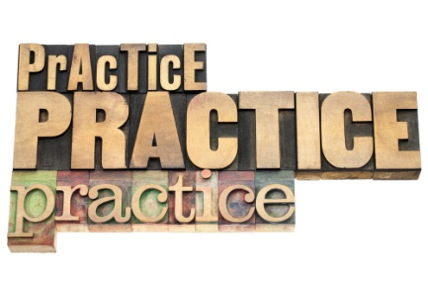
Translation
1. 他沒有注意安全指示。
He wasn't paying attention to the safety instructions.
2. 女士们、先生们，请安静。
Ladies and gentlemen, could I have your attention, please?
3. 我体会到，你作出这样的决定有多难。
I appreciate that it’s a difficult decision for you to make.

Slide 18

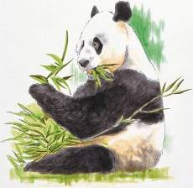
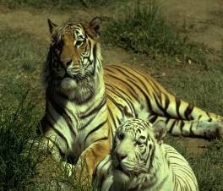
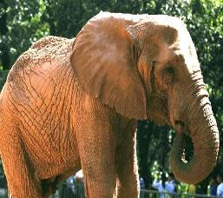
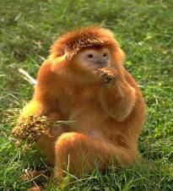
Discussion
adj. 濒临灭绝的;有生命危险的
What can we do to help endangered animals?
en+danger+ed=endangered
en- pref.
表示“使” “使成为” “使处于……状态”
e.g. endanger enlarge enrich

Slide 19
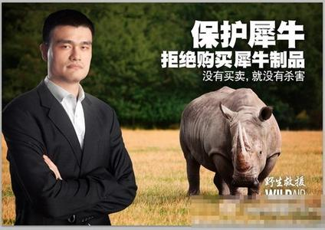
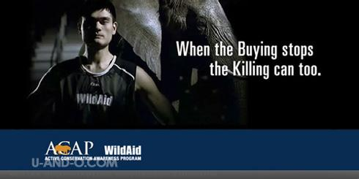
No buying, no killing.

Slide 20
Measures to protect the endangered
animals:
▪ reduce hunting, treat them as our friends
▪ protect our environment
▪ to set up nature reserves/protection zones
▪ make laws to prevent them from being caught and killed
▪ the governments should educate people to love nature and protect it
▪ raise money to help them

Slide 21
I. Complete the passage with proper words, which will help you retell the text.
One day, Daisy dreamed a strange dream. She asked a _______ (fly) carpet to take her to a _________(distance) land where she could find the animal that gave fur to make the sweater. The carpet took her to Tibet and she talked with _____antelope. The antelope told her they ________________
(hunt) because of their fur __________can be used to make sweaters for people like ________and that they were now dying out.
flying
distant
an
were being hunted
which/that
her

Slide 22
where
Later, she flew to Zimbabwe ______she talked with an elephant and got to know the farmers there no longer hunted them. That’s ________the government decided to help. At last she arrived at the thick rainforest where a monkey told her that more attention should be paid ______the rainforest and people should appreciate _______the animals live together. “No rainforest, no animals and no drugs.” said the monkey. Although finally everything was gone, she had learned so much.
because
to
how

Slide 23
II. Task-based reading.
Please answer the following questions.
1. When did Calista first get the idea to
be an official Special Olympics
volunteer?
In 2005.

Slide 24
2. What is Calista’s plan to help out their
local Special Olympics program?
3. List three activities which Calista has
been doing to help out at the Special
Olympics events she attends.
① _______________________________;
② _______________________________;
③ _______________________________
_______________________________.
Making and selling crafts to help fundraise for the program.
Keeping scores in bowling
timing during track and field
ball chasing during the softball throws / or cheering on the athletes

