Slide 1

广东省高考英语听说考试
(CELST)
Part C Retelling 故事复述

Slide 2
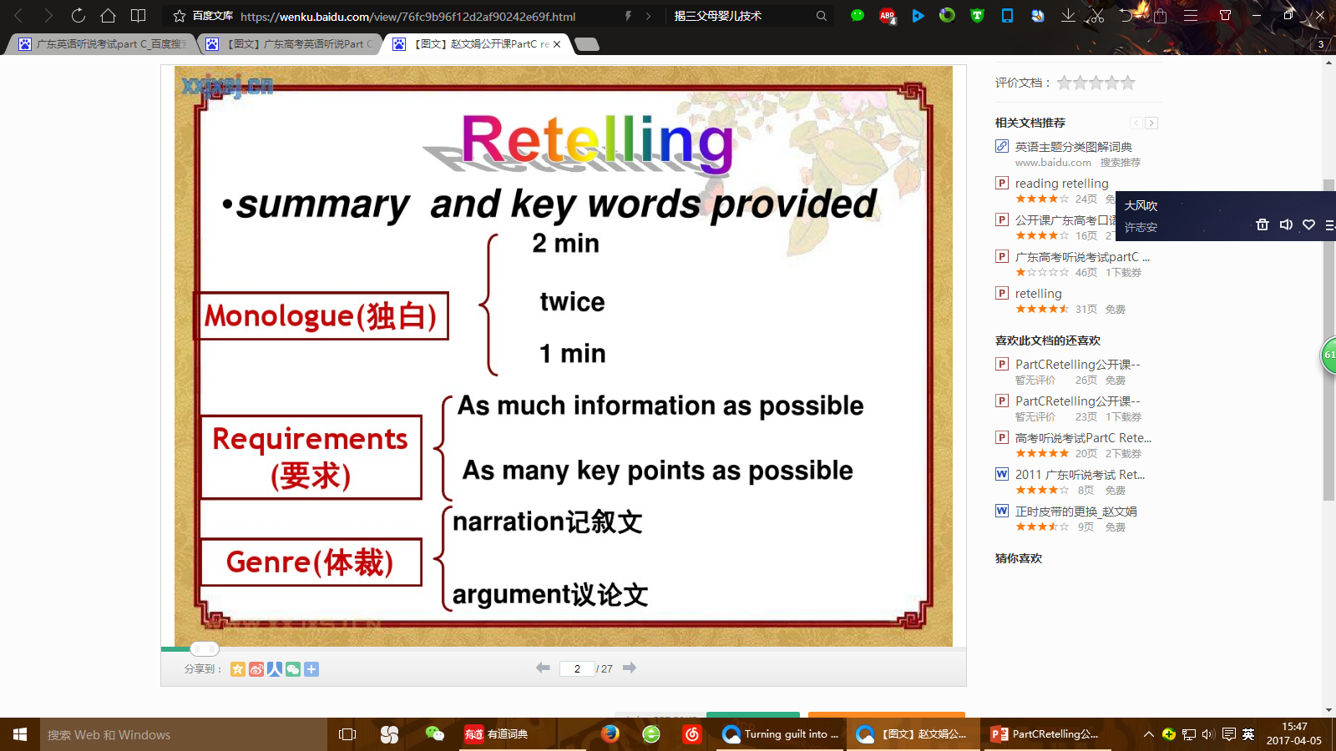

Slide 3
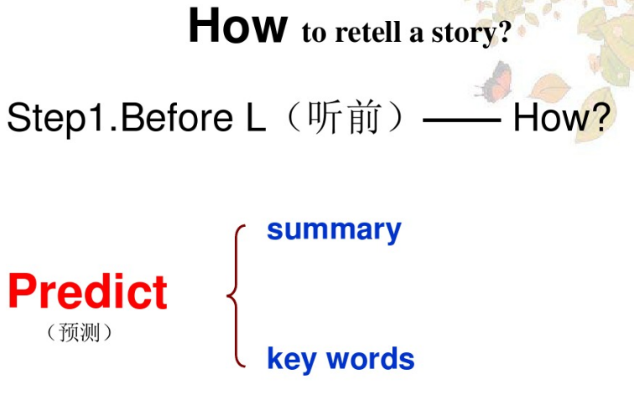

Slide 4
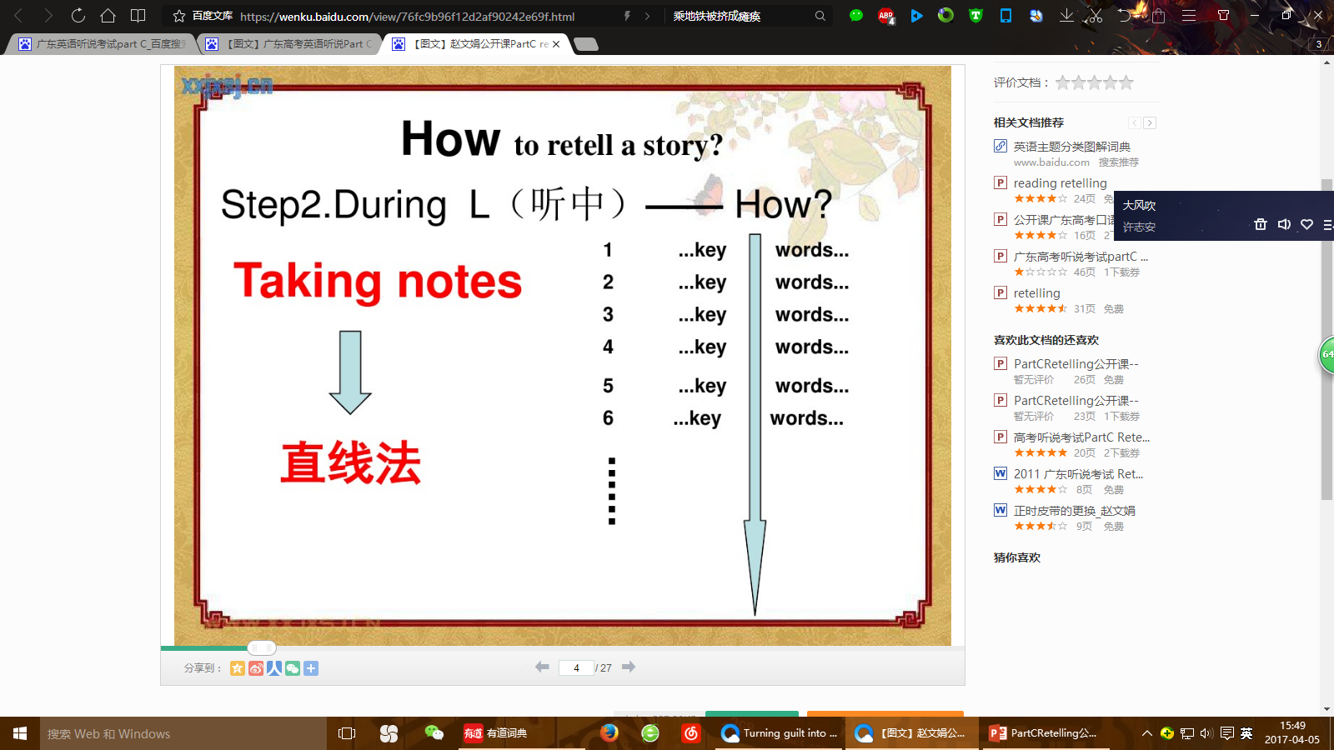

Slide 5
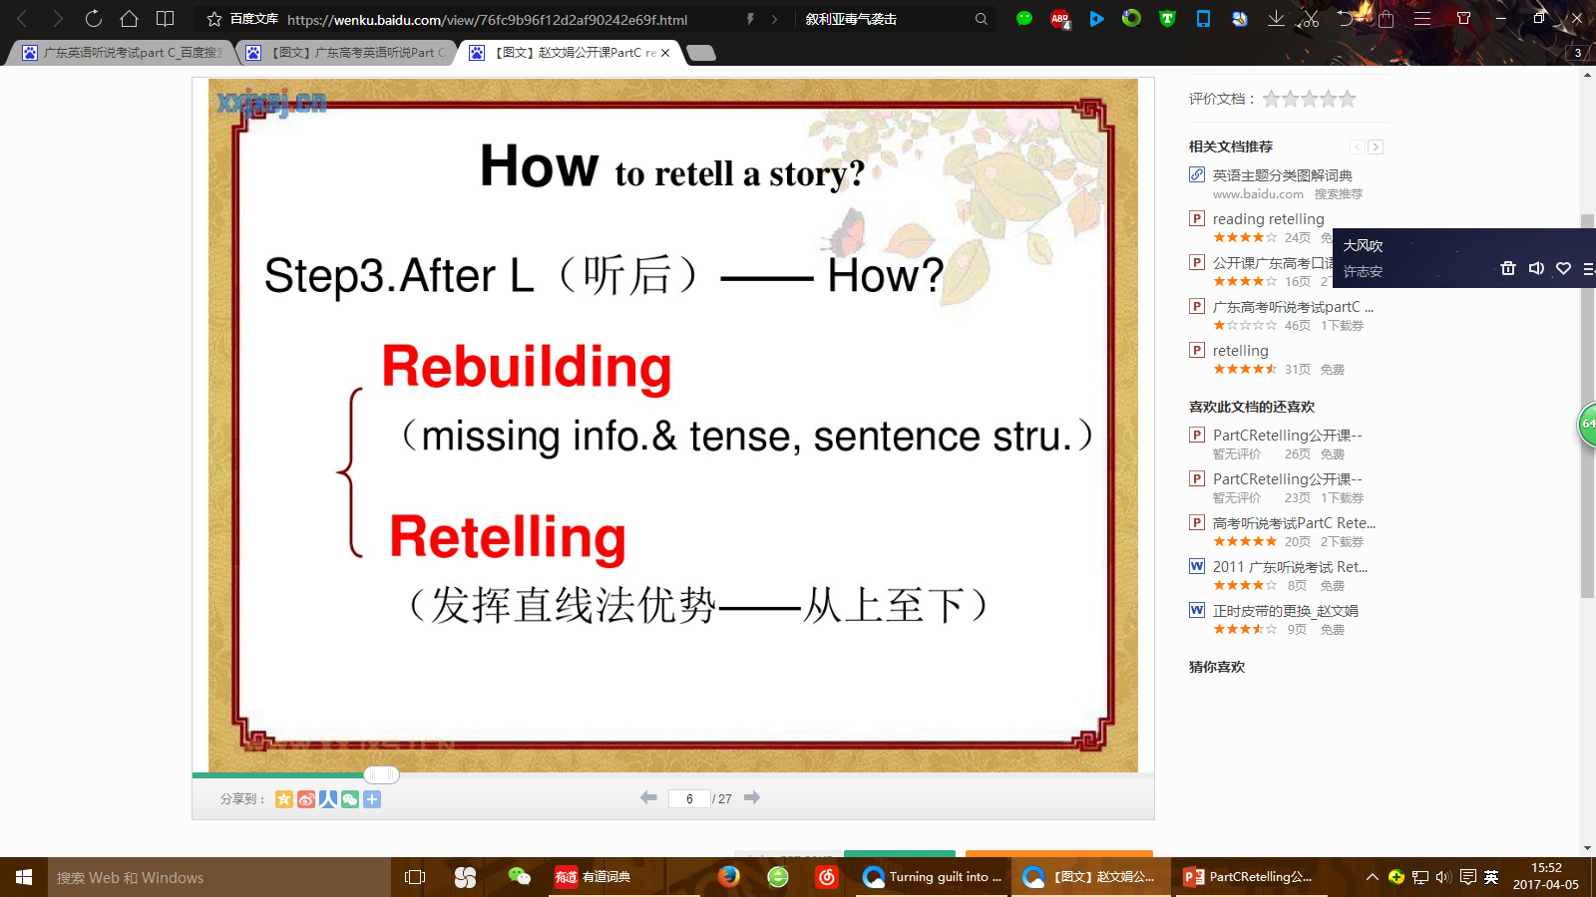

Slide 6
The steps for retelling a story
第一步：考生可根据屏幕上显示的故事梗概和关键词预测故事内容。
第二步：听一段大约两分钟的独白，无视频，只有声音，录音播放两遍。考生可以在以下空白处记录主要信息或关键词。
第三步：考生准备一分钟。
You have ONE minute to prepare the story.
第四步：现在开始复述。（请在两分钟内完成）
Now please get ready. When you hear a beep, begin to retell it.

Slide 7
3.考题探究
2012年湛江一模英语听说考试B卷
记叙文
Part C 故事复述（Story Retelling）
故事梗概：Mr. King帮Mr. Baker试旧车，引起事故连连。
关键词：calm 冷静的 traffic 交通 seller 卖家 trial 实验worth价值

Slide 8
Locked In--- Mr. King works in a shop and drives a car for the manager. He drives carefully and can keep calm in time of danger. The manager pays him more. Mr. Baker, one of his friends, works in a factory outside the city. It is far from his house and he has to go to work by bus. As the traffic is crowded in the morning, sometimes he is late for the work. He hopes to buy a car, but he hasn’t enough money. He decides to buy an old one. He chose a beautiful but cheap car. He said he wanted to have a trial drive, the seller agreed. He called Mr. King and asked him to help him. Mr. King examined the car at first and then drove it away. At first he drove slowly and it worked well. Then he drove fast. And when he reached a crossing, the light turned red. He tried to stop it, but he failed and nearly hit an old woman. A policeman told him to stop, but the car went on until it hit a big tree by the road. After this lesson, Mr. King never dared to drive an old car. He advised Mr. Baker to borrow money for a new car. Anyway, life is worth more than a dangerous car.

Slide 9
Key:
Mr. King is an experienced driver.（信息点1） He is paid more due to his skillful driving. （信息点2）One day, his friend Mr. Baker wanted to buy a car. （信息点3）But he couldn’t afford a new car, so he decided to buy an old one.（信息点4） After he chose a cheap car, he asked Mr. King to help him have a trial drive. （信息点5）At first, Mr. King drove it slowly and it worked well. （信息点6）Then he drove fast to a crossing. Suddenly the light turned red, he tried to stop but failed.（信息点7） He nearly hit an old woman. He couldn’t stop the car until he hit a big tree by the road.（信息点8） Mr. King never had the courage to drive an old car. （信息点9）He asked Mr. Baker to buy a new one because life is more expensive. （信息点10）

Slide 10
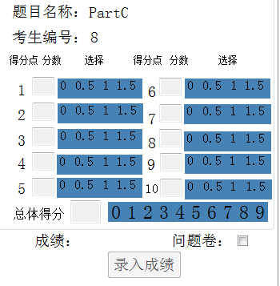
分为10个信息点。每个信息点满分为1.5分，还有一个总体印象分为9分,满分24分。评分模板如下：

Slide 11
学生的得分：22分
信息点得分：14
总体得分：8

Slide 12

解题技巧
How can we take notes efficiently?
1. 在记叙文中常用时间顺序的连词或连接词来叙述故事发展的先后或做某事的过程。
one day, on one’s way to, at first, then, later, afterwards, soon, before, after, when, while, as soon as, since, during, eventually, in the end, immediately, on arrival

Slide 13

2. Use special signs.
because，since, for : ∵
thus, so, therefore : ∴
more than : ﹥
good, well : ＋
happy : angry : ﹥○﹤
yesterday: ‘d today : d ’
tomorrow : d～ success : V thousand : t million : m billion : b

Slide 14
How can we retell a story well?
Step 1: Predict
Predict the main idea of the story according to the hints or key words given before listening to the story.
PART C Retelling
梗概：
出租车司机John在车里发现了一只红色的手提包，并立刻将其物归原主。
关键词：
take a taxi（乘出租车）the Central Park (中心公园) handbag (手提包) exhibition （展览）get …back （取回）

Slide 15
Predict
关键词：
take a taxi: Who? Where to ? When?
the Central Park: What happened?
handbag: Whose? What’s in ? Where was it?
exhibition: When? Who? What about?
get.. back: How?

Slide 16
Step 2: listen and take notes
For the first time, focus more on listening and understanding.
听第一遍录音： 不要急于做笔记，先听懂情节捕捉故事的基本线索。
原因(cause)、经过(development) 、结果(result)
2. For the second time, try to write down key words, use some signs.
听第二遍录音： 听清细节，记录重点信息。（时间、人物、地点及身份等）

Slide 17
Step 3: Organize the story
Prepare about 10-12 sentences.
2. Attention Please:
★ Complete plot
★ the five key words
(who, where, when, what, why)
★ useful structure
★ tense –past tense
★ the agreement between person and number
★ transitional words (过渡词）and linkers（连接词）

Slide 18
Step 4 : Retell the story
1. Cover as much as information as possible
2. Attention Please
★ proper speed
★ good pronunciation and intonation
★ appropriate pause
3. Be in a good mood

Slide 19
故事情节
4. 精题精练
2013年广东高考英语听说考试 A
PART C Retelling
梗概：
Tom给Brown夫人送信时无人应答，从窗户进屋后看到她躺在地板上。
关键词：
postman 邮递员; deliver a letter 送信; house 房子; milk牛奶; lie 躺

Slide 20
Find out the main idea (listen for the first time)
Who? ---
Tom
Where?---
Mrs. Brown ’s house
When? ---
yesterday
Tom delivered a letter to Mrs. Brown but there was no answer.
What?---
Why?---
Mrs. Brown was lying on the floor.
The result ---
Tom called for an ambulance.
Main idea and important information can help us retell a story !

Slide 21
Key:
Tom was a postman.（信息点1） Mrs. Brown always kindly invited Tom in for a drink. （信息点2） Yesterday, he delivered a letter to Mrs. Brown but he didn’t see her working in the garden. （信息点3） He knocked hard on the door but nobody answered. （信息点4） He noticed that her milk delivered early in the morning was still out the door. （信息点5） He thought if Mrs. Brown hadn’t taken in her milk, perhaps she was ill. （信息点6） He found an open window and went inside the house. （信息点7） He found Mrs. Brown was lying on the floor. （信息点8） He realized that there was little he could do. （信息点9） He called for an ambulance. （信息点10）

Slide 22
小结
Part C Retelling
1. 从关键词和梗概，预测故事内容，并写出梗概的英语译文；
2. 故事开始，不看屏幕，迅速按故事顺序做笔记；
3. 一分钟准备中，边讲边整理笔记（注意标记动词，提醒正式录音时使用过去式），在梗概的译文基础上加上故事的主要细节“what, who, when,where,why”等。复述内容应涵盖尽可能多的原文信息点 。
4. 两分钟录音中，语速不要太慢（不要连续重复某个词或某句话）
5. 复述完毕，录音未结束时，绝不摘耳机，以免造成多余的杂音，影响录音效果（建议将麦克风轻轻压下，不致于录入呼吸声）

