Slide 1

1．“介词＋关系代词”引导的非限制性定语从句
Sometimes I wonder how relevant chemistry is to these students，________________(他们中大多数)will be going back to their villages after Year 8 anyway.
典型句式
most of whom

Slide 2
2．doubt后接由whether引导的宾语从句
To be honest，________________(我真有点怀疑是否)I’m making any difference to these boys’ lives at all.
I doubt whether

Slide 3
3．did＋动词原形的强调句
But last weekend another teacher，Jenny，and I ________________(确实拜访了一个村庄)which is the home of one of the boys，Tombe.
did visit a village

Slide 4
4．with复合结构在句中作定语
Tombe’s father，Mukap，led us to his house，a low bamboo hut _________________________________(草伸出了屋顶)．
with grass sticking out of the roof

Slide 5
5．not...but连接两个并列成分
The gift you give ______________________________________________________________(不是给你所爱的人留念的，而是……)a voluntary contribution towards the lives of people who really need it.
is not something your loved one keeps but

Slide 6
6．from where引导的定语从句
We walked for two and a half hours to get there—first up a mountain to a ridge ______________(从那里)we had fantastic views and then down a steep path to the valley below.
from where

Slide 7
限制性定语从句
1．(2011·济南5月份练习)There are some customs in China __________ foreigners will never understand.
A．that B．whose
C．where D．why
解析：选A。考查定语从句。分析句子可知，从句为限定customs的定语从句，从句谓语为及物动词understand,缺少指物的宾语，故选A。句意为：中国有很多外国人永远也不会理解的风俗习惯。

Slide 8
2．(2012·德州模拟)The course is a must for all those __________ mother tongue is not English.
A．whose B．who
C．that D．which
解析：选A。考查定语从句。句意为：这门课程对那些母语非英语的人来说是必须的条件。mother tongue与先行词those之间构成所属关系，用whose作定语。故选A项。

Slide 9
3．(2012·临沂质量检测)There stands an old tree with a history of over 500 years，__________ many branches have broken off.
A．that B．when
C．of which D．which
解析：选C。考查定语从句。分析句子可知，先行词an old tree与many branches构成所属关系，故选of which作定语。

Slide 10
4．(2012·山西师大附中)As a teacher，I seldom give my students so difficult a problem __ they cannot work out.
A．that B．if
C．in order that D．as
选D。作为老师，我很少给我的学生难以解决的问题。
先行词为so difficult a problem，They cannot work out so difficult a problem. 先行词在定语从句中作宾语。
“so或such＋名词”作先行词，且先行词在定语从句中作主语、宾语或表语时，需用as引导定语从句。
如选A项,题干应该为：As a teacher，I seldom give my students so difficult a problem that they cannot work it out.

Slide 11
5．(2012·潍坊)Safety in school has been of great concern because of frequent reports about accidents ____students got injured or killed while in school.
A．in which B．for which
C．which D．when
解析： 选A。该题考查定语从句。该句中in which 引导定语从句修饰先行词accidents。句意为：由于对学生在学校受伤或死亡事件的不断报道，学校安全成为一个重要问题。

Slide 12
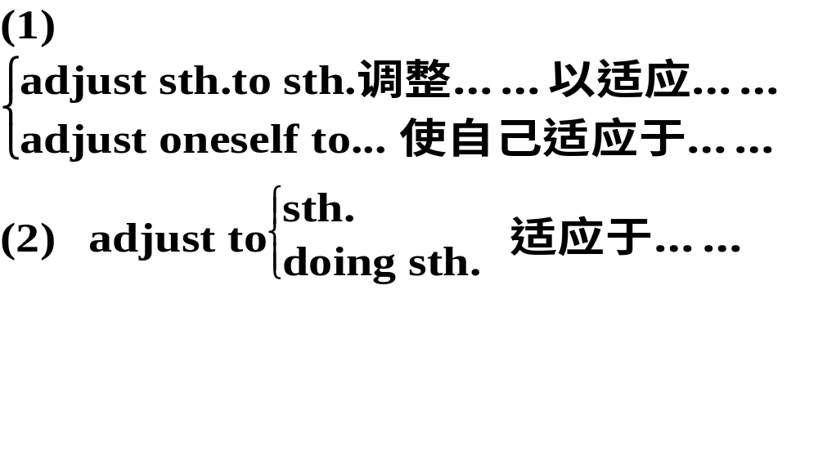
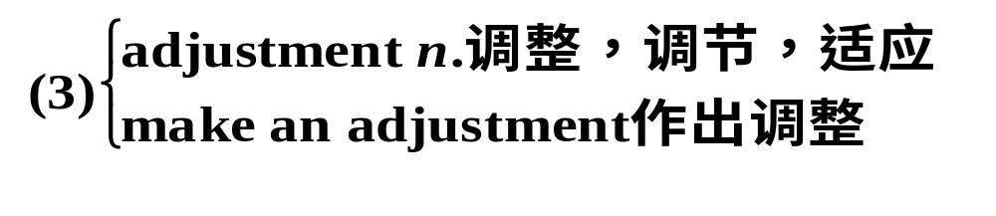
1. adjust vi.& vt. 调整；使适合
The hut was dark inside so it took time for our eyes to adjust.小屋内很黑，因此眼睛要过好一阵才能适应过来。

Slide 13
①It took her a while to adjust to living alone.
她过了一段时间才适应独自生活。
②You will quickly adjust_yourself_to_ student life.
你将很快适应学生生活。
③This kind of desk can be adjusted to the height you need. Besides，it’s not expensive at all.
这种课桌可以调整你需要的高度，况且一点也不贵
④Just as I tried to make the Necessary adjustment to this new situation，He appeared.
我正努力适应这里的新环境，这时他出现了。

Slide 14
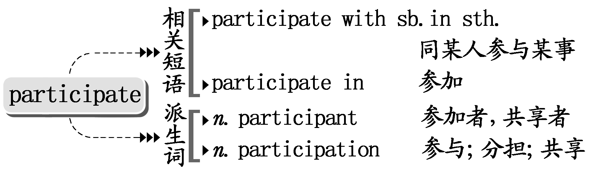
2. participate vi. 参与；参加
I loved listening to the family softly talking to each other in their language，even though I could not participate in the conversation.
我喜欢听一家人用他们的语言轻声细语地交谈，虽然我无法参与到他们的对话中去。

Slide 15
①As far as I know，she didn’t participate in the discussion.
据我所知,她没有参加讨论。
②We encourage students to participate fully in the running of the college.
我们鼓励学生全面参与学院的运作。
③All the participants in the debate will have an opportunity to speak.
所有参加辩论的人都有机会发言。

Slide 16
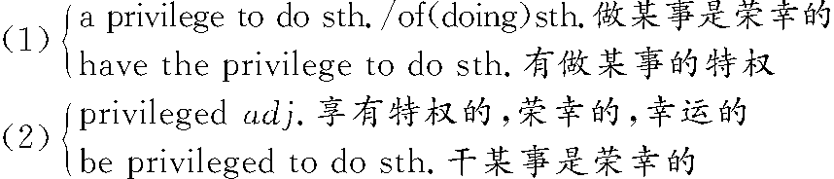
3. privilege n．特权；特别优待
It was such a privilege to have spent a day with Tombe’s family. 能与汤贝一家度过一天的时间真是莫大的荣幸。

Slide 17
①You can enjoy all the benefits and privileges of club membership.
你可以享受俱乐部成员的一切福利和优惠。
②I hope to have_the_privilege_of_working with them again.
但愿有幸与他们再度合作。
③We are privileged to have a distinguished guest with us tonight.
我们今晚有幸与一位贵宾在一起。

Slide 18
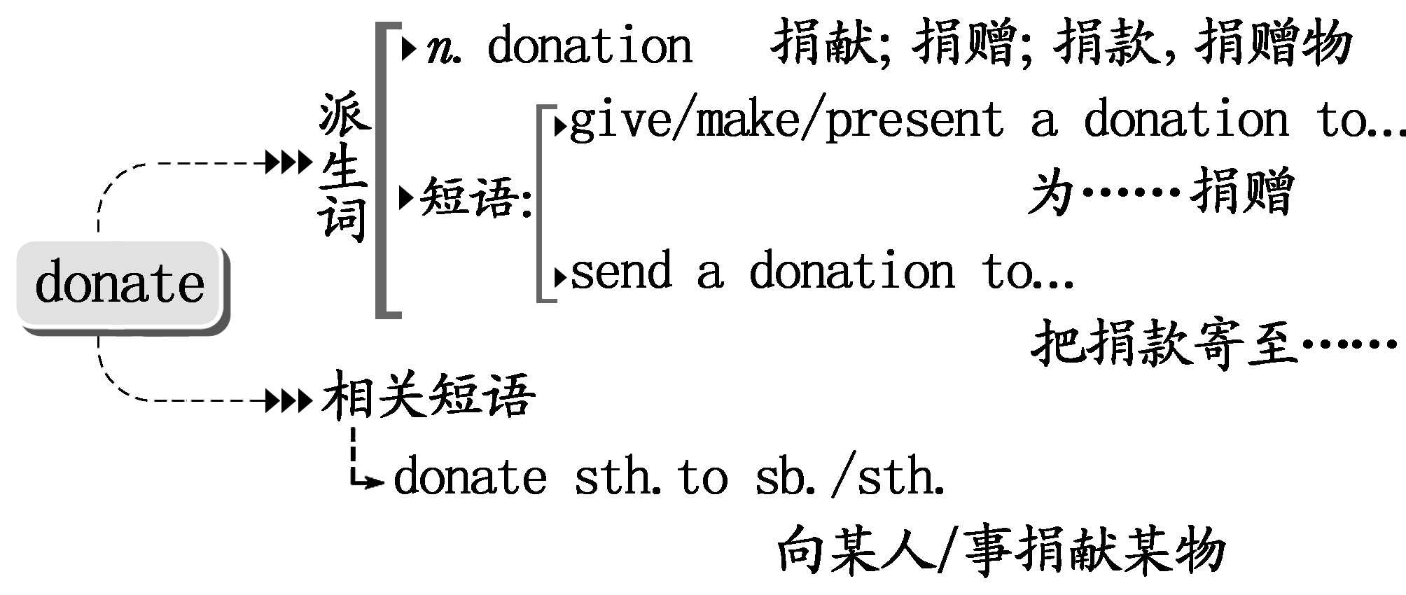
4. donate vt.捐赠；赠送
Would you like to donate an unusual gift?
你愿意捐献一份不平常的礼物吗？

Slide 19
①There is no risk of getting AIDS when donating blood.献血不会染上艾滋病。
②Last year he donated 100,000 dollars to cancer research.
去年他捐赠10万美元支持癌症研究工作。
③All donations were sent to the earthquake-­striken areas.
所有捐赠都送往地震灾区了。

Slide 20
5. otherwise
adv.用别的方法；其他方面；除此之外 conj.否则；不然
Otherwise they don’t waste anything.
否则他们不会浪费任何东西。
①(2011·高考陕西卷阅读C)What’s more，they had not wanted enough to be rich and successful；otherwise they could not possibily have managed their lives so badly.
而且，他们并不想富有或成功，否则他们不可能把生活搞得如此糟糕。

Slide 21
②Seize the chance，otherwise/or you will regret it.
抓住这个机会，否则你会后悔的。
③They(must have)liked the apartment, otherwise/or they wouldn’t have stayed so long.
他们(一定)喜欢这个公寓，不然他们不会呆这么久。
【温馨提示】
otherwise表示相反的假设时，otherwise的分句谓语动词用虚拟语气。

Slide 22
1．—Where were the Blacks then?
—They got caught in a traffic jam；otherwise ______.
A．they would be here
B．they have been here
C．they had been here
D．they would have been here
解析：选D。考查虚拟语气。They got caught in a traffic jam和otherwise暗示后面应是对过去情况的虚拟，用would have done，故选D。

Slide 23
2．In China，people over sixty­five can enjoy some __________ in public places as long as they can provide their identifications.
A．advantages B．good
C．privileges D．welfare

Slide 24
解析：选C。考查名词辨析。privilege“特权，特别优待”；advantage“优点，长处”；good“好处，益处”，welfare“福利，幸福”。由“只要提供身份证明”可知，应为享有某些特权而不是好处或福利。故C项正确。

Slide 25
3．(2012·无锡市高三检测)Leave him alone.He is __________ himself to the preparations for the coming exam.
A．adjusting B．applying
C．losing D．engaging

Slide 26
解析：选B。考查动词辨析。apply oneself to努力学习，勤奋工作，符合语意。adjust oneself to适应，习惯；lose oneself in沉迷于，全神贯注于；engage sb.in(使)从事，参加。

Slide 27
4．To be honest，it took me more than a month to __________
myself__________the new school life.
A．adopt；to B．adjust；to
C．adapt；into D．suit；for

Slide 28
解析：选B。adjust...to意为“调整……使适合”。句意为：老实说，我花了一个多月时间才适应新学校的生活。adapt与to搭配；adopt意为“采纳，收养”；当suit 表示“使适合”时，与to搭配。

Slide 29
5．Students in our school are encouraged to________more activities after class in order to broaden their knowledge.
A．attend B．join
C．take part D．participate in

Slide 30
解析：选D。participate in＝take part in表示“参加集体活动”的意思。

Slide 31
6．—Have you known Dr.Jackson for a long time?
—Yes，since she________the Chinese Society.
A．has joined B．joins
C．had joined D．joined

Slide 32
解析：选D。句意为：——你认识Dr.Jackson很长时间了吗？——是的,自从她加入华人社团我就认识了她。since自从……以来，引导时间状语从句，强调过去认识时的时间，第一句话所用的现在完成时是判断该句子时态的重要依据。

Slide 33
1(be)dying to 极想；渴望
(教材P₂₉) I know you’re dying to hear all about my life here，so I’ve included some photos which will help you picture the places I talk about.
我知道你急于了解我在这儿的生活情况，我在信中附有几张照片，能够帮助你想象出我所谈到的地方。

Slide 34
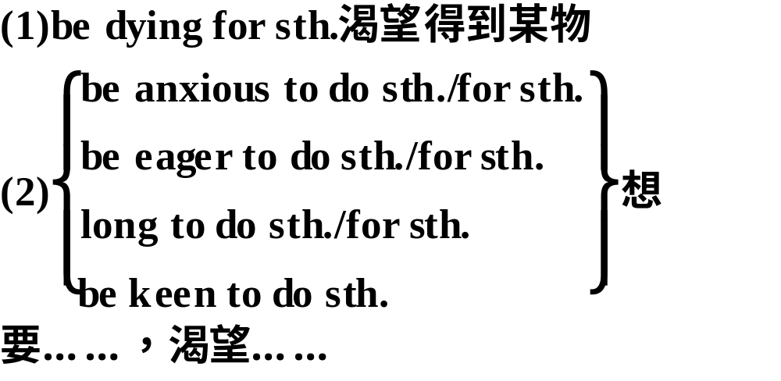
归纳拓展

Slide 35
①I haven’t seen him for a few days.I’m dying to know what has happened to him.
我好几天没见到他，我很想知道他发生了什么事情。
②She was_dying_for a holiday to relax herself.
她非常渴望一个假期来放松一下自己。

Slide 36
③Mike is_eager_to stay away from the busy city life for a while.迈克渴望离开繁忙的城市生活一段时间。
④(2011·高考山东卷阅读表达)Are you anxious and restless if you are separated from your mobile phone?
没有手机在你身边你会焦躁不安吗？

Slide 37
2come across 偶然遇到或发现，碰见
(教材P₂₉)The boys who had never come across anything like this before started jumping out of the windows.
那些从未见过这种情况的男孩子们，(吓得)都往窗外跳去。

Slide 38
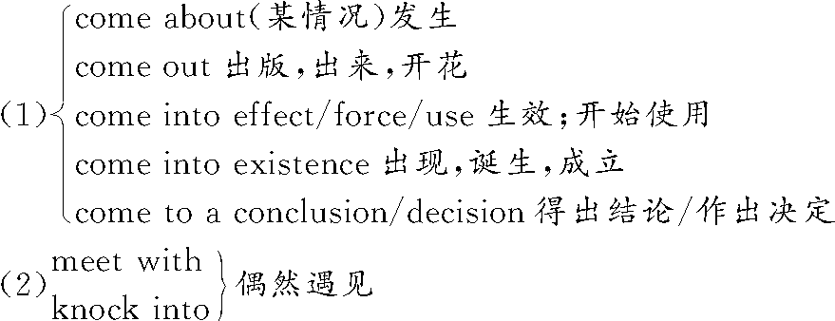
归纳拓展

Slide 39
①(2011·高考天津卷)She came across an old friend of hers yesterday while she was shopping at the department store.昨天她在百货商店购物的时候偶遇一位老朋友。
②(牛津P₃₈₆)She came_across some old photographs in a drawer.她在抽屉里偶然发现了一些旧照片。

Slide 40
③This situation should never have come about.
这种情况本来不应该发生。
④They met_with an accident on their way home.
他们在回家的路上出了车祸。

Slide 41
3in need 在困难中；在危急中
(教材P₃₄)Choose from this catalogue a really useful gift for some of the world’s poorest and bring hope for a better future to a community in need.

Slide 42
从这份清单中选择一份确实有用的礼物，送给世界上一些最穷苦的人，给急需帮助的社区带去对未来的希望。

Slide 43
归纳拓展
in need of需要
There is no need for sth.不需要某物
There is no need for sb.to do sth.
某人没有必要做某事

Slide 44
①A friend in need is a friend indeed.
患难朋友才是真朋友。
②We are collecting money for families in_need.
我们正在为有困难的家庭募捐。

Slide 45
③Deeds are better than words when people are in need of help.当人们需要帮助时，行动比话语更好。
④There_is_no_need_to_regret what has happened.
没必要为已经发生的事感到后悔。

Slide 46
Ⅱ.单项填空
1．An airport employee __________ the three kids alone in the terminal.
A．came across B．care about
C．look for D．focus upon

Slide 47
解析：选A。句意为：一位机场工作人员在候机厅里偶然发现了这3个没有大人陪伴的孩子。本题考查动词短语辨析。come across偶然发现，碰到；care about在意，关心；look for寻找；focus upon集中注意力于。根据句意可知正确答案为A项。

Slide 48
2．If we can______our present difficulties，then everything should be all right.
A．come across B．get over
C．come over D．get off

Slide 49
解析：选B。本题考查动词短语。come across偶然碰到/遇见；get over克服(困难)；come over过来，从远方来，顺便来访；get off意为“下车/来,动身，开始”。本题为“克服我们目前的困难”之意，故选B。

Slide 50
3．Many Chinese universities provide scholarships for students
________financial aid.
A．in favour of B．in honour of
C．in face of D．in need of

Slide 51
解析：选D。句意为：很多中国大学为需要经济资助的大学生提供奖学金。in favour of 赞同，支持，有利于；in honour of 向……表示敬意；in face of 面临；in need of 需要。

Slide 52
1(教材P₃₄)The gift you give is not something your loved one keeps but a voluntary contribution towards the lives of people who really need it. 你送的礼物不是给你所爱的人留念的，而是给那些确有生活需要的人的一项志愿性捐助。

Slide 53
【点津】 not...but...意思是“不是……而是……”，连接两个表语。not...but...连接两个平行成分，当连接两个主语时，谓语动词的数按“就近一致”原则确定。

Slide 54
①What surprised me was not what he said but the way he said it.
使我吃惊的是不是他说了什么，而是他说话的方式。
②He does not work but play all day.
他整天不学习只是玩耍。

Slide 55
③Not you but he is to blame.
不是你而是他该受谴责。

Slide 56
归纳拓展
not only...but(also)，either...or...，neither...nor...连接两个主语时，谓语动词按“就近一致”原则确定。as well as连接主语时，谓语动词按“就前一致”原则确定。

Slide 57
④Not he but you are wanted on the telephone.
电话找的是你不是他。

Slide 58
2(教材P₂₉)We walked for two and a half hours to get there－first up a mountain to a ridge from_where we had fantastic views and then down a steep path to the valley below.

Slide 59
我们走了两个半小时才到了那儿。先爬到了一座山的山顶，从那儿我们欣赏到了优美的风景，然后又沿着陡峭的山坡到了下面的山谷。

Slide 60
【点津】 from where引导的定语从句修饰a ridge，关系副词where前一般不加介词，但from where却是个例外。

Slide 61
①There are many websites，from where you can find almost all the necessary information.
有许多网址，从那里你能够找到几乎所有必要的信息。

Slide 62
②China is the birthplace of kites，from_where kiteflying spread to Japan,Korea and India.中国是风筝的故乡，从那里放风筝传到了日本、朝鲜和印度。

Slide 63
③Alice stood at the window，from where she could watch her classmates playing football.
Alice站在窗户旁边，从那里她可以观看同学们踢足球。

Slide 64
跟踪训练
1．It is often said that the joy of traveling is ________ in arriving at your destination ________ in the journey itself.
A．/；but B．/；or
C．not；or D．not；but

Slide 65
解析：选D。本题考查的是固定搭配。not...but...是固定词组，意为“不是……而是……”。句意为：人们常常说旅行不在于你到达目的地而在于旅程本身。

Slide 66
2．The following are some popular websites________people can sell goods to each other.
A．where B．which
C．when D．whose

Slide 67
解析：选A。where引导定语从句，并在从句中作地点状语，意思是“在这些网站上”。

Slide 68
3．After supper，he usually stood near the window，__________ he could see the tower，the tallest building in this city.
A．from which B．on which
C．on where D．from where

Slide 69
解析：选D。考查定语从句。句意为：晚饭后，他通常站在窗户旁，从那里他能看见塔，那是这座城市里最高的建筑。from是比较特殊的介词，后面可以接另外一个介词，比如from behind the door,接定语从句时就用from where，本句中from where＝from near the window。

