Slide 1


n. 任务；分配
I have a lot of reading assignments(阅读功课) to complete before the end of term.
Look at the title. What information could you get from it?
▲
key information

Slide 2
skim the passage quickly, and find out all the questions Zhou Yang asked. And then divide the passage into three sections.

Slide 3

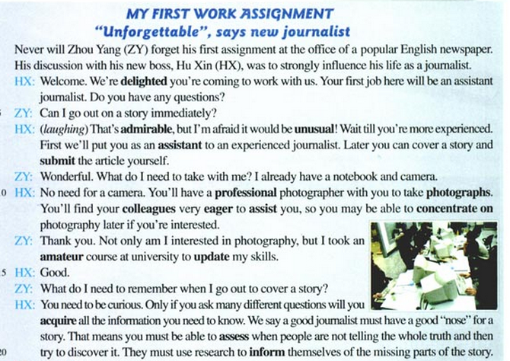
how to work in a team

Slide 4
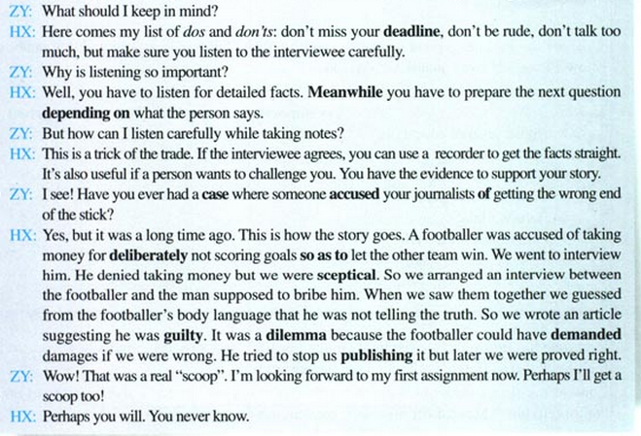
how to get an accurate story
how to keep the truth of a story

Slide 5


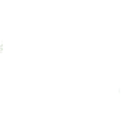
Choose the best answer.
Check your answer.
1. Zhou Yang will never forget his first
assignment at the office because ______.
A. his first assignment was quite a failure
B. Hu Xin was very strict with him even
though he was a journalist
C. his new boss Hu Xin asked him to go
out on a story by himself
D. his discussion with his new boss, Hu
Xin, was to strongly influence his life
as a journalist

Slide 6
2. Zhou Yang can cover a story on his own only when _____.
A. he has a nose for a story
B. he listens to the answers carefully
C. he is interested in photography
D. he has seen what an experienced journalist does
3. Who will take the pictures when Zhou Yang goes out on a story for the first time?
A. Zhou Yang himself.
B. A professional photographer.
C. Hu Xin.
D. A more experienced reporter.

Slide 7
4. Which of the following is NOT included
in Hu Xin’s list of “dos” and “don’ts”?
A. Don’t be rude.
B. Don’t laugh at the people being
interviewed.
C. Don’t miss your deadline.
D. Don’t talk too much, but make sure
you listen to the interviewee carefully.

Slide 8



True or False
not
1. Zhou can go out on a story immediately.
2. Zhou needs to take a notebook
and a camera.
3. While interviewing, the journalist would
just ask the questions prepared before-
hand.
have to prepare the next question depending on what the person says
4. Zhou took a course of photography at
middle school.
university
5. Zhou is very enthusiastic.

Slide 9


1. go and interview sb. about an incident or happening
1. cover a story
2. be able to “smell” when sb. is trying to hide a good story that may reflect badly on him/herself
2. to have a “nose” for a story
3. a trick of the trade
3. sth. that helps you do the job in a professional way
Read the passage and guess the meanings of these expressions.
4. get all your facts straight
4. make sure the story is accurate
5. you do not understand what is being said to you
5. get the wrong end of the stick
6. an important story which your newspaper gets ahead of all the other newspapers
6. a real “scoop”

Slide 10

p27 1
How to become a journalist
Use the information from the reading passage to help you.
Zhou Yang’s notes
The skills needed__________________
The importance of listening__________
Stages in researching a story__________
How to check facts______________
How to deal with accusations of printing lies__________________________

Slide 11
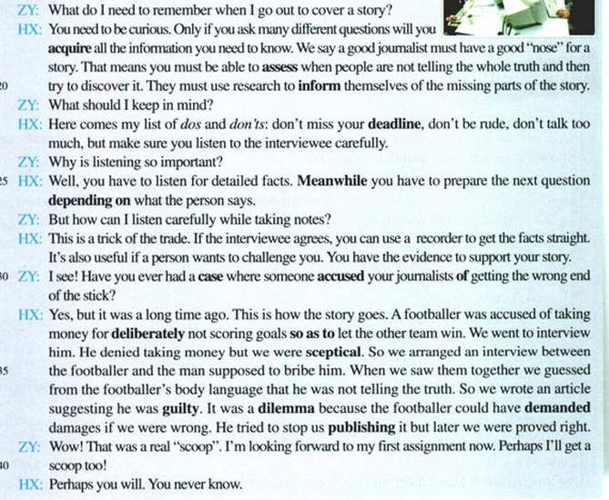
The skills needed
The importance of listening
Stages in researching a story
How to deal with accusations of printing lies
Zhou Yang’s notes

Slide 12
Zhou Yang’s notes
be able to tell if someone
is telling the truth
2. be accurate
3. do research
4. ask questions
The skills
needed
The importance
of listening
1. get the detailed facts
2. prepare the next
question

Slide 13
ask questions
note reactions
check facts
do research
Stages in researching a story
use research and ask witnesses
How to check facts
How to deal with accusations of printing lies
use a tape recorder for the interview

Slide 14

状语
1. Only if you ask many different questions
will you acquire all the information you
need to know.
谓语
宾语
定语
主语
该句为倒装句
“only + 状语（从句）”放在句首时，可引起局部倒装，即把助动词、情态动词或系动词be放在主语之前。
回顾复习：… only then did we decide to answer violence with violence. ……只是在那时，我们才决定用暴力反抗暴力。(必修1 U5)
只有提很多不同的问题，你才能收集到
你所需要的信息。

Slide 15
2. A footballer was accused of taking money
for deliberately not scoring goals so as to
let the other team win.
原因状语
目的状语
deliberately adv. 故意地
accuse ... of ...: 因......指责或控告......
The surgeon was accused of negligence.
这名外科医生被控玩忽职守。
so as to …: in order to … 为了；目的是
I got up early this morning so as to catch the early train.
为了赶早车，今天早晨我起床很早。
一个足球运动员被控受贿，故意不进球，好让另一队赢球。

Slide 16

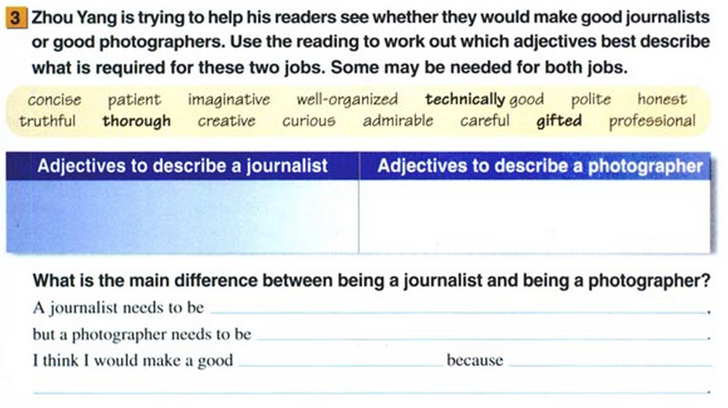
p27 3

Slide 17
A journalist needs to be ___________ ________________________, but a photographer needs to be __________ __________________________________.
They both need to be ______________
_______________________.
I think I would make a good _________
_______________________________ _______________________________.
thorough, curious, careful and concise
creative, imaginative, technically good and gifted
professional, well-organized and patient
photographer because I am creative and I enjoy being technically good at things

Slide 18
Zhou Yang will never forget his first assignment at the office of a popular English newspaper. His discussion with his new boss was to strongly influence his life ___ a journalist. The boss told him to wait ______ he was more experienced. Later he could ______ a story and ______ the article himself. Zhou Yang asked the boss _____ he needed to remember when he went out to cover a story. The boss told him that he needed to be curious. ______ he asked many different questions ______ he acquire all the information he needed to know. According to the boss, a good journalist must have a good “_____” for a story. That means that one must be able to _____ when people are not telling the whole truth and then try to ________ it. At last they discussed a case ______ someone accused the journalists of ________ the wrong end of the stick.
as
until
cover
submit
what
Only if
would
nose
assess
discover
where
getting

Slide 19
Happiness, I have discovered, is nearly always a rebound from hard work. (David Grayson, American journalist)
It is no use doing what you like; you have got to like what you do. (Winston Churchill)
I do not like work – no man does – but I like what is in the work – the chance to find yourself.
About Work

Slide 20

Spelling Bee
Now two minutes to test your spelling.
1. English-Chinese
assistant, colleague, amateur, deadline, case,
dilemma, demand
2. Chinese-English
递交，集中，快乐的，渴望的，值得赞扬的，
帮助，更新，专业的，怀疑的，不同寻常的，
获得，评估，犯罪的，故意地，告知，其间，
控告，出版
When finishing, exchange your papers to see who does the best.

Slide 21
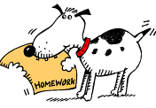
Homework
1. Read aloud the dialogue. Pay attention to the intonation and stress.
2. 发挥想象，连词成文(50-100字).
delighted, assist, colleague, update, inform, meanwhile, depend on, case, guilty, dilemma.

