Slide 1


Slide 2

What does the sign stand for?
the Chinese
Young Volunteers
help
A hand: _________________
A heart:_________________
A dove: _________________
A letter Y:_______________
love and care
peace
youth

Slide 3

Give roses to others and the lasting fragrance will remain in your hand.

Slide 4
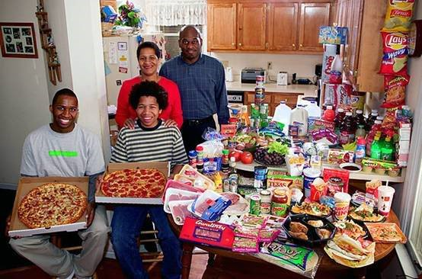
341.9 dollars

Slide 5
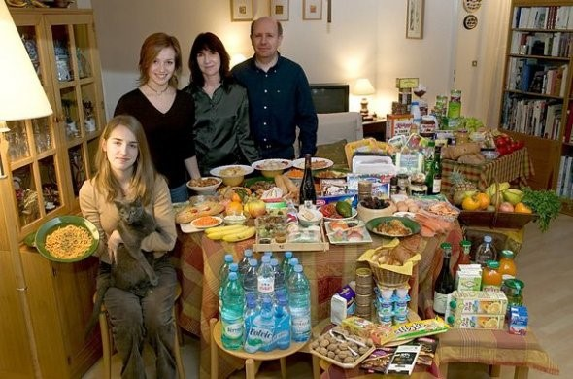
419.95 dollars

Slide 6
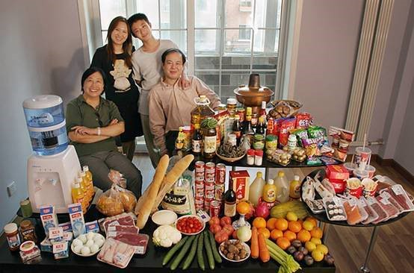
155.6 dollars

Slide 7
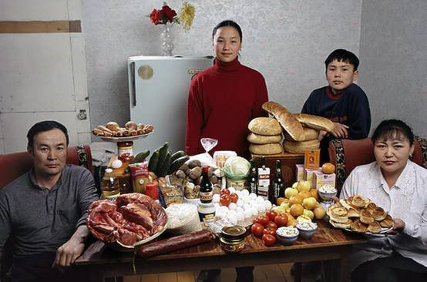
40.02 dollars

Slide 8
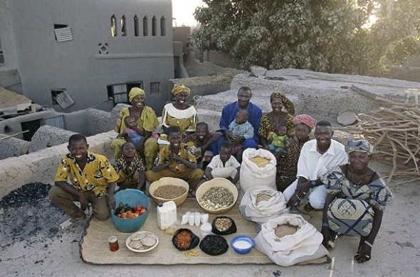
26.39 dollars

Slide 9
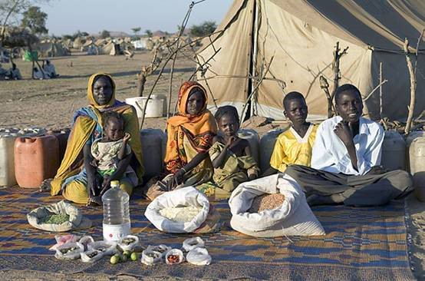
1.23 dollars
Papua New Guinea (PNG)?

Slide 10
Language Points
hear from
receive a letter from…
How often do you hear from him?

Slide 11
Be dying to do / for sth
渴望做某事；迫切想要
Deadly [attrib 作定语] extreme
deadly weapons, deadly coldness, deadly silence , deadly seriousness…
up to as many as
The hall can hold up to 1,000 people.

Slide 12
the other day = some days ago
(一般过去时)
联想：one day； some day；every other day; day after day； day by day…
be relevant to…
The essay isn't relevant to the topic at all.
anyway（= anyhow） 无论如何; 至少
It‘s too late now, anyway.
Anyhow, you can try.

Slide 13
adjust
adjust sth to…
He adjusted his tie before entering.
adjust to… = adapt to
adjustment n. make an ~
Participate
vi. ~ (in sth)
participant n. 参加者
Participation n. 参加
Thank you for your participation.

Slide 14
otherwise
adv. 用别的方法; 不同地
You obviously think otherwise.
他本应该在工作, 可他却干别的事.
He should have been working, but he was otherwise engaged in doing something else.
conj. 不然; 否则
We must run, otherwise we'll be too late.

Slide 15
B
1. Hurry up , ________ you will be late.
A. and B. otherwise C. if D. unless
2. Study hard , _______ you will pass
the exam .
A. and B. or C. if D. unless
3. Study hard , ______ you will not pass
the exam .
A. and B. otherwise C. if D. unless
A
B
Notes:
本资料来自于资源最齐全的２１世纪教育网www.21cnjy.com

Slide 16
1. The country is changing very quickly
and many of the old traditions have____.
A. died of B. died away
C. died down D. died out
2. All the children on the playground stared up into the sky until the noise of the plane______.
A. gave up B. took off
C. went off D. died down
D
D
Notes:
本资料来自于资源最齐全的２１世纪教育网www.21cnjy.com

Slide 17
3. The research is finishing, because the money has ____.
A. dried out B. died off
C. dried up D. died away
4. All his family jumped with joy when he ______ Shandong University.
A. hear about B. heard from
C. hear out D. heard of
C
B
Notes:
本资料来自于资源最齐全的２１世纪教育网www.21cnjy.com

Slide 18
Language points
1. donate
捐赠, 赠送（财物等）
~ sth to sb
donation
[C] 捐赠物: a donation to/for …
[U] 捐赠; 赠送

Slide 19
2. voluntary
adj. 自愿的; 主动的; 志愿的；无偿的
His donation is purely voluntary.
a voluntary contribution
voluntary social work.
Voluntarily adv.

Slide 20
3. in need
A friend in need is a friend indeed.
When (you are) in need, don't hesitate to ask me for help.
in need of 需要…
The doctor told me I was in need of a good rest.

Slide 21
4. Purchase
vt. 购买
Young adults are encouraged to purchase houses with loans from banks.
鼓励年轻人贷款买房。
Chinese people purchased the victory of the war with deaths.
中国人民用生命换来了战争的胜利。
n. 购买；购买物
He’s saving money for the purchase of a car.
He filled the car with his purchases.
purchaser n 购买人; 买主

Slide 22
5. anniversary
the hundredth anniversary of the composer's death
作曲家逝世一百周年纪念
wedding anniversary
结婚周年纪念
an anniversary celebration
周年庆典

Slide 23
6. sew
(sew-sewed-sewed)或(sew-sewed-sewn)
vi. 缝 sew by hand/by machine
vt. 缝制;缝合
sew a dress
a hand-sewn shirt
sew a button onto the shirt
sew the parts of the shirt together
sew up a hole in a sock
a sewing machine

Slide 24
7. distribute
vt.分发﹑ 分配某事物
~ sth (to/among sb/sth)
The demonstrators distributed leaflets to/among passers-by.
示威者向行人分发传单。
distribution
n [C&U] 分发；分布
the distribution of prizes.
Trees have a very wide distribution here.

Slide 25
8. operate
vi. 工作; 运转
This machine operates day and night.
上周我们学校的电梯运转失灵了。
The lift in our school was not operating properly last week.
vt. 操作; 经营; 管理或掌管
They operate three factories.
他们经营三家工厂。
operate the teaching facilities.

