Slide 1

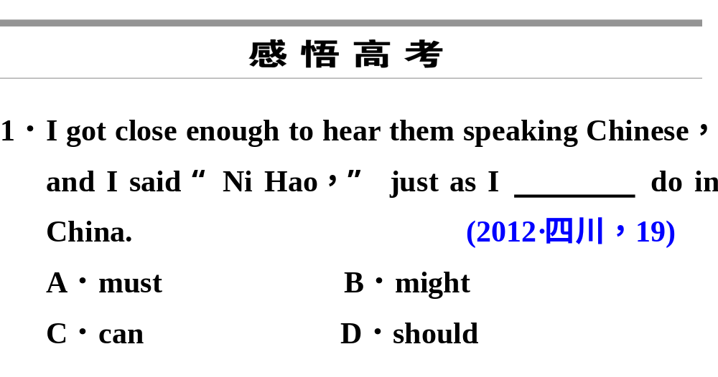


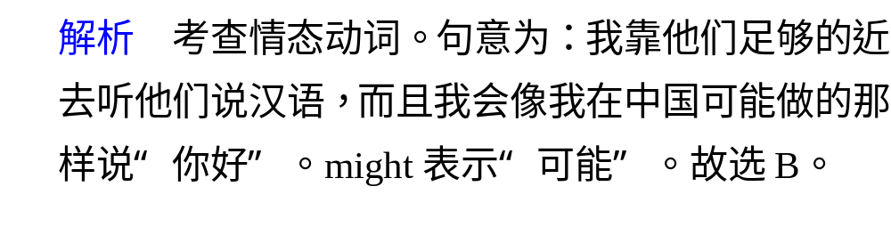
感悟高考
Period Four
学前热身
本课栏目开关
B
合作探究
感悟高考

Slide 2
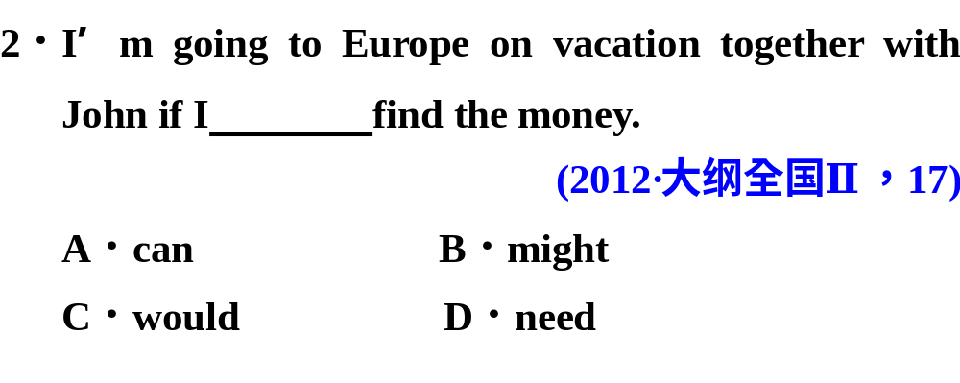
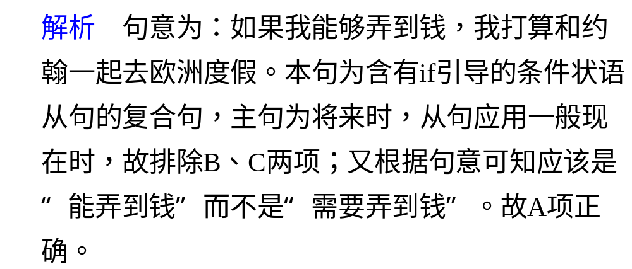
感悟高考
Period Four
A
学前热身
本课栏目开关
合作探究
感悟高考

Slide 3
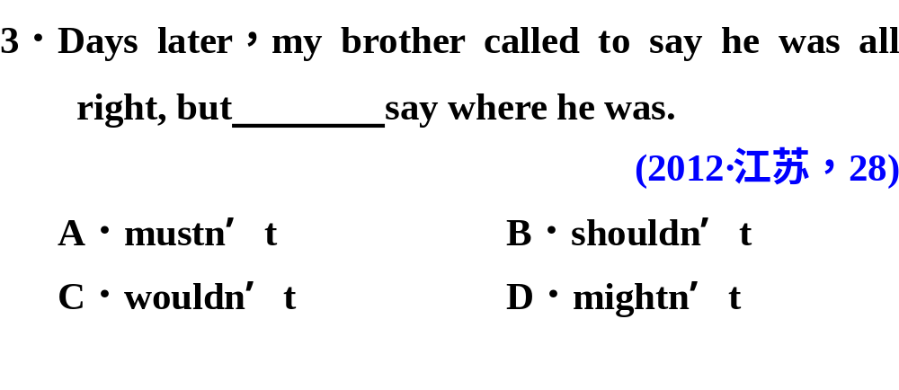
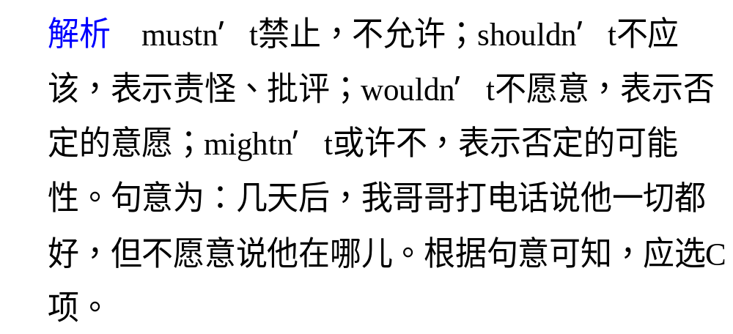
感悟高考
Period Four
C
学前热身
本课栏目开关
合作探究
感悟高考

Slide 4
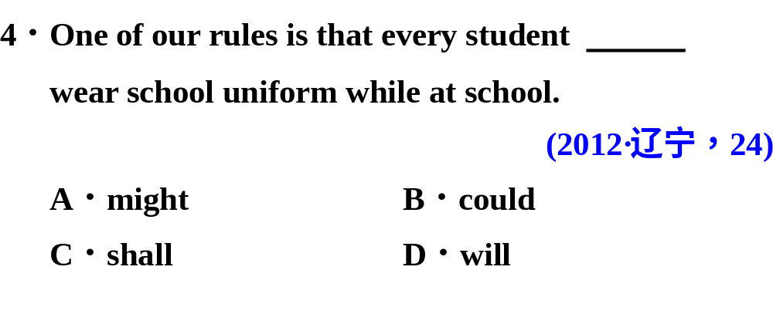
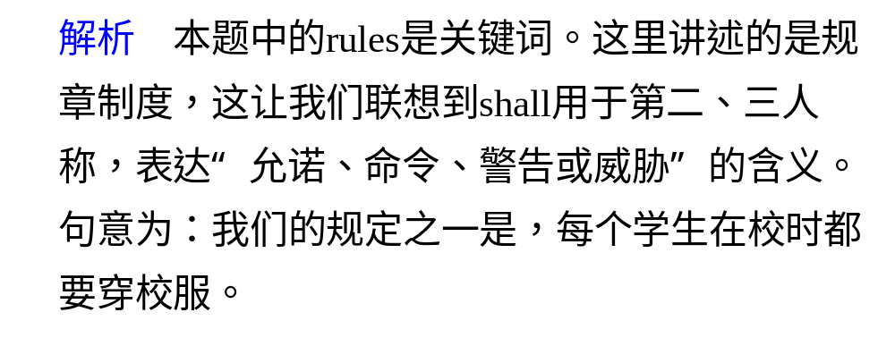
感悟高考
Period Four
C
学前热身
本课栏目开关
合作探究
感悟高考

Slide 5
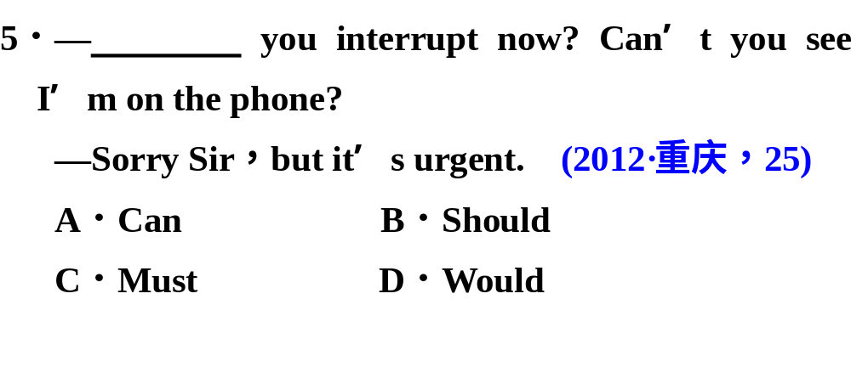
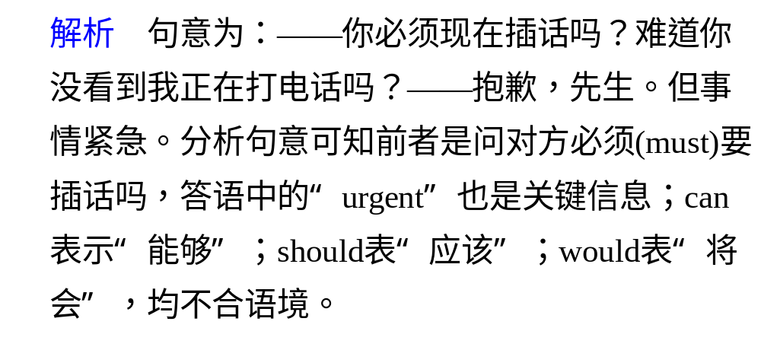
感悟高考
Period Four
C
学前热身
本课栏目开关
合作探究
感悟高考

Slide 6
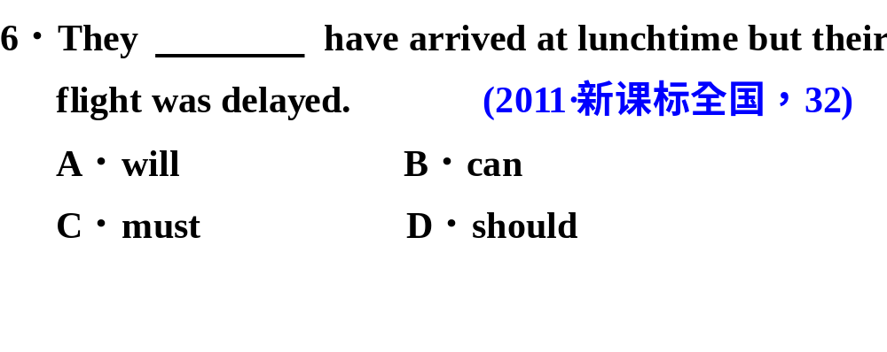
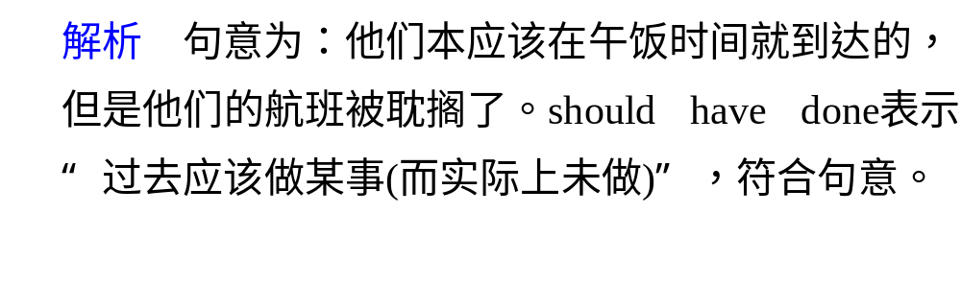
感悟高考
Period Four
D
学前热身
本课栏目开关
合作探究
感悟高考

Slide 7
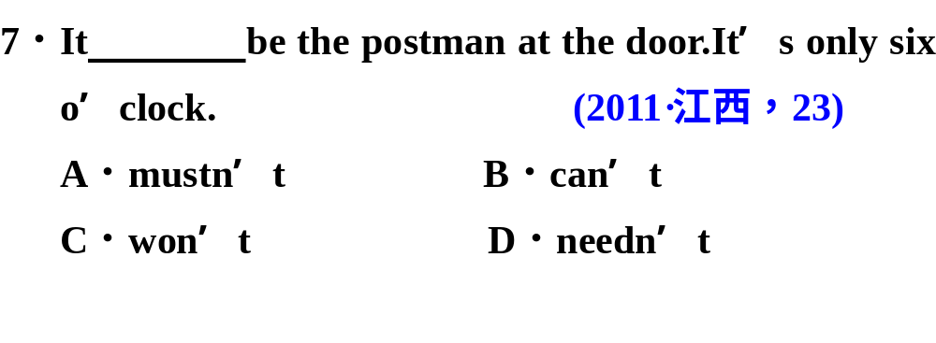
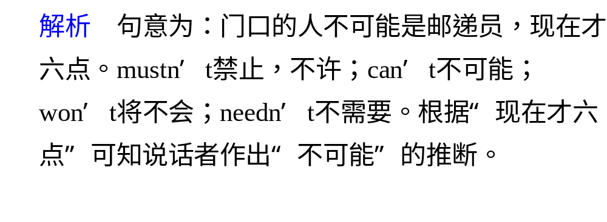
感悟高考
Period Four
B
学前热身
本课栏目开关
合作探究
感悟高考

Slide 8
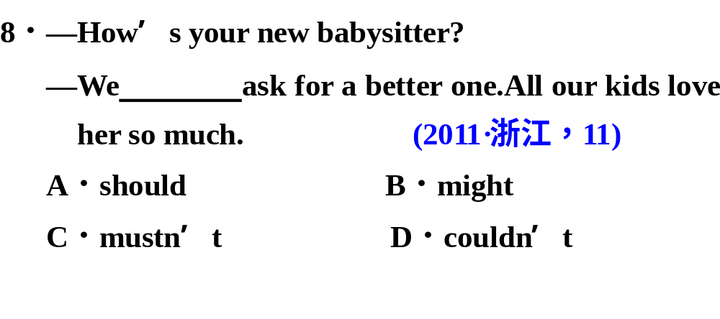
感悟高考
Period Four
学前热身
本课栏目开关
合作探究
感悟高考

Slide 9
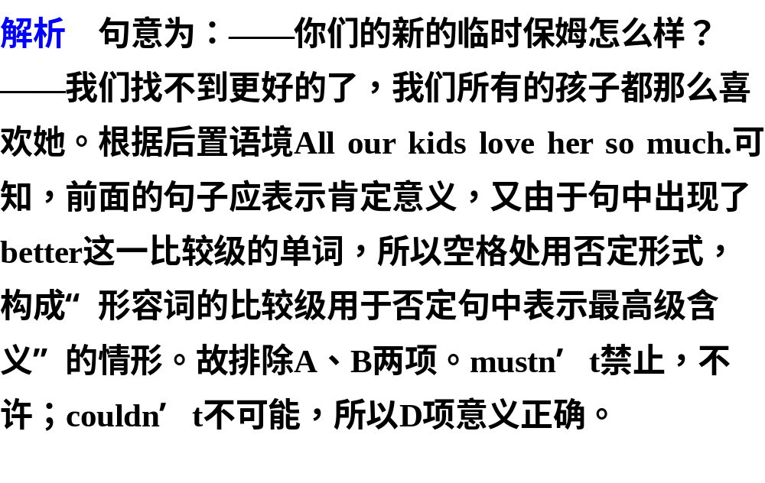
感悟高考
Period Four
学前热身
本课栏目开关
合作探究
感悟高考
答案 D

Slide 10
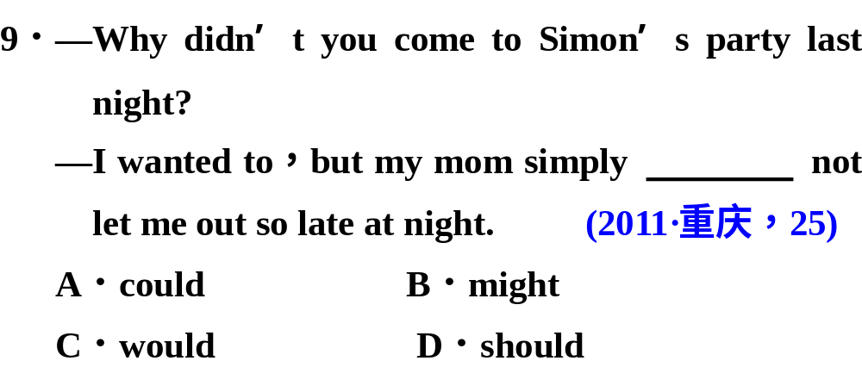
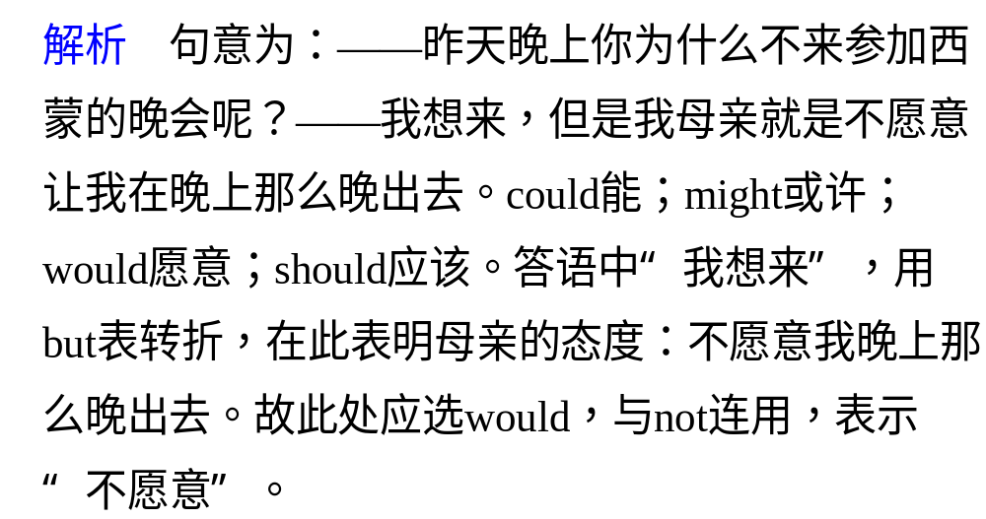
感悟高考
Period Four
C
学前热身
本课栏目开关
合作探究
感悟高考

Slide 11
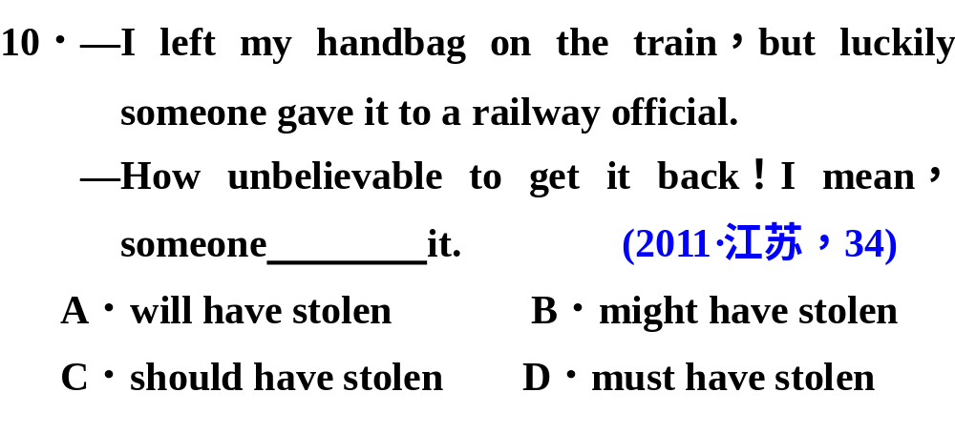
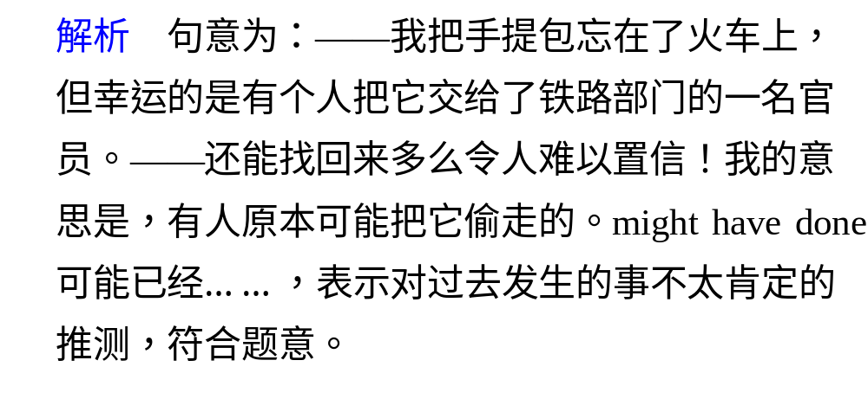
感悟高考
Period Four
学前热身
本课栏目开关
B
合作探究
感悟高考

Slide 12
1. —Isn’t that Ann’s husband over there?
—No, it ________ be him. I’m sure he doesn’t wear glasses.
(04全国I 29)
A. can’t B. must not C. won’t D. may not
2. —I’ll tell Mary about her new job tomorrow.
—You ________ her last week. (04福建32)
A. ought to tell B. would have told
C. must tell D. should have told
3. I often see lights in that empty house. Do you think I ________
report it to the police? (04广西21)
A. should B. may C. will D. can
4. Mr. White ________ at 8:30 for the meeting, but he didn’t show
up. (04广西27)
A. should have arrived B. should arrive
C. should have had arrived D. should be arriving
5. —Excuse me. Is this the right way to the Summer Palace?
—Sorry, I am not sure. But it ________ be. (04湖北26)
A. might B. will C. must D. can
√
√
√
√
√

Slide 13
6. —Excuse me, but I want to use your computer to type a report.
—You ________ have my computer if you don't take care of it.
(04湖南28)
A. shan't B. might not C. needn't D. shouldn't
7. —I don't mind telling you what I know.
—You ________. I'm not asking you for it. (04江苏22)
A. mustn't B. may not C. can't D. needn’t
8. —Mum, I’ve been studying English since 8 o’clock. ________ I go out
and play with Tom for a while?
—No, I’m afraid not . Besides, it’s raining outside now. (04辽宁29)
A. Can’t B. Wouldn’t C. May not D. Won’t
9. You ________ be tired — you've only been working for an hour.
(04全国II 29)
A. must not B. won't C. can't D. may not
10. Children under 12 years of age in that country ________ be under
adult supervision when in a public library. (04上海28)
A. must B. may C. can D. need
√
√
√
√
√

Slide 14
11. —Who is the girl standing over there?
—Well, if you ________ know, her name is Mabel. (04天津31)
A. may B. can C. must D. shall
12. I ________ pay Tracy a visit, but I am not sure whether I will
have time this Sunday. (04浙江26)
A. should B. might C. would D. could
13. “The interest ________ be divided into five parts, according to
the agreement made by both sides,” declared the judge.
(04重庆24)
A. may B. should C. must D. shall
14. He paid for a seat, when he ________ have entered free.
(05年山东34)
A. could B. would C. must D. need
15. He ________ have completed his work; otherwise, he wouldn’t
be enjoying himself by the seaside. (05年北京26)
A. should B. must C. wouldn’t D. can’t
√
√
√
√
√

Slide 15
16. I ________ have been more than six years old when the
accident happened. (05年天津14)
A. shouldn’t B. couldn’t C. mustn’t D. needn’t
17. —I’ve taken someone else’s green sweater by mistake.
—It ________ Harry’s. He always wears green. (05年广东33)
A. has to be B. will be C. mustn’t be D. could be
18. —Tom is never late for work. Why is he absent today?
—Something ________ to him. (05年江西22)
A. must happen B. should have happened
C. could have happened D. must have happened
19. The World Wide Web is sometimes jokingly called the World
Wide Wait because it ________ be very slow. (05年浙江9)
A. should B. must C. will D. can
20. —Lucy doesn’t mind lending you her dictionary.
—She ________. I’ve already borrowed one. (05年湖南24)
A. can’t B. mustn’t C. needn’t D. shouldn’t
√
√
√
√
√

