Slide 1
Unit 2 Reading 1

Slide 2
While-reading
四、阅读课文A PIONEER FOR ALL PEOPLE,回答下列问题
1.Why has Yuan Longping struggled for many years?
A.He wants to become one of the top scientists.
B.He wants to prove farmers can also become scientists.
C.He wants to do something for the farmers.
D.He wants other countries to know him.
答案:C

Slide 3
一
二
三
四
五
2.When Yuan Longping was a young man, .
A.many people in the countryside didn’t have enough food to eat
B.all the people in the countryside were living a happy life
C.no one in the cities was able to help the poor in the countryside
D.he didn’t like the life in the countryside
答案:A

Slide 4
一
二
三
四
五
3.From the passage we can know that Yuan Longping’s hybrid rice .
A.helps the farmers produce larger harvests
B.can be only grown in China
C.is not accepted by the United Nations
D.is now grown around the globe
答案:A
4.What kind of person is Yuan Longping?
A.He likes to live with the poor and is ready to help them.
B.He thinks much of himself but little of others.
C.He is strict with other scientists and the farmers.
D.He has his own dreams to help the people.
答案:D

Slide 5
一
二
三
四
五
Post-reading
五、阅读课文A PIONEER FOR ALL PEOPLE,完成下列短文
Famous scientist as he is,Yuan Longping considers himself a farmer.As a young man,Yuan Longping saw the great need for increasing the rice 1. .At that time,2. was a disturbing problem in China.He wanted to increase rice harvests without 3. the area of the fields.In 1973,a special strain of rice made it possible to produce 20% more of the 4. in the same fields.5. to his research,the UN has more tools in the 6. to rid the world of hunger.
output
hunger
expanding
crop
Thanks
battle

Slide 6
一
二
三
四
五
circulating
He is now 7. his rice knowledge in less developed countries to increase their rice harvests and he wants to 8. his rice so that it can be grown around the globe.Though he has
9. for the past five decades,Yuan Longping is quite 10. with his life.In his spare time,he enjoys listening to violin music,playing mah-jong,swimming and reading.
export
struggled
satisfied

Slide 7
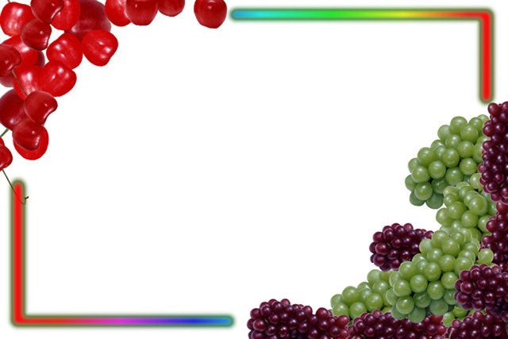
Chemical Or Organic Farming?

Slide 8
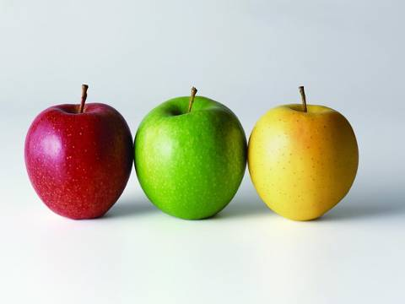


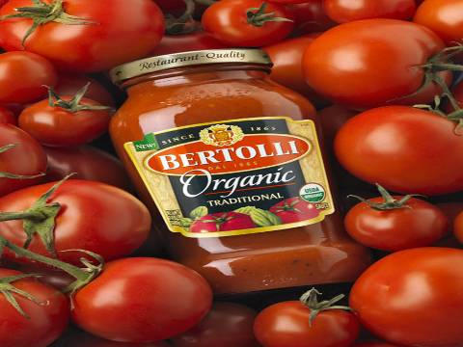

green food
organic food

Slide 9
Chemical Or Organic Farming?

Slide 10
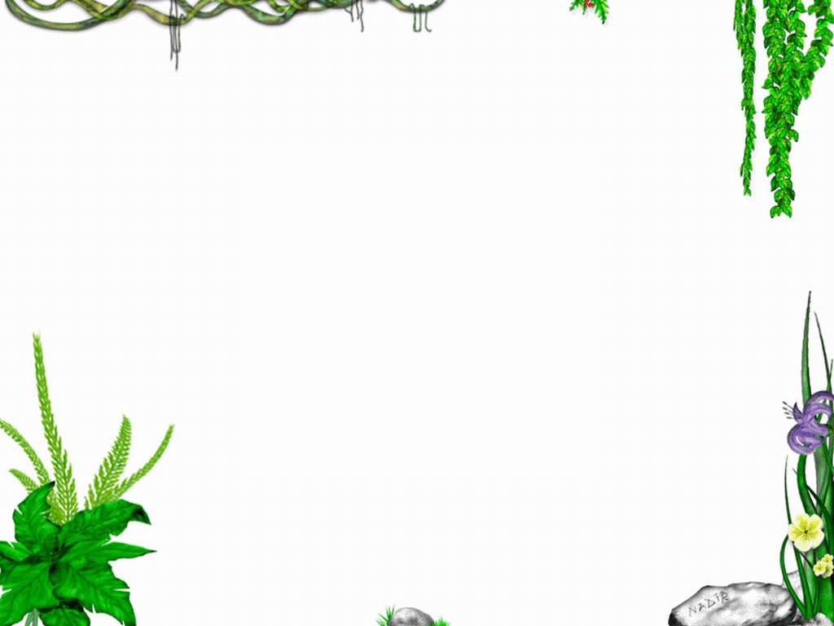

First reading: get the main idea of each paragraph.
para1: A new discovery of scientists.
para2: Several problems caused by using chemical fertilizers.
para3: The advantages of using organic farming.
para4: Some methods to keep the soil fertile.

Slide 11
Second reading
therefore; meanwhile; anyhow; thus ;otherwise; moreover; besides etc.
Tips: the usage of several adverbs means clear and reasonable connection between parts.
Many farmers welcomed them as a great way to stop crop disease and increase production.
Long-term use of chemical fertilizers can cause damage to the land and , even more dangerous, to people’s health.
1 Why are chemical fertilizers so popular in farming today?
2 After the long-term use of chemical fertilizers, what have scientists found?
Recently, however,

Slide 12
Read paragraph 2 and find out the problems caused by using chemical fertilizers.
There are three problems.First, they can damage … as well as …. They also stay in the … and …. In addition, …grow too fast to ….
first;second; finally;last but not least ,etc.
Tips: connectives（过渡词） and transitional phrases（过渡词） for development

Slide 13
Read paragraph 3-4
What are the advantages of organic farming?
The farmers focus on keeping their soil rich and free of disease and keeping the air , soil, water and crops free from chemicals.
Tips: several phrases can be used.

Slide 14
Tips: infinitive” to” is used to express the purpose
The methods to keep the soil fertile
1 using natural waste from animals as fertilizer.
2 changing the kind of crop in each field .
3 planting crops to use different levels of soil
4 planting grass between crops to prevent …
The same goal : ________________________
______________________________________
______________________________
to grow good food and to avoid damaging the environment or people’s health.

Slide 15
Read the following sentence, and find what they have in common?
1 …such as wheat or corn that need rich and fertile soil.
2 …planting peanuts that use the ground’s surface followed by vegetables that put down deep roots.
The two sentences both include attibutive clause.
Tips: clauses make the passage logical（逻辑的） and beautiful
Noun Clauses & Attributive Clause

Slide 16
The structure of this passage
Para1 Topic
para1: A new discovery of scientists.
para2: Several problems caused by using chemical fertilizers.
para3: The advantages of using organic farming.
para4: Some methods to keep the soil fertile.
illustration（阐明）
comparison
conclusion
Para2 Problems
Para3 Advantages
Para4 Several methods
The type of the article is_____________
exposition（说明文）

Slide 17
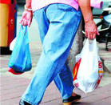

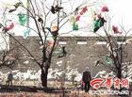
请以“PLASTIC OR CLOTH BAGS?”为题模仿这篇文章的篇章结构和句子结构去写一篇说明文。

Slide 18
Discussion and practice
Plastic Or Cloth Bags?
Para1:
Para2:
Para3:
Para4:
Have a brief illustration of the present situation.
The problems caused by using plastic bags.
The advanages of using cloth bags.
Conclusion.
illustration（阐明）
comparison
conclusion

Slide 19
The following words may help you.
Over the past half century, …have become very common …. …welcomed them as a … way to …. Recently, however, we have been finding that they can cause damage to …, even …, to people’s health.

Slide 20

Homework :
Finish the writing .

Slide 21
The following words may help you.
Over the past half century, …have become very common …. …welcomed them as a … way to …. Recently, however, we have been finding that they can cause damage to …, even …, to people’s health.
What are some of the problems caused by …? First,…
With these discoveries, …are beginning to turn to ….
….

Slide 22
The structure of this passage
Para1 Topic
Para2 Problems
Para3 Advantages
Para4 Several methods
Illustration（阐明）
comparison
conclusion
The type of the article is_____________
Exposition（说明文）

Slide 23
Over the past half century, plastic bags have become very common in our daily life. We welcomed them as a convenient way to carry goods. Recently, however, we have been finding that they can cause damage to the environment, even worse, to people’s health.

Slide 24
What are some of the problems caused by plastic bags? First, people often leave plastic bags here and there, making white pollution. Second, it takes a long time, more than 100 years ,to be exact, to break up .Last but not least, when heated, plastic bags can produce something harmful, which can build up in our body and eventually lead to cancer or other illnesses.

Slide 25
With these discoveries, we are beginning to turn to cloth bags. They can be used many times. People can save a lot of source in this way. It is also a good idea to make some by ourselves, which is interesting.
Let’s use cloth bags in our daily life instead of plastic bags, not only for the environment protection, but also the sake of our health.

Slide 26
What do you think of the farming today?
healthy?
environment-friendly?
natural?
chemical?
organic?
green?
transgenic?

