Slide 1

Book 4 Unit 2
Working the land

Slide 2

1
重点单词
Ⅰ.写作必记单词
1. vi.& n.斗争；拼搏；努力
2. vt.& vi.使变大；伸展
3. vt.摆脱；除去
4. adv.因此；所以；因而
5. vt.& vi.配备；装备
n.设备
struggle
expand
rid
therefore
equip
equipment

Slide 3
6. vt.使迷惑；使为难
adj.迷惑的
adj.令人困惑的
7. vt.遗憾；惋惜
n.遗憾；懊悔
8. n.焦点；中心点
vt.集中；聚焦
9. vt.减少；减缩
10. n.评论；议论
vi.& vt.表达意见；作出评论
confuse
confused
confusing
regret
focus
reduce
comment

Slide 4
Ⅱ.阅读识记单词
11.statistic n._______________________________
12.sunburnt adj.______
13.decade n.____________
14.output n.___________
15.hunger n.___________
vt.& vi.________
16.disturbing adj._______________________
vt.打扰
数据；统计；统计数字；统计资料
晒黑的
十年；十年期
产量；输出
饥饿；欲望
(使)饥饿
引起烦恼的；令人不安的
disturb

Slide 5
17.circulate vt.& vi.__________
18.battle n._______________________
vt.& vi.___________
19.freedom n.__________
20.nationality n._____
________ adj.国家的；民族的
21.occupation n._________________
vt.占据；占领
22.chemical adj.__________________
23.production n.___________
循环；流传
战役；战斗；斗争；较量
搏斗；奋斗
自由；自主
国籍
national
工作；职业；占领
occupy
化学的；关于化学的
生产；制造

Slide 6
24.bacteria n.____
25.nutrition n._________________
26.mineral n.__________
27.discovery n.__________
vt.发现
28.skim vt.___________
29.underline vt._________________
30.summary n._________________
细菌
营养；滋养；食物
矿物；矿石
发现；发觉
discover
浏览；略读
画底线标出；强调
总结；摘要；概要

Slide 7
语境活用 [用所给词的正确形式填空]
1.Most of us are more (focus) on our tasks in the morning than we
are later in the day.(2016·全国Ⅱ)
2.In addition to their simple beauty，what makes the adobe dwellings admirable is their ability to “air condition”a house without using electric (equip).(2015·全国Ⅱ)
3.Neighbors should do all they can to avoid __________(disturb)
other people.(2014·湖南)
focused
equipment
disturbing

Slide 8
4.The people who want to improve their lives are left (confuse)
by all of the conflicting information.(2014·新课标全国Ⅰ)
5.Curiosity is important because it leads to (discover) or invention.
6.The pressure at work is on the increase in all (occupy).
confused
discovery
occupations

Slide 9

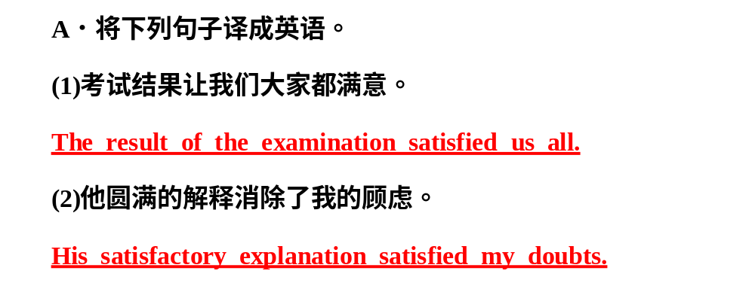

Slide 10
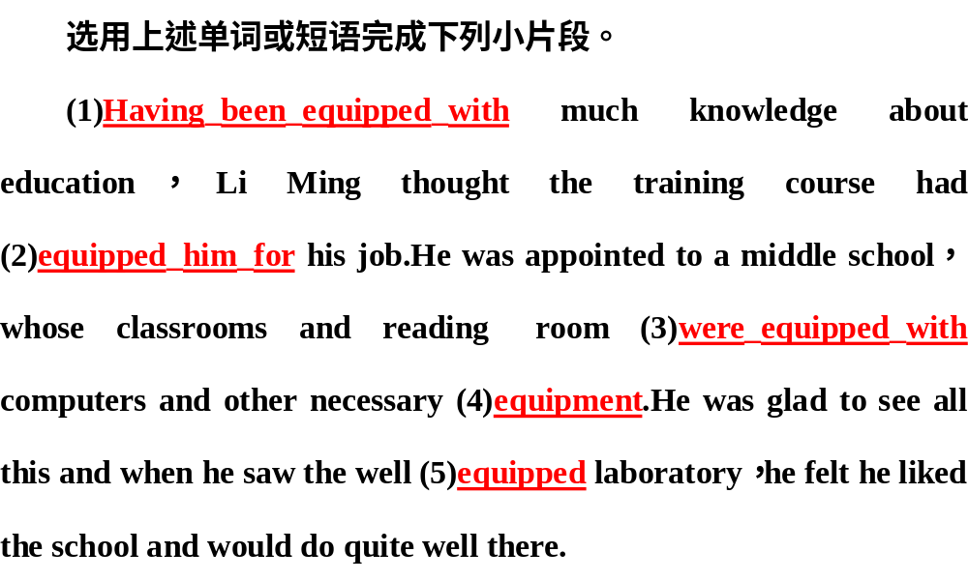

Slide 11
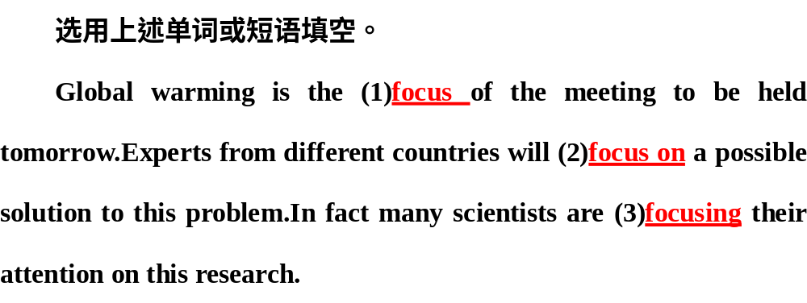

Slide 12
2
高频短语
1. 幸亏；由于；因为
2. 使……摆脱或除去
3. 对……感到满意
4. 逐渐增强；建立；开发
5. 导致；造成(后果)
6. 另外
7. 集中(注意力、精力等)于
thanks to
rid...of
be satisfied with
build up
lead to
in addition
focus on

Slide 13
8. 减少了……
9. 盛产
10. 使……免受(影响、伤害等)；使……不含(有害物)
reduce by
be rich in
keep...free from/of

Slide 14
语境活用 [运用上述短语完成片段]
In order to 1.___ local people (使……摆脱) poverty，he made up his mind to 2. (扩大) his business.More and more people have good jobs and earn a great deal of money at present.However，they 3.__________________(对……不满意) the life because of the haze.4._________(多亏了) the government’s effort，the air pollution has been 5. (减少了) more than 50%.As is known to us，it is our activity that 6. (导致) air pollution.
rid
of
build up
are not satisfied with
Thanks to
reduced by
leads to

Slide 15
边讲
边练
突破核心词汇
struggle vi.斗争；拼搏；努力
n.斗争；战争
1
(1)She’s struggling to bring up a family on a very low income.
她靠着非常微薄的收入艰难地供养着一家人。(朗文词典)
(2)We have to all kinds of difficulties.
我们得和各种各样的困难作斗争。
struggle with/against

Slide 16
struggle to do...努力做……；挣扎着做……
struggle against/with同……作斗争；与……抗争
struggle with...for...为争取……而与……作斗争
struggle to one’s feet挣扎着站起来
a struggle for为争取……的斗争

Slide 17
即时训练
[单句语法填空]
(1)He has been struggling illness for many years.
(2)What ideals will you fight and struggle ____?
(3)She struggled her feet and continued walking.
(4)It was struggle for her to make him understand.
against/with
for
to
a

Slide 18
rid vt.摆脱；除去
2
(1)She’s trying to rid herself of a dependence on drugs.
她正在努力戒除毒瘾。(朗文词典)
(2)He believed that his manager wanted to him for personal reasons.他认为经理是出于个人原因想开除他。
get rid of
rid...of...使……摆脱/除去……
get rid of摆脱掉；除掉；处理掉
be rid of摆脱

Slide 19
层级训练
基础知识训练——[单句语法填空]
(1)You must rid yourself these old­-fashioned ideas.
(2)You must get rid this bad mood.
写作能力提升——[一句多译]
(3)作为一名学生，你应该改掉你的坏习惯。
① (rid v.)
② (rid n.)
③ (remove v.)
of
of
As a student，you should rid yourself of the bad habits.
As a student，you should get rid of the bad habits.
As a student，you should remove the bad habits.

Slide 20
equip v.配备；装备；使有所准备；使有能力
3
(1)Please equip yourself with a sharp pencil and a rubber for the exam.
请准备一枝削尖的铅笔和一块橡皮参加考试。(牛津词典)
(2)A degree in the history of art is very nice but it doesn’t exactly equip you many jobs.
能获得一个艺术史学位固然不错，但在很多工作中它并不见得会使你有用武之地。
for

Slide 21
(1)equip...with...用……装备……
equip sb. for (doing) sth.使某人为(做)某事而准备
(2)equipment n.设备，器材；配备，装备
a piece of equipment一件设备

Slide 22
层级训练
基础知识训练——[单句语法填空]
(1)They equipped themselves a pair of sharp axes and set off for the forest.
(2)The (equip) picked up the signal from the satellite.
(3)Your education will equip you your future life.
with
equipment
for

Slide 23
写作能力提升——[句式升级]
(4)They are equipped with new scientific farming methods，so they have been able to use less farmland than in the past.(用过去分词短语作状语改写)
，they have been able to use less farmland than in the past.
Equipped with new scientific farming methods

Slide 24
focus vt.集中；聚焦
n.中心点；焦点
4
(1)All you need to do is focus on one thing.(2014·新课标全国Ⅰ)
你要做的就是集中精力在一件事上。
(2)The children’s faces were badly in the photograph. 照片上孩子们的面部非常模糊。
out of focus
focus...on/upon...把……集中于…… bring...into focus使……成为焦点 in focus对准焦点；清晰 out of focus没对准焦点；不清晰

Slide 25
层级训练
基础知识训练——[单句语法填空]
(1)Bring the subject focus if you want to have a good picture.
(2)With his attention (focus) on his homework，he forgot all about what I had told him.
(3)Consider carefully what you want to be focus.
[单句改错]
(4)His eyes focused on the blackboard so that he didn’t notice the flying
birds outside.
into
focused
in
∧
were

Slide 26
写作能力提升——[一句多译]
(5)他集中精力学习。
① (focus)
② (fix)
③ (absorb)
④ (apply)
⑤ (concentrate)
He focused his attention on his study.
He fixed his attention on his study.
He was absorbed in his study.
He applied himself to his study.
He concentrated his attention on his study.

Slide 27
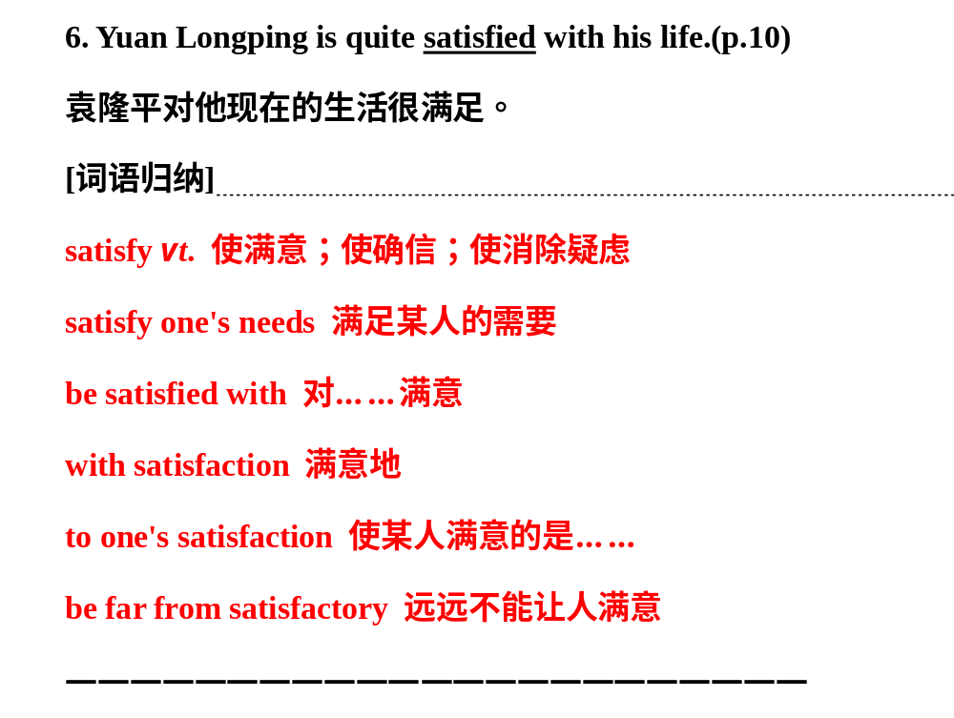

Slide 28
lead to导致；造成(后果)；通往
5
(1)Studying babies’ play may lead to a better understanding of science.
研究婴儿的游戏可能会更好地了解科学。(2016·浙江)
(2)None of the competitors could catch up with the untiring runner who was .
没有一个参赛者能追上那个不知疲倦的领跑者。
(3)He always in response to the government’s call.
他总是带头响应政府的号召。
in the lead
takes the lead

Slide 29
lead sb. to do...使某人做…… lead sb. to...带某人去…… lead the way带路 lead sb. by the nose牵着某人的鼻子走 in the lead领先；处于首位 take the lead带头；领先

Slide 30
层级训练
基础知识训练——[根据提示语填空]
(1)With him ① (带路)，we got there without any difficulty.But for him，we would have been lost，which would ②_______
(导致) serious consequences.His action ③ (使我们相信) that he was our true friend.
leading the way
lead to
led us to believe

Slide 31

写作能力提升——[一句多译]
(2)他的粗心导致了他考试失败。
① (lead to)
② (result in)
③ (contribute to)
His carelessness led to his failure in the exam.
His carelessness resulted in his failure in the exam.
His carelessness contributed to his failure in the exam.

Slide 32

自主训练
突破常考词汇
regret vt.懊悔；后悔；遗憾
n.痛惜；懊悔；遗憾
6
层级训练
基础知识训练——[单句语法填空]
(1)His father says that he has never regretted _______(send) his son to study abroad.
(2)We regret (inform) you that your application has not been accepted.
(3)We heard regret that you were not successful in your plan.
(4)Much my regret，I didn’t help him when he was in trouble.
sending
to inform
with
to

Slide 33
写作能力提升——[一句多译]
(5)事实上，约翰后悔没参加上周的讲座。
①In fact，John last week’s lecture.
②Actually，John last week’s lecture.
regretted not having attended
regretted that he had not attended

Slide 34
comment n.议论，评论；解释；批评，指责
v.表达意见；发表评论
7
[单句语法填空]
(1)I don’t feel I can comment their decision.
(2) (comment) on others too much does no good.
(3)Customers leave negative (comment) on the website Taobao.com to show their dissatisfaction with online service.
on
Commenting
comments

Slide 35
名师点拨
(1)comment on＝make comments on对……评论。
(2)comment用作及物动词时，其宾语通常只能是that从句，一般不能是名词或代词，若语义上需要接名词或代词作宾语，则通常用comment on sth.结构。

Slide 36
点拨规律
突破经典句型
If so，what did you do to grow them？
如果是这样的话，你怎样来种植这些植物？
8
句型：if引导的条件状语从句的省略
(1)Is the ability to speak just another sort of instinct？If so，how did human beings acquire this amazing skill?
说话的能力是另一种本能吗？如果是，人类是怎样获得这种神奇的技能的呢？
(2)I think there’s a train at midday. ，you’ll have to wait till 12：30.
我想正午会有一班火车。要是没有，你只好等到12点半了。
If not

Slide 37
if so如果是这样的话
if not如果不这样的话，如果没有
if ever如果有过/发生过的话
if any如果可能的话，如果有的话
if possible如果有可能
if necessary如果有必要

Slide 38
层级训练
基础知识训练——[对比填空if ever，if possible，if not]
(1)Is everybody feeling cold？ ，let us open the windows.
(2)The girl seldom， ，turned to her brother for protection.
(3)—Have you got any particular plans for the coming holiday?
—Yes. ，I’m going to visit some old people’s homes in the city.
If not
if ever
If possible

Slide 39
写作能力提升——[将下列句子改为省略形式]
(4)Some of you may have finished Unit One.If you have done so，you can go on to Unit Two.
__________________________________________________________________
(5)Wash it in water and pick out the small particles，if there are any.
_____________________________________________
Some of you may have finished Unit One. If so，you can go on to Unit Two.
Wash it in water and pick out the small particles，if any.

Slide 40
He would much rather keep time for his hobbies.
他宁愿把时间花在自己的爱好上。
9
句型：would rather...
(1)We would rather our daughter stayed at home with us，but it is her choice，and she is not a child any longer.
我们宁愿女儿和我们一起待在家里，但是这是她的选择，她已不再是小孩了。(2014·陕西)
(2)I him about it.
我宁愿当时把这件事告诉了他。
would rather have told

Slide 41
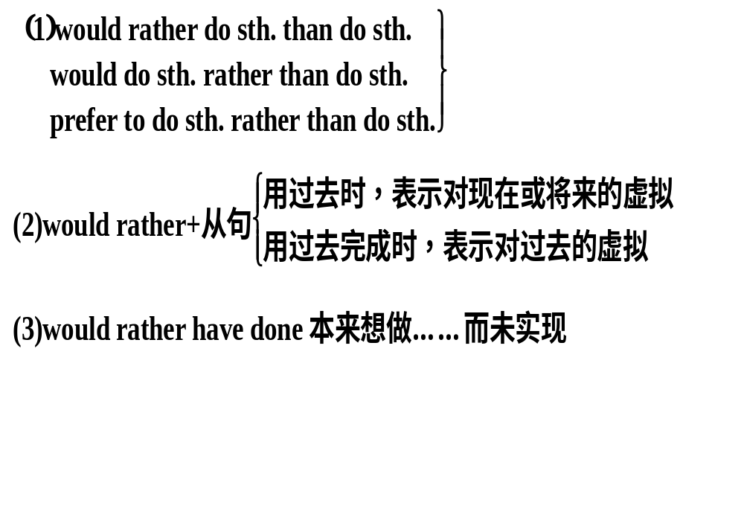
宁愿……而不愿……/与其……倒不如……

Slide 42
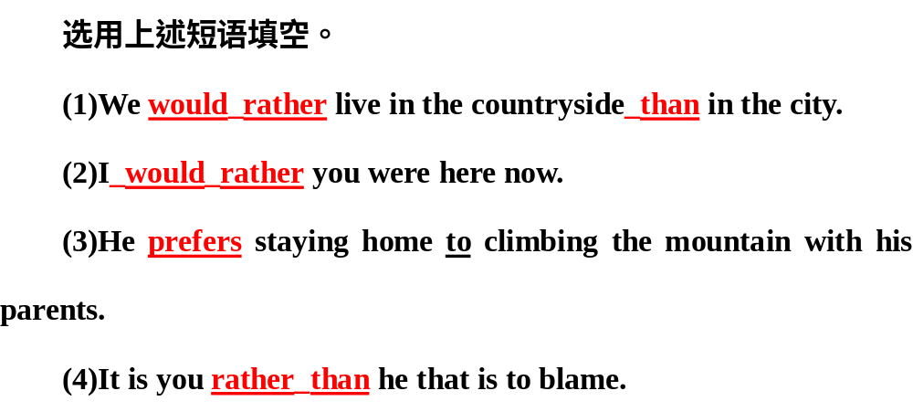

Slide 43
层级训练
基础知识训练——[单句语法填空]
(1)I would rather he (turn) up at that moment.
(2)She would rather you (come) tomorrow than today.
写作能力提升——[同义句改写]
(3)I prefer to play football rather than play basketball.
①I would play football .
②I’d rather play football .
had turned
came
rather than play basketball
than play basketball

