Slide 1
Unit 2
Working the land
1.1.1 集合的概念

Slide 2
Section Ⅰ
Warming­up & Reading
1.1.1 集合的概念

Slide 3
Ⅰ.单词速记
1．________(n.)数据；统计；统计数字；统计资料
2．________(adj.)晒黑的
3．________(vi.&n.)斗争；拼搏；努力
4．________(n.)十年；十年期
5．________(adj.)特级的；超级的
6．________(n.)产量；输出
7．________(vt.&vi.)使变大；伸展
8．________(adv.)因此；所以；因而
9．hunger(n.)饥饿；欲望(vt.&vi.)(使)饥饿→________(adj.)饥饿的；空腹的
statisti
sunburnt
struggle
decade
super
output
expand
therefore
hungry

Slide 4
10．disturbing(adj.)引起烦恼的；令人不安的→________(adj.)被打扰的→________(vt.)搅乱，扰乱
11．circulate(vt.&vi.)循环；流传→__________(n.)循环；运行
12．________(n.)自由；自主→free(adj.)自由的；自主的
13．equip(vt.&vi.)配备；装备→_________(n.)设备，装备
14．export(vt.&vi.)输出；出口→______(vt.&n.)输入；进口
15．nationality(n.)国籍→________(adj.)民族的；国民的→________(n.)民族；国家
16．occupation(n.)工作；职业；占领→________(vt.)占领，占据
disturbed
disturb
circulation
freedom
equipment
import
national
nation
occupy

Slide 5
Ⅱ.短语互译
1．work the land ________________
2．graduate from ________________
3．thanks to ________________
4．rid... of ________________
5．be satisfied with ________________
6．关心；在乎 ________________
7．宁愿；宁可 ________________
8．怀有……的希望 ________________
9．喜欢；照顾 ________________
10．有关系；有影响 ________________
耕种土地
毕业于
幸亏；由于；因为
使……摆脱或除去
对……感到满意
care about
would rather
with the hope of
9.care for
make a difference

Slide 6
Ⅲ.完成句子
1．你种过植物吗？如果种过的话，你是怎样种植的？如果没有种过的话，你想要尝试种什么植物？
Have you ever grown any plants? ________， what did you do to grow them? ________， what kind of plant would you like to try growing？(状语从句的省略)
2．每天，有超过8亿人饿着肚子睡觉。
More than 800 million people go to bed _______________. (形容词作状语)

Slide 7
3．袁隆平种植的是被称之为“超级杂交水稻”的稻种。
Yuan Longping grows _______________________________
(what引导宾语从句)
4．1973年，他成为世界上第一位种植高产水稻的农业先锋。
In 1973, he became _________________________ that has a high output.(the first＋n. to do sth.第一位做……人)
5．这种特殊的稻种使得同样的田地多收获五分之一的粮食。
This special strain of rice _____________________ in the same fields.(make it＋adj.＋to do sth.)

Slide 8
6．用他的杂交水稻种子，农民们种出的粮食比以前多了一倍。
Using his hybrid rice, farmers are producing harvests ____________________________.(倍数＋as... as...)
答案：1.If so; If not 2.hungry every day 3.what is called super hybrid rice 4.the first agricultural pioneer in the world to grow rice 5.makes it possible to produce 20% more of the crop 6.twice as large as before

Slide 9
Ⅳ.课文理解
Step 1 Fast Reading
Skim the passage and give the general idea of the text.
1．It is about ________________ who made a great contribution to producing better ________.
2．Skim the text to get the main idea of each paragraph.
A．Yuan Longping's dreams.
B．Yuan Longping's personality.
C．Yuan Longping's brief life experiences.
D．Yuan Longping's appearance and his achievement.

Slide 10
Para.1 | Para.2 | Para.3 | Para.4
_____ | _____ | _____ | _____
Step 2 Careful Reading
1．Choose the best answer according to the passage.
(1)Why has Yuan Longping struggled for many years?
A．He wants to become one of the top scientists.
B．He wants to prove farmers can also become scientists.
C．He wants to do something for the farmers.
D．He wants other countries to know him.

Slide 11
(2)When did he begin to make a study of the ways to increase the rice output?
A．More than 60 years ago.
B．More than 50 years ago.
C．About 40 years ago.
D．About 30 years ago.

Slide 12
(3)When Yuan Longping was a young man, ________.
A．many people in the countryside didn't have enough food to eat
B．all the people in the countryside were living a happy life
C．no one in the cities was able to help the poor in the countryside
D．he didn't like the life in the countryside

Slide 13
(4)From the passage we can know that Yuan Longping's hybrid rice ________.
A．helps the farmers produce larger harvests
B．can be only grown in China
C．is not accepted by the UN
D．is now grown around the globe
(5)What kind of person is Yuan Longping?
A．He likes to live with the poor and is ready to help them.
B．He thinks much of himself but little of others.
C．He is strict with other scientists and the farmers.
D．He has his own dreams to help the people.

Slide 14
2．Read the text and try to answer the following questions.
(1)What is Yuan Longping's great achievement?
___________________________________________
(2)What does he think of fame and money?
____________________________________________
(3)What does the word “battle” refer to in the second paragraph?
____________________________________________
(4)List at least three Yuan's hobbies. (no more than 10 words)
_____________________________________________

Slide 15
(5)List two dreams of Yuan Longping. (no more than 30 words)
①_____________________________________________
②________________________________________________

Slide 16
3．Fill in the blanks with proper words in the passage.
Yuan Longping, the father of (1)________ hybrid rice, is a famous scientist. He has (2)________ for the past five (3)________ for the Chinese farmers. In 1953 when Yuan Longping graduated from college, hunger was a (4)________ problem in many parts of the countryside. Therefore, Yuan wanted to help (5)________ his motherland of (6)________ by increasing the rice output without (7)________ the area of the fields and he made it. Yuan Longping's another dream is to (8)________ his rice to the world. (9)________ Yuan Longping, the UN has more tools in the (10)________ against hunger throughout the world.

Slide 17
Step 4 Discussion
Is Yuan Longping more of a scientist or more of a farmer？What can we learn from him?
________________________________________________________________________________________________________
答案：Step 1 (1)Yuan Longping; rice (2)DCBA
Step 2 1.(1)～(5)CBAAD

Slide 18
2．(1)He grows what is called super hybrid rice, which makes it possible to produce 20% more of the crop in the same fields.
(2)He doesn't care about being famous and feels it gives him less freedom to do his research. He would much rather keep time for his hobbies. He cares little about spending the money on himself or leading a comfortable life.
(3)Ridding the world of hunger.
(4)Listening to violin music/playing mahjong/swimming/reading
(5)①To produce a kind of rice that could feed more people.

Slide 19
②To export his rice so that it can be grown around the globe.
Step 3.(1)super (2)struggled (3)decades (4)disturbing
(5)rid (6)hunger (7)expanding (8)export
(9)Thanks to (10)battle
Step 4 I think Yuan Longping is more of a scientist, who carries out his research by farming. He has made great contributions to the mankind, ridding the world of hunger.

Slide 20
课堂要点探究

Slide 21

1.struggle
(1)v.
①奋斗，努力；斗争；搏斗，挣扎
They were poor and had to struggle for a living.
他们很穷，必须为生活而挣扎。
②艰难的行进；吃力地进行
I struggled up the hill with the heavy bags.
我背着几个沉重的包吃力地爬上山去。

Slide 22
(2)n. 奋斗，努力；斗争；搏斗，挣扎
①Three people were hurt in the struggle.
有三人在打斗中受伤。
②We will not give up our struggle for better working conditions.
我们不会放弃争取改善工作条件的斗争。
知识拓展
struggle to do sth.努力做某事
struggle for努力争取……；为……而斗争
struggle with/against与……作斗争
struggle with sb.与……搏斗
struggle to one's feet挣扎着站起来

Slide 23
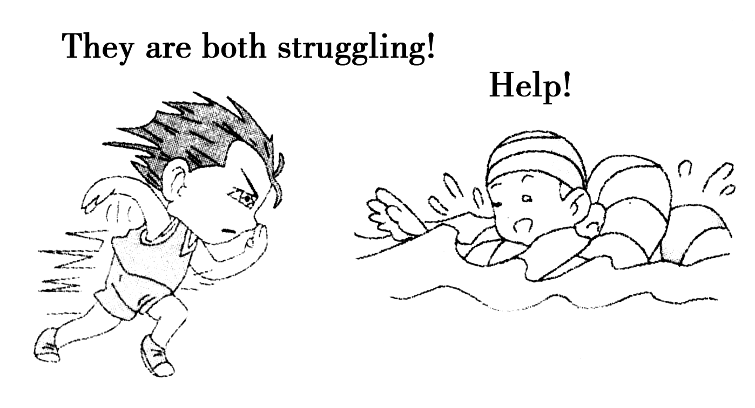
巧学助记
图文巧解struggle

Slide 24
活学活用
填入恰当的介词、副词。
①The wounded young man struggled ________ his feet.
②The workers have been struggling ________________ bad conditions for too long.
③她从来没有放弃，努力过着一种积极向上的(active)生活。
译：______________________________________________
答案：①to ②against/with ③She never gave up and struggled to lead an active life.

Slide 25
2．disturbing adj.引起烦恼的；令人不安的
①He has had some disturbing experiences.
他有过一些使他很不安的经历。
②It is very disturbing that we haven't seen him for a long time.
好长时间没见到他，这令我们深感不安。
知识拓展
(1)disturbed adj.心神不安的；担心的
(2)disturb vt.打扰；弄乱；使不安
disturbance n．打扰；扰乱；骚动

Slide 26
①I'm very disturbed about him.
我很担心他。
②Heavy truck traffic disturbed the neighborhood.
重型卡车的来来往往扰乱了这一带的安宁。
巧学助记
They were all disturbed by the disturbing news, that is, the news disturbed all of them.
这条令人不安的消息使他们都深感不安。也就是说，这条消息使他们都感到不安。

Slide 27
活学活用
选词填空(disturbing/disturbed/disturb/disturbance)。
①Don't ________ the sleeping child.
②The ________ news has made everyone present upset.
③I felt ________ to hear of your illness.
④The drunken man caused a ________ in the street.
答案：①disturb ②disturbing ③disturbed ④disturbance

Slide 28
3．expand vt.&vi.使变大，伸展
①Yuan Longping searched for a way to increase rice harvests without expanding the area of the fields.
袁隆平要在不增加土地面积的基础上寻求增收稻谷的方法。
②Our foreign trade has expanded during recent years.
我们的对外贸易近年来已得到扩大。
③She expanded her umbrella and went out.
她撑开伞就走出去了。

Slide 29
知识拓展
(1)expand... into...把……扩展/发展成……
expand into...发展成/扩大成……
expand on...细说(阐述)……
(2)expansion n．扩大；膨胀
They managed to expand the little firm into a big company; that is, the little firm expanded_into a big company.
他们把这家小公司发展成了一家大公司；也就是说，这家小公司发展成了一家大公司。

Slide 30
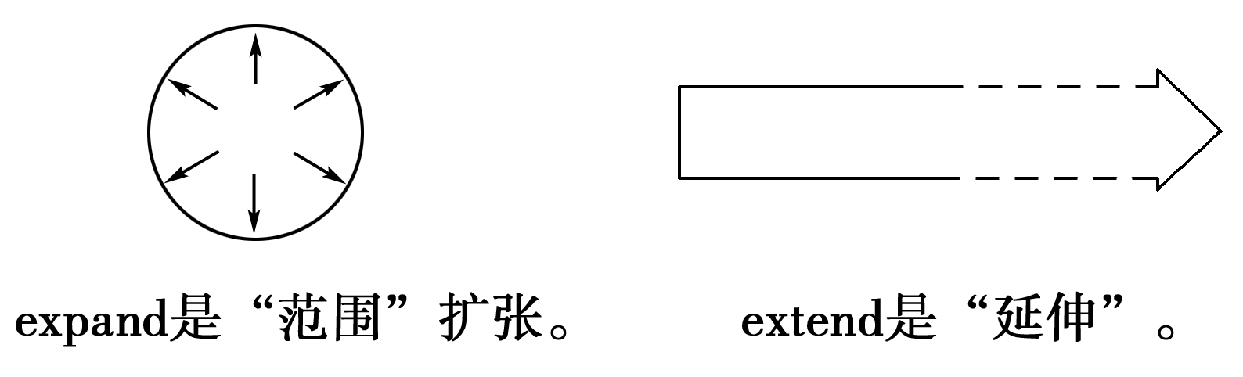
易混辨析
expand | “扩大；使膨胀”，指范围、体积的扩大
extend | “扩充；伸长”，指空间范围等的扩大，长度、宽度的延伸及时间的延长
巧学助记
形象记忆expand/extend

Slide 31
①A child's vocabulary expands through reading.
孩子的词汇量通过阅读得到扩大。
②My garden extends as far as the river.
我的花园一直延伸到河边。
活学活用
完成句子。
①He did not ________________ his statement.
他未就他的声明多加解释。
②The writer ________________ a long one.
那位作者把他的短篇小说扩展为长篇。

Slide 32
③The narrow path in the village___________________.
村里的狭窄小路被拓宽成一条大道。
④The eagle ______________________________________.
老鹰展开翅膀。
答案：①expand greatly on ②expanded his short novel into ③expanded into a wide road ④expanded its wings

Slide 33
4．rid vt.摆脱；除去
①It's not easy to rid oneself of a habit.
要改掉一个习惯是不容易的。
②We will be glad to get_rid_of him.
摆脱他，我们将很高兴。
知识拓展
(1)rid... of摆脱；除去
get/be rid of摆脱；除去；处理掉
(2)rid的过去式及过去分词为：rid/ridded；rid/ridded。

Slide 34
活学活用
完成句子。
①Do you think it possible ____________________________ nuclear weapons?
你认为世界可能会摆脱核武器吗？
②You should ____________________________.
你应当戒掉吸烟的习惯。
③We have to ____________________________.
我们必须把这些旧报纸处理掉。
答案：①to rid the world of ②get rid of the habit of smoking ③get rid of these old newspapers

Slide 35
5．equip vt.& vi.配备；装备
①Please equip yourself with a sharp pencil and a rubber for the exam.
请准备一支尖的铅笔和一块橡皮参加考试。
②His work experience equipped him to deal with all kinds of people.
他的工作经验使他能与各种各样的人打交道。

Slide 36
知识拓展
(1)equip... with...用……装备……
equip sb. to do sth.使某人有能力干某事
be equipped with装备着……
be well/poorly equipped设备精良的/较差的
(2)equipment n．装备；设备(不可数名词)
a piece of equipment一件设备

Slide 37
活学活用
完成句子。
①Our factory ________________________ modern machines.
我们厂是用现代化机械装备的。
②Our laboratory ________________ and ________________ America.
我们的实验室装备良好，大部分设备来自美国。
答案：①is equipped with ②is well equipped; most of its equipment is from

Slide 38
6．export vt.&vi.输出；出口
①Africa is exporting beef to Europe.
非洲向欧洲出口牛肉。
②Many raw materials are exported to foreign countries.
许多原料输出国外。

Slide 39
知识拓展
(1)export n．输出，出口 (pl.)输出品，输出额
exporter n．出口商；出口公司；出口国
(2)import vt.输入；进口 n．输入；进口；进口产品
The country is a big exporter to export tea to foreign countries, but imports a lot of wheat from other countries.
这个国家是一个大的出口茶叶的出口国，但是要从其他国家进口很多小麦。

Slide 40
活学活用
完成句子。
①90% of the engines________________________________.
90%的发动机都出口到欧洲。
②____________________________________engines of cars.
该国的主要出口产品是汽车的发动机。
③Can you tell me the main product ___________________?
请告诉我你们出口的主要产品好吗？
答案：①are exported to Europe ②The country's major exports are ③you export

Slide 41
7．therefore adv.因此；所以；因而
Their car was bigger and therefore more comfortable.
他们的车比较大，所以要舒适些。
易混辨析
therefore | 副词，正式用语，用于说明事情的结果，可用逗号与后面的句子隔开。
so | 连词，非正式用语，用于简洁的会话和平时的对话中。

Slide 42
①The new trains have more powerful engines and are therefore faster.
新火车安装了功率更大的机车，因此车速更快。
②I was ill so I couldn't come to her party.
我病了，所以没能来参加她的聚会。
活学活用
选词填空(therefore，so)
①I was feeling hungry, ________ I made myself a sandwich.
②There is still much to discuss. We shall, ________， return to this item at our next meeting.
答案：①so ②therefore

Slide 43
③Progress so far has been very good. ________， we are sure that the project will be completed on time.
A．However B．Otherwise
C．Therefore D．Besides
答案：C 句意：到目前为止进展还是不错的。因此我们确信工作会按期完工的。therefore“因此”，表示结果，符合句意。however“然而”，表示转折；otherwise“否则；要不然”，表转折；besides“除此以外；而且”，表示递进。

Slide 44
④(2014·安徽，33)It's our hope that we will play a greater role in the market place and, ________， supply more jobs.
A．however B．anywhere
C．therefore D．otherwise
答案：C 考查副词。句意：我们希望我们会在市场上起更大的作用，因此提供更多的工作。A项为：然而；B项为：任何地方；C项为：因此；D项为：否则。由句意可知选C项。

Slide 45

8.thanks to幸亏；由于；因为
①Thanks_to his research, the UN has more tools in the battle to rid the world of hunger.
由于他的研究，联合国在消除世界饥饿的战斗中有了更多的方法。
②Thanks_to you, I was saved from drowning.
幸亏你，我才没有被淹死。

Slide 46
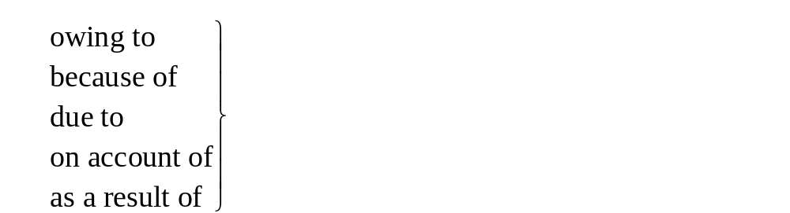
知识拓展
由于；因为
名师点拨
(1)thanks to，owing to，due to，because of都是介词(直接用在名词之前)，而不是连接词(不可用来连接句子的两个部分)。
[译]由于飞机误点，我只得等了好几个小时。

Slide 47
[正]I had to wait hours because the plane was delayed.
[误]I had to wait hours owing to(because of) the plane was delayed.
(2)thanks to表示“幸亏，多亏”，多用来解释某件好事发生的原因，相当于感谢，在句中作状语或表语。
活学活用
完成句子。
①________________________， we finished our work on time.
幸亏有他的帮助，我们按时完成了工作。

Slide 48
②It was ______________________ that I succeeded.
幸亏他的建议我才成功。
③Thanks to John we arrived three hours late.
译：_____________________________________________
答案：①Thanks to his help ②thanks to his advice ③我们迟到了3小时，这都怪约翰。

Slide 49
9．be satisfied with对……感到满意
①Yuan Longping is quite satisfied_with his life.
袁隆平对生活很满足。
②I am not satisfied_with your work; you must improve it.
我对你的工作不满意，你必须加以改进。
知识拓展
(1)be satisfied to do...对做……感到满意
(2)satisfy vt.使……满意
satisfy one's needs满足某人的需要
(3)satisfaction n．满意
with satisfaction满意地
to one's satisfaction使某人满意的是

Slide 50
(4)satisfying adj.令人满意的
satisfactory adj.令人满意的
①She's_satisfied_to stay at home.待在家里她很满意。
②We must develop production to satisfy_the_people's_needs.
我们必须发展生产，满足人民的需要。
活学活用
根据句意用与satisfy有关的词填空。
①I hope you are ________ with the new car.
我希望你对这辆新车感到满意。

Slide 51
②Much to the customers' ________， the company is trying hard to ________ their needs.
令顾客们感到非常满意的是，公司正尽力满足他们的需求。
③His reply to my questions was not ________.
他给我的答复不尽如人意。
答案：①satisfied ②satisfaction; satisfy ③satisfactory

Slide 52
10．would rather宁愿；宁可
①He would much rather keep time for his hobbies.
他宁愿把时间花在自己的业余爱好上。
②I'd_rather die than apologize to her.
我宁可死也不会向她道歉。

Slide 53
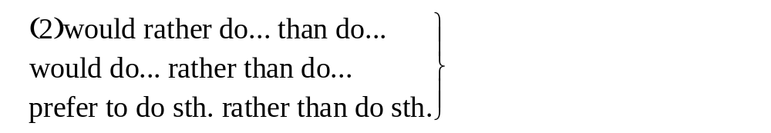
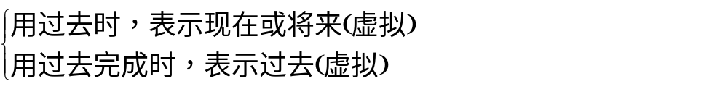
知识拓展
(1)would rather (not) do宁愿(不)做……
宁愿……(而)不愿 ……/与 其……倒不如……
(3)would rather＋从句
①I would_rather have the small one than the big one.
我宁愿要小的，不要大的。
②I would rather he had_turned_up at that moment.
我宁愿他在那时露面。

Slide 54
活学活用
用所给词的适当形式填空。
①We would rather ________(live) in China freely than ________(live) in rich countries.
②David would rather (that) I ________(treat) him next Monday.
答案：①live; live ②treated

Slide 55
句型转换。
③I'd rather play football than play basketball.
→I ________________ football ________________ basketball.
→I ________________ football ________________ basketball.
答案：would blay; rather than play; prefer to play; rather than play

Slide 56
④George is going to talk about the geography of his country，but I'd rather he________more on its culture.
A．focus B．focused
C．would focus D．had focused
答案：B 句意：乔治将要谈他的国家的地理，但是我宁愿他能更多地谈一下文化。would rather后跟从句，要用过去时表示现在或将来的动作。

Slide 57

11.Have you ever grown any plants? If_so,_what did you do to grow them? If_not,_what kind of plant would you like to try growing？你种过植物吗？如果种过的话，你是怎样种植的？如果没有种过的话，你想要尝试种什么植物？
句式分析
(1)此句用了省略结构。
(2)If so为if it is so省略句式，if为连词，so指代上文的内容。意为：如果是这样的话。

Slide 58
(3)If not为If so的否定形式。
①Do you want to join in the summer camp? If_so,_please sign your name here.
你想参加夏令营吗？如果想的话，请在这里签名吧。
②Can we attend your lecture? If_not,_please let us know.
我们能参加你的演讲吗？如果不可以的话，请让我们知道。
活学活用
仿写句子。
①你去过上海吗？如果去过，什么给你留下了深刻的印象？如果没有过去，那么你何时想去欣赏它呢？

Slide 59
Have you ever travelled to Shanghai? ________， what impressed you most there? ________， when will you want to admire it?
②你已完成工作了吗？如果已完成，下一步你要做什么？如果没完成，你怎么才能按时完成它？
__________________________________________________
__________________________________________________
答案：①If so; If not ②Have you finished your work? If so, what will you do next? If not, how can you finish it on time?

Slide 60
③It sounds like something is wrong with the car's engine. ________， we'd better take it to the garage immediately.
A．Otherwise B．If not
C．But for that D．If so
答案：D 句意：听起来好像是汽车的发动机出问题了。如果是这样的话，我们最好立刻把车送到修理厂去。if so相当于if it is so，意为“如果这样的话”，其中so指代前句内容，符合句意。otherwise“不然的话”；if not“如果不”；but for that“如果不是那样”。

Slide 61
④(2014·福建，28)The climate here is quite pleasant, the temperature rarely, ________， reaching 30℃ in summer.
A．if not B．if ever
C．if any D．if so
答案：B 考查if从句的省略。if not如果不的话； if ever要是有的话(频率); if any要是有的话(量多少); if so如果这样、那样的话。根据形容词pleasant“令人愉悦的”及副词rarely“很少”可知，气温达到30度只是偶尔才会出现的情况，故选择B。句意为：这儿的气候是相当舒适的，要是曾经有的话，气温也很少达到30度。

Slide 62
12．Yuan Longping grows what_is_called_super_hybrid_rice.
袁隆平种植的是被称之为“超级杂交水稻”的稻种。
句式分析
(1)此句为主从复合句。
(2)句中含有what引导的宾语从句，在句中作谓语动词grows的
宾语，what在从句中充当主语。
(3)call意为：把……叫做，此处用了其被动结构，其主动用法
为：call＋宾语＋宾语补足语。
①We all call the little boy baby.
我们都称这小男孩宝贝。

Slide 63
②What would you like to call the dog?
你想叫这条狗什么？
活学活用
仿写句子。
①为了挣钱，这里的农民种植被称为花生的作物。
To make money, farmers here grow ___________________
②这家商店主要卖被称之为运动服的服饰。
The shop mainly sells _______________________________.
答案：①what is called peanuts ②what is called sports clothes.

Slide 64
13．In 1973, he became the first agricultural Pioneer in the world to grow rice that has a high output.
1973年，他成为世界上第一位种植高产水稻的农业先锋。
句式分析
(1)此句为主从复合句。
(2)句中含有that引导的定语从句，修饰先行词“rice”，且that在从句中充当主语。
(3)主句中表语中心词“pioneer”由序数词修饰，后面为不定式作后置定语。

Slide 65
名师点拨
当名词由形容词最高级或表示次序的词汇the first，the last以及the only，the very，the right修饰时，后面要用不定式作定语，这些名词与动词不定式有逻辑上的主谓关系。
①He was the_first_man_to_map the coast line of this part.
他是第一位为这部分海岸线绘图的人。
②The girl student bought a book that is useful to her study.
这名女学生买了一本对她的学习很有帮助的书。

Slide 66
活学活用
仿写句子。
①郑和是航行到很多其他中国人没有到过的国外的地方的先锋。
Zheng He was ______________________________________
______ that no other Chinese people had ever been to.
②王亚平是第一个在太空授课的中国宇航员。
Wang Yaping______________________________ in space.
答案：①the first pioneer to sail to many foreign places ②is the first Chinese astronaut to give lessons

Slide 67
③When there is a football match, he is always the first boy ________.
A．comes B．coming
C．came D．to come
答案：D 句意：当有足球赛时他总是第一个来的男孩。“the first＋n.”后常接动词不定式作定语，表示“第一个做某事的……”。

Slide 68
④—The last one ________ pays the meal.
—Agreed!
A．arrived B．arrives
C．to arrive D．arriving
答案：C 句意：——最后到达的结账。——同意！“the last/next/first＋n.”后常接动词不定式作定语。

Slide 69
14．This special strain of rice makes it possible to produce 20% more of the crop in the same fields.
这种特殊的稻种使得同样的田地多收获百分之二十的粮食。
句式分析
(1)此句为复杂的简单句。
(2)本句中用了“make＋it＋adj./n.＋to do sth./that...”结构，it作形式宾语代替动词不定式短语to produce 20% more of the crop in the same fields, possible作宾语补足语。
①They made_it_possible_to_deal_with the matter in this way.
他们使得用这种方法处理这件事成为可能。

Slide 70
②We made_it_a_rule_to_visit those old people every week.
我们每个周规定好去拜访那些老人。
名师点拨
常跟如上结构的词还有：find，consider，think，believe，feel等。
①We found it pleasant to work in this company.
我们发现在这家公司工作很愉快。
②I consider it a great honour to be invited to the party.
我认为能被邀请参加晚会是很大的荣幸。

Slide 71
活学活用
仿写句子。
①这种特别的方法使得在一个小时内记住200个英语单词成为可能。
The special way____________________________________ 200 English words in one hour.
②他们帮忙尽可能在很短的时间内把这些信送到主人手里。
Their help ______________________________these letters
to the owners in a short time.
答案：①makes it possible to remember ②made it possible to deliver

Slide 72
③New technologies have made ________ possible to turn out new products faster and at a lower cost.
A．that B．this
C．one D．it
答案：D 句意：新科技使以更低的成本更快地生产新产品成为可能。本句的真正宾语是to turn out new products faster and at a lower cost，所以用it作形式宾语。其他选项无此用法。

Slide 73
④We feel ________ our duty to make our country a better place.
A．it B．this
C．that D．one
答案：A 句意：我们认为使国家变得更好是我们的责任。it作形式宾语，真正的宾语是后面的不定式to make our country a better place。其他三项均不可作形式宾语。

Slide 74
15．Using his hybrid rice, farmers are producing harvests twice as large as before.
用他的杂交水稻种子，农民们种出的粮食比以前多了一倍。
句式分析
(1)此句为简单句。
(2)句中分词短语“Using his hybrid rice”为方式状语。
(3)“twice as large as”为倍数的表达方式。
①Typing_it_into_the_computer,_the article was stored.
这篇文章被打入电脑储存了起来。
②The room is twice_as_large_as that one.
这个房间是那个房间的两倍。

Slide 75
名师点拨
(1)倍数(a quarter, half, twice, three times, etc.)＋as... as...；倍数＋as much/many＋名词＋as
①This bridge is three times as long as that one.
这座桥的长度是那座的三倍。
②He received three times as many presents as he had expected.
他收到的礼物是他预料的三倍。

Slide 76
(2)倍数＋adj./adv.的比较级＋than；倍数＋more＋名词＋than
Asia is three_times_larger_than Europe.
亚洲比欧洲大三倍。
(3)倍数＋the size/length/width/depth/height/amount of...
This river is a_quarter_the_length_of that one.
这条河是那条河的四分之一长。
(4)倍数＋what­clause
The production now is three_times_what it was ten years ago.
现在的产量是10年前的3倍。

Slide 77
(5)．..＋by＋倍数．..
Compared with that of last year, our coal output has increased by_3_times.
与去年相比，我们的煤产量增长了3倍。
活学活用
仿写句子 。
①使用这种新机器，他们收割庄稼是以前的两倍快。
__________， they can harvest the crops ________________.

Slide 78
②用他自己的方法，他一天内读的这本书多达以前的两倍。
________________，he has finished reading the book in one day ________________.
答案：①Using this new kind of machine; twice as fast as before ②Using his own way; twice as much as before

Slide 79
③(2011·陕西高考)The new stadium being built for the next Asian Games will be ________ the present one.
A．as three times big as B．three times as big as
C．as big as three times D．as big three times as
答案：B 句意：正在建的下一届亚运会的新体育馆将是现在体育馆的三倍大。本题考查倍数的表达法：倍数＋as＋形容词的原级＋as...。

Slide 80
④I like this jacket better than that one, but it costs almost three times________.
A．as much B．as many
C．so much D．so many
答案：A 考查倍数的表达。...be＋倍数＋as ＋形容词或副词的原级＋as...。另外，金钱应该用much修饰而不用many。此处后面省略了as that one。

Slide 81
⑤What a table! I've never seen such a thing before. It is________it is long.
A．half not as wide as B．wide not as half as
C．not half as wide as D．as wide as not half
答案：C 句意：多么奇怪的一张桌子！我以前从来没见过这样的桌子。它的宽度还不到长度的一半。本题考查“倍数＋as＋adj.＋as”结构；half表示“一半的(即：1/2倍)”，必须位于as... as...之前。排除选项B以及选项D。否定词not必须位于动词be的后面，排除选项A。

Slide 82
⑥(2013·安徽，33)It's said that the power plant is now ________ large as what it was.
A．twice as B．as twice
C．twice much D．much twice
答案：A 本题考查倍数的表达法。句意：据说这个发电厂现在是过去的两倍大。“倍数＋as……as”是倍数的表达法，意为“是……的几倍”，其中as……as之间要用原级。故答案为A。

Slide 83
课堂达标验收

Slide 84
Ⅰ.用所给词的适当形式填空
1．They were ________(struggle) to get out from the burning car.
2．He had great trouble ________(rid) himself of the debt.
3．I would rather (that) you ________(go) home now.
4．I haven't eaten since breakfast and I'm very ________(hunger)．
5．Each classroom is ________(equip) with a TV set.
6．An electric fan keeps the air in ________(circulate)．
7．In ten years the city's population ________(expand) by 12%, which has made the city more crowded.

Slide 85
8．Our products are ________(export) to Southeast Asia to gain more benefits.
9．After five years the prisoner was given his ______(free)．
10．A ________(disturb) piece of news made her upset.
答案：1.struggling 2.ridding 3.went 4.hungry
5.equipped 6.circulation 7.expanded 8.exported
9.freedom 10.disturbing

Slide 86
Ⅱ.选词填空
as... as； rid... of...； equip... with...； struggle with；get sunburnt；thanks to；would rather； care for； make a difference； be satisfied with
1．We should be brave to ________ the difficulty.
2．________ your help，much trouble was saved.
3．It is very hard for the people to ________ the earth ________ pollution.
4．I ________ choose to give up than give in to him.
5．The bedroom is twice ________ big ________ the kitchen.

Slide 87
6．We all ________ from a day on the beach.
7．He likes pop；he doesn't ________ classical music.
8．Both he and I ________ the result.
9．If everyone is devoted to doing some meaningful things，they all will ________ in this world.
10．He has ________ himself ________ much experience in teaching.
答案：1.struggle with 2.Thanks to 3.rid；of 4.would rather 5.as；as 6.got sunburnt 7.care for 8.are satisfied with 9.make a difference 10.equipped; with

Slide 88
Ⅲ.单项填空
1．(2014·天津，8)Life is like ________ ocean: Only ________ strong­willed can reach the other shore.
A．an; the B．the; a
C．the; / D．/; a
答案：A 考查冠词。句意：生命像一个大海，只有意志坚强的人才能到达彼岸。第一空表示泛指；第二空是“the ＋ 形容词”， 表示一类人。

Slide 89
2．(2014·温州高一检测)—Does Shelly like shopping?
—Well, she would rather spend time ________ at home than ________ in the street.
A．read; wander B．reading; wander
C．in reading；to wander D．reading；to wander
答案：B 根据would rather do than do句型，可知第二个空应该用wander，故排除C、D两项；另外，根据“spend＋一段时间＋(in)＋动名词”，可知第一个空需用reading。

Slide 90
3．Every morning we should open the window to make air ________.
A．spread B．circulate
C．remove D．float
答案：B 考查动词词义。句意：每天上午我们应该开窗使空气流通。circulate循环；流通，符合句意。spread传播；伸展；remove取走；移走；float漂浮；飘动。

Slide 91
4．(2014·临沂高一检测)If I have any further news，you will be the first person ________.
A．to know B．known
C．knowing D．knew
答案：A 考查非谓语动词。句意：如果我有任何新的消息，你都将是第一个知道的人。在the first/second...后接不定式作定语，表示“第一个/第二个做……”。

Slide 92
5．In order to let their children receive a better education, parents often have to ________ hard for quite a long time.
A．observe B．struggle
C．expand D．circulate
答案：B 考查动词辨析。句意：为了让孩子接受更好的教育，父母常常要努力奋斗相当长的时间。struggle“拼搏；努力”，符合句意。observe观察；遵守；expand伸展；(使)变大；circulate循环；流转。

Slide 93
6．The population of Africa is ________ so rapidly as to cause concern of the whole world.
A．expanding B．stretching
C．extending D．spreading
答案：A 考查动词词义辨析。句意：非洲的人口膨胀得如此迅速，引起了全球的关注。expand使伸展，使膨胀；stretch伸展，伸出；extend伸出(手等)；伸展；spread伸开，伸长。结合句意选A。

Slide 94
7．Sometimes you just have to learn to ________ the things that you can't change.
A．run out of B．get rid of
C．take charge of D．make fun of
答案：B 考查短语词义辨析。句意：有时你必须学会摆脱你不能改变的事情。run out of用光；get rid of摆脱，除去；take charge of管理；make fun of取笑。结合句意选B。

Slide 95
8．If not ________， you're allowed to return everything within 10 days for a full refund and no further duties.
A．to satisfy B．being satisfied
C．satisfied D．satisfying
答案：C 考查省略。句意：如果不满意，十天之内可以全款退货并且没有进一步的责任。satisfied满意的，说明主语的状态，符合句意。

Slide 96
9．(2014·福州高一检测)Most of the reporters invited to the World Economic Forum in Dalian stayed in the flats in this building，each ________ solar heaters.
A．was equipped with B．equipped with
C．is equipped by D．equipped by
答案：B 句意：应邀参加大连世界经济论坛的多数记者住在这座大楼的公寓里，每套公寓都配有太阳能加热器。 be equipped with装备着，此处未用关系词，所以为“逻辑主语＋过去分词”构成的独立主格结构。

Slide 97
10．She walked into the classroom quietly so as not to ________ the students who were studying.
A．upset B．interrupt
C．disturb D．release
答案：C 考查动词辨析。句意：她悄悄地走进教室，为了不打扰正在学习的学生们。disturb“打扰，妨碍”，符合句意。upset使某人心烦；interrupt打断；release释放，发布。

Slide 98
11．________ his help, she found a job shortly after she lost her last job.
A．Owe to B．As a result
C．In case of D．Thanks to
答案：D 考查短语用法。句意：多亏了他的帮助，她在丢了上一份工作之后不久就又找了一份工作。表达“原因”的短语有：owing to；as a result of；because of；thanks to；due to。A项应为owing to；B项as a result结果；C项的意思是“以防，万一”；D项thanks to多亏了，表达正面的含义，与句意相符。

Slide 99
12．The factory produced a large amount of furniture last year, so far 65 percent of which has been ________ to some European countries.
A．exported B．imported
C．produced D．made
答案：A 考查动词词义辨析。句意：这家工厂去年生产了大量的家具，到目前为止其中的65%已出口到欧洲的一些国家。export出口；import进口；produce生产；make制造。结合句意选A。

Slide 100
13．(2014·无锡高一检测)They played basketball all afternoon in such hot weather, ________.
A．hungry and thirstily B．hungrily and thirst
C．hunger and thirst D．hungry and thirsty
答案：D 考查形容词作状语。句意：在如此热的天他们打了一下午的篮球，他们又饿又渴。此处形容词短语hungry and thirsty作伴随状语。

Slide 101
14．Our new school is ________ as the old one in size, as far as I know.
A．the large B．the largest
C．three times as large D．larger three times
答案：C 考查倍数表达法。通常表达形式有：A is倍数as＋adj.＋as B；A is倍数＋形容词比较级＋than B；A is倍数＋the＋n.(size，weight，length...)of B。结合题目只有C项格式正确。

Slide 102
15．(2014·芜湖高一检测)The lack of experience makes ________ impossible for Jane to get along well in her new job.
A．it B．that
C．itself D．so
答案：A 句意：缺乏经验使简不可能对她的新工作应对自如。此处为“make＋it＋adj.＋to do sth.”结构，it作形式宾语，动词不定式短语为真正的宾语。

Slide 103
课后强化作业
（点此链接）

