Slide 1
Key words in Unit 1

Slide 2

achieve success/nothing/one’s aim
写出下列单词的变化形式
1．实现 vt.________；可实现的 adj.____________
成就 n._____________；
2．特殊的 _________ 专家，专业工作者 n．____________；
专门从事 v．________
3. 连接v.___________; 连接n.___________
4. 组织v.________；组织，机构n.___________；组织者n._________:有组织的adj.__________
5. 行为，举动 v.__________；举止n.___________
achieve
achievable
achievement
某方面的专家
be a specialist in sth
sb specialize in sth
special
specialist
specialize (in)
connect
connection
organize
organization
organizer
organized
behave
behavior

Slide 3
6．看到，观察，观测，遵守，庆祝 vt.________；
看到，观察，观测n.____________: 观察者n._________
7. _________ v./n.尊敬；_____________adj.值得尊敬的；_________ adj.有礼貌的, 恭敬的；______ n.尊敬，敬意，问候
8. 争论；辩论，讨论v.________； 争论，争辩n．________
9．激励，鼓舞vt.________；鼓舞人的 adj.________ 激励，鼓舞n._____________；受到鼓舞的，有灵感的______
10. 病的，恶心的adj._________;恶心；n.___________
11．打算，计划vt.________；打算，计划n.________
12.考虑v.______；考虑，体谅n.______________； 考虑周到的adj._______；
observe
observation
observer
respect
respectable
respectful
respects
argue
argument
inspire
inspiring
inspiration
inspired
sick
sickness
intend
intention
consider
consideration
considerate

Slide 4
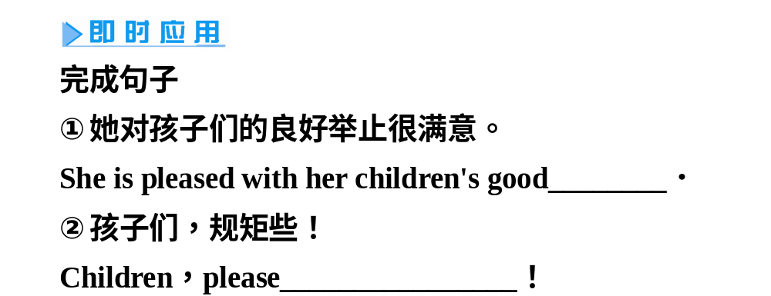

Slide 5
①They ____________________the guests，which made us disappointed.
他们对客人很不礼貌，这使我们非常失望。
②I think all of us should______________in public places.
我认为我们大家都应该注意在公共场所的行为举止。
③I want you to____________while I am away.
我不在家时你要守规矩些。
答案： ① behaved badly to/towards ②mind our behaviour ③behave yourself

Slide 6
[比较辨析]
[填一填]
①As a child，he liked to ________ the behaviour of the insect.
②The detective ________ a scratch on the window.
③He ________ the sun setting behind the trees.
observe | “观察”，从不同的角度长时间地看并研究
watch | “看，观看，特别留意”，感兴趣地看运动着的东西
notice | “看到，注意到，觉察到”，偶尔看到细小的但可能是重要的事物，强调无意地注意
答案：①observe ②noticed ③watched

Slide 7
1
比较：worth； worthy; worthwhile
* It is worthwhile to do sth./doing sth.
* To do sth./Doing sth. is worthwhile.
be worth + doing sth.
be worth + n.
be worthy to be done
be worthy of + being done
be worthy of + n.

Slide 8
一、运用worthwhile/worth/worthy填空
worth
(1)This dictionary was __________ 150 yuan.
worthwhile
(2)Everyone has roots.It is ___________ to look for his roots.
(3)He proved himself a __________ teacher.
worthy
worth
worthy
(4)This film is well ______ seeing and it is ________ of being
seen for a second time.

Slide 9
①It is _____________ to take his advice.
他的建议值得采纳。
②Helping the disabled is a____________activity.
帮助残疾人是一项很有意义的活动。
③Hangzhou is a beautiful place；it is worthwhile_________(go)there.
杭州是个美丽的地方，值得一去。
④His first book is of great use for our course.But his latest one is________worth reading.
他的第一本书对我们的课程很有用，但他最新的一本书很值得一读。
答案： ① worthwhile ②worthwhile ③going/to go ④well

Slide 10
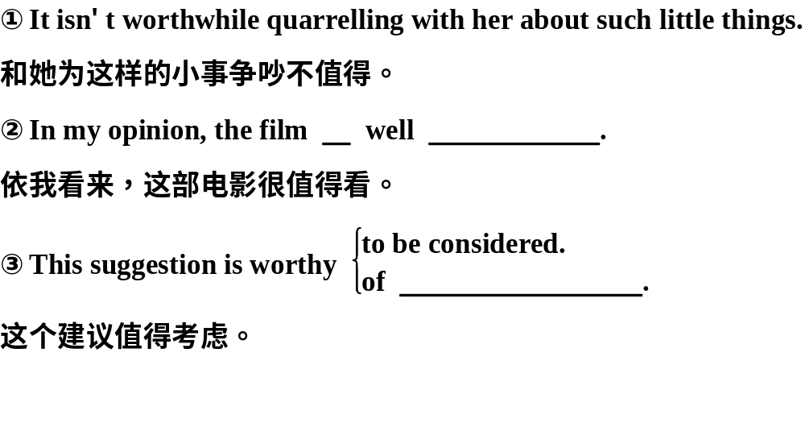

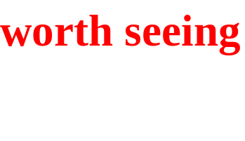
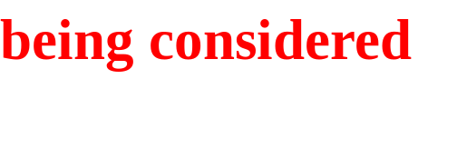

Slide 11
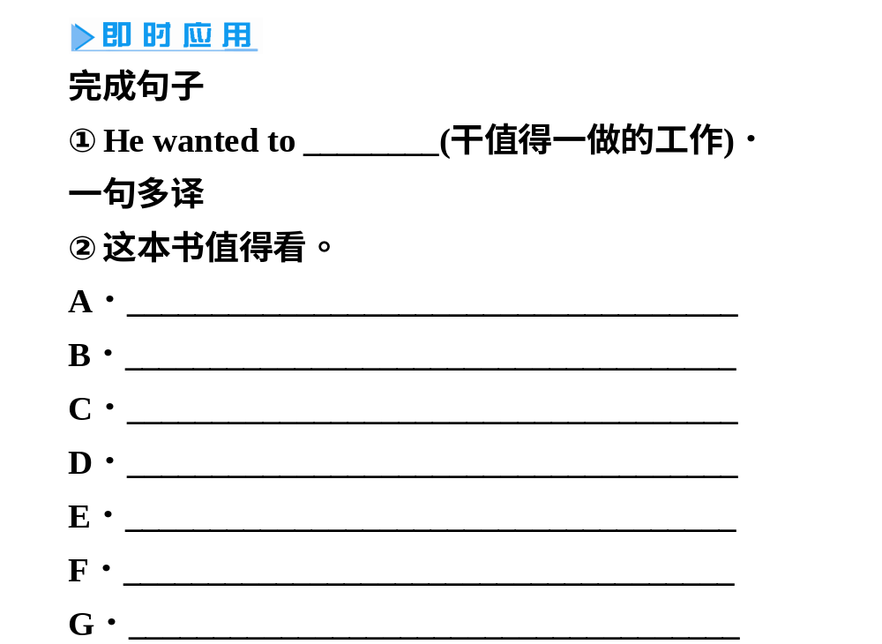

Slide 12
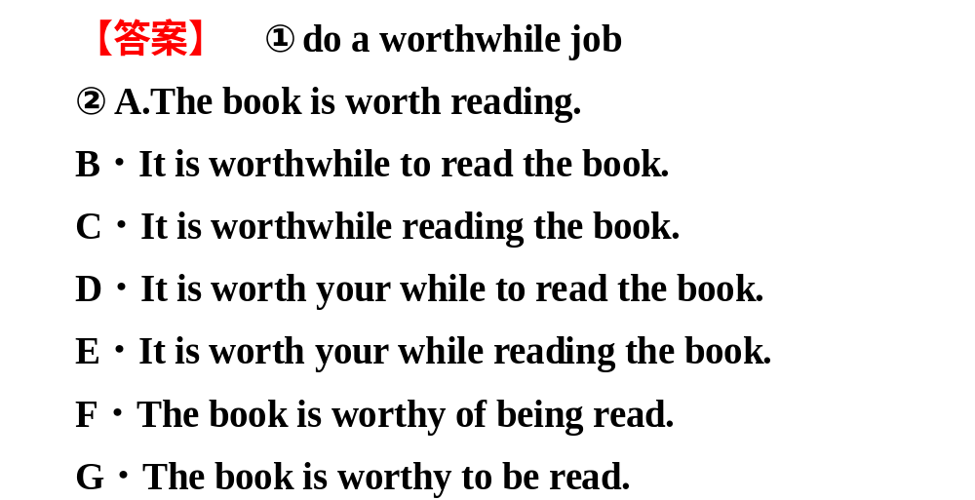

Slide 13
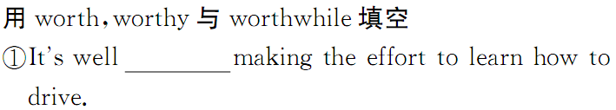
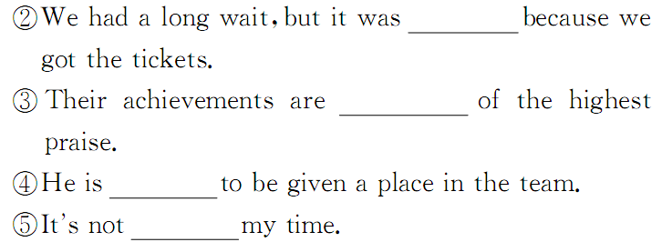
答案： ① worth ②worthwhile ③worthy ④worthy 5. worth

Slide 14
5．respect vt.尊敬；尊重；敬意
n. 细节；方面；敬意；问候
(1)respect sb.for sth.因某事而尊重某人
(2)have/show respect for sb.尊重某人
give/send one's respects to sb.向某人表示敬意
out of respect for...出于对……的尊敬；顾及
(3)in all/many respects在各个方面/在许多方面
in respect of＝with respect to关于；就……而言

Slide 15
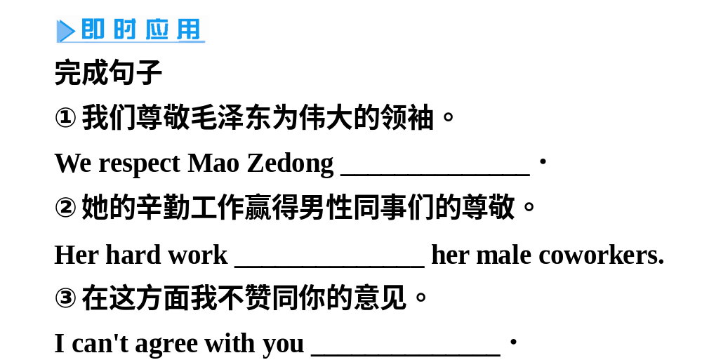
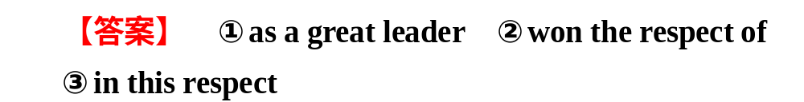

Slide 16
①I deeply respect him ______his courage.
我深深敬佩他的勇气。
②________________your other suggestions，I am not yet able to tell you our decision.
谈到你的其他建议，我现在还无法把我们的决定告诉你。
③Please send__________to them when you write.
你写信的时候请代我向他们致意。
④________________the new version is less good than the old one.从许多方面来看，新的版本并不比旧的强。
⑤The secret to education lies________________ the pupil.教育的秘诀在于尊重学生。
答案： ① for ②With respect to ③my respects ④In many respects ⑤in respecting

Slide 17
2. 形容词respectable，respectful 与respective 的区别：
respectable 指“值得尊敬的”；respectful表示“尊敬的；恭敬的”；respected，受人尊敬的; respective 指“各自的；分别的”。
An upright man is respectable.诚实的人是值得尊敬的.
He was respectful before his betters.他在长者之前很是恭敬.
They rode their respective bikes.他们各自骑着自己的自行车.
Tolerance consists in respecting the opinions of others.宽容在于尊重别人的意见.
The pianist is well respected.钢琴家很受尊重.

Slide 18
表示“尊敬”时，respect和honour，regard的区别：
respect 正式用语，指对父母、年长者、正直的人、学者、法律、秘密等的尊敬或敬重。如：
He respects his teachers.他尊敬老师。
honour非常尊敬（respect highly），指对君主、长辈、父母、贵人、德高望重之人、正直之人、天神等的敬意。如：
He was honoured as a man of courage.他被尊为勇者。
regard指对父母、他人的感情，对法律、安息日等的尊敬。如：
We all regard our English teacher highly.我们都很尊敬我们的英语老师。

Slide 19
3. argue vi.争论；辩论 vt. 争论；说服
He argued that the experiment could be done in another way.
他认为这项实验可以换一种方法做。
1)同根词：argument n. 论点，争论，论据；
arguable adj.有商榷余地的;可辩驳的；可论证的
2)argue 的用法归纳：
argue with sb.about/over sth.因为……和……争辩,如：
They are arguing with the officials over foreign policies.
他们正就外交政策与官员们进行辩论。
argue+that 从句,如：
We argued that we should be paid more.
我们据理力争我们应该得到更高的薪水。
argue+sb.to be...说明……，如：
The way he spends money argues him to be rich/that he is rich.
他花钱的方式说明他很富有。
argue for/against提出理由支持/反对，如：
He argued against the use of animals in this experiment.
他反对用动物做这个实验。

Slide 20
(1)argue for ... 为……而争论；为……而辩护 argue against 争辩(反对……) argue with sb.on/about/over sth.与某人争辩某事 (2)argue sb.into/out of doing sth. 说服某人做/不做某事 (3)argue that ... 提出理由说明；主张…… (4)argument n. 争论；争辩；论点 beyond aryument 无可辩解

Slide 21
即境活用：
We ______________________each other ______money.我们总是为钱吵嘴。
They ______________________________to strike.他们据理力争罢工权利。
He _____________________they needed more time to finish the project.他提出理由说明他们需要更多的时间来完成该项目。
They ______________________________his complaint.他们说服他撤回（withdraw）投诉。
答案： (1) are always arguing with; about
(2) argued for the right
(3) argued that
(4) argued him into withdrawing

Slide 22
[比较辨析]
[填一填]
①My sister and I used to ________ all the time.
②We will ________ the proposal at the meeting.
③I ________ with him for a long time，but he refused to listen to the reason.
discuss | “讨论”，指为了解决问题或弄清对方的观点而交换意见
argue | “争论，辩论”，指举出理由或事实来与对方争辩，有“企图说服对方”的含义
quarrel | “争吵，吵架，争辩”，侧重用“口角”方式争执
答案： ①quarrel ②discuss ③argued

Slide 23
He has never shown much consideration for
his wife’s feelings.
他从不顾及他妻子的感情。
归纳总结
consideration ____________________________。
in consideration of...考虑到……，顾及……
take...into consideration考虑到……;体谅……
be under consideration在考虑中，在审议中
give consideration to sth./give sth.
consideration考虑某事
consider v.考虑；认为
consider doing sth.考虑某事
be considered to be/as...被认为……；被看作……
n.［U］考虑;体贴;体谅；关心

Slide 24
out of consideration for出于对……的关心/体谅
show consideration for sb./sth.体谅/关心……
considerate adj.考虑周到的；体谅的；体贴的
considerable adj.相当多/大/重要的
即学即用
(1)他们考虑到他还年轻没给他重活。
They didn’t give him heavy work ____
_________________ his youth.
(2)老师说对于学生的要求他会予以考虑的。
The teacher said that he would _________
______________ the request of the students.
in
consideration of
take into
consideration

Slide 25
4. 表示“认为”时，consider与 think，believe，regard，suppose，guess，imagine，fancy的区别：
consider 经考虑而认为，较客观；
think是最普通的词，含推理、判断，形成看法之意；
believe相信，认为；
regard与consider常可换用，但含个人的主观认识较强一些；
suppose近似于think，但含不确切之意，比think少根据；
guess凭想像加以猜测；
imagine想像；fancy凭空想像。

Slide 26
5
campaign (noun/ verb); campaigner (noun)
★ 国际禁雷运动
an international _________ to stop the making
of __________
★ 他参加了禁烟运动。
He ___________ _______ smoking.
= He ___________ _____ stop people from smoking.
★ 我们都参加了争取平等权利的运动。
We all ____________ ______ equal rights.
campaign
landmines
参加反对……的运动
campaigned against
campaigned to
campaigned for
参加争取……的运动

Slide 27
6
* behave well/badly to/towards sb.
对某人表现好/差
★ 她显得很尊贵。
She ____________ ________ great dignity.
behave oneself 守规矩，表现得体
well-behaved/ badly-behaved child
表现好/ 差的孩子
be on one’s good behavior 举止规矩
behaves with

Slide 28
7
Everybody sits and waits in the ______ of the trees while the family begins to wake up and ___________ (=set off).
* shade n. (树) 荫；阴凉处；
vt. 遮住光线
shade
move off
in the shade of 在阴凉处
shade sb/sth from/against…给…遮挡

Slide 29
move over/ up
= to change your position in order to make room
for other people 挪开、让位
move in/ move into sth 搬进新居
move out (of) 搬出去、迁出
move off 启动、离去
move on to sth
= to start doing or discussing sth new
开始做别的事情、换话题

Slide 30
9
________ I stop, it all comes ______________.
sth crowd in on sb.
sth crowd into one’s mind/ head.
某事涌上心头/ 脑海
crowd around/ round sb/sth 聚集在……周围
sb crowd into some place
人大批涌入（狭小的空间）
Once
crowding in

Slide 31

10
★ sb intend to do sth/ doing sth.
某人打算/计划做某事
★ sb intend sb to do sth.
某人打算让某人做某事
★ It is intended that…
计划是……
intended adj. 打算的、计划的
intention n. 打算、计划

Slide 32
①When I am faced with a difficulty，I usually choose to ___________relevant learning materials or Web pages.当我碰到困难时，我通常选择参考相关的学习材料或网页。
②He__________________a living Lei Feng.
他被称为活雷锋。
③I didn't know whom she was____________.
我不知道她指的是谁。
④You should________________ our teacher for a decision.你应该把这件事交给我们老师决定。
答案： ① refer to ②is referred to as ③referring to ④refer this matter to

Slide 33
11．look down upon/on 蔑视；轻视；瞧不起
[教材原句] Many people look down upon poor people.许多人瞧不起穷人。
①look forward to 盼望；期待
②look into 调查；审查
③look up 抬头看；查阅
④look on...as...把……看作……
⑤look out(for...) 注意；留神(……)
⑥look through 浏览；仔细查看
⑦look up to 尊敬；仰视
⑧look for 寻找

Slide 34
[见证2014]Terry，please look up from your cell phone when Grandma is talking to you.
Terry，当奶奶跟你讲话时，请你不要再看手机了。(2014·安徽卷)
①I look down upon/on those who always rely on others.
我看不起那些总是依赖别人的人。
②He usually______________several newspapers before breakfast.
他早饭前通常浏览几份报纸。
③She has always__________________her father.
她一向尊敬父亲。
答案：②looks through ③looked up to

Slide 35
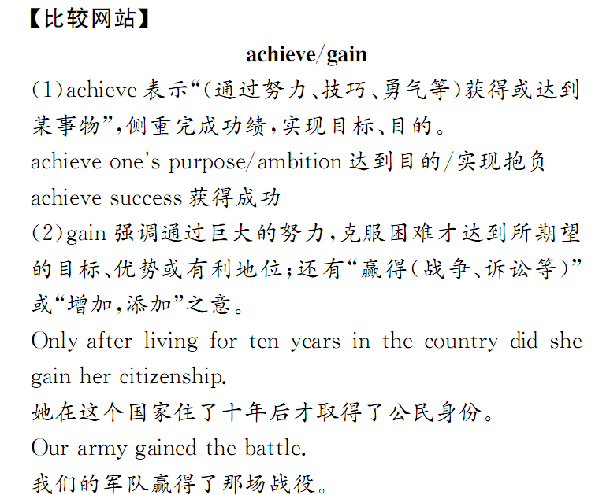

Slide 36
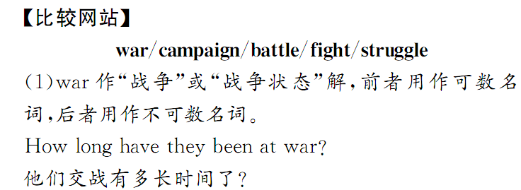
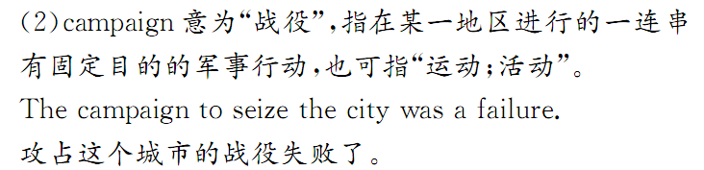

Slide 37
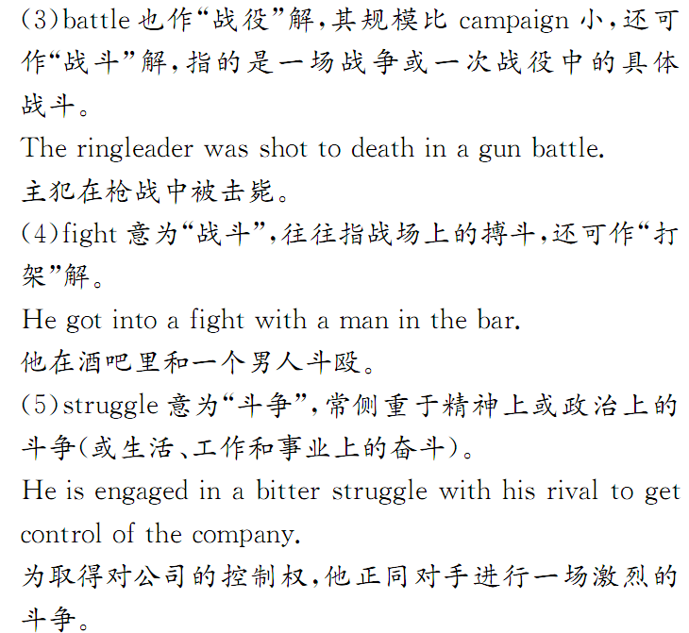

Slide 38
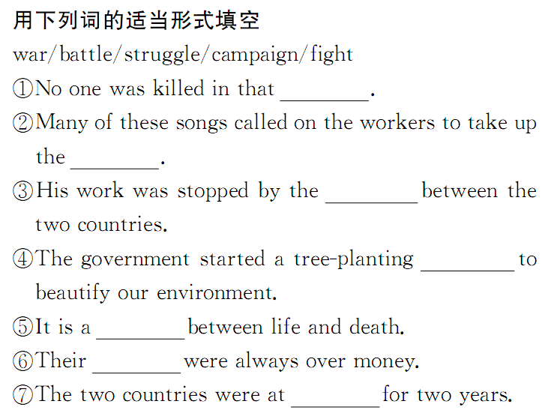

Slide 39


Slide 40
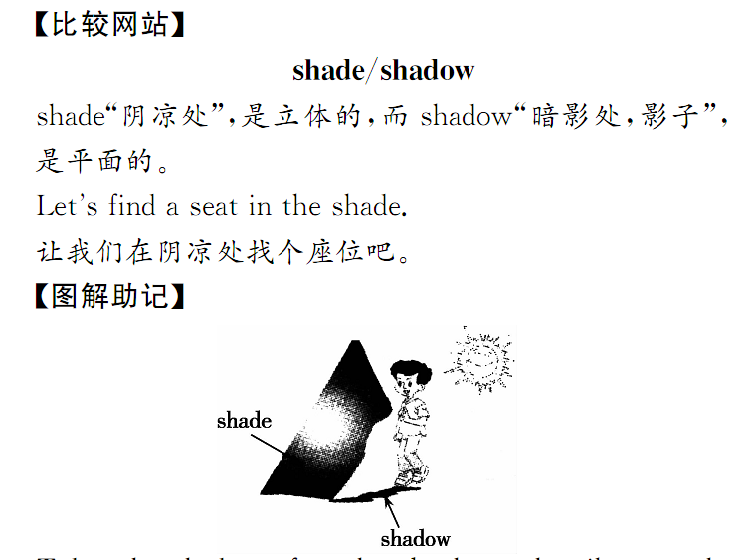

Slide 41
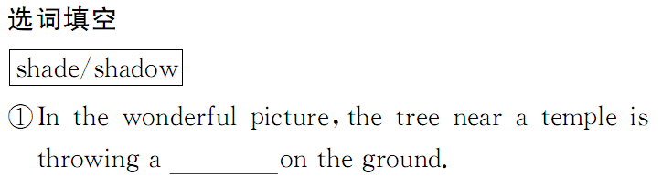
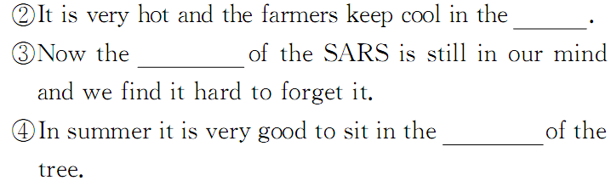

Slide 43
condition, situation, state 与position的辨析
condition“状况，尤指外观，品质，工作状况”，常用于短语in good/poor condition状况好/坏；in /out of condition身体好/欠佳。常用复数形式表示“环境；情况；形势”，如：under favorable conditions “在有利的（顺利的）形势下”。 situation “形势、状况、局面”，主要指各种情况间的相互关系，强调相互间的联系和影响。 state “状态，状况”，只有单数形式，常与 in a…state ，说明处于某一特定情境的状态或状况。 position “位置，处境，地位”，指某事物所处的具体位置或某人的地位、职位等。

Slide 44
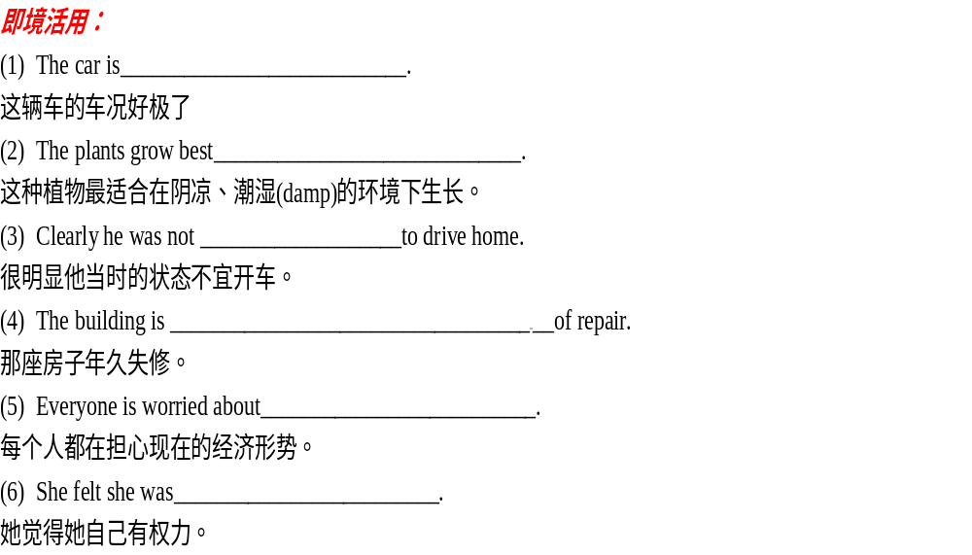

Slide 45
in excellent condition
(2) in cool, damp conditions
(3) in a fit state
(4) in a bad state
(5) the present economic situation
(6) in a position of power

