Slide 1

Grammar
Subject – verb agreement

Slide 2

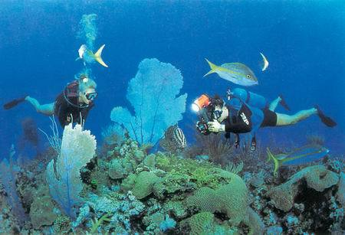
Finish the following exercises.
The boy ___ diving.
is
are
They ____ diving.
are
Both Jack and Tim ___ diving.
Neither Jack nor Tim ___ walking.
is
All of them ____ diving.
are

Slide 3
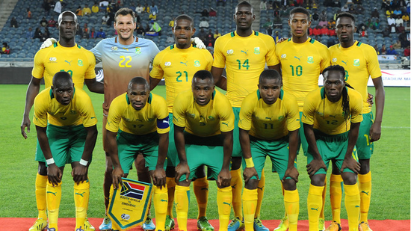
The team ____ some good players. (have)
The team ____ handsome. (be)
has
are

Slide 4
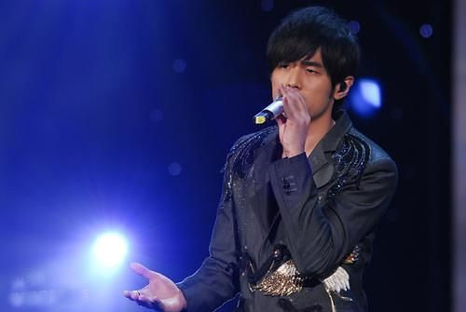
The singer and dancer _____ on the stage.
is

Slide 5

A knife and fork ____ used to have meals.
is

Slide 6

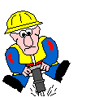
Bob _____ a worker.
is
Mike and Bob _____ workers.
are
Both Mike and Bob _______
workers.
are
Bob
Neither Mike nor Bob _______
a teacher.
is
Neither of them ___________
(know) how to teach English.
knows/know
Mike
knows/know
None of them ___________
(know) how to teach English.

Slide 7
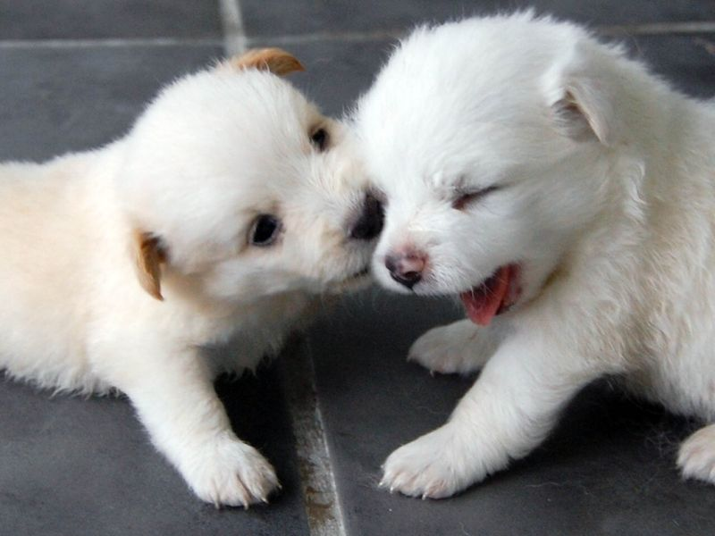
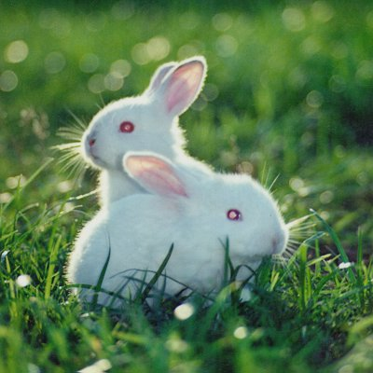
Neither dog _____ big.
is
Neither of them ______ big.
is/are
Neither rabbit _____ handsome.
is
Neither of the rabbits ______ handsome.
is/are

Slide 8
主谓一致是指谓语在人称和数上必须
和主语的人称和数保持一致。这是英语
语法中必须遵循的基本规则。主谓一致
主要有以下几种情况：
一、语法一致原则
主谓一致
二、意义一致原则
三、就近原则

Slide 9
一、语法一致
主语为单数形式, 谓语动词也用单数形式;
主语为复数形式, 谓语动词也用复数形式。
e.g. I often help him and he often helps
me.
We often help each other.
不可数名词作主语, 谓语动词用单数；
可数名词的复数形式作主语, 谓语动词
用复数。

Slide 10
二、意义一致
主语形式虽为单数, 但意义为复数, 谓语
动词用复数; 主语形式为复数, 而意义
为单数, 谓语动词用单数。如：
The crowd were surrounding the
government official.
人群包围了这位政府官员。
Maths is hard to learn.
数学难学。

Slide 11
三、就近原则
就近原则即谓语动词的单复数形式
取决于最靠近它的主语。
There is a pen and two pencils on the desk.
桌子上有一支钢笔和两支铅笔。

Slide 12
A or B
Not A but B
Either A or B
Neither A nor B
Not only A but also B
+ Verb
There / Here + Verb A and B.

Slide 13
Not only you but also he is wrong.
Neither you nor he is right.
There are two shops and a cinema beside the railway station.
There is one television and 56 desks in our classroom.
Here is a map and a handbook for you.

Slide 14
注意: 1. and连接两个或两个以上单数
名词或代词作主语时, 谓语动词有以下
两种情况:
1) and连接两个或两个以上不同的人或
物作主语时, 谓语动词用复数。如：
He and I are both students of this school.
Time and tide wait for no man.
岁月不饶人。

Slide 15
2) 如果连接两个或两个以上的并列结构
是指同一个人或物, 或指同一概念时, 谓语动词
用单数, 这时and后面的名词前不加冠词。
如: 表整体概念的并列结构
bread and butter knife and fork
iron and steel law and order
配套事物：
a watch and chain a needle and thread
The knife and fork is on the desk.
刀叉放在桌子上。

Slide 16
2.主语后面带有with, along with, together with,
as well as, besides, like, without, except,
including, but 等引导的短语时, 谓语动词必须
与前面的主语在人称和数上保持一致。
e.g. The teacher, together with his students,
is planting trees in the garden.
老师和同学们正在花园里种树。
E-mail, as well as the telephones, ______ playing
an important part in daily communication.
is

Slide 17
3. 如果主语是不定式, 动词-ing形式或
主语从句时, 谓语动词用单数。
What he is doing seems very important.
他正在做什么看起来很重要。
Serving the people is my great happiness.
为人民服务是我最大的幸福。

Slide 18
4. 用连接的并列主语被each, every 或no
修饰时, 谓语动词用单数。
Every boy and every girl in the class is
diligent. 班里的每个男孩女孩都很用功。
5. each of + 复数代词, 谓语动用单数。
复数代词+ each, 谓语动词用单数。
Each of us has something to say.
We each have something to say.
我们每个人都有些话要说。

Slide 19
6. 不定代词 all, more, some, any, none等
作主语时, 谓语动词视情况而定。可用
单数, 也可用复数; 但当它指代不可数名词
时看作单数, 谓语动词用单数。
All the apples are rotten.
All the apple is rotten.
None of us are /is perfect.
None of the money is left.

Slide 20
1. None of these people ___ doctors.
A. has B. have C. are D. was
2. Neither of them ___ a good singer.
A. was B. is
C. were D. is used to be
C
B
3. Neither of us ________ (was/were) ready
when the party began.
4. None of them ________ (has/have)
watched the talk show.
was / were
have / has

Slide 21
7. 复合不定代词作主语时, 谓语动词
用单数。
Someone is calling you.
有人叫你。
Nothing is found in the room.
在屋里找不到什么东西。

Slide 22
8. 名词如trousers, scissors, clothes, goods,
glasses 等作主语时, 谓语动词必须用复数;
而形复义单的名词如news, 以-ics结尾的
学科名称如physics, politics, 国名如
the United States; 报纸名如the New Times;
书名如Great Expectations《远大前程》,
以及the United Nations作主语时, 谓语动词
用单数。

Slide 23
如：
The scissors are sharp.
No news is good news.
Great Expectations was written by
Charles Dickens in 1860.

Slide 24
are
Tom is one of the students who_____ good at playing football.
Tom is the only one of the students who____ good at playing football.
is
[注意]在“one of+复数名词+关系代词”的结构中，定语从句中谓语动词用复数形式；但是若前有the only、将其限定为只有一个时,谓语动词用单数形式。

Slide 25
9. 集体名词作主语, 谓语动词可用单数，
也可用复数, 主要由句子的意思决定。
强调整体时用单数, 强调整体中的个体
的用复数。这类名词有people, family,
class, population, crowd, team, ground等。
His family is going out. 他们全家要外出。
His family are all music lovers.
他们全家都是音乐爱好者。

Slide 26
The team ____ some good players. (have)
The team ____ handsome. (be)
has
are
The group ____ made up of nine students.
is
The group____ dancing happily.
are

Slide 27
Choose the correct verb form to complete the following sentences.
is
1.The research group (is / are) made up of
five people.
2. What (do / does) the group want for
their lunch?
do
is
3. Our family (is / are) not poor any more.
are
4. He has to worry. His family (is / are)
waiting for him.
is
5. The class (is / are) more than forty in
number.

Slide 28
have
6.The class (have / has) disagreed among
themselves about where they should go and
have a picnic.
has
7.The government (has / have) spent more
than two million yuan in planting trees.
have
8.The city government ( has / have)
different opinions about next year’s plan.
9.The police________ (is / are) searching for the
thief.
are
注意：集体名词 people, police, cattle等在任何情况下谓
语动词都用复数形式。

Slide 29
10. 有些名词单复数形式相同, 作主语时,
谓语动词由上下文决定。这类名词有
means, deer, sheep, Chinese, Japanese,
fish等。如：
Not every means is useful.
并非每种方法都有效。
Not all means are useful.
并非所有的方法都有效。

Slide 30
11. 表示一类人的 “the +形容词(分词)”
作主语时, 谓语动词用复数。
The sick in the accident have been
taken to the hospital.
The lost have been found.

Slide 31
12. 表示时间、金钱、距离、度量等名词
作主语时, 不管单复数形式, 其谓语动词
用单数。如：
Thirty years is not a long time.
30年的时间并不长。
Two hours is enough for me to finish
the work.两个小时对我来说完成
这项工作足够了。

Slide 32
13. the rest of, half of, majority of, part of,
a lot of, lots of, one of, a number of,
a plenty of, percent of 以及分数词等作
主语时, 谓语动词的单复数取决于后面
名词的数, 即就近原则。如：
A part of the students have arrived.
A part of the apple has been eaten by
the mouse.

Slide 33
14. 在表存在的there be 句式中, 主语是
两个或多个并列名词(短语), be的形式
与最近的一个名词(短语)保持一致。
There is a pen, two pencils and several
books on the desk.
=There are two pencils, a pen and several
books on the desk.
=There are several books, a pen and two
pencils on the desk.

Slide 34
15. 由here, there等引导的倒装句中,
若主语不止一个时, 谓语动词与最近的
主语保持一致。如：
Here comes the bus.
Here is a pen and two books for you.

Slide 35
16. 用连词 or, either…or, neither…nor,
not only…but also等连接并列主语时，
谓语动词应与最近的主语保持一致。如：
Neither you nor I am wrong.
Neither I nor you are wrong.
Not only the students but also the
teacher enjoys listening to the music.
Not only the teacher but also the
students enjoy listening to the music.

Slide 36
用所给动词的正确形式填空。
1. He as well as his two friends ___ (be)
going for a picnic this Saturday.
2. According to the report, three hours
of outdoor exercise a week ____ (be)
good for one’s health.
is
is

Slide 37
3. The teacher, with 6 girls and 8 boys of
her class, __________ (visit) a museum
when the earthquake struck.
4. 70 percent of the students in our class
_____ (be) girls.
5. Most of his time ________ (spend) on
computer games in the past.
was visiting
are
was spent

Slide 38
6. The football team ____ (be) made up
of 22 players and the team ____ (be)
very young.
7. Every man and every woman
___________ (ask) to help when the
earthquake broke out.
8. Either he or you ____ (be) interested
in playing football in our class.
is
are
was asked
are

Slide 39
9. At present the police __________ (look)
for the lost boy whose trousers ____ (be)
blue.
10. Physics ___ (be) difficult to learn and
every means _____________ (try) to
improve it.
are looking
are
is
has been tried

Slide 40
Choose the best answer.
One or two days ____ enough to see the
city．
A. is B. are C. am D. be
2. Neither my wife nor I myself ____ able
to persuade my daughter to change
her mind．
A. is B. are C. am D. be
A
C

Slide 41
3. Not only I but also Jane and Mary ____
tired of having one examination
after another．
A. is B. are C. am D. be
4. Not the teacher, but the students ____
looking forward to seeing the film．
A. is B. are C. am D. be
B
B

Slide 42
5. Nobody but Betty and Mary ____ late
for class yesterday．
A. was B. were C. has been D. have been
6. A woman with some children ____ soon．
A. is coming B. are coming
C. has come D. have come
A
A

Slide 43
7. No one except my parents ____ anything
about this.
A. know B.knows C. is known D. are known
8. The teacher as well as the students ____ the
book already．
A. has read B. have read
C. are reading D. is reading
9. All but one ____ in the accident．
A. was killed B. were killed
C. will be killed D. are killed
B
A
B

Slide 44
10. When and where to build the new factory
_____ yet.
A. is not decided B. are not decided
C. has not been decided D. have not decided
11. The number of people invited _____fifty,
but a number of them ___ absent for
different reasons.
A. were; was B. was; was
C. was; were D. were; were
A
C

Slide 45
12. ____ of the land in that district ____
covered with trees and grass.
A. Two fifth; is B. Two fifth; are
C. Two fifths; is D. Two fifths; are
C

