Slide 1
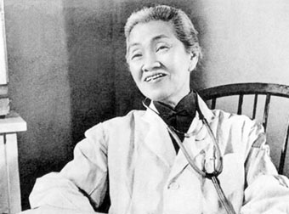
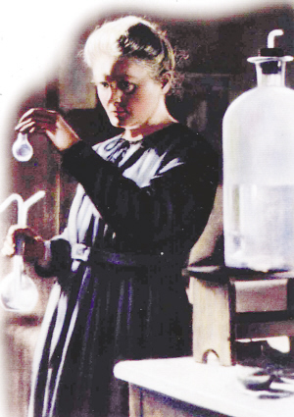
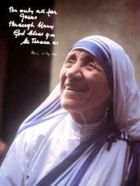
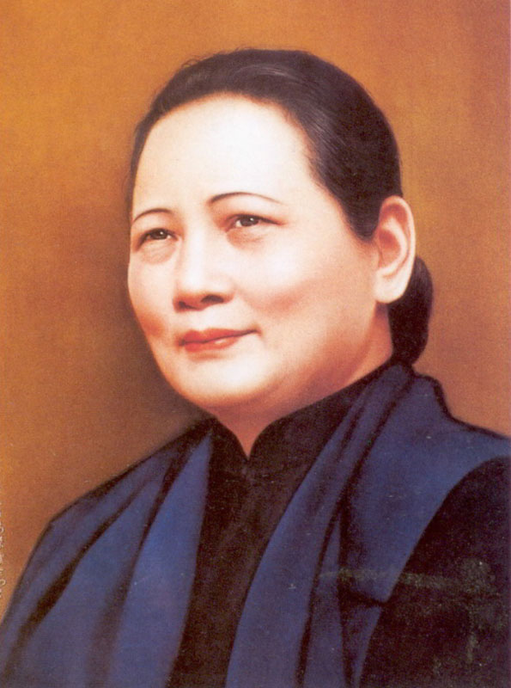
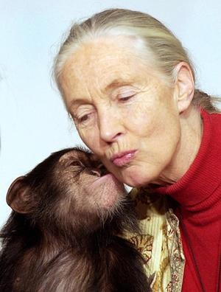
Women of achievement

Slide 2
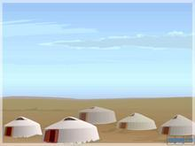
1. 单词过关
2. 要点梳理
3.高考佳句赏析
4. 课文详解
5. 限时规范训练
6.黄冈八测
7.纠错卷
8.高考题

Slide 3
achievement
△Quaker
welfare ['welfeə]
project
institute
specialist
△specialize
△chimp
connection
human being
campaign [kæm'peɪn]
△landmine
organization
behave
behaviour (=behavior)
n. 成就；功绩
n. 教友派信徒；贵格会会员
n. 福利；福利事业
n. 项目；工程；规划
n. 学会；学院；协会
n. 专家；专业工作者
vi. 专攻；专门从事；专注于
n. （非洲）黑猩猩
n. 连接；关系
人类
n. 运动；战役 vi. 作战；参加运动
n. 地雷
n. 组织；机构；团体
vt. & vi. 举动;(举止或行为)表现
n.行为；举止；习性

Slide 4
shade
move off
worthwhile
nest
bond
observe[əb'zɜːv]
observation
childhood
outspoken
respect
argue
argument
entertainment
lead a … life
crowd[kraʊd]
n. 荫；阴凉处 vt. 遮住光线
离开；起程；出发
adj. 值得的；值得做的
n. 巢；窝
n. 联系；关系；结合；纽带
vt. 观察；观测；遵守
n. 观察；观测
n. 童年；幼年时代
adj. 直言的；坦诚
vt. & n. 尊敬；尊重；敬意
vt. & vi. 讨论；辩论；争论
n. 争论；争辩；争吵
n. 款待；娱乐；娱乐表演
过着……的生活
n. 人群；观众 vt. 挤满；使拥挤
[ɒbzə'veɪʃ(ə)n]

Slide 5
crowd in
inspire
△inspiration
support
look down upon/on
refer
refer to
audience['ɔːdɪəns]
by chance
come across
△career[kə'rɪə]
rate
sickness
intend
emergency
（想法、问题等）涌上心头；
vt. 鼓舞；激发；启示
n. 灵感；鼓舞
n. & vt. 支持；拥护
蔑视；瞧不起
vi. 谈到；查阅；参考
查阅；参考；谈到
n. 观众；听众；读者
碰巧；凑巧
（偶然）遇见；碰见
n. 事业；生涯
n. 比率；速度
n. 疾病；恶心
vt. 计划；打算
n. 突发事件；紧急情况
[ɪnspɪ'reɪʃ(ə)n]
[ɪn'tend]
[ɪ'mɜːdʒ(ə)nsɪ]

Slide 6
generation
△determination
kindness
considerate
consideration
deliver
carry on
modest ['mɒdɪst]
n. 一代；一辈
n. 决心；果断
n. 仁慈；好意
adj. 考虑周到的
n. 考虑；体谅
递送;生（小孩儿）; 发表(演说等)
继续；坚持
adj. 谦虚的；谦让的；适度的
[kən'sɪd(ə)rət]
[kənsɪdə'reɪʃ(ə)n]

Slide 7


Unit 1
Women of achievement
Language points

Slide 8
1. achievement
n.［C］成就；功绩; [U]实现；完成；达到
He received the Nobel Prize for his scientific achievements.
Even a small success gives you a sense of achievement.
achieve vt.取得，实现
achieve one’s success /ambition/goal/dream
2. Specialist --special adj. --specially adv. ---specialize v.
A feeling of accomplishment
获得成功/实现抱负/达到目标
special(ly ); especial(ly) ; particular(ly)
He went to his hometown ,___________ to see his grandma.
Wheat grows well in the north, _________ in North China.
She is _________ about food so she is very thin.
adj. 特别的,专门的
尤其
特别的；挑剔的
specially
especially
particular
(挑剔的）

Slide 9

3.campaign n.运动;战役 vi.作战；参加运动
campaign for/against... 争取/反对……的运动
⑴ 她领导了一场禁猎运动。
She conducted a campaign __________ hunting.
against
⑵工会领导人正在从事为工人争取更好的工作条件的运动。
The leaders of the union are campaigning ____ better working conditions for workers.
for
a campaign for equal rights.
the educational campaigns against smoking.

Slide 10

4.behave vt.& vi. 举动；(举止或行为)表现
behave oneself
behave well/badly
behavior
misbehave
表现得体/有礼貌
表现好/差
n.行为
v.行为不端
⑴ The teacher told the children________ __________(表现好点).
⑵ His recent ___________(behave) puzzles me.
⑶ Ignore the child if he________ (behave),and he’ll soon stop.
to behave themselves
behavior
misbehaves

Slide 11

5.respect vt.& vi. 尊敬；尊重；敬意
show respect for sb./sth.
respectable adj.
respective adj.
in all respects = in every respect
respecting = with respect to
重视；尊重
值得尊敬的; 高尚的
各自的；分别的
在各方面,
关于；就…而言
Eg: We should respect food and think about the people who
don’t have____we have here and treat food nicely.(10福建)
A.that B. which C. what D. whether
1.We all should respect our parents and teachers.
2.With respect to the content, the article is very good.
3.He drove them both to their respective homes.
4.The student is excellent in all respects.
5. a respectable scientist
C

Slide 12



6.crowd n.人群；观众 vt.挤满；使拥挤
a crowd of
in crowds
follow the crowds
be crowded with
crowd in
crowded adj.
一群；一堆
成群，大群地
随大流
满是…
(想法、问题等)涌上心头；
拥挤的
房间里挤满了客人。
The house_______________________.
is crowded with guests
Childhood memories crowded in on/upon him.
The crowd cheered wildly at the sight Liu Xiang, who was reported _____ the world record in the 110- meter hurdle race. (2007 高考)
breaking B. having broken C. to have broken D. to break

Slide 13
观察；遵守；庆祝
7. observe vt.
She spent many years observing and recording their daily activities.
We should strictly observe the discipline.
observe the Mid –Autumn Day
observer n.
observation n.
观察者
观察
8.intend vt. 计划；打算
be intended for
had intended to do
专门给…
本来打算做某事
(1)I _________ to come, but was prevented by the bad weather.
(2) I think the bomb was intended for me.
⑶ The book is intended _____ advanced learners.
had intended
for

Slide 14
9.look down upon/on 蔑视；瞧不起
She looks down on people who’ve never been to university.
look up to
look up
look on sb./ sth. as
look into sth.
look out （for sb./sth.）
look back
look forward to your reply
look for
look over
look through
尊敬 ，赞赏
查阅(单词、资料)；向上看；
把某人/某物看作……
调查；
警惕或留心（某人/某物）
回顾；回忆
盼望；期待
寻找
检查；检阅
浏览；检查

Slide 15

轻松走近高考

Slide 16

1.I often_______ the words I don’t know in the dictionary
or on the Internet. （2011四川卷14）
A. look up B. look at C. look for D. look into
2.The building around the corner caught fire last night. The police are now the matter.(2007湖北)
A.seeing through B.working out
C. watching over D. looking into
3. If you _____faults but you still want the bicycle, ask the
shop assistant to reduce the price. （2011安徽卷34）
come across B. care about
C. look for D. focus upon
句意：如果你发现这辆自行车有毛病但还是想要，
你就要求这家商店的营业员减价。

Slide 17

It’s surprising that your brother __ Russian so quickly—he hasn’t lived there very long. 【2012四川】
A. picked up B. looked up
C. put up D. made up
carry on
carry out
the experiment shows that proper amounts of exercise, if _______ regularly, can improve our health.
being carried out B. carrying out
C. carried out D. to carried out
继续
执行

Slide 18

10.deliver vt.
递送；生(小孩儿)；接生；发表(演说等)
deliver sth. to sb.
deliver a speech
deliver a baby
delivery n.
Special delivery
把某物交付给某人
作演讲
接生
递送；交付；分娩
特快专递(express delivery)
(10全国卷). The workers _____ the glasses and marked
on each box “this side up”
carried B. delivered C. pressed D. packed
递送

Slide 19
11.consideration n.考虑;体谅 vt.考虑；认为
under consideration
take sth into consideration
considerate adj.
considering prep.& conj.
consider doing
consider sb. as/ to do
正在考虑中
把….考虑进去
体贴人的；体谅人的
考虑到；就……而论
考虑做….
把…认作
⑵ Your proposal is _________ consideration.
⑶ ____________ (consider) the distance，he arrived very quickly.
⑷ One who is____________ (consider) is always liked by others.
(1)They show us every__________
他们对我们关心备至。
consideration.
under
Considering
considerate

Slide 20
12. worthwhile adj.值得做的；值得的
a worthwhile job
___is worthwhile to do/doing sth.
be ____worth +钱数/n. / doing
be worthy ___+ n./being done
Eg. His first book is of great use for our course, but his latest one is _____ worth reading.
A. better B. more C. much D. very
It
做……是值得的
well
值得……
of
值得……
to be done
1.The place is ________ a visit/visiting.
2.The place is ________ of a visit/ being visited.
to be visited.
3.It is __________ visiting the place.
to visit the place.
worth
worthy
worthwhile

Slide 21
三、词组互译
1. 人类 ________________
2. 接生 ________________
3. 蔑视；瞧不起 ________________
4. 离开；起程；出发 ________________
5. (想法、问题)等涌上心头_______________
6. 查阅；参考；谈到 ________________
鼓舞某人 ________________
偶遇 ———————
human beings
deliver a baby
look down upon/on
move off
crowd in...
refer to
inspire sb
come across

Slide 22
9. 选择做某事 __________________
10. 比……差；次于 __________________
11.为……打算(设计) __________________
12.by chance __________________
13.carry on __________________
14. carry out ___________________
15.lead a ... life __________________
16.say to oneself __________________
17. In the shade ___________________
choose to do
second to none
be intended for
（偶然）遇见，碰见
继续，坚持
vt. 执行，实行；贯彻
过着……的生活
自言自语
在荫凉处

Slide 23
18.be considered as _______________
19.mean(doing)sth. _______________
20.dress as a man _______________
21.be determined to do_______________
22.communicate with _______________
23.devote ... to ... _______________
被认为
意味着（做某事）
女扮男装
下决心去做
与……交流
把……献给，把……用在

Slide 24



It was the trouble to settle the problem.
A. worth to take B. worthwhile taking
C. worth being taken D. worth taking
①This vase was five hundred francs at the most.
②Everybody has roots. It is to search for his roots.
③Their efforts are of your support.
④This book is well reading and it is of being read a second time.
worth
worthwhile
worthy
worth
worthy

Slide 25



Slide 26
21. the Us president
a strong and prosperous China
have a good knowledge of
have a good command of
22. explanation[eksplə'neɪʃ(ə)n]
direction
introduction
expression
23. could have done
must have done
25. let alone=
leave alone
other than
or rather
anniversary[ænɪ'vɜːs(ə)rɪ]
27. consistently[kən'sɪstəntli]
美国总统
一个强大繁荣的中国
有好的 … 知识
有好的… 知识
解释
说明,指导
介绍 (introduce)
短语，表达，表情
过去本来可以做
过去一定做某事了
更不用说
让… 独自呆着
除了
更确切的说
周年纪念
一贯地，始终如一地
instruction
not to mention

Slide 27
通知
声明，声称
呼吁，吸引
递送，接生，发表演说
(旅馆,飞机)登记
出现，出版
发生
想出
进口和出口
精巧的,雅致的,易碎的
进步的，随时代进步的
基本的，主要的
多产的，富有成效的
脸谱网
参与,涉及
天才
奇迹
28. announce
declare[dɪ'kleə]
appeal to
deliver
check in
29. come out
come about
come up with
30. import and export
delicate['delɪkət]
progressive
fundamental[fʌndə'ment(ə)l]
productive
31. service provider facebook
32.be involved in
33.genius
miracle['mɪrək(ə)l]

Slide 28
34.be short of
be fond of
be worthy of
be proud of
35. at your service
Shall I take your order?
缺少
喜欢
值得的
骄傲的
愿意为你效劳
请点单

Slide 29
柔软，缓和
为…着想， 为了…缘故
犹豫
完全的
着急的，担心的
痛苦的
含泪的
遵守承诺
送某人
有强烈感受，突然发现
伟大的
上学
嘲笑，戏弄问题
照顾，处理（deal with）
奉献
无私的
soft
for sb’s sake
hesitate
entire
curious
painfully
in tears
keep one’s promise
drop sb. at school
strike
great
attend school/lesson/meeting/interview
teasing issue
take care of
sacrifice['sækrɪfaɪs]
selfless

Slide 30


locker
valedictorian[,vælɪdɪk'tɔːrɪən]
gratitude['grætɪtjuːd]
deliver a farewell speech
conclude
gesture
衣帽柜 储物柜
致告别辞者
感激 感谢
发表告别演说
结束, 结论 ,推断出
姿势 ,手势, 姿态

Slide 31

express their emotion
involve them in activities
go against
boy-focused
表达他们的情感
参与活动
反对, 违背 ,违反
关注男孩

Slide 32


萌芽
儿童肥胖
垃圾食品
一部分的 ，一份
减肥夏令营
sprout[sprəʊt]
children obesity
junk food
a portion of
weigh loss camps
Chinese Childhood Obesity Explosion
中国儿童肥胖爆炸

Slide 33

stay fit
warming up
slower walk
tone up your muscles
保持健康
热身
慢跑
增强你的肌肉

Slide 34


1. before---ago
2. them
3. came---come
4. costs---cost
5. cent-----cents
6. was disappointed
7. Unfortunately---Luckily
8. an----a
9. and
10. written-----writing

Slide 35
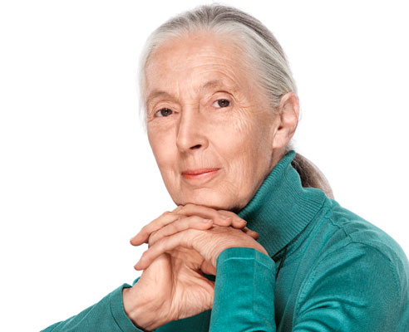
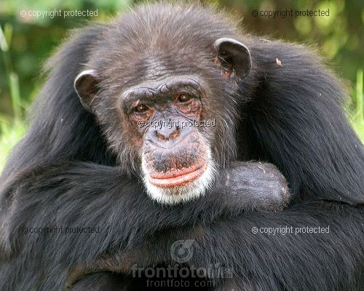

A student of African wildlife
Jane Goodall
chimp

Slide 36
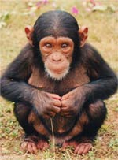
We have a choice to use the gift
of our lives to make the world
a better place
------Jane Goodall

Slide 37
rising
It is 5:45 am and the sun is just _____ (升起)over Gombe National Park in East Africa. _________Jane’s way ___studying chimps, our group are all going to visit them in the forest. Jane has studied these families of chimps for many years and helped people understand how much they b_______ like humans. Watching a family of chimps _______(醒来)is our first ________(活动)of the day. This means _____back to the place _____we left the family sleeping in a tree the night before. Everybody sits and waits in the s_______ (阴凉) of the trees while the family begins to wake up and m______ off. Then we follow as they wander into the forest. Most of the time, chimps either feed ___clean each other as a way of ________love in their family. Jane warns us that our group is going to be very tired and dirty by the afternoon and she is right. However, the evening makes it all w__________. We watch the mother chimp and her babies play in the tree. Then we see them go to sleep together in their nest for the night. We realize that the b_____ between members of a chimp family is as strong as in a human family.
Following
of
ehave
wake up
activity
going
where
hade
ove
or
showing
orthwhile
ond

Slide 38
Nobody before Jane fully understood chimp b________(行为). She spent years o________(观察)and recording their daily activities. Since her c________ she had wanted to work with animals in their own environment. However, this was not easy. When she first arrived in Gombe in 1960, it was _________for a woman to live in the forest. Only after her mother came to help her for the first few months _____she allowed to begin her project. Her work changed the way people think about chimps. For example, one important thing she discovered was _____chimps hunt and eat meat. Until then everyone had thought chimps ate only fruit and nuts. She _________observed chimps as a group hunting a monkey and then eating it. She also discovered how chimps _____________()each other, and her study of their _________ helped her work out their social system.
ehavior
bserving
hildhood
unusual
was
that
actually
communicate with
body language

Slide 39

Spend (spent/spent)
spend time ／money on sth.
eg：I spent two hours on this maths problem.
(2) spend time ／ money (in) doing sth.
eg：They spent two years (in) building this bridge.
2. cost(cost---cost)
(1)sth. costs (sb.) ＋金钱
eg：A new computer costs a lot of money.
买一台新电脑要花一大笔钱。
(2) 使… 失去(健康，生命)
Careless driving cost him his life.
(3) 成本，代价，费用
Living costs are higher in cities than in countries.
At the cost of …
在……上花费时间（金钱）
花费时间（金钱）做某事
…花了（某人）多少钱
以…为代价

Slide 40

It takes sb. ＋时间＋to do sth.
例：It took them three years to build this road.
他们用了三年时间修完了这条路。
2)doing sth. takes sb. ＋时间,
例：Repairing this car took him the whole afternoon.
Pay(paid---paid)
pay (sb.) money for sth. 付钱（给某人）买……
例：I have to pay them 20 pounds for this room each month.
pay for sth.
pay money back
pay off debt
做某事花了某人多少时间
做某事花了某人多少时间
为……付钱
还钱
还清, 回报

Slide 41
only引起的倒装
Only after her mother came to help her for the first few months was she allowed to begin her project. 她母亲头几个月来帮她的忙，这才使她得以开始自己的计划。
(1)“only+状语(副词，介词短语，状语从句）”放在句首时，主句部分要用部分倒装，即：将助动词、情态动词或连系动词置于主语之前。
(2)但“only+主语”放在句首时，句子不倒装。
Only in this way _____we learn English better.
Only then ______I remember that I had left my cell phone in the restaurant.
Only when we know the importance of English ____ we study English harder
Only I can be fit for this job.
can
did
will

Slide 42

Only if we can understand can we care;
Only if we care will we help;
Only if we help shall all the life is hopeful.
if we can
understand
唯有了解，我们才会关心 ；
唯有关心，我们才会行动；
唯有行动，生命才会有希望。
------Jane Goodall

Slide 43
support n/ vt. 支撑，支持，拥护，供养，维持,
This old bridge is not strong enough to support trucks.
She was very weak, so he had to support her.
We need water to support life.
I have a big family to support.
His theory is not supported by the facts.
support one’s family
in support of
supportive
支撑
扶持
维持
养，供养
支持，证实
养家糊口
支持；拥护
adj. 支持的

Slide 44



Slide 45
1.challenge
host
approve of
achieve success/ambition
2.believe it or not
behave as if…
direct---direction(instruction)
declare
3.shade
shadow
shelter
reflection
Observe the movement of that object
record
argue (with sb.) about sth
fight with sb. for /against
挑战；champion['tʃæmpɪən]
主持；做东
赞成；赞同
达到
信不信由你
表现；行动
指导；说明
宣布；声明
阴凉处(in the shade)
阴影；影子
隐蔽处；避难所；掩蔽
映像(reflect on)
观察物体的运动
记录,唱片
争论；辩论
战斗
冠军

Slide 46
6.Live with pressures
competitive
comfortable
stressful
miserable['mɪz(ə)rəb(ə)l]
7.fashion show
With great interest
be sympathetic of [sɪmpə'θetɪk]
Out of sympathy
look forward to doing /reply
think highly/well/badly of
pay attention to
look down upon
Suggest that should＋动词原形
Suggest 暗示，表明
面对压力
竞争(性)的；好竞争的
舒适的；安逸的；
有压力的；
痛苦的
时装秀
有浓厚兴趣的
同情…
出于同情
盼望
高度评价评价差
注意
瞧不起
建议某人做某事
正常时态
Lead a happy/miserable/comfortable/simple/hard life

Slide 47
10.came across
cut across
ran after
Nothing is impossible for a willing heart.
14.put away
take down
look over
carry on
15. master
偶然)遇到
横穿；抄近路
追求
放好；储存
写下；拿下；拆卸
仔细检查
继续(坚持)；从事
N.主人；V.控制；精通
一切皆有可能

Slide 48
precious moment
her presence
gather papers
pester ['pestə]
delicacy['delɪkəsɪ]
response
sigh with relief
openly
secretly
hang back
principal
stricken['strɪk(ə)n]
珍贵的时刻
她在场
收作业
vt. 纠缠，烦扰
美味；佳肴 delicious
响应；反应(respond to)
放松地出了口气
公开地
秘密地；背地里
犹豫， 踌躇，畏缩不前
校长
受挫折的，受打击的

Slide 49

essential[ɪ'senʃ(ə)l]
the Phoenix Mars Lands
land on
deep underground
要素,必需品；必要的
凤凰号火星着陆
登陆
幽深地底下

Slide 50
11. argue v.争论,辩论;说服;主张;认为
argue with sb. about/over sth. 就某事和某人争辩
argue sb. into/out of doing说服某人做/不做某事
=persuade sb. to/not to do
=persuade sb. into/out of doing
argue for/against 据理力争/反对
We argued that we should be paid more.
They are arguing with the officials over foreign policies.
They argued the park into lowering the price.
argument n. 论点;争论;论据
settle an argument 解决争端
beyond argument 无可争辩

Slide 51
16. refer to谈到,提及，指的是；参考，查阅
We agreed never to refer to the matter again.
She thought I was referring to her daughter when we were talking.
当我们谈话时她以为我指的是她的女儿。
Don’t refer to a dictionary often and just guess its meaning when you meet a new word or expression in reading.
refer to sb./sth. as 把某人/物称作
refer to/consult/look up查阅
refer to和consult“查阅（词典、参考书等）”
look up“（在词典、时刻表等中）查找……”

Slide 52
①The professor at the meeting will give us a lecture next week.
A. Referred B. referred to
C. Referring D. referring to
②If you are not sure of the meaning of this word, you can ___________the dictionary.
A. refer to B. look up
C. See D. make use of
③During his stay in our college, he often began his talk by ＿＿＿ this past experience as a soldier.
（2010·01·江西南昌检测）
A. turning to B. referring to
C. sticking to D. speaking to

Slide 53

背诵以下内容：// 今日任务：必修4 Unit1 Words
Not until you failed completely in the end did you know how stubborn you are.
I have a sharp knife in my drawer, with which to protect myself when I work at night.
The reason why … is that…
Could have done
The amazed look on her face
do sb. a favor give sb. a hand as far as I know
We got twice as many people to attend the meeting as we expected.
Growing corn doesn’t need as much water as growing rice.
get stuck / get paid … rather than have a gift for
it is / was … that … not me

Slide 54
1.achieve v.
获得，取得（胜利，成功，成就，成果等）
Professor Yang Zhenning has achieved great success
in his research.
The actor achieved fame when he was only nineteen.
They worked hard, but didn’t achieve what they had expected to.
达到，实现（目标，目的等）
We are determined to achieve our purpose.
They hoped to achieve their goal by peaceful means.
achieve one’s purpose
achieve one’s ambition
achieve success
achieve victory
达到目的
实现抱负
获得成功
获得胜利

Slide 55
achievement n.成就，功绩
The invention of the computer is a great achievement.
Even a small success gives you a sense of achievement.
Ex.
Without any special training, he has _____ everything he wanted to do.
achieved B. got C. arrived D. reached
Reaching this agreement so quickly was a
great _____ for the meeting.
benefit B. performance
C. achievement D. progress
A
C

Slide 56
2. specialist 专家；专业工作者 - special
3.connection n.
连接
The machine won’t work because of a faulty
connection.
关系，联系
There is no connection between the events.
Do you believe that there’s a connection between
smoking and heart disease?
in connection with 与…有关
The police are interviewing two men in connection
with the jewel robbery.
connect vt. connect A with B

Slide 57
4.campaign n.战役,运动,活动
The campaign to seize the city was a failure.
攻占这个城市的战役失败了。
The city hall is planning to start a campaign against
smoking.
市政府计划发起禁烟运动。
vi.从事运动 +for/against ；作战
The union leaders are campaigning for better
working conditions.
工会领导人为争取改善工作条件而积极活动

Slide 58
5.behave v.举动，表现
The young lady behaved courageously in the face
of danger.
behave oneself!
守规矩，表现得体
Behave yourself during my absence.
behave well/badly/like a gentleman
They behaved very badly towards their guests.
behaviour = behavior n.行为，举止
Their behaviour towards me shows that they do
not like me.

Slide 59
6.shade n. 阴凉处
in the shade
在阴凉处
I saw him sitting in the shade of a tree.
What a pleasant shade the tree gives us!
v. 遮住光线，遮蔽 +from
She shaded her eyes from the sun.
7.move off 出发，离开
The troops moved off at dawn.
move in
move out
move on
move to
住进新居
搬出
前进，往前走
搬到；移居

Slide 60
背诵以下内容：// 今日任务：必修4 Unit1 Words
achievement
project
specialist
connection
human being
organization
move off
nest
childhood
outspoken
argue argument
lead a … life
crowd crowd in
support
look down upon / on
准备： 课本、高调、U5小卷
16. by chance
17. come across
18. sickness
19. kindness
20. carry on

Slide 61
1. achieve one’s purpose
achieve one’s ambition
achieve success
achieve victory
achievement n.成就，功绩 a sense of achievement
2. in connection with 与…有关
connect vt. connect A with B
3. special - specialist - specialize
4.campaign n.战役,运动,活动
vi.从事运动 +for/against
5.behave v.举动，表现
behave oneself! 守规矩，表现得体
behave well / badly / like a gentleman
behaviour = behavior n.行为，举止
6.shade n. 阴凉处 in the shade 在阴凉处
v. 遮住光线，遮蔽 She shaded her eyes from the sun.
7.move off 出发，离开
move in move out move on move to

Slide 62
8.worthwhile 值得的，值得做的
干某事是值得的
It is worthwhile doing sth./ to do sth.
但不能说：sth. is worthwhile doing/ to do
长城值得去旅游。
It is worthwhile visiting/ to visit the Great Wall.
复习： worth / worthy
sth. is worth sth/ doing (不能使用被动)
这个博物馆值得参观
The museum is worth a visit.
The museum is worth visiting.
这个想法很值得考虑。
This idea is well worth considering.

Slide 63
sth. be worthy of +n. /
of being done
sth. be worthy to be done
这部电影值得看。
The film is worthy of being seen.
The film is worthy to be seen.

Slide 64
总结：worthwhile / worth / worthy
it is worthwhile to do / doing sth
sth. be worth + n.
sth. be worth doing
sth. be worthy of + n.
sth. be worthy of being done
sth. be worthy to be done
这个博物馆值得参观。
It is worthwhile to visit the museum. / visiting the museum.
The museum is worth a visit.
The museum is worth visiting.
The museum is worthy of a visit.
The museum is worthy of being visited.
The museum is worthy to be visited

Slide 65
9.observe v.
看到,注意到
observe sb. do/doing sth.
He observed a stranger hanging around the store.
I observed him stop at the gate.
观察,观测;监视
They carefully observed the behavior of deer.
遵守,奉行
This law must be strictly observed.
庆祝(节日等)
Some people observe Christmas here.
observation n.
under observation 在观察中

Slide 66
10.childhood n. 童年；幼年时代
boyhood
neighbourhood
11. outspoken adj. 直言的；坦诚的
12. respect n. vt.
高调 P2
13. argue 讨论；辩论；争论
argue with sb. about/over sth.
We are always arguing about money with each
other.
I’m too tired to argue the point with you.
argument n. 争论，争吵，争辩

Slide 67
14.lead a … life 过着……的生活
= live a … life
life 做live （vi）的 同源宾语
lead/ live a happy/hard / simple… life
sing an old song
dream a sweet dream
die a heroic death
laugh a merry laugh
breathe a deep breath
smile a forced smile
sleep a sound sleep
高调P4

Slide 68
15. inspire vt 鼓舞；激发；启示
inspire sb to do sth
=sb be inspired to do sth
He inspired me to try again.
I was inspired to try again.
inspiration n 灵感；鼓舞
inspiring adj 鼓舞人心的
inspired adj 受到鼓舞的，得到灵感的
an inspiring speech
an inspired boy

Slide 69
16.look down upon/on 蔑视，瞧不起
He did well in everything, so he looked down on others.
高调 P7
17.refer to 查阅；参考；谈到
18. by chance
= by accident
by design / on purpose
高调 P13

Slide 70
19.sickness n 疾病；恶心
sick 与 ill 作生病讲
sick 可以做定语和表语
ill 只能做表语
a sick man
The man was ill/sick.
The boy always feels sick when he travels by car.
be sick of 对……感到厌烦
Tom was sick of his job.
homesick
seasick

Slide 71
20.intend vt 计划；打算
高调 P12
21.generation n. 一代；一辈
generation gap 代沟
the coming/rising generation 下一代
from generation to generation
generation after generation
世世代代
22.determination n 决心；果断
determine vt 决定
be determined to do
determine to do

Slide 72
复习以下单词和短语用法，让同学到黑板上来写；
今日任务：完成必修4 Unit1 Words学习；U5小卷
总结：worthwhile / worth / worthy 的用法；
observe v. （意思） observation n.
respect n. vt. （意思及短语）
argue （意思及短语）
lead a … life 过着……的生活 (类似短语)
inspire vt 鼓舞；激发；启示 （短语及派生词）
look down upon/on 蔑视，瞧不起 （含look短语）
refer to （意思）
by chance （相关短语）
sickness n 疾病；恶心 （区分ill）
intend vt 计划；打算 （用法）

Slide 73
21.generation n. 一代；一辈
generation gap 代沟
the coming/rising generation 下一代
from generation to generation
generation after generation
世世代代
22.determination n 决心；果断
determine vt 决定
be determined to do
determine to do

Slide 74
23.considerate adj 考虑周到的
It was very considerate of you to remember my birthday.
considerately adv 考虑周到地
consideration n 考虑；体谅
take into ~ 考虑到；顾及
under ~ 在考虑中
consider vt/vi 考虑，细想
consider … as / to be 把···看作
consider doing 考虑做某事
considering prep 就…而论；考虑到
He did the job quite well considering his age.

Slide 75
24.carry on 继续；坚持
We will carry on our discussion tomorrow.
carry out 实施
carry out a plan (order/duty/policy/ promise)
实施计划（执行命令/履行职责/落实政策/实现诺言）
高调P13

