Slide 1
2017-5第二阶段复习
Book 3 Units 4-5
Book 4 Unit 1

Slide 2
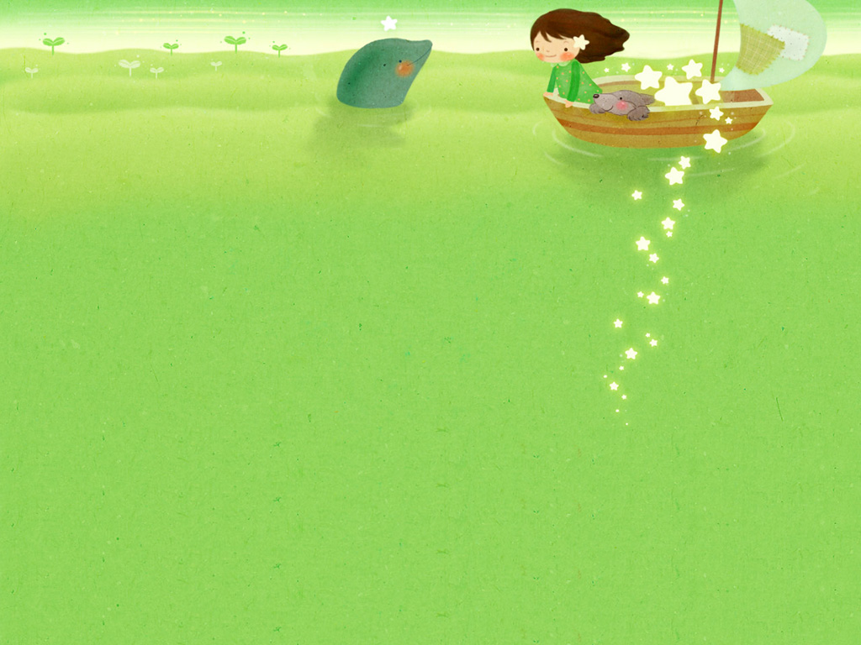
M3 Unit 4
Astronomy: the science of the stars

Slide 3
重要词汇拓展
1. adj. 猛烈的；激烈的；强暴的→ （n.）激烈； 猛烈
2 adj. 有害的→ （n. / v）伤害 （反义词）
3. n. 发展→(v.) →( adj.) 发展中的→(adj.) 发达的；先进的
4. v. 依靠；依赖→ ( n.)→ (adj.)→（反义词)_______________
5. v. 存在；生存→ (n.)
6. n.出现，出席 → ( n. ;adj.; v. ) )→ (缺席的；不到场的)
7. v. 使失望；使落空 → (感到失望的)→ (令人失望的) → ( n.)
8. adv. 逐渐地→ (adj.)
9. n; 谜；难题；v. 使迷惑 → adj.( 感到迷惑的 )→ adj. ( 令人迷惑的)
violent
violence
harmful
harm
harmless
development
develop
developing
developed
depend
dependence
dependent
independent
exist
existence
presence
absent
present
disappoint
disappointed
disappointing
disappointment
gradually
gradual
puzzle
puzzled
puzzling

Slide 4
重点短语梳理
1. Solar 太阳系
2. eggs 下蛋
3. in one’s 轮到某人
4. out 挡住（光线 ）
5. get the of 熟悉；掌握；理解
6. out 密切注视；当心；提防
7. on 依靠；依赖
8. in 及时；终于
9. give to 产生；分娩
10. up 感到高兴；感到振奋
system
lay
turn
block
hang
watch
depend
time
birth
cheer

Slide 5
11. 既然 ________
12. 爆发；突发 out
13 由于…… 的结果 as a of
14. 靠近 get to
15. 对…… 有害 be to
16. 阻止，制止 … from
17 令某人失望的是 to one’s _________
18 冷却 ________________
19 （时间）前进；推移；走过 _________
20 开始存在；产生 come into _________
now that
break
result
close
harmful
prevent
disappointment
cool down
go by
existence

Slide 6
重点句型再现
1. They were to produce carbon, nitrogen, water vapour and other gases, make the earth’s atmosphere.
最终产生了碳，氮气，水蒸气和其他多种气体，从而形成了地球的大气层。
2 ______________________________ water was to be fundamental to the development of life.
水会对生命的发展起关键作用，这一点在当时并不明显。
in time
which were to
It was not immediately obvious that

Slide 7
3.. So_______ life will continue on the earth for millions of years to come will depend on_______ this problem can be solved .
所以，在未来的数百万年中，生命能否在地球上延续取决于这个问题能否得到解决。
4.. When we got closer to the moon, we shall feel its gravity pulling us, but it will not be ________________ the earth’s.
当我们更接近月球时，就会感到月球的引力在拉我们。但是，月球的引力不想地球的引力那么大。
5. But when I tried to step forward, I found I was carried ____________ on the earth and fell off. 而当我试着向前迈步时，我发觉我被送出去很远，跨度竟是地球上的两倍，因而我摔倒了。
whether
whether
as strong a pull as
twice as far as

Slide 8
把…当作…
及时，总有一天
冷却，平静下来
在表面
5.允许做….
6.鼓励某人去做…
7.第一次
8.通过…，用…
9.随着时间的推移
10.阻止，制止
think of …as
in time
cool down/off
on the surface
allow /permit sb to do
encourage sb to do sth.
for the first time
by doing sth.
As time goes by
prevent …from doing

Slide 9
11.依靠，信赖
12.水的存在
13.有机会做…
14.出发，动身
15.逐渐地
16.感到高兴，振奋
17.既然
18.熟悉/掌握/理解
19.突发，爆发
depend on /upon
presence of water
have a chance to do
be off
Gradually
cheer up
now that
get the hang of
break out

Slide 10
(一)基础单词(根据汉语提示写单词)
1．The (气氛) over the dinner was warm
  and friendly.
2．Her school report shows that she is weak at arithmetic
  and (生物学)．
3．Before we can travel in space, men must escape from
  (重力)．
4．The plane (坠毁) within seconds of taking off.
atmosphere
biology
gravity
crashed

Slide 11
5．Do you think our education (制度) needs
improving?
6．Without practice there would be no (理论)．
7．The smell of new bread (漂浮) up from the
  kitchen.
8．Raising your child to tell the difference between right
  and wrong is one of the (基本的) tasks of parenthood.
system
theory
floated
foundamental

Slide 12
9．Protect our earth, or we'll be involved in the threat of
  global (气候) change.
10．The dentist (拔) one of my teeth.
climate
pulled

Slide 13
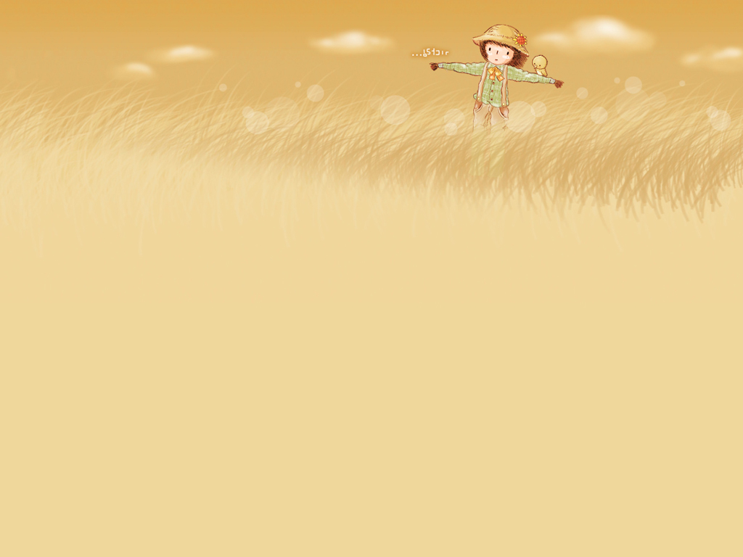
M3 Unit 5
Canada- “The True North”

Slide 14
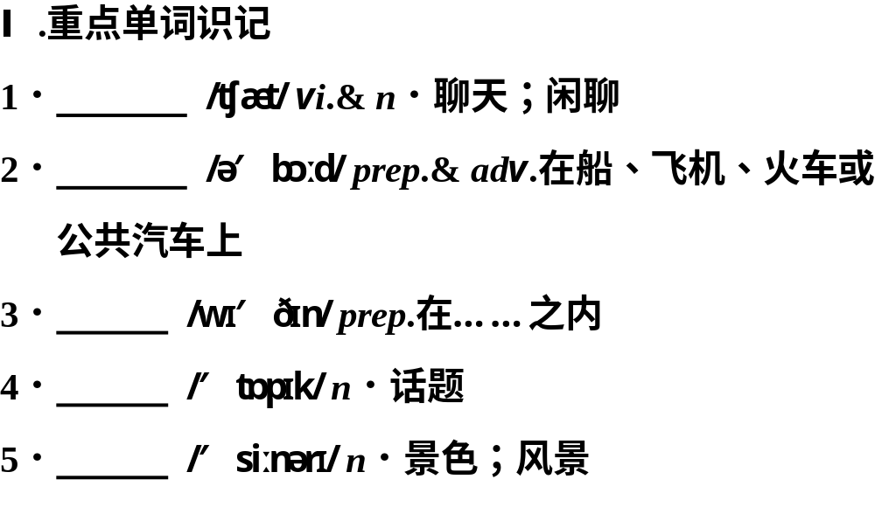
chat
aboard
within
topic
scenery

Slide 15
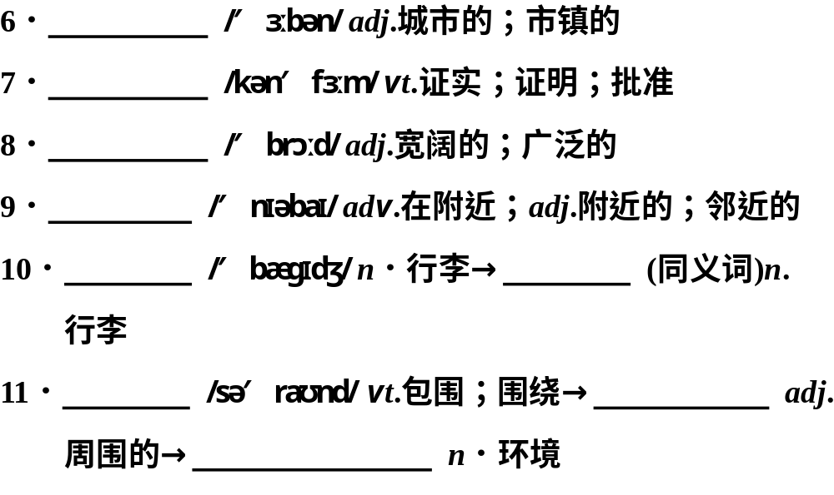
urban
confirm
broad
nearby
baggage
luggage
surround
surrounding
surroundings

Slide 16
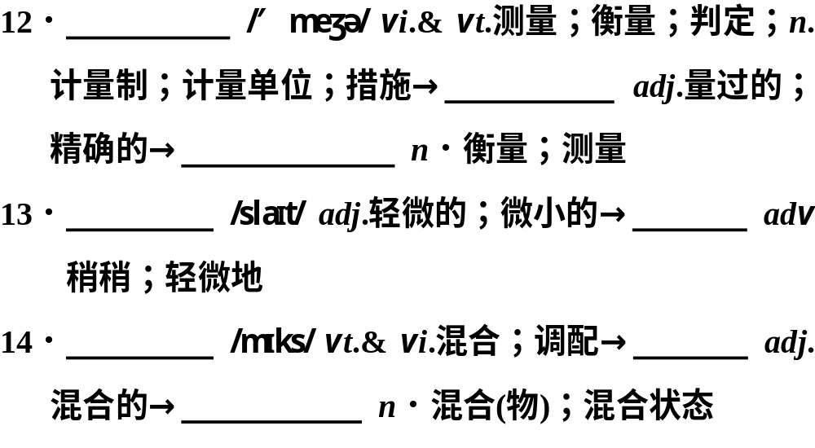
measure
measured
measurement
slight
slightly
mix
mixed
mixture

Slide 17
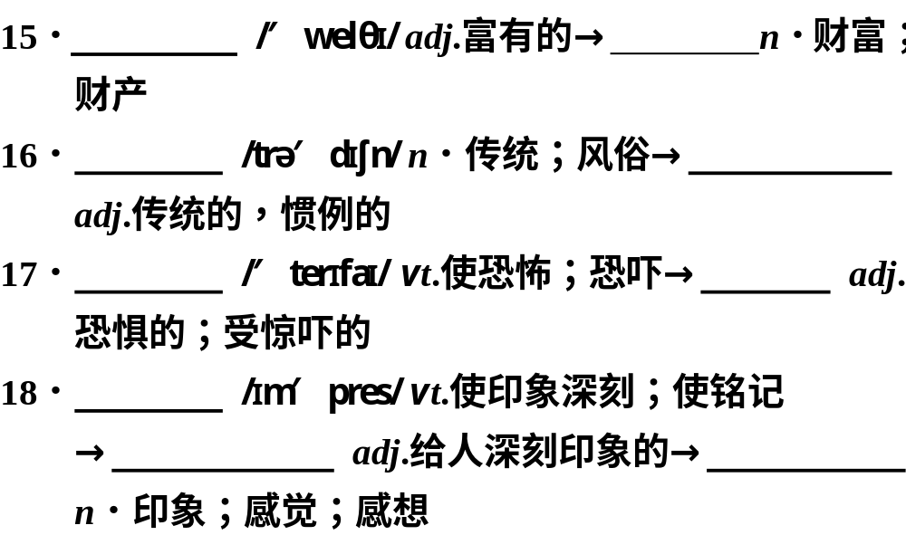
wealthy
wealth
tradition
traditional
terrify
terrified
impress
impressive
impression

Slide 18
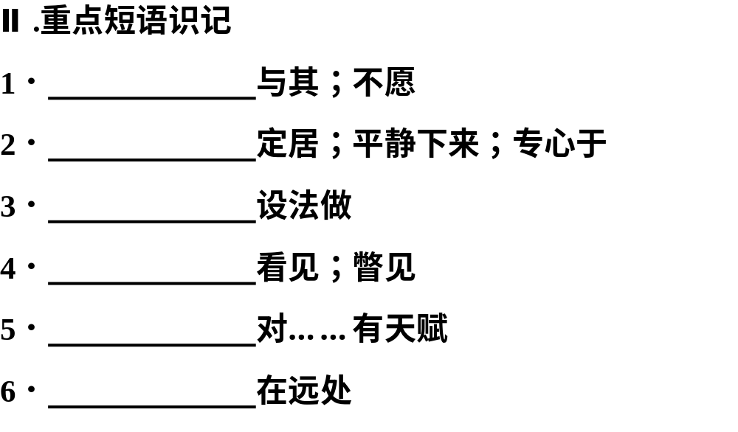
rather than
settle down
manage to do
catch sight of
have a gift for
in the distance

Slide 19
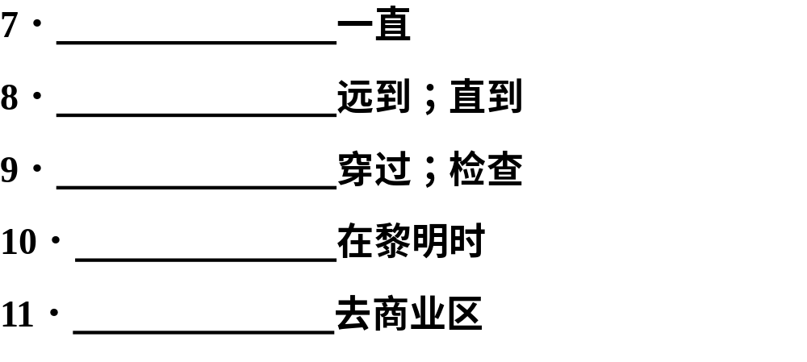
all the way
as far as
go through
at dawn
go downtown

Slide 20
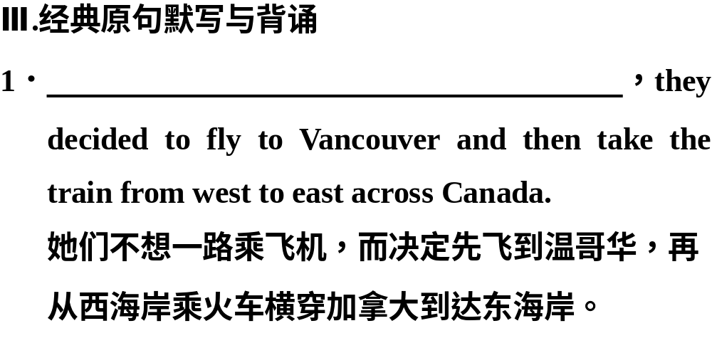
Rather than take the aeroplane all the way

Slide 21
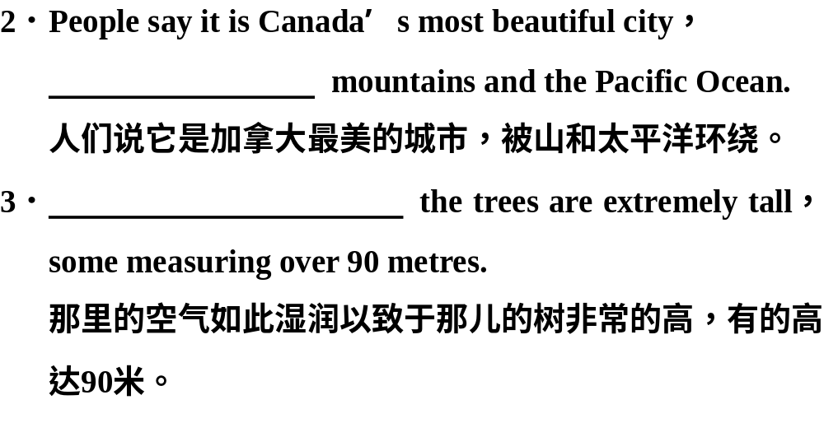
surrounded by
It is so wet there that

Slide 22
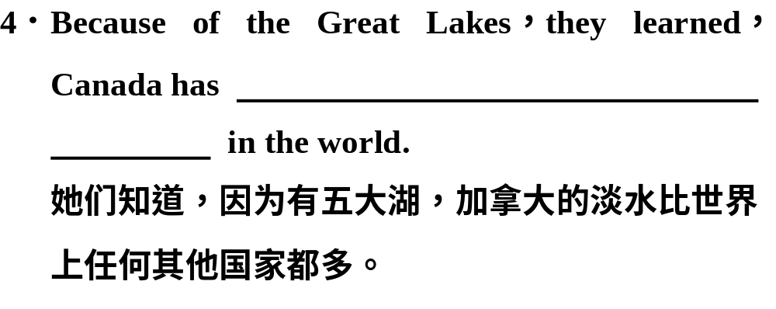
more fresh water than any other
country

Slide 23
go on/ take/make a trip/tour
1.去…旅行
2.而不是
3.向东
4.被…包围
5.剩下的.其余
6.定居/平静/专心于
7.参与…竞争
8.有…天赋
9.合计/计算出/解决
10.上升，上涨
rather than
go eastward
be surrounded by
the rest of
settle down
compete in
have a gift for
figure out
go up

Slide 24
11. 在远处
12.很可惜
13.远到，直到，至于
14.在黎明
15.去市区
in the distance
It’s too bad…
as far as
at dawn
go downtown

Slide 25

M4 Unit 1
Women of achievement

Slide 26
一.单词拼写
1. Over the years many great a____________ have been made in the different fields of science.
2. The effort seemed w____________ because they got what they had hoped for.
3. Listen! They are a___________ fiercely about something.
4. The police o__________ the man entering the bank with a stocking organized by the local government.
5. At that time , there were many ___________(医学的 ) teams organized by the local government.
6. It is very clear that he ______________(支持 ) you .
7. Don’t you think he is a ________________( 考虑周全的) child?
8. What ________________ (打动 ) me most was that he never lost heart.
9. It is necessary for us to ______________( 尊重) each other.
10. His noble example _____________(鼓舞 ) the rest of us to make greater efforts.

Slide 27
1.从事于，热忠于
2.献身于,专心于
3.处于好的/坏的状态
4.举止
5.决定去做…
6.辩论某事
7.一切涌上心头
8.取得很大的成就
9.想要，计划做…
concern ….with
devote oneself /one’s
life to (doing) sth
be in good condition
behave ----behaviour
be determined to do
argue for
It all comes crowding in
make great achievements
be intended to

Slide 28
10.蔑视,瞧不起
11.在银幕上
12.似乎,好象
13.选择的事业/生涯
14.引起某人的注意
15.死亡率
16.照顾,照看,喜爱
17.为…准备, 预订
18.次于,不如
look down upon /on
on the screen
It seemed that…..
chosen career
catch one’s eye
death rate
care for
be intended for
second to

Slide 29
19.劳累一天后
20.接生
21.到如今
22.迫不及待想做某事
23.进行…, 继续进行
24.激发某人做某事
tired after a day’s work
deliver a baby
give birth to a child 生孩子
be delivered of a baby
by now
could/can not wait to do sth.
carry on (doing) sth
inspire sb to do sth

Slide 30
词组互译
1. 献身于_______________
2. 醒来________________
3. 蔑视; 瞧不起_________________
4. 照顾; 喜爱_________________
5. 接生________________
6. 使自己参与; 关心______________
7.作某事的方法__________________
8. argue for ____________
9. do research on_______________
10. of one’s own ________________
11. on one’s own _______________
12. carry on ___________________
13. be intended for ______________
devote --- to
2. wake up
3. look down upon
4. care for
5. deliver a baby
6. concern oneself with
7. a way of doing sth
8. 为---辩护
9. 从事---研究
10. 属于某人自己的
11. 独自; 单独地
12. 继续
13. 为… 而准备; 预定

Slide 31
6.devote ---to
7. looks down upon
8. caring for
9. devote ---to
10. carry on

Slide 32
用以上词组填空
1. I ______________ catch up with the better students this term.
2. she ________________improving social welfare in the poor regions.
3. The doctor spent about two hours _______________.
4. I can’t carry the box _____________; it’s too heavy.
5. He ‘d like a car ___________ but , as he works in a very small company, he is unable to
afford one at the moment.
am determined to
has been concerning herself with
delivering her baby
on my own
of his own

Slide 33
6. I could only ________ two hours a day ___ work on the project.
7.She ________________people who haven’t been to college.
8. It was a small book explaining how to cut the death rate from having and _________ babies
by following some simple rules for keeping babies clean and healthy.
9. He has _________his life ______ finding ways to row more and more rice.
10. We will _______ our work tomorrow.
6.devote .,..to 7. looks down upon
8. caring for 9. devote …to 10. carry on

Slide 34
1.worth adj. 值......的, 值得......的
be (well) worth doing... 值得做......
2. worthy adj. 值得,受人敬仰的
be worthy of sth
be worthy of being done/to be done值得被做
3. worthwhile adj.值得做的, 值得出力的
The effort seemed worthwhile.
be worthwhile doing/ to do
4. worthless adj. 没有价值的,无用的,无益的

Slide 35
将only及其后面的状语提前放在句首,句子要用部分倒装语序，即将be动词、助动词或情态动词放在主语之前。
Only then did we get to know each other better.
Only after new China was founded was he able to go to school.
Only in this way can we learn English better.
only在句首修饰句子的主语时，不用倒装语序。Only Mary and Tom failed in the exam.

